Slide 1
CIVICPULSE · GOVERNED ACTION
CivicPulse turns public frustration into governed action
A clear operating model for hearing, prioritizing, resolving, and learning from citizen voice.
Notes:
Open with the central proposition: CivicPulse is not another complaints inbox. It turns public frustration into an accountable operating loop that leaders can see, govern, and improve.

Slide 2



Government leaders see complaints, but not always the system behind them
Fragmented intake
Hidden operating logic
Public experience
Grievances arrive across channels, departments, and formats.
Ownership, urgency, and recurring patterns are hard to see in one view.
Citizens experience the gaps as silence, repetition, and low trust.
Notes:
The issue is not a lack of public input. It is that the system behind the input is difficult to see: where issues enter, who owns them, what is urgent, and what patterns are repeating.

Slide 3
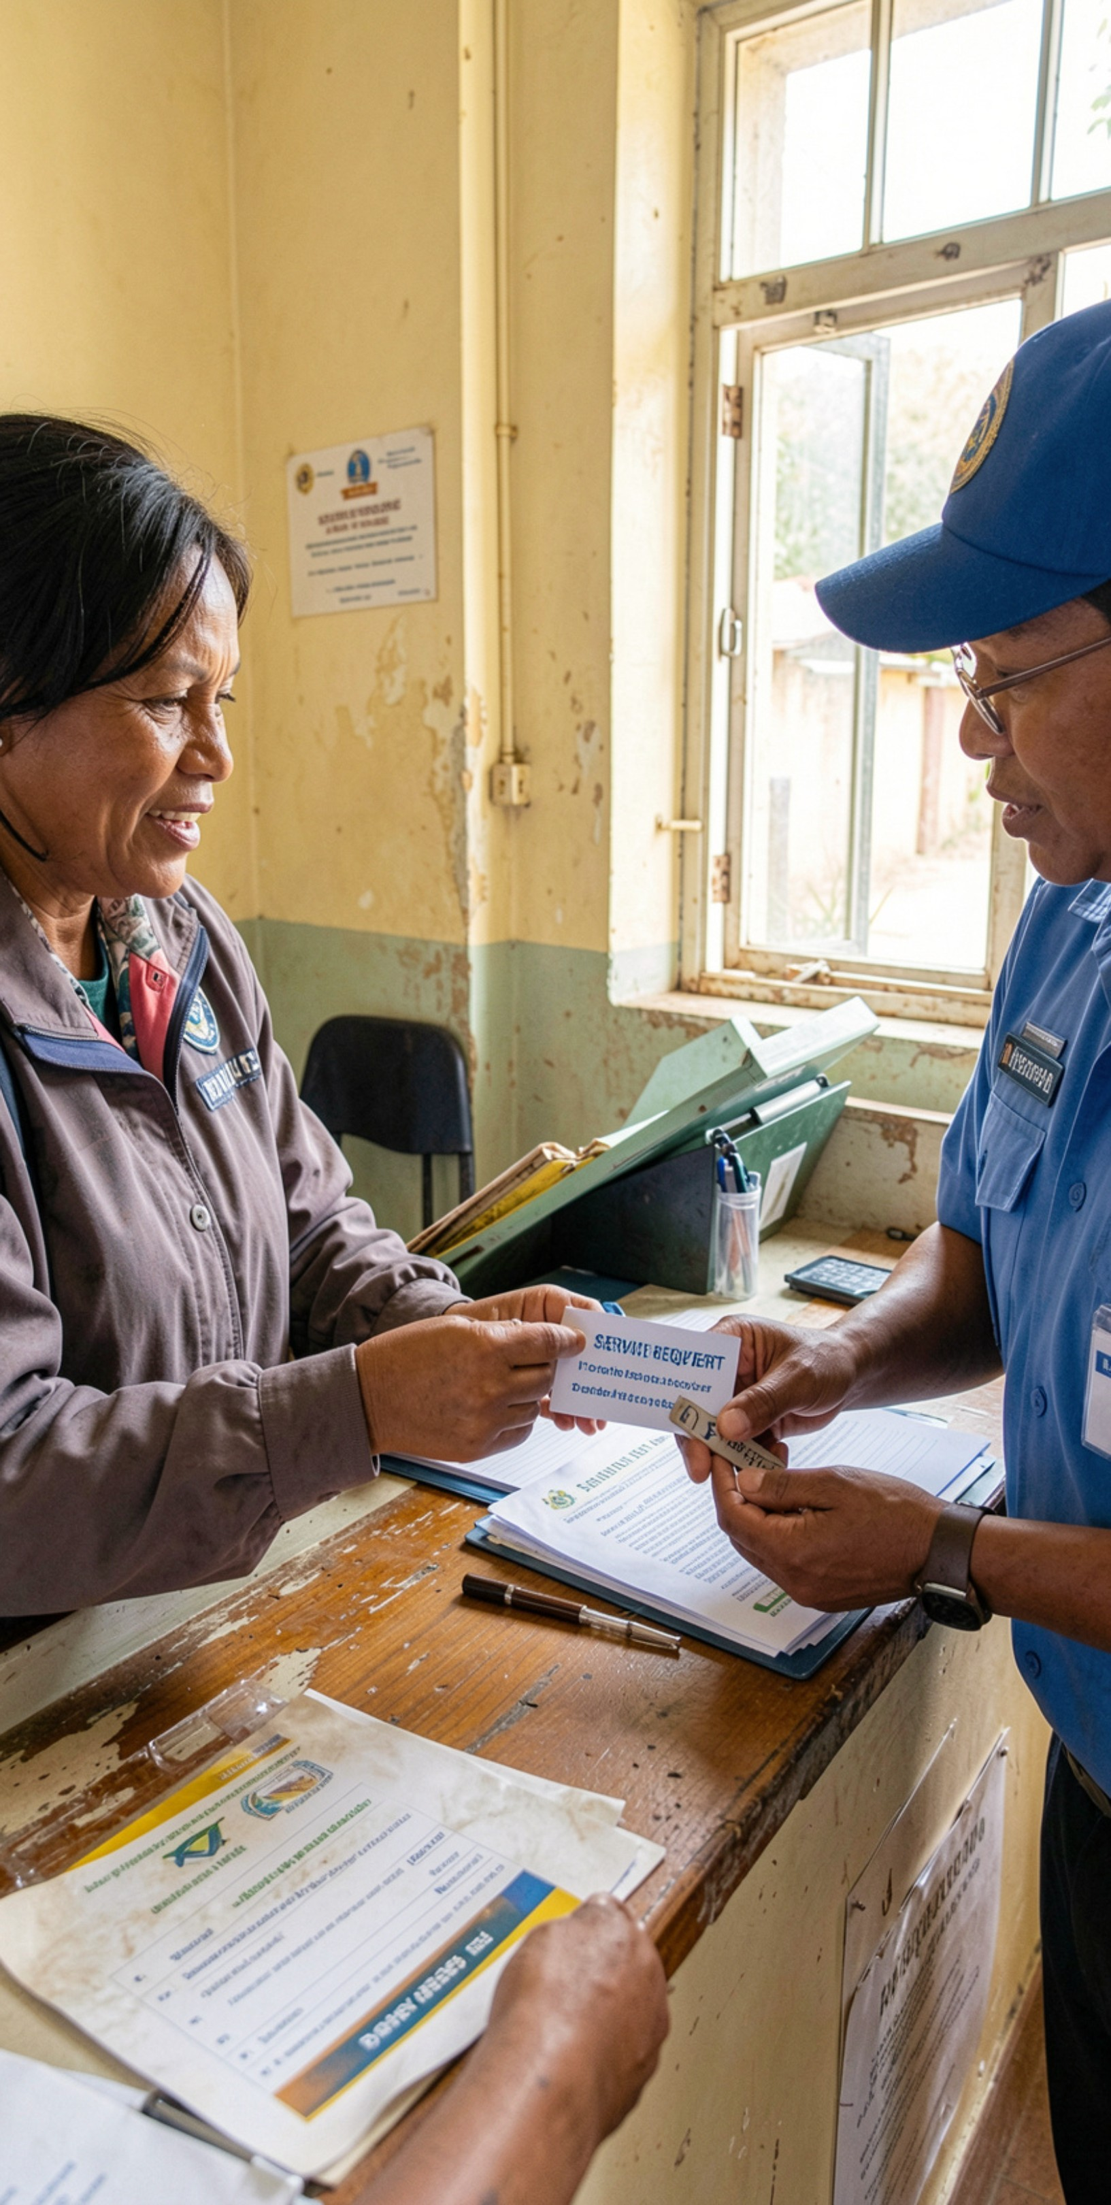
THE FULL-CYCLE OPERATING MODEL
One full-cycle model connects every grievance to an outcome
1
Capture + verify
Confirm the citizen issue and the facts needed to act.
2
Classify + prioritize
Recognize service, severity, geography, and urgency.
3
Route + own
Assign the accountable department and next step.
4
Act + communicate
Track progress and keep the citizen informed.
5
Close + learn
Resolve the issue and use the outcome to improve services.
Notes:
Walk the model from left to right conceptually, even though it is shown vertically: capture the issue, make sense of it, assign it, act, communicate, close, and learn. The last step feeds the next improvement cycle.

Slide 4
Every complaint gets a clear owner, priority, and next step
1
2
3
Unified intake
Rules-based routing
Escalation
Digital, assisted, and field channels enter one operating flow.
Geography, service, severity, and department determine ownership.
Deadlines, vulnerability, or risk demand attention.
In plain words: no complaint should disappear between the channel where it starts and the team responsible for resolving it.
Notes:
This is the operating promise at the case level. Every complaint has a visible path: how it entered, why it was prioritized, who owns it, and what happens next.

Slide 5




BEYOND VOLUME
Sentiment intelligence reveals what volume alone misses
Read the signal
See the pattern
Act earlier
Detect frustration, urgency, recurring themes, and emerging hotspots.
Separate isolated incidents from systemic service problems.
Give leaders an early-warning layer before dissatisfaction compounds.
Notes:
Volume is an important starting signal, but it is not the whole story. Sentiment intelligence helps leaders distinguish a one-off complaint from a pattern that is becoming urgent, repeated, or systemic.

Slide 6
Leaders get one operating view from intake to resolution
Monitor
Drill down
LEADERSHIP VIEW
One view
Backlog, ageing, response times, resolution rates, and escalations.
Move from district or department trends to the underlying citizen issue.
From the first intake signal to the final resolution and follow-up.
Focus action
Use evidence to target reviews, resources, and corrective action.
The dashboard is not the outcome. It is the shared evidence leaders use to decide what happens next.
Notes:
Emphasize the difference between reporting and operating. The view matters because it connects measures to action: leaders can see where work is accumulating, investigate the underlying issue, and direct the next review.

Slide 7



Accountability becomes visible without becoming punitive
Make ownership explicit
Keep citizens informed
Publish what helps
Provide status updates and a credible path to follow-up when work takes time.
Share the right measures to build confidence and support continuous improvement.
Set clear service commitments and make responsibility visible to the teams doing the work.
Notes:
Accountability works best when it creates clarity rather than fear. CivicPulse makes ownership and commitments visible, gives citizens a reliable line of sight, and uses public measures to improve the system.

Slide 8
THE NEXT DECISION
CivicPulse closes the loop between citizen voice and better government
3
moves from listening to governed action
Focus
Baseline
Scale
Start with a focused service or geography.
Establish baseline measures and escalation rules.
Scale the model as departments demonstrate faster, fairer resolution.
Notes:
Close with a practical path, not a broad promise. Begin with a focused service or geography, establish the baseline and the rules for escalation, then scale the model as departments demonstrate faster and fairer resolution.

