Slide 1
CIVICPULSE · GOVERNED ACTION
CivicPulse turns public frustration into governed action
A clear operating model for hearing, prioritizing, resolving, and learning from citizen voice.
Notes:
Open with the central proposition: CivicPulse is not another complaints inbox. It turns public frustration into an accountable operating loop that leaders can see, govern, and improve.

Slide 2



Government leaders see complaints, but not always the system behind them
Fragmented intake
Hidden operating logic
Public experience
Grievances arrive across channels, departments, and formats.
Ownership, urgency, and recurring patterns are hard to see in one view.
Citizens experience the gaps as silence, repetition, and low trust.
Notes:
The issue is not a lack of public input. It is that the system behind the input is difficult to see: where issues enter, who owns them, what is urgent, and what patterns are repeating.

Slide 3
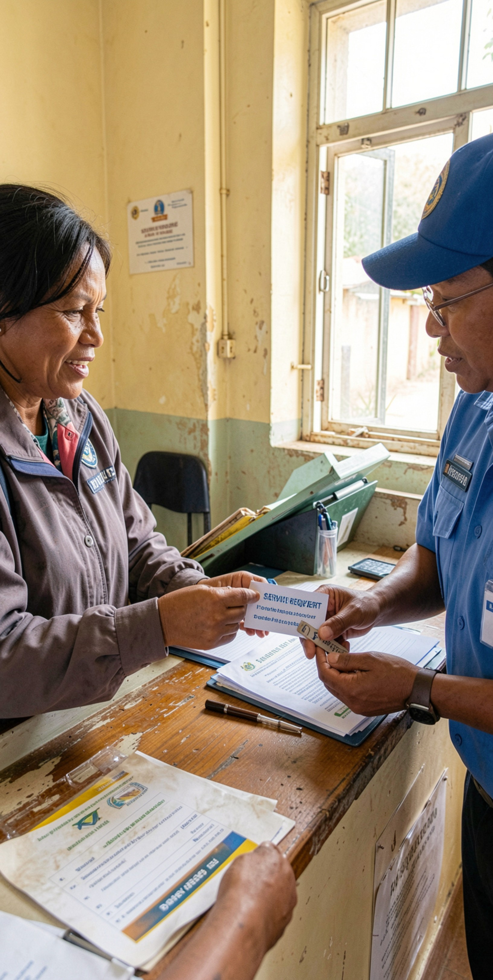
THE FULL-CYCLE OPERATING MODEL
One full-cycle model connects every grievance to an outcome
1
Capture + verify
Confirm the citizen issue and the facts needed to act.
2
Classify + prioritize
Recognize service, severity, geography, and urgency.
3
Route + own
Assign the accountable department and next step.
4
Act + communicate
Track progress and keep the citizen informed.
5
Close + learn
Resolve the issue and use the outcome to improve services.
Notes:
Walk the model from left to right conceptually, even though it is shown vertically: capture the issue, make sense of it, assign it, act, communicate, close, and learn. The last step feeds the next improvement cycle.

Slide 4
Every complaint gets a clear owner, priority, and next step
1
2
3
Unified intake
Rules-based routing
Escalation
Digital, assisted, and field channels enter one operating flow.
Geography, service, severity, and department determine ownership.
Deadlines, vulnerability, or risk demand attention.
In plain words: no complaint should disappear between the channel where it starts and the team responsible for resolving it.
Notes:
This is the operating promise at the case level. Every complaint has a visible path: how it entered, why it was prioritized, who owns it, and what happens next.

Slide 5




BEYOND VOLUME
Sentiment intelligence reveals what volume alone misses
Read the signal
See the pattern
Act earlier
Detect frustration, urgency, recurring themes, and emerging hotspots.
Separate isolated incidents from systemic service problems.
Give leaders an early-warning layer before dissatisfaction compounds.
Notes:
Volume is an important starting signal, but it is not the whole story. Sentiment intelligence helps leaders distinguish a one-off complaint from a pattern that is becoming urgent, repeated, or systemic.

Slide 6
Leaders get one operating view from intake to resolution
Monitor
Drill down
LEADERSHIP VIEW
One view
Backlog, ageing, response times, resolution rates, and escalations.
Move from district or department trends to the underlying citizen issue.
From the first intake signal to the final resolution and follow-up.
Focus action
Use evidence to target reviews, resources, and corrective action.
The dashboard is not the outcome. It is the shared evidence leaders use to decide what happens next.
Notes:
Emphasize the difference between reporting and operating. The view matters because it connects measures to action: leaders can see where work is accumulating, investigate the underlying issue, and direct the next review.

Slide 7



Accountability becomes visible without becoming punitive
Make ownership explicit
Keep citizens informed
Publish what helps
Provide status updates and a credible path to follow-up when work takes time.
Share the right measures to build confidence and support continuous improvement.
Set clear service commitments and make responsibility visible to the teams doing the work.
Notes:
Accountability works best when it creates clarity rather than fear. CivicPulse makes ownership and commitments visible, gives citizens a reliable line of sight, and uses public measures to improve the system.

Slide 8
THE NEXT DECISION
CivicPulse closes the loop between citizen voice and better government
3
moves from listening to governed action
Focus
Baseline
Scale
Start with a focused service or geography.
Establish baseline measures and escalation rules.
Scale the model as departments demonstrate faster, fairer resolution.
Notes:
Close with a practical path, not a broad promise. Begin with a focused service or geography, establish the baseline and the rules for escalation, then scale the model as departments demonstrate faster and fairer resolution.

Slide 9
CivicPulse — Project Overview
An AI-assisted civic grievance management and decision-support platform
Problem
Solution
Value
Citizen complaints are distributed across channels. Departments can lose visibility into ownership, urgency, recurring issues, and resolution status.
CivicPulse creates one governed workflow: capture → verify → classify → prioritize → route → resolve → communicate → learn.
Leaders get operational visibility, teams get clear ownership, and citizens get status visibility and a consistent follow-up path.
Core principle: turn citizen voice into measurable, accountable action.

Slide 10
Key Features
Major functional modules of the CivicPulse system
Citizen Complaint Intake
AI Classification
Priority Engine
Submit issues through web/mobile/assisted channels with category, location, description and optional evidence.
Classify complaint type, department, severity and urgency using NLP/ML-assisted rules.
Combine severity, urgency, location, vulnerability and service rules to determine priority.
Smart Routing
Sentiment & Trend Analysis
Case Tracking
Automatically assign the responsible department/team and create a trackable case.
Detect frustration signals, recurring themes and emerging service hotspots.
Track status, owner, SLA/deadline, escalations and citizen communications.

Slide 11
System Architecture
How the major components work together
1. User Layer
Citizen portal • Officer portal • Leadership dashboard
2. Application Layer
Complaint API • Authentication • Case management • Notifications
3. AI / Analytics Layer
NLP classification • Sentiment analysis • Priority rules • Trend detection
4. Data Layer
Users • Complaints • Departments • Locations • Status history • Analytics
5. Governance Layer
Role-based access • Audit logs • Escalation rules • Data protection

Slide 12
AI / ML Components
Where artificial intelligence can support the CivicPulse workflow
NLP / Text Classification
Extract complaint category, department and key entities from citizen text.
Sentiment Analysis
Estimate sentiment signals such as positive, neutral or negative to identify frustration patterns.
Priority Prediction
Use historical cases and defined governance rules to assist priority recommendations.
Topic / Trend Detection
Group similar complaints and surface repeated service issues or geographic hotspots.
Human-in-the-Loop
Officers can review, correct or override AI outputs; corrections can become feedback for improvement.
AI should assist decisions; final accountability remains with authorized human officials.

Slide 13
End-to-End Complaint Workflow
A case moves through a controlled lifecycle
Submit
→
Verify
→
Classify
→
Prioritize
→
Route
→
Resolve
→
Notify
→
Learn
Citizen
Department
Leadership
Receives case ID, status updates and a clear follow-up path.
Gets owner, priority, SLA/deadline and next action.
Sees backlog, ageing, trends, escalations and resolution performance.

Slide 14
User Roles & Responsibilities
Role-based access keeps the workflow accountable
Citizen
Create complaint, attach evidence, view status, receive updates, provide feedback.
Case Officer
Verify information, update status, communicate, document action and close cases.
Department Manager
Monitor team workload, escalations, ageing cases and service performance.
Administrator
Manage users, departments, categories, rules, permissions and audit controls.
Leadership
Review cross-department trends, hotspots, KPIs and improvement priorities.

Slide 15
Suggested Technology Stack
A practical stack for implementing the prototype
Frontend
Backend
HTML5 • CSS3 • JavaScript / React
Python Flask/FastAPI or Java Spring Boot
Database
AI / ML
MySQL / PostgreSQL
Python • scikit-learn • NLP libraries • optional transformer models
Analytics
Deployment
Pandas • NumPy • Matplotlib/Plotly
Docker • Cloud VM / AWS / Azure
Security
JWT/session authentication • RBAC • audit logs • HTTPS

Slide 16
Core Data Model
Main entities required to manage the case lifecycle
Users
Complaints
Departments
user_id, name, role, department_id, contact
complaint_id, citizen_id, category, description, location, priority, status
department_id, name, service_area, escalation_contact
Case History
Notifications
Feedback
history_id, complaint_id, owner, action, timestamp, remarks
notification_id, complaint_id, recipient, message, sent_at
feedback_id, complaint_id, rating, comment, submitted_at

Slide 17
Performance Metrics & KPIs
Measures that connect the dashboard to operational improvement
First Response Time
Resolution Time
Resolution Rate
Time from complaint submission to first official response.
Time from case creation to verified closure.
Share of cases resolved within the selected reporting period.
SLA Compliance
Backlog & Ageing
Escalation Rate
Share of cases completed within the defined service commitment.
Open cases grouped by age to identify accumulation.
Share of cases requiring escalation or higher-level intervention.

Slide 18
Implementation Roadmap
Build incrementally and validate the workflow at each stage
Phase 1 — Prototype
Citizen complaint form, database, authentication and basic case tracking.
Phase 2 — Workflow
Departments, routing rules, priority logic, status updates and notifications.
Phase 3 — AI
Text classification, sentiment analysis, topic detection and assisted prioritization.
Phase 4 — Dashboard
Leadership KPIs, trend charts, geography/department drill-down and escalations.
Phase 5 — Pilot & Scale
Pilot one service/geography, measure baseline, improve rules, then expand.

Slide 19
Security, Privacy & Responsible AI
Controls that should be built into the system
Access Control
Privacy & Audit
Responsible AI
Role-based permissions.
Citizens should see only their own cases. Officers should access authorized departmental cases. Leadership views should follow governance permissions.
Minimize collected personal data, protect sensitive fields, encrypt data in transit, maintain audit logs, and define retention policies.
AI outputs should be reviewable. Monitor errors and bias. Automated suggestions should not replace accountable human decisions.

Slide 20
Expected Project Benefits
Outcomes the prototype is designed to support
• Centralized visibility across complaint channels
• Clear ownership and next actions for each case
• Faster identification of urgent or recurring issues
• Improved communication with citizens
• Evidence-based departmental reviews
• Data-driven service improvement
• Traceable case history and accountability
• Scalable architecture for additional departments or services
Project success should be measured using defined baseline metrics rather than assumptions.

Slide 21
Project Demonstration Flow
A simple sequence for presenting the working prototype
• 1. Citizen submits a complaint with category, location and description.
• 2. System stores the complaint and generates a case identifier.
• 3. AI/rules classify the issue and suggest priority and department.
• 4. Officer receives the case and updates progress.
• 5. Citizen views status and receives a notification.
• 6. Dashboard updates backlog, ageing and resolution metrics.
• 7. Leadership reviews recurring themes and decides follow-up action.
CivicPulse: Listen → Understand → Assign → Act → Communicate → Learn

