Slide 1
FINAL SBA-JAVA AWS-S2
Karthik Rajendran
454988

Slide 2
Microservice API Details
Authentication API
Outreach Management API
Notification service APS
Service Discovery –Registry
Service API Gateway
Service Config Server

Slide 3
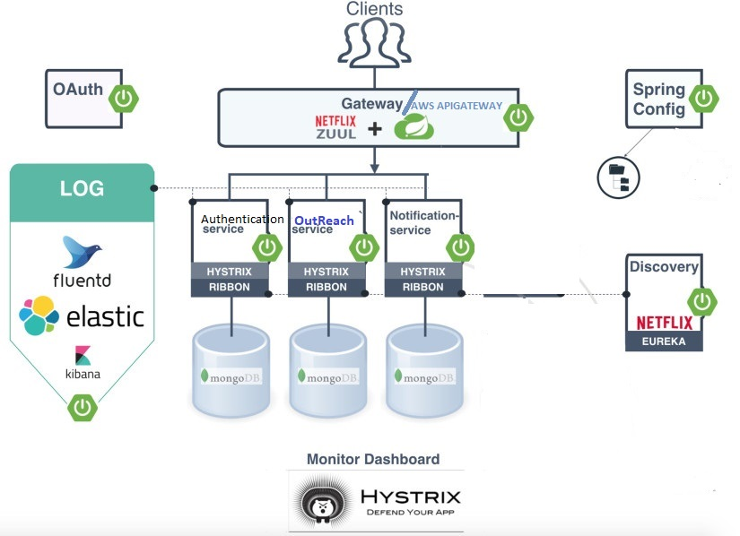
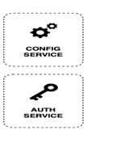



Travel Mgmt.System-Web App
Api Gateway
Customer service
Employer Service
Admin Service
Customer RestApi
Employer WebApi
Admin RestAPi
RestAPi
DB
RestApi
DB
RestApi
DB

Slide 4
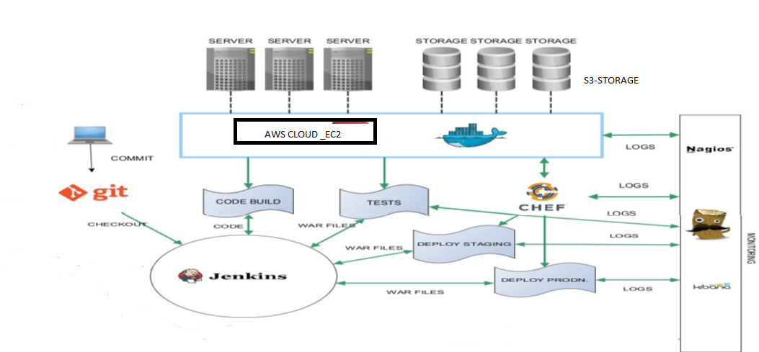
DevOps –I(Jenkins, Docker, Chef Pipeline)

Slide 5
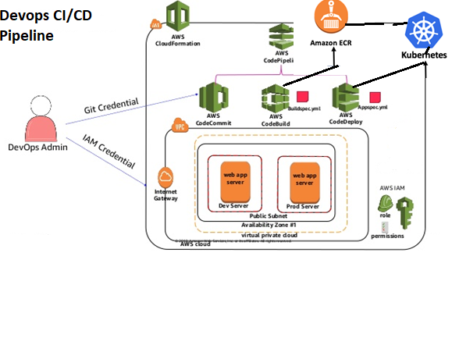
DevOps-2 - AWS DevOps
Jenkins

Slide 6
AWS -Services
AWS EC2
S3
AWS Code Pipeline(code commit/Code build/Code deploy)
AWS ECR(container registry
Route53
Load Balancer
Auto Scaling
API GATEWAY
VPC & Subnets
Security Group
IAM

