Slide 1
CALIBER 2020 Hackathon Submission
Team BANK AI
Karthik, Rajendran
Rajaram, Senthilkumar

Slide 2
Introduction of the Team with Pictures Karthik Rajendran -Full Stack Developer Rajaram, Senthilkumar –Full Stack Developer

Slide 3
VM Details & Instructions to execute code
VM Details
IP :13.65.26.255
User Id : CTS\caliber20
Password :Shastha@2020
How to Execute the Code (Steps)
Please follow the below steps to execute

Slide 4
Executive Summary 1. we use machine learning training data to simulate a device sending telemetry to Azure IoT Hub. As stated in the introduction, The simulation data set to simulate data from a set of Bank sensorss for training and testing and store to Could data storage. 2. The web applications will retrieve the data and populate from cloud data storage

Slide 5
Use Case / Idea Predictive maintenance The goal is to predict remaining useful life (RUL) of a set of bank branches. This data was generated using IOT Sensor and devices transaction. This software provides a flexible turbofan engine simulation environment to conveniently simulate the customer, control, and devices parameters.

Slide 6
What Problem are we Solving? The Bank is operating normally at the start of each time series and develops a fault at some point during the series. In the training set, the fault grows in magnitude until system failure. In the test set, the time series ends some time prior to system failure. The objective of the competition is to predict the number of remaining operational cycles before failure in the test set, i.e., the number of operational cycles after the last cycle that the engine will continue to operate. Also provided a vector of true Remaining Useful Life (RUL) values for the test data.

Slide 7
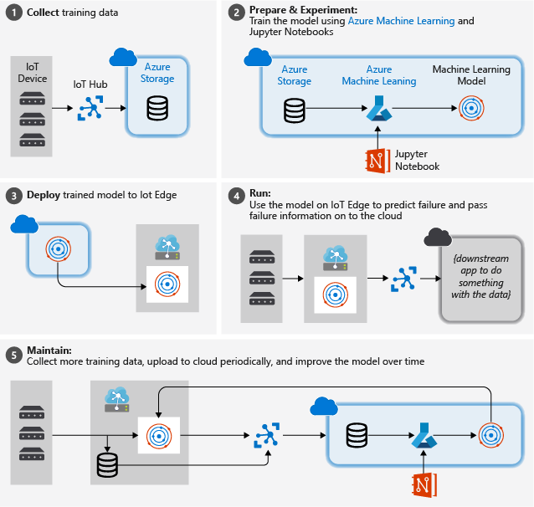
Introduction to Solution
Collect training data: The process begins by collecting training data. In some cases, data has already been collected and is available in a database, or in form of data files. In other cases, especially for IoT scenarios, the data needs to be collected from IoT devices and sensors and stored in the cloud.
We assume that you don't have a collection of turbofan engines, so the project files include a simple device simulator that sends the NASA device data to the cloud.
Prepare data. In most cases, the raw data as collected from devices and sensors will require preparation for machine learning. This step may involve data clean up, data reformatting, or preprocessing to inject additional information machine learning can key off.
For our airplane engine machine data, data preparation involves calculating explicit time-to-failure times for every data point in the sample based on the actual observations on the data. This information allows the machine learning algorithm to find correlations between actual sensor data patterns and the expected remaining life time of the engine. This step is highly domain-specific.
Build a machine learning model. Based on the prepared data, we can now experiment with different machine learning algorithms and parameterizations to train models and compare the results to one another.
In this case, for testing we compare the predicted outcome computed by the model with the real outcome observed on a set of engines. In Azure Machine Learning, we can manage the different iterations of models we create in a model registry.
Deploy the model. Once we have a model that satisfies our success criteria, we can move to deployment. That involves wrapping the model into a web service app that can be fed with data using REST calls and return analysis results. The web service app is then packaged into a docker container, which in turn can be deployed either in the cloud or as an IoT Edge module. In this example, we focus on deployment to IoT Edge.
Maintain and refine the model. Our work is not done once the model is deployed. In many cases, we want to continue collecting data and periodically upload that data to the cloud. We can then use this data to retrain and refine our model, which we then can redeploy to IoT Edge.

Slide 8
What it does (detail it out)? This is suitable for predict the any secure information from IOT device

Slide 9
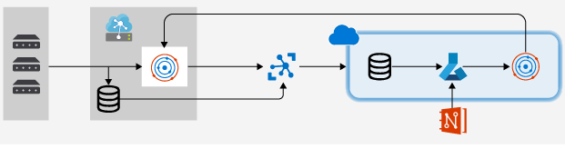
Detailed Architecture Diagram

Slide 10
Architecture Explanation Training a machine learning model with data collected from IoT devices in the cloud, deploying that model to IoT Edge, and maintaining and refining the model periodically. The processing of IoT data with machine learning, specifically on the edge. While we touch many aspects of a general machine learning workflow After Procssing the data that will store into Cloud Storage

Slide 11
Technical Details (Explain why you have chosen particular components in your architecture) 1. We created a PowerShell script that creates an Azure virtual machine with many of the prerequisites already configured. The VM that we create needs to be able to handle nested virtualization, which is why we chose a Standard_D8s_v3 machine size. The development VM will be set up with: Windows 10 Chocolatey Docker Desktop for Windows Git for Windows Git Credential Manager for Windows .NET Core SDK Python 3 Visual Studio Code Azure PowerShell VS Code Extensions Azure IoT Tools,Python,C#,Docker,PowerShell

Slide 12
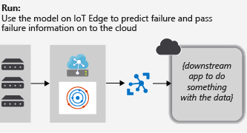
Sample Execution Flow

Slide 13
Thank You

