Slide 1
Comparison
By karthik

Slide 2
Cloud vs on premise
Cloud
Non Cloud
Deployment-While there are different forms of cloud computing (such as public cloud, private cloud, and a hybrid cloud), in a public cloud computing environment, resources are hosted on the premises of the service provider but enterprises are able to access those resources and use as much as they want at any given time.
Cost - Enterprises that elect to use a cloud computing model only need to pay for the resources that they use, with none of the maintenance and upkeep costs, and the price adjusts up or down depending on how much is consumed.
Control - In a cloud computing environment, even though the data and encryption keys are shared with the third-party provider, there is shared ownership and accessibility remains an issue if there is to be any downtime.
Security- With Cloud ERP systems there are very less chances of any hardware, software of infrastructure malfunction that can hinder the entire operation and result in hefty losses. The ERP vendor is more likely to have multiple disaster and redundancy protocols for data security. For both platforms, reliable network connectivity plays a very important role when it comes to remote areas.
Compliance-When opting for a cloud computing model, companies need to ensure that the service provider is meeting the regulatory mandates within their specific industry. It is important that the data of customers, employees and partners is secure, whereby ensuring privacy.
In an on-premises environment, resources are deployed in-house and within an enterprise’s IT infrastructure. An enterprise is responsible for maintaining the solution and all its related processes.
For enterprises that deploy software on premise, they are responsible for the ongoing costs of the server hardware, power consumption, and space.
In an on premises environment, enterprises enjoy complete control over their systems and maintain 100 percent privacy. These are two reasons why most big organizations choose to stay away from the cloud.
Security is an essential requirement of any organisation when it comes to financial account, customer and employee details. Even though traditional on premise seems more secure as it is in-house, there are multiple measures that need to be taken to fully maintain the security of the data.
There are regulatory controls that most companies need to abide by. To meet these government and industry regulations, it is imperative that companies remain complaint and have their data in place. This can easily be if all the data is maintained in-house.

Slide 3
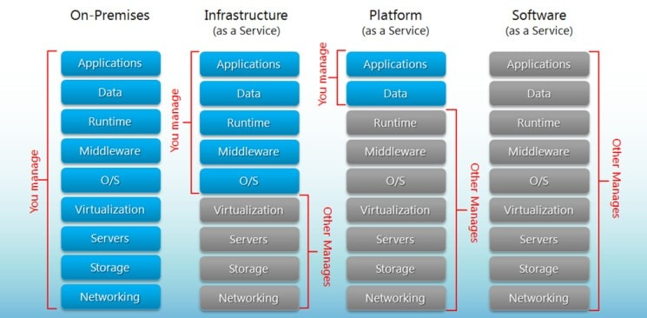
Cloud
Types
Descriptions
IaaS: cloud-based services, pay-as-you-go for services such as storage, networking, and virtualization.
PaaS: hardware and software tools available over the internet.
SaaS: software that’s available via a third-party over the internet.
On-premise: software that’s installed in the same building as your business
Examples of SaaS, PaaS, and IaaS
Most businesses use a combination of SaaS and IaaS cloud computing service models, and many engage developers to create applications using PaaS, too.
SaaS examples: BigCommerce, Google Apps, Salesforce, Dropbox, MailChimp, ZenDesk, DocuSign, Slack, Hubspot.
PaaS examples: AWS Elastic Beanstalk, Heroku, Windows Azure (mostly used as PaaS), Force.com, OpenShift, Apache Stratos, Magento Commerce Cloud.
IaaS examples: AWS EC2, Ra

Slide 4
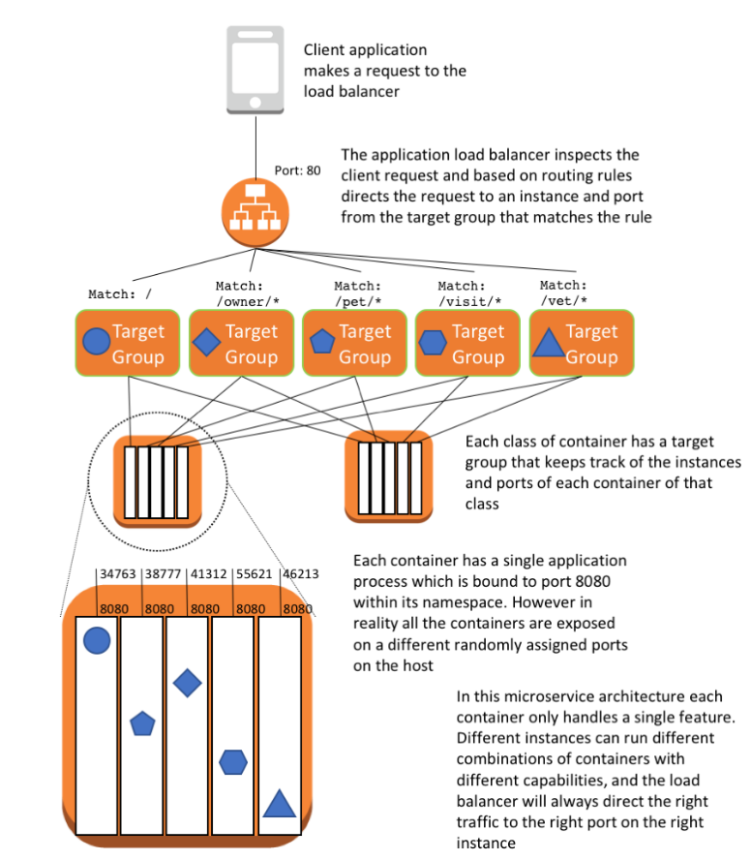
Micro services -AWS
Container deployment overview
This setup consists of the following resources:
The client application that makes a request to the load balancer.
The Application Load Balancer that inspects the client request. Based on routing rules, it directs the request to an instance and port from the target group that matches the rule.
The Application Load Balancer that has a target group for each microservice. The target groups are used by the corresponding services to register available container instances. Each target group has a path, so when you call the path for a particular microservice, it is mapped to the correct target group. This allows you to use one Application Load Balancer to serve all the different microservices, accessed by the path. For example, https:///owner/* would be mapped and directed to the Owner microservice.
One Amazon ECS cluster that hosts the containers for each microservice of the application.
A VPC network to host the Amazon ECS cluster and associated security groups.
Because you are running multiple containers on the same instances, use dynamic port mapping to avoid port clashing. By using dynamic port mapping, the container is allocated an anonymous port on the host to which the container port (8080) is mapped. The anonymous port is registered with the Application Load Balancer and target group so that traffic is routed correctly.
The following is also part of the solution but not depicted in the above diagram:
One Amazon ECR repository for each microservice.
A service/task definition per microservice that spins up containers on the instances of the Amazon ECS cluster.
A MySQL RDS instance that hosts the applications schema. The information about the MySQL RDS instance is sent in through environment variables to the containers. That way, the application can connect to the MySQL RDS instance.
https://aws.amazon.com/blogs/compute/deploying-java-microservices-on-amazon-ec2-container-service/

Slide 5
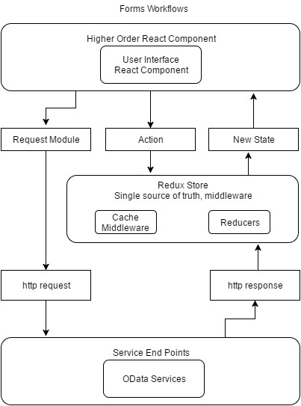
ReactJS Architecture
Overview
The higher order components are the ReactJS containers, which are not visible to the user, but they hold the main components the user will be accessing. The containers provide the UI components with the state and actions they can perform.
The UI ReactJS components are the one seen by the users, they are the web interface elements like labels, textbox and dropdowns. They receive parameters, perform data access by calling the Request Module (e.g. ajax get function), send actions to the redux store to update the state, send data to be store by a OData Services (through the Request Module again).
The ReduxJS store receives actions from the UI ReactJS components, these actions contain the information passed to the Reducers. The Reducers receive the current data state, the changing data and they return the new state.

Slide 6
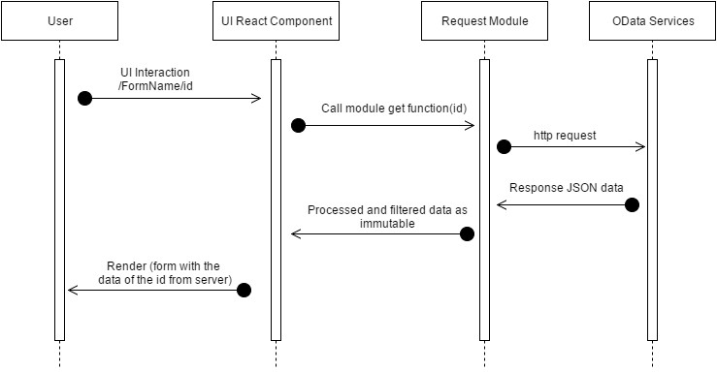
Activity
The UI ReactJS component is calling a get function defined at the Request Module, this functions contains the modularity to work will all the forms and organizing the data to make the request (making a very useful single functions to get data dynamically). The Request Module runs an ajax asynchronous function to the OData Services, they respond with a JSON object which is passed back to the UI ReactJS component by the Request Module after being sorted, filtered and converted to an immutable object. Then the UI ReactJS component updates the state and re-renders itself to be presented to the user with all the information obtained by the request.

Slide 7
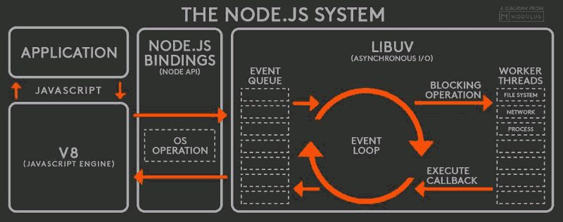
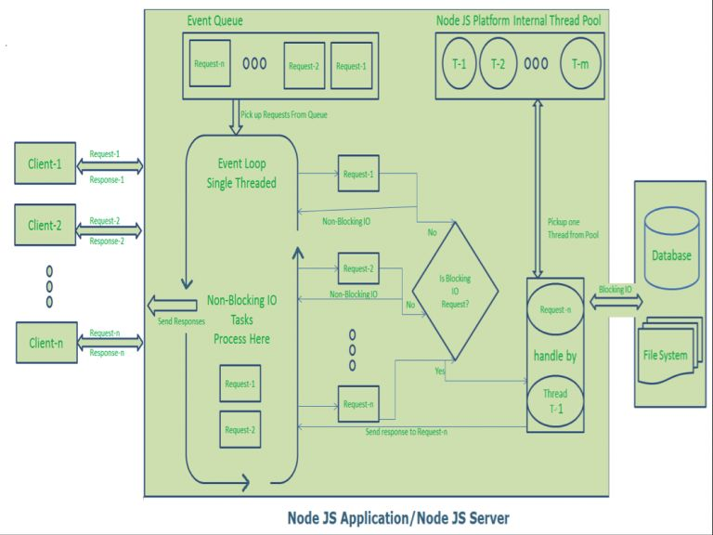
Node JS-Platform does not follow Request/Response Multi-Threaded Stateless Model. It follows Single Threaded with Event Loop Model. Node JS Processing model mainly based on JavaScript Event based model with JavaScript callback mechanism
Single Threaded Event Loop Model Processing Steps:
Clients Send request to Web Server.
Node JS Web Server internally maintains a Limited Thread pool to provide services to the Client Requests.
Node JS Web Server receives those requests and places them into a Queue. It is known as “Event Queue”.
Node JS Web Server internally has a Component, known as “Event Loop”. Why it got this name is that it uses indefinite loop to receive requests and process them.
Event Loop uses Single Thread only. It is main heart of Node JS Platform Processing Model.
Even Loop checks any Client Request is placed in Event Queue. If no, then wait for incoming requests for indefinitely.
If yes, then pick up one Client Request from Event Queue
Starts process that Client Request
If that Client Request Does Not requires any Blocking IO Operations, then process everything, prepare response and send it back to client.
If that Client Request requires some Blocking IO Operations like interacting with Database, File System, External Services then it will follow different approach
Checks Threads availability from Internal Thread Pool
Picks up one Thread and assign this Client Request to that thread.
That Thread is responsible for taking that request, process it, perform Blocking IO operations, prepare response and send it back to the Event Loop
Event Loop in turn, sends that Response to the respective Client.
https://www.vskills.in/certification/tutorial/web-development/mean-stack/node-js-architecture-2/

