Slide 1
Caliber 2020 Hackathon Submission
BANK AI
TEAM KARTHIK RAJENDRAN(454988)

Slide 2
Use case: Predictive maintenance
The goal is to predict remaining useful life (RUL) of a set of bank branches. This data was generated using IOT Sensor and devices transaction.This software provides a flexible turbofan engine simulation environment to conveniently simulate the customer, control, and devices parameters.

Slide 3
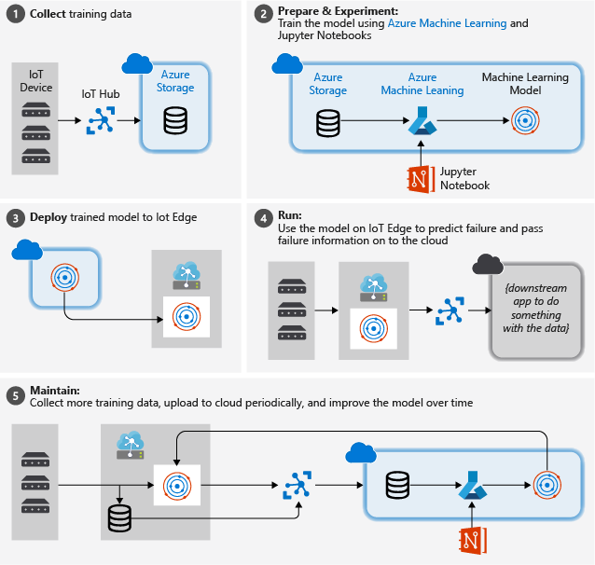
Introduction Solutions
Collect training data: The process begins by collecting training data. In some cases, data has already been collected and is available in a database, or in form of data files. In other cases, especially for IoT scenarios, the data needs to be collected from IoT devices and sensors and stored in the cloud.
We assume that you don't have a collection of turbofan engines, so the project files include a simple device simulator that sends the NASA device data to the cloud.
Prepare data. In most cases, the raw data as collected from devices and sensors will require preparation for machine learning. This step may involve data clean up, data reformatting, or preprocessing to inject additional information machine learning can key off.
For our airplane engine machine data, data preparation involves calculating explicit time-to-failure times for every data point in the sample based on the actual observations on the data. This information allows the machine learning algorithm to find correlations between actual sensor data patterns and the expected remaining life time of the engine. This step is highly domain-specific.
Build a machine learning model. Based on the prepared data, we can now experiment with different machine learning algorithms and parameterizations to train models and compare the results to one another.
In this case, for testing we compare the predicted outcome computed by the model with the real outcome observed on a set of engines. In Azure Machine Learning, we can manage the different iterations of models we create in a model registry.
Deploy the model. Once we have a model that satisfies our success criteria, we can move to deployment. That involves wrapping the model into a web service app that can be fed with data using REST calls and return analysis results. The web service app is then packaged into a docker container, which in turn can be deployed either in the cloud or as an IoT Edge module. In this example, we focus on deployment to IoT Edge.
Maintain and refine the model. Our work is not done once the model is deployed. In many cases, we want to continue collecting data and periodically upload that data to the cloud. We can then use this data to retrain and refine our model, which we then can redeploy to IoT Edge.

Slide 4
Technical Details
Set up the development VM
This step is typically performed by a cloud developer. Some of the software may also be helpful for a data scientist.
We created a PowerShell script that creates an Azure virtual machine with many of the prerequisites already configured. The VM that we create needs to be able to handle nested virtualization, which is why we chose a Standard_D8s_v3 machine size.
The development VM will be set up with:
Windows 10
Chocolatey
Docker Desktop for Windows
Git for Windows
Git Credential Manager for Windows
.NET Core SDK
Python 3
Visual Studio Code
Azure PowerShell
VS Code Extensions
Azure IoT Tools,Python,C#,Docker,PowerShell

