Slide 1
FINAL SBA-JAVA AWS-S2
Karthik Rajendran
454988

Slide 2
Assignment Problem Statement
Design and develop the cloud native application to solve the given problem. Associates are free to use any tools and techniques for performing the functionalities like scripts for loading and manipulating data, data modeling etc.
Associates have to design and develop the application using any one of the stack given below.
· Java – Spring Boot
Problem Statement:
Cognizant Outreach Volunteer Management System will allow the users (Cognizant Associates) to register and volunteer for the social events. Develop the online application to track the volunteer activities.
Cognizant Outreach team will create the social events and users can register and volunteer for the events.
This system should manage the below functionalities

Slide 3
Assignment Problem Statement
Admin will be able to do the below functionalities :
Create the event in the system
Trigger email to the users for the created events
View all the created event details
View user details who have registered for the events
View the reports and dashboards of all the events
Email should be triggered to admin with reports insights
Users should be able to do the below functionalities
Register to the events
View the registered event details
· Admin will manage the entire process of the application

Slide 4
Twelve Factors
Codebase
One codebase tracked in revision control, many deploys
Dependencies
Explicitly declare and isolate dependencies
Config
Store config in the environment
Backing services
Treat backing services as attached resources
Build, release, run
Strictly separate build and run stages

Slide 5
Technology Stack
Java 8
Spring /Spring Boot 2/Spring Cloud
AWS-Cloud
Mongo DB
Junit
Angular 6s
Karma/Jasmine

Slide 6
DevOps Tools
CI Pipeline tools
Jmeter- Performance reports
Jprofiler
Sonar qube
Jenkins
CD Pipeline tools
AWS Code Pipeline

Slide 7
AWS -Services
S3
AWS Code Pipeline(code commit/Code build/Code deploy)
AWS ECR(container registry/Container service)
AWS EC2
Route53
Load Balancer
Auto Scaling
API GATEWAY
VPC & Subnets
Security Group
IAM

Slide 8
Microservice API Details
Authentication API
Outreach Management API
Service Discovery –Registry
Service API Gateway
Service Config Server

Slide 9
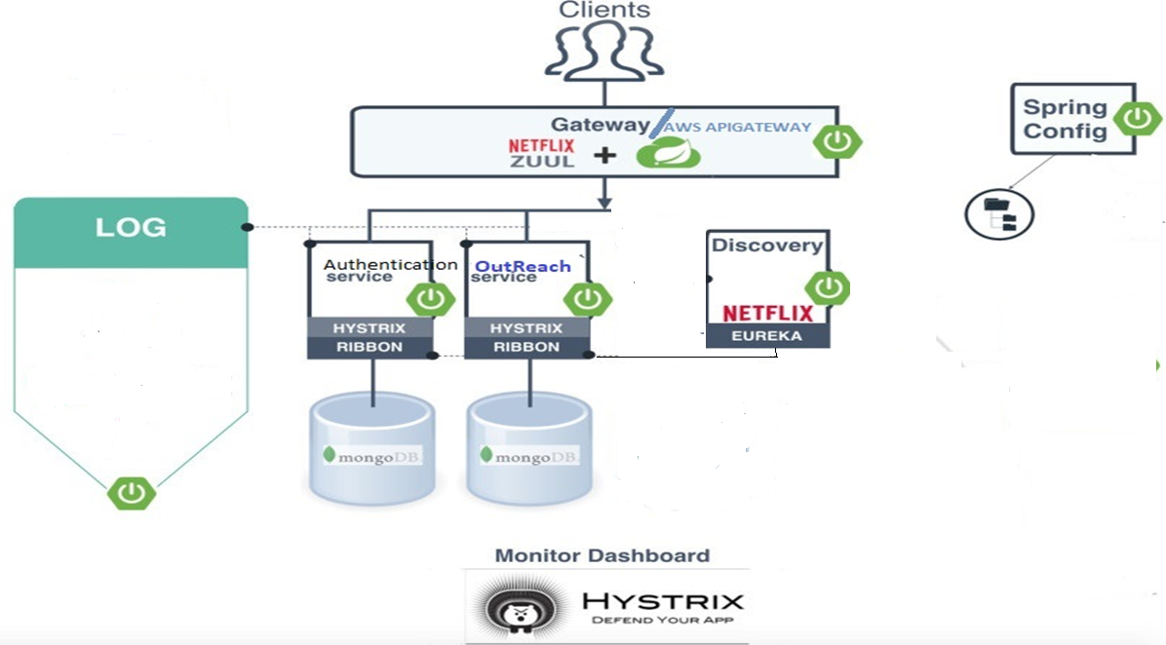

Slide 10
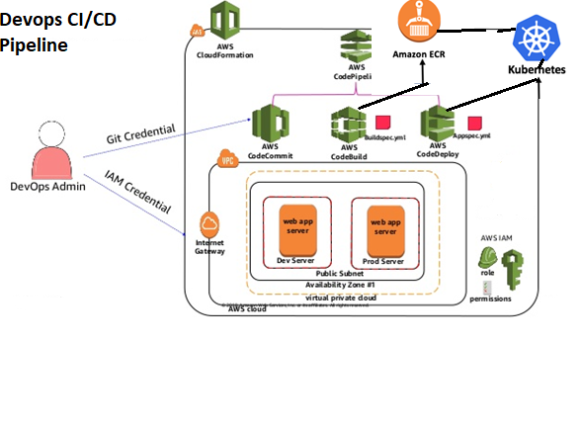
DevOps-2 - AWS DevOps
Jenkins

