Slide 1

Red Wine Quality
Computer Science
Wang Peng
Gero
Moscow,2023

Slide 2
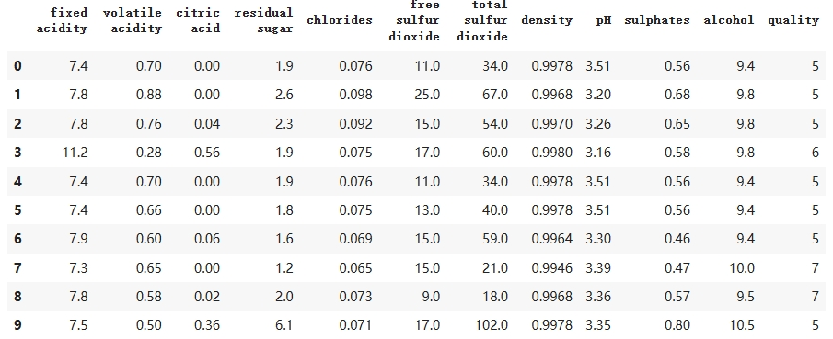
Dataset
Computer Science
Wang Peng
Moscow,2023
All features are float64,and the target(quality) is an interger(1-10)

Slide 3
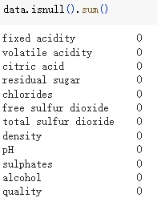
Data preprocessing
Computer Science
Wang Peng
Moscow,2023
None features are null

Slide 4
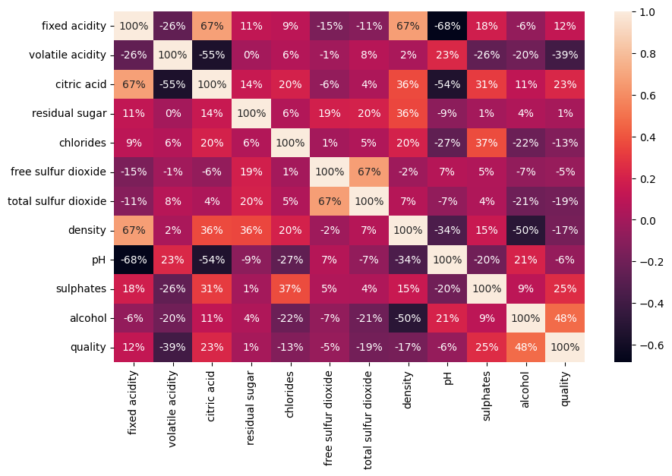
Computer Science
Wang Peng
Moscow,2023
Relations between features

Slide 5
Computer Science
Wang Peng
Moscow,2023

Slide 6
Computer Science
Wang Peng
Moscow,2023

Slide 7
Computer Science
Wang Peng
Moscow,2023

Slide 8
Computer Science
Wang Peng
Moscow,2023

Slide 9
Computer Science
Wang Peng
Moscow,2023
Thanks

