Slide 1

Red Wine Quality
Computer Science
Wang Peng
Gero
Moscow,2023

Slide 2
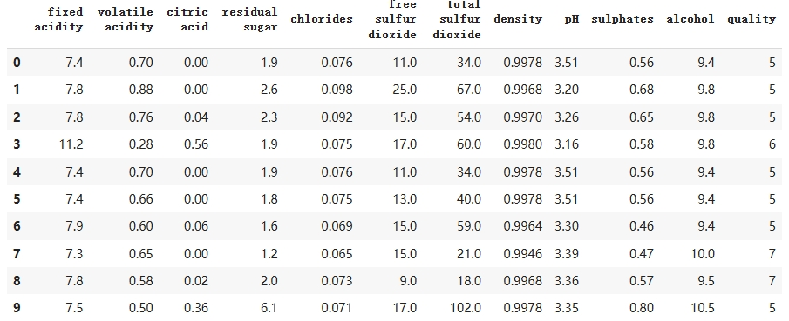
Dataset
Computer Science
Wang Peng
Moscow,2023
All features are float64,and the target(quality) is an interger(1-10)

Slide 3
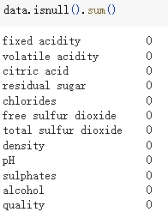
Data preprocessing
Computer Science
Wang Peng
Moscow,2023
None features are null

Slide 4
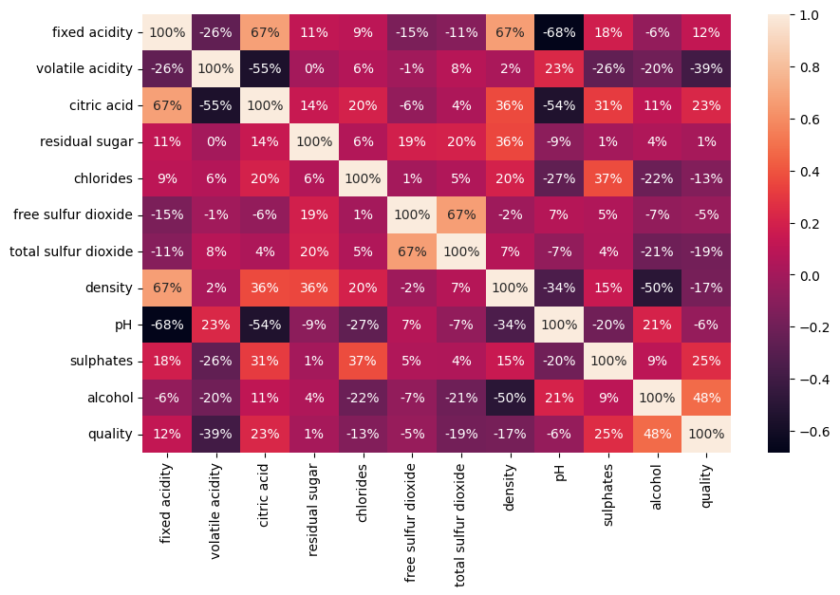
Computer Science
Wang Peng
Moscow,2023
Relations between features

Slide 5
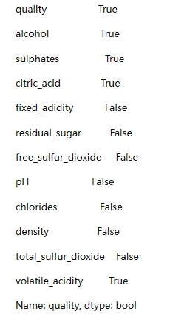
Computer Science
Wang Peng
Moscow,2023
Choose features
We choose the features which abs of the correlations beyond 0.2:
alcohol,sulphates,citric_acid,volatile_acidity

Slide 6
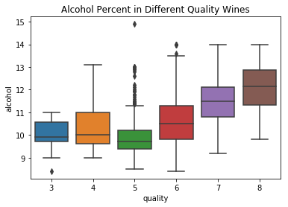
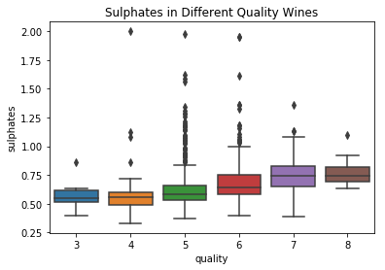
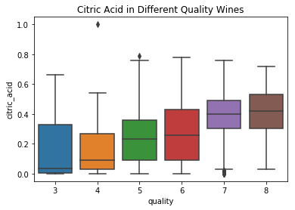
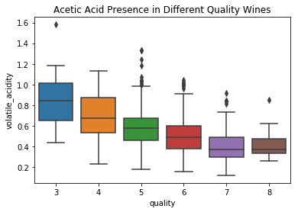
Computer Science
Wang Peng
Moscow,2023

Slide 7
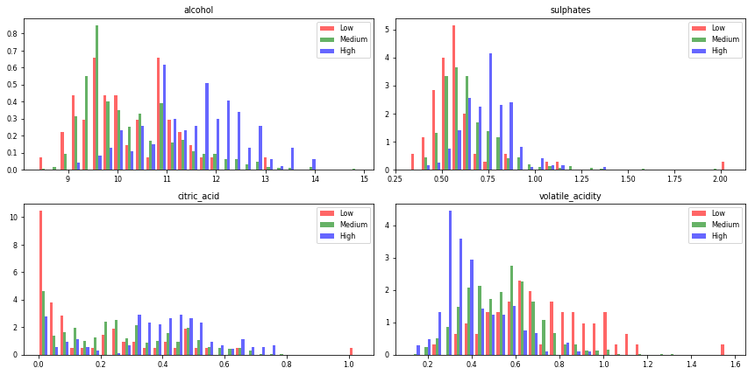
Computer Science
Wang Peng
Moscow,2023
Alcohol, sulfate and citric acid are positively correlated,acetic acid is negatively correlated

Slide 8
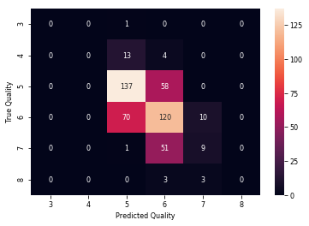
Computer Science
Wang Peng
Moscow,2023
Linear regression

Slide 9
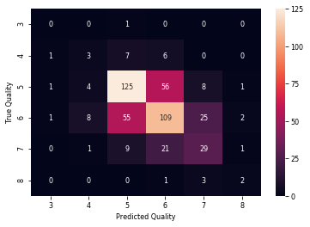
Computer Science
Wang Peng
Moscow,2023
Decision tree

Slide 10
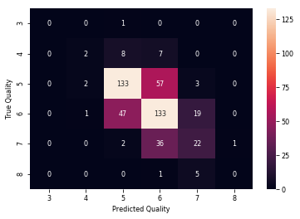
Computer Science
Wang Peng
Moscow,2023
Random forest

Slide 11
Computer Science
Wang Peng
Moscow,2023
Conclusion:
We used root mean square error (RMSE) to evaluate 3 models, random forest performs best, with an RMSE of 0.54

Slide 12
Computer Science
Wang Peng
Moscow,2023
Thanks

