Slide 1
ONLINE COLLEGE YEAR BOOK SYSTEM

Slide 2
DOMAIN INTRODUCTION
JAVA SERVER PAGE (JSP)
It is a server side technology.
used for creating web application.
used to create dynamic web content.
In this JSP tags are used to insert JAVA code into HTML pages.
an advanced version of Servlet Technology.
a Web based technology helps us to create dynamic and platform independent web pages.
In this, Java code can be inserted in HTML/ XML pages or both.
JSP is first converted into servlet by JSP container before processing the client’s request.

Slide 3
ABSTRACT
A yearbook, also known as an annual, is a type of a book published annually. One use is to record, highlight, and commemorate the past year of a school or college. The term also refers to a book of statistics or facts published annually this book was improve college or school worth. We create website for yearbook because all people easily access our yearbook anytime any ware and improve college worth hypertext Mark-up Language, is used to create web pages.
Site authors use HTML to format text as titles and headings, to arrange graphics on a webpage, to link to different pages within a website, and to link to different websites. MySQL is a relational database management system based on SQL – Structured Query Language. The application is used for a wide range of purposes, including data warehousing, e-commerce, and logging applications. The most common use for MySQL however, is for the purpose of a web database.

Slide 4
OBJECTIVES
The main aim & objective of development of Online College Yearbook java project is to provide an online platform to the college management, Staff and student alumni.
With the help of this project Students & Staff can able see the tasks & achievements done in previous years.

Slide 5
EXISTING SYSTEM
Yearbook is done manually in existing system.
It takes a lot of time while updating each events in year book.
Manual errors may happen.
Maintanence of records is a major issue.
It has lot of loss information

Slide 6
DISADVANTAGES
Less Secure
Data loss
Maintanence is low.
Cost is high

Slide 7
PROPOSED SYSTEM
All the events can be updated easily using digital manner,
Everyone can view the details
Images , exact information about the events can be viewed in a digital manner.
Year book is not done manually.

Slide 8
ADVANTAGES
The Year book is prepared in a digital manner.
Updating the events is done easily.
Time taken is less compared to manual updation.
It is very cost efficient.
Manual errors are avoided.

Slide 9
ARCHITECTURE DIAGRAM
ONLINE COLLEGE YEARBOOK SYSTEM
Student
User
Database
Admin

Slide 10
FLOW DIAGRAM
Register
Teacher
Student
Login
Admin
Add/update student and teacher achievements
view student achievements
Database
View Teacher achievements details

Slide 11
USECASE DIAGRAM
Student
REGISTER
LOGIN
Teacher
ADD /VIEW AND UPDATE ACHIEVEMENT YEARWISE
UPDATE PROFILE
VIEW AND SEARCH TEACHER ACHIEVEMENTS YEARWISE
Admin
VIEW AND SEARCH STUDENT ACHIEVEMENTS YEARWISE

Slide 12
CLASS DIAGRAM
Home page
Login
User/Teacher Register
User/Teacher Login
Admin Login
Admin()
User/ Teacher
Register
Login
View and search event by the year
Admin
Login
Add the event
View and search the event

Slide 13
SEQUENCE DIAGRAM
Start
Admin
User / Teacher
login
Register and login
View the events and search the achievements
Add and view the event

Slide 14
E-R DIAGRAM
Add/update achievements
View student and teacher acheivements yearwise
Update Profile
Preview Data
Login
ADMIN
TEACHER
STUDENT
View student and teacher acheivements yearwise
Update Profile

Slide 15
MODULES
Admin
Teacher
Students

Slide 16
MODULE DESCRIPTION
ADMIN:
Admin can login with their username and password.
Then add/update the achievements with the particular details like branch name, experience , year and image.
Then admin can view the data and also search with the branch name, year.

Slide 17
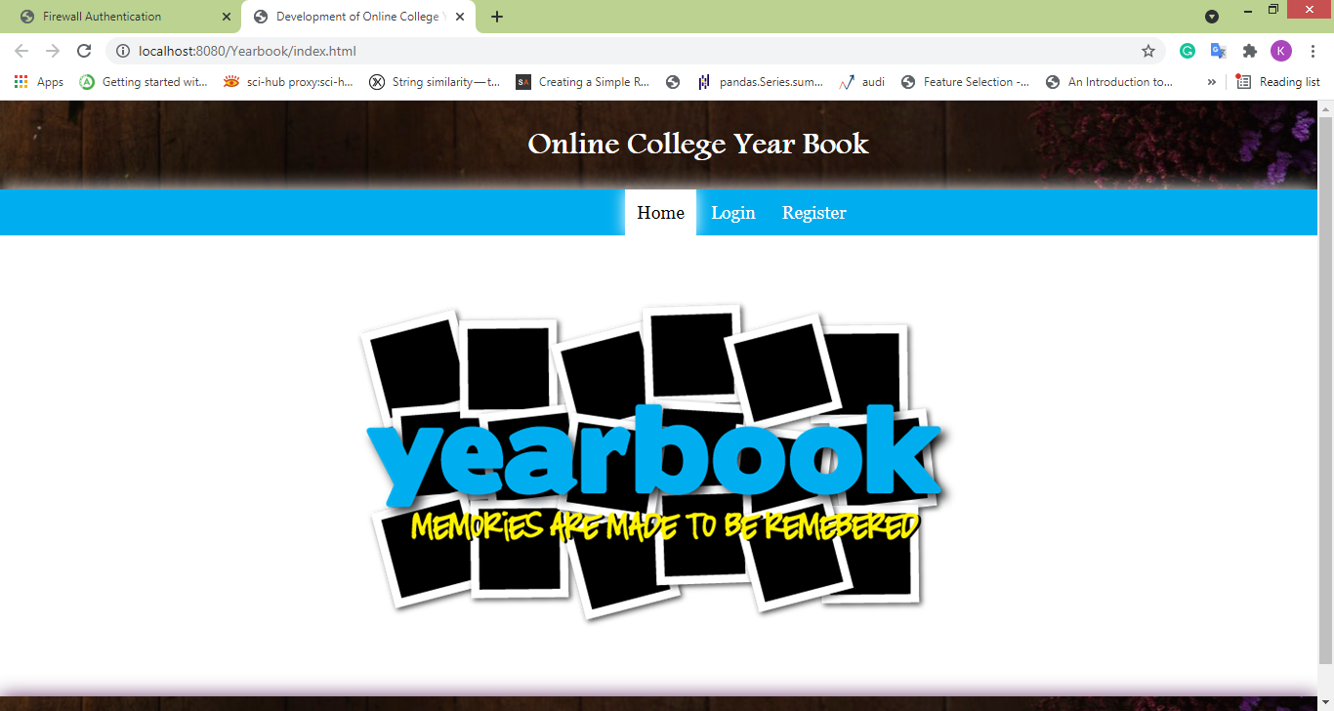
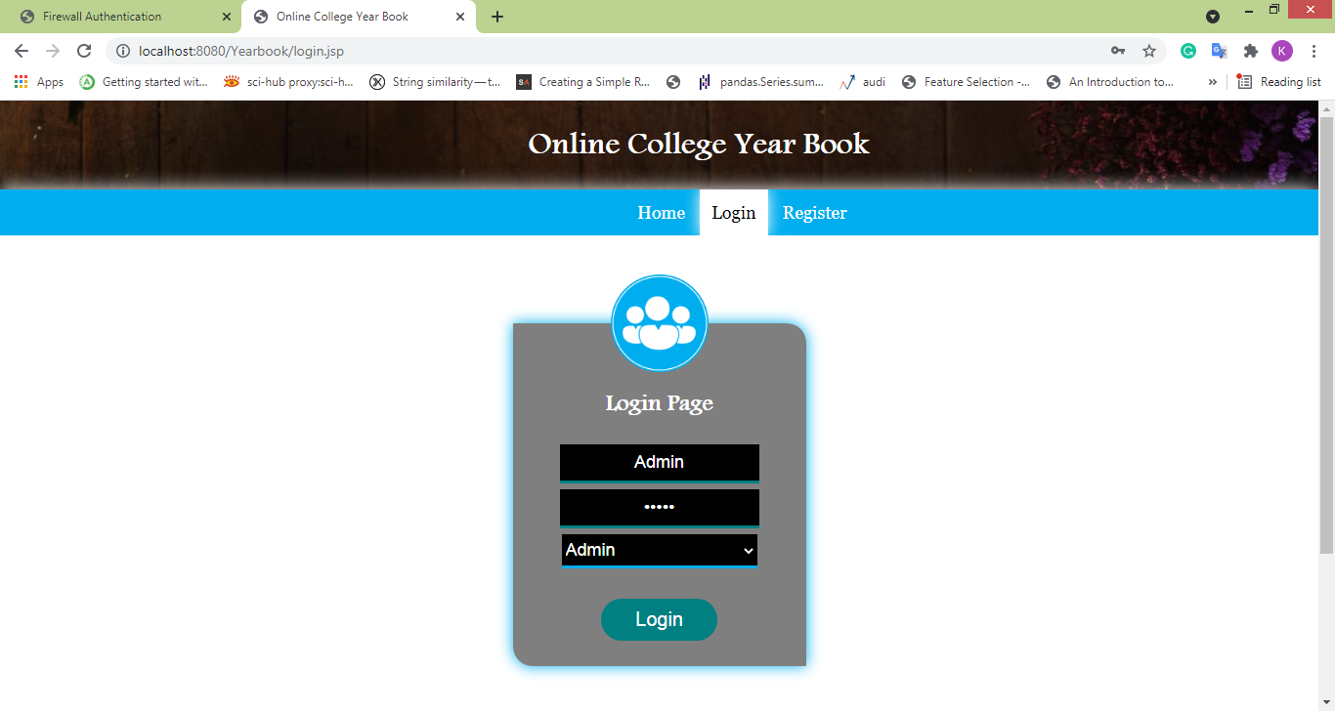

Slide 18
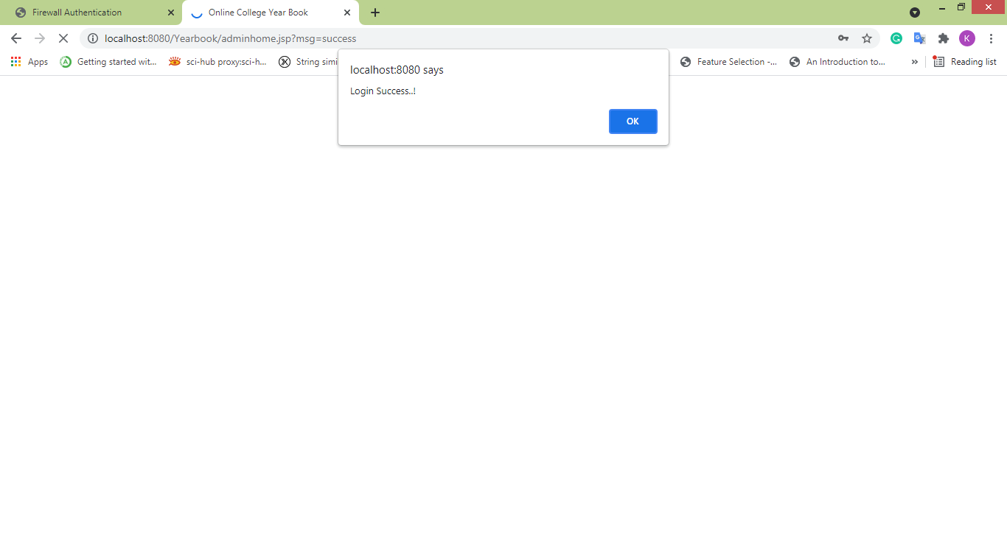
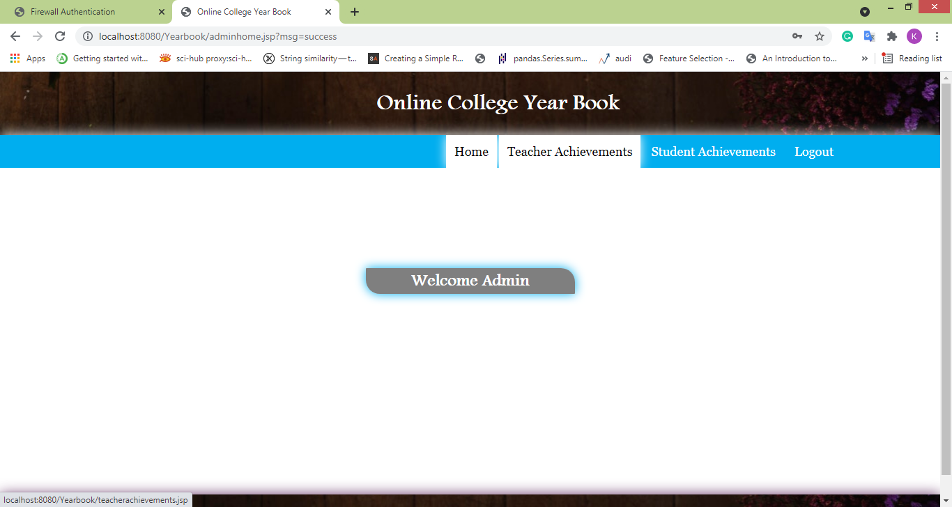

Slide 19
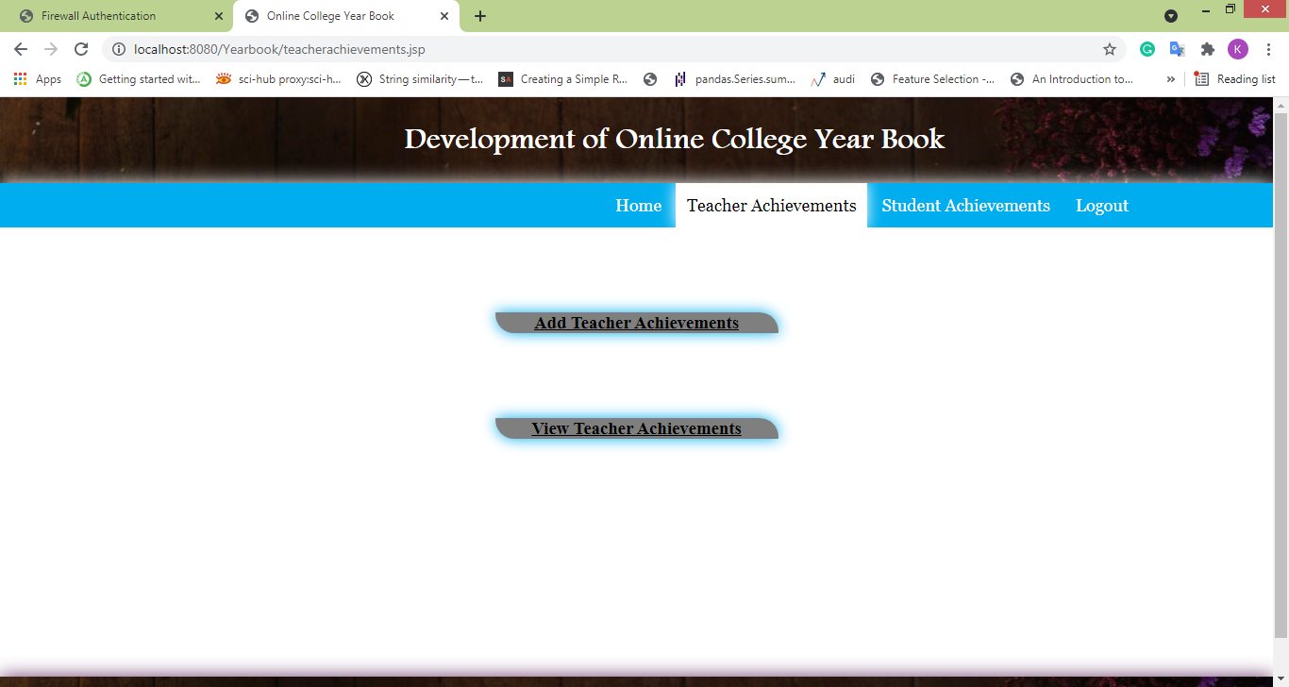
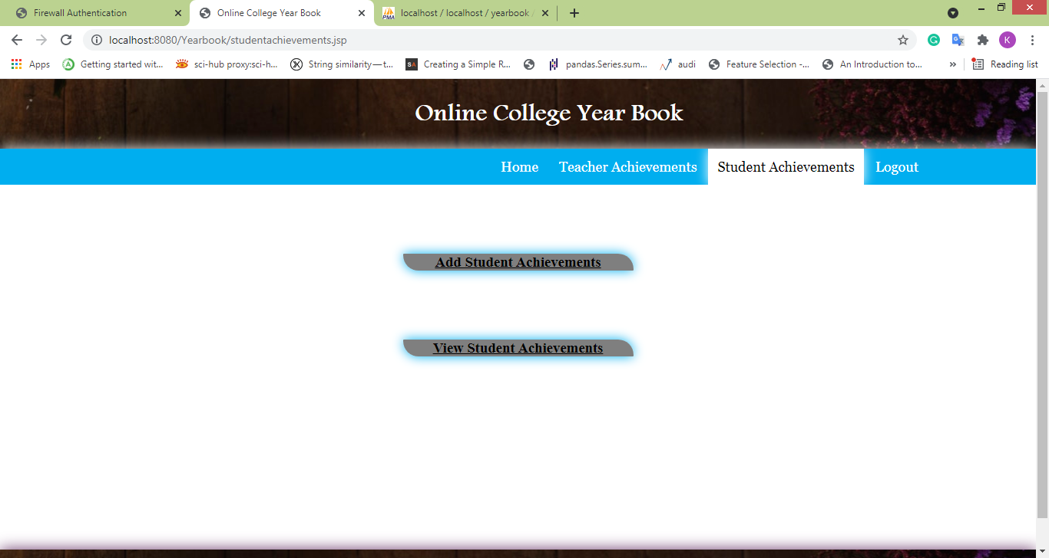

Slide 20
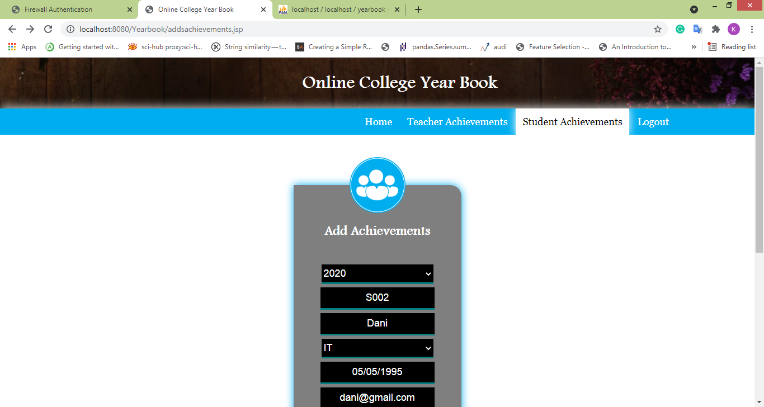
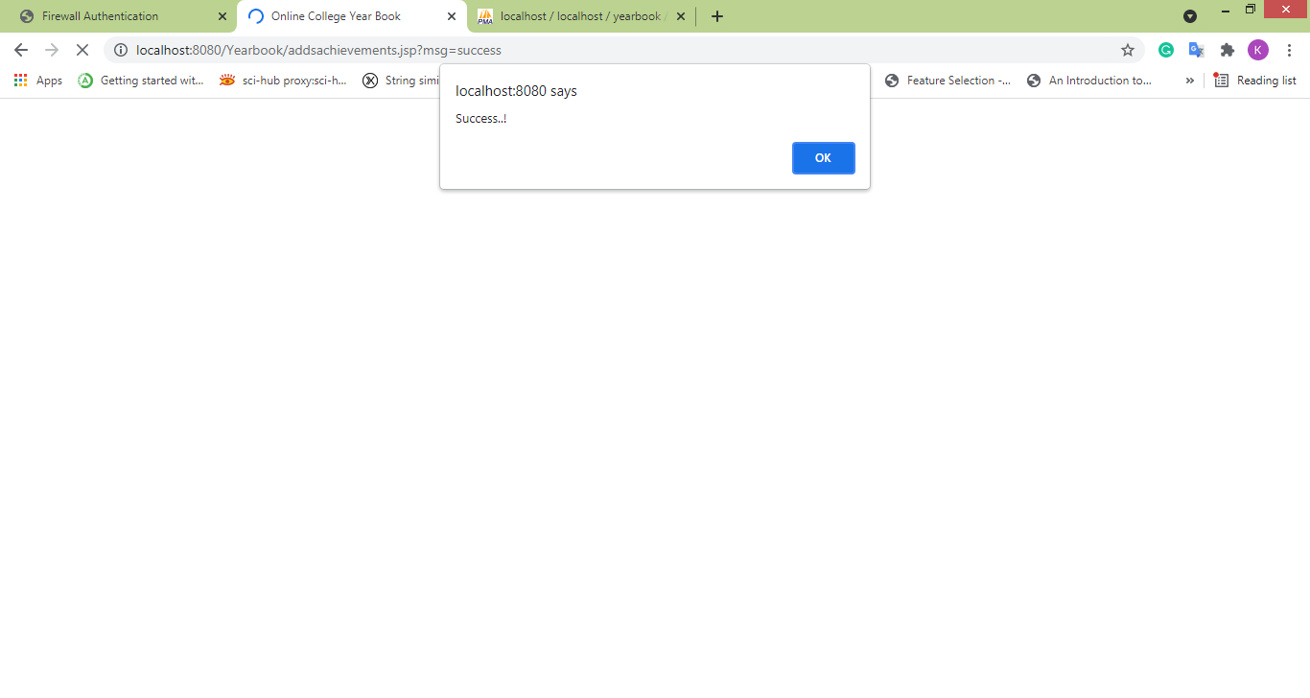

Slide 21
MODULE DESCRIPTION
TEACHER:
The teacher can register with some details and also login with the username and password that given in register page.
Teacher can update the profile with their details if they want.
Teachers can view the yearwise achievements of students and teachers search using year and the branch name.

Slide 22
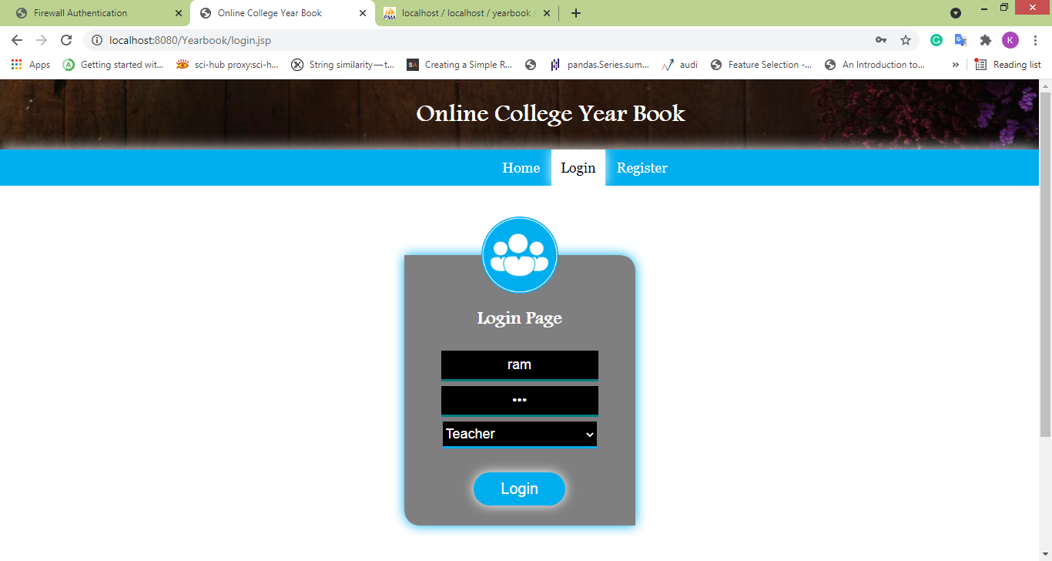
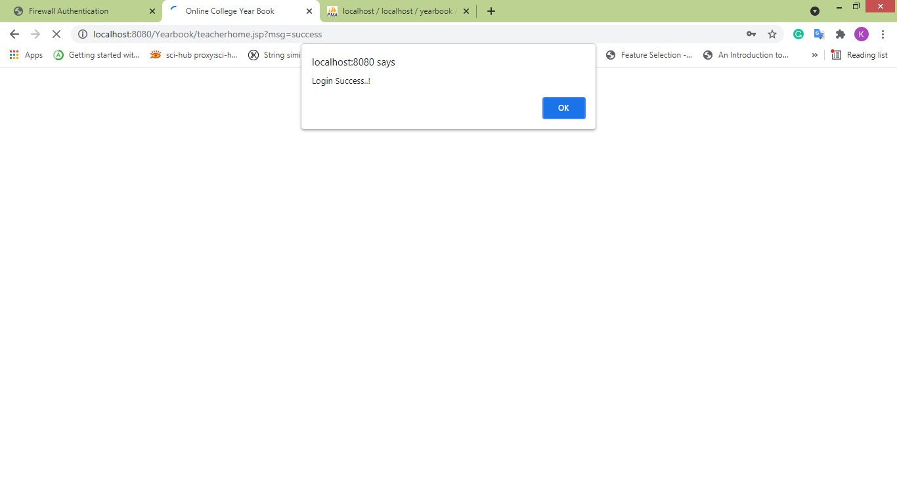

Slide 23
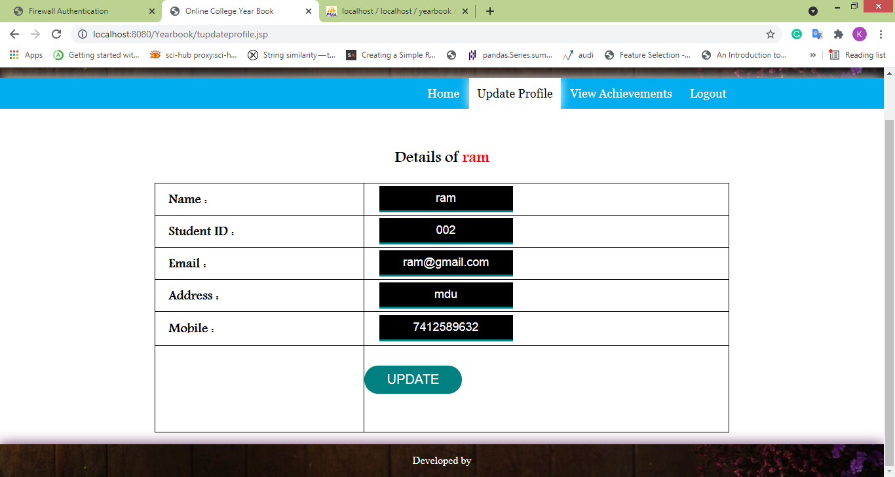
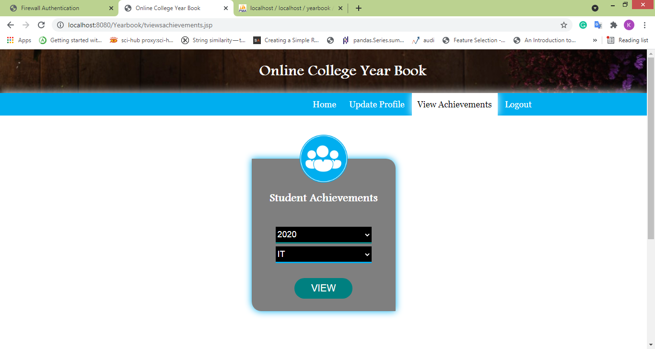

Slide 24
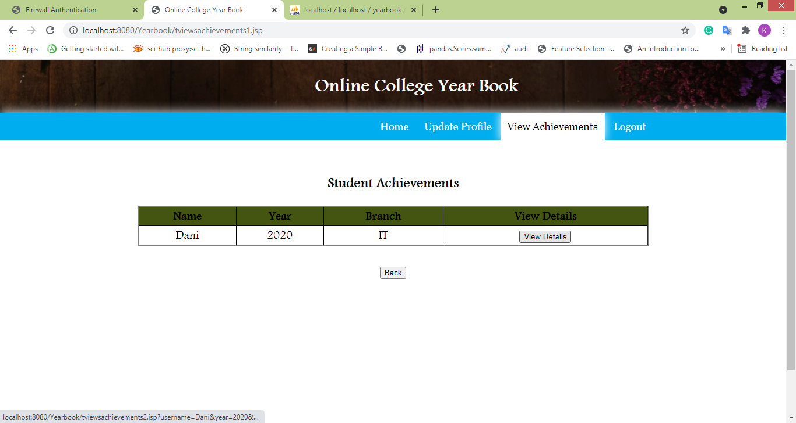
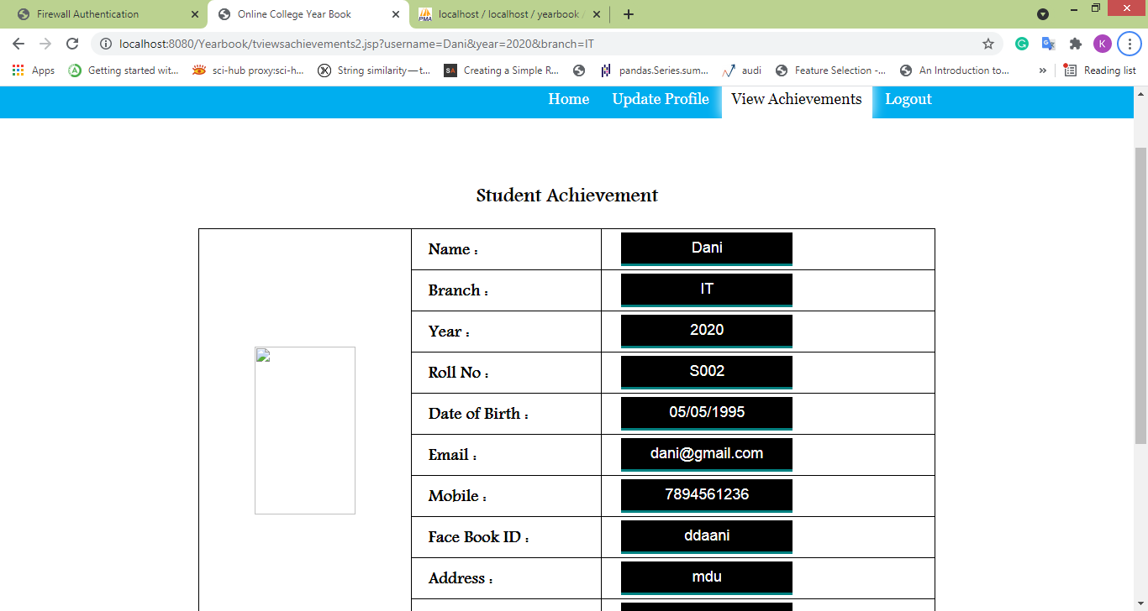

Slide 25
MODULE DESCRIPTION
STUDENTS:
The teacher can register with some details and also login with the username and password that given in register page.
Teacher can update the profile with their details if they want.
Teachers can view the yearwise achievements of students and teachers search using year and the branch name.

Slide 26



Slide 27
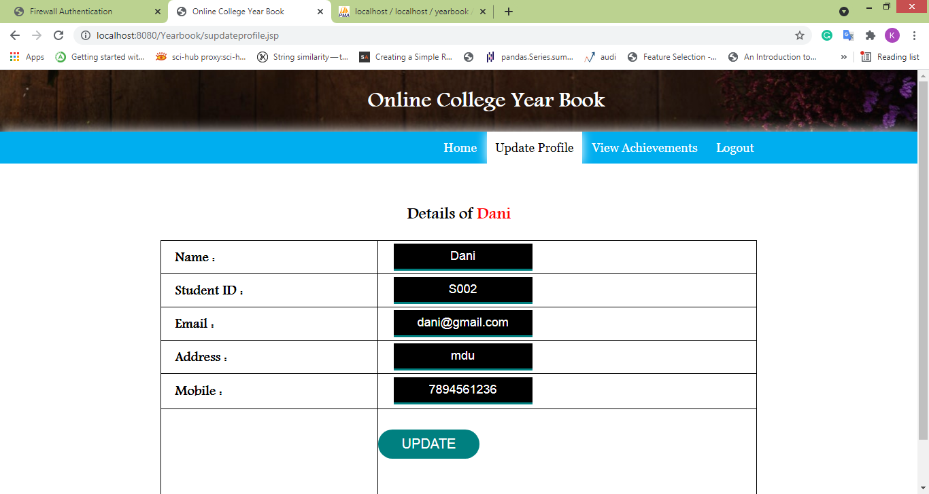
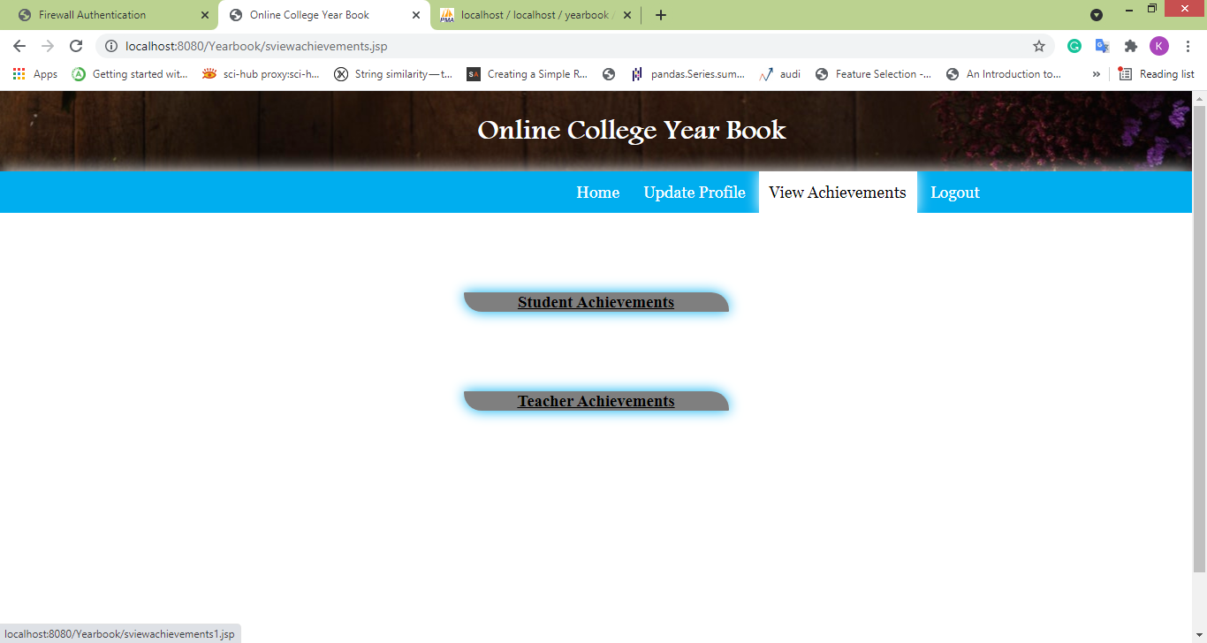

Slide 28
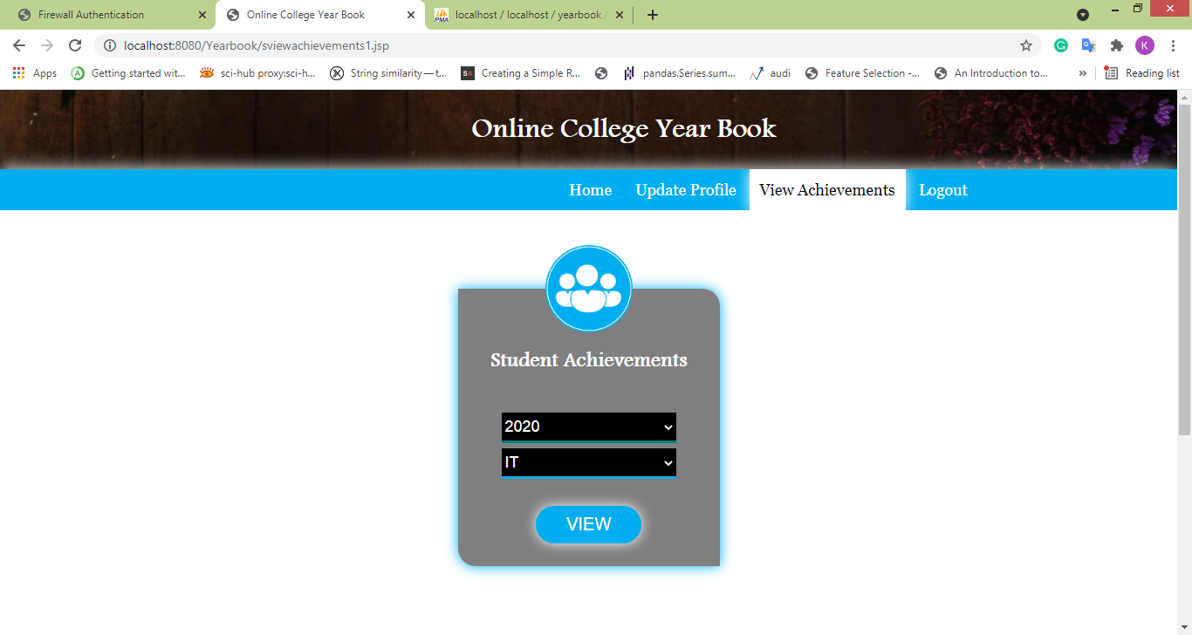


Slide 29
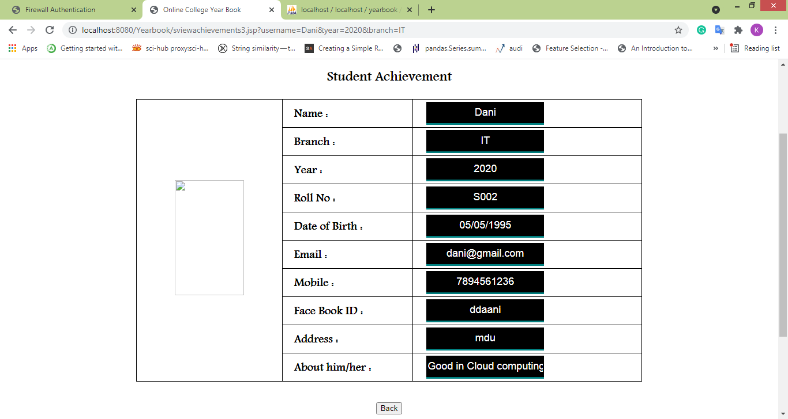

Slide 30
SYSTEM REQUIREMENTS
Hardware Requirements
Processor : Intel Core i5
Hard Disk : 200 GB
Monitor : 18’ LED color
Mouse : DELL.
Keyboard : 110 keys enhanced
RAM : 3GB

Slide 31
SYSTEM REQUIREMENTS
Software Requirements
Operating System : Windows 7 / 8 / 10
Language Used : Java (Servlet, JSP)
Database : My SQL
User Interface Design : HTML, CSS , JAVA SCRIPT
Web Browser : Mozilla, IE8, Chrome
Server : Apache Derby Network Server , Glass Fish Server 4.1

Slide 32
CONCLUSION
We conclude that the online yearbook system can be update all the achievements of students and teachers based on the previous year easily using digital manner.
Everyone can easily access the webpage with the proper authentication using username and password to enter into the process to update profile and view the achievements of the students and teachers.
This process overcome the manual process and it is converted into digital manner effectively.

Slide 33
FUTURE ENHANCEMENT
In Future, for the students who make the yearbook—their view of information value, salience, and framing could be different than the intended audience’s view.
For each of these areas of further study a larger sample of yearbooks would be needed.

Slide 34
PROBLEM STATEMENT
Every year, for each institution it is a part of the curriculum to showcase the tasks, achievements completed by students and teachers, manually.
It is not suitable and chores take longer time to prepare.

Slide 35
REFERENCES
https://www.geeksforgeeks.org/introduction-to-jsp/
https://www.javatpoint.com/servlet-tutorial
https://www.mysql.com/

Slide 36
THANK YOU…

