Slide 1
Pseudo Programmers
Team -14

Slide 2
Poblem Statement
Assumptions:
1. You have data 3 months of 50 customers going daily at different time intervals during the day from Home to Office & back. You can a generate random sample using excel.
2. You can generate the (lat,long) coordinates randomly for 50 customers.
3. You cannot use google Maps API. You can use any other API.
4. Ride ETAs can vary due to day of the week, time of the day and live traffic.
5. Source live traffic from the best possible source possible (Except google maps API)
Build an application to predict the exact the time taken for a customer to go from point A (Home) to point B(Office) with >95% accuracy. Assume traffic as constant & Ignore accidents, roadblocks, major traffic jams. Take logical assumptions wherever possible

Slide 3
OBJECTIVES
The objective of this project is to develop a machine learning model capable of predicting customer travel time between home and office locations based on simulated data and traffic conditions. For which the steps required to be fulfilled are:
=>Data Creation
=>Regression Model Building
=>Model Validation
=> Web page development

Slide 4
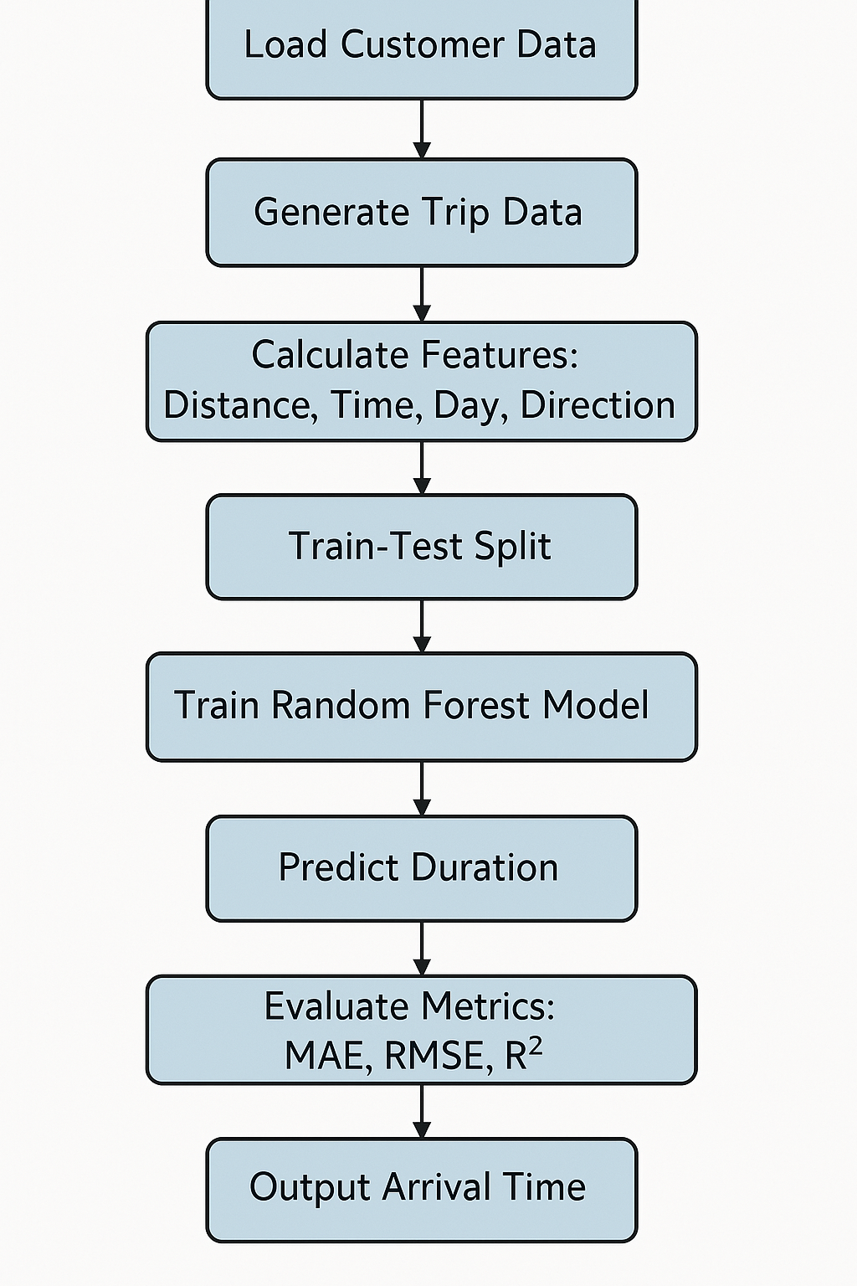
FLOWCHART

Slide 5
Tech Stack Used
Programming language
Python
Platforms
Excel
Jupyter
Pycharm
Libraries or Frameworks
Streamlit
Sklearn
geopy

Slide 6
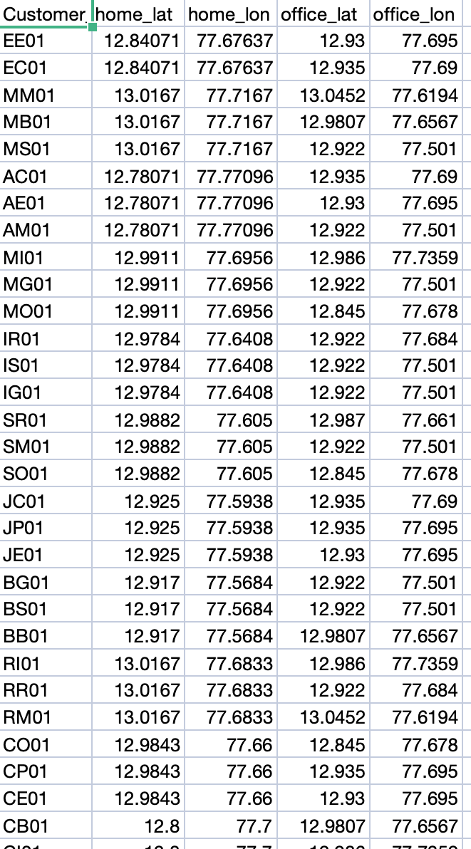
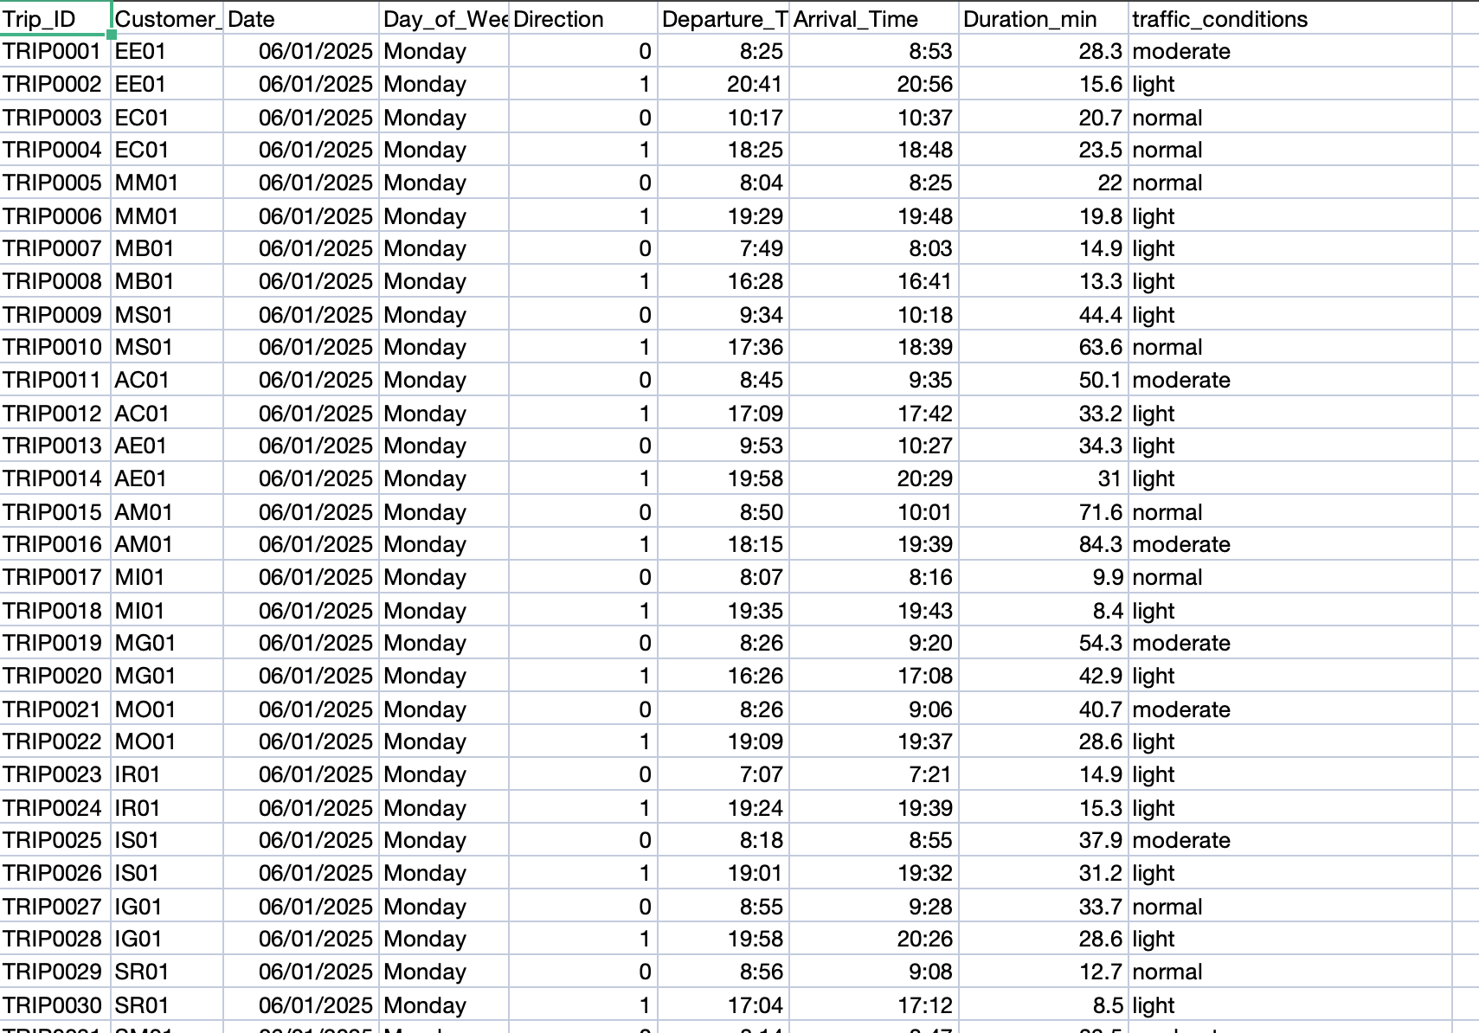
Data Creation
We created synthetic data in Excel using random functions to simulate real-world commuting data. The dataset consists of two tables: trips_full and customer_ao
Customer_ao Table Trips_full Table
Customer_ID Trips_id
Home_lat Customer_ID
Home_lon Departure_Time
Office_lat Arrival_Time
Direction Direction
Office_lon traffic_conditions

Slide 7
Regression model
This project uses a Random Forest Regressor to predict commute durations in Bangalore based on historical trip data. The model analyzes key features like distance, departure time, day of the week, and traffic conditions to estimate travel time accurately.
Features:
Distance: Road distance between locations (km).
Departure_Minutes: Time of day in minutes (e.g., 8:30 AM → 510).
Day_Numeric: Day of week (Monday=0, Friday=4).
Time_Of_Day_Numeric: Morning (0), Midday (1), Evening (2).
Direction_Numeric: Home→Office (0) or Office→Home (1).
Model Performance:
MAE: 0.07 minutes (mean absolute error).
RMSE: 0.60 minutes (root mean squared error).
R² Score: 0.9995 (near-perfect fit, likely due to synthetic data).
Accuracy: 99.1% of predictions within 5% of actual duration.

Slide 8
Model Validation
Train-Test Split (80:20):
80% of the synthetic trip data trained the model, while 20% tested its performance.
Performance Metrics:
MAE (0.07 min): Indicates near-perfect precision in predictions.
RMSE (0.60 min): Confirms minimal deviation from actual durations.
R² Score (0.9995): Demonstrates the model explains 99.95% of variance in the data.
Error Analysis:
99.1% of predictions were within 5% of actual durations.
99.75% fell within 10%, highlighting robustness.

Slide 9
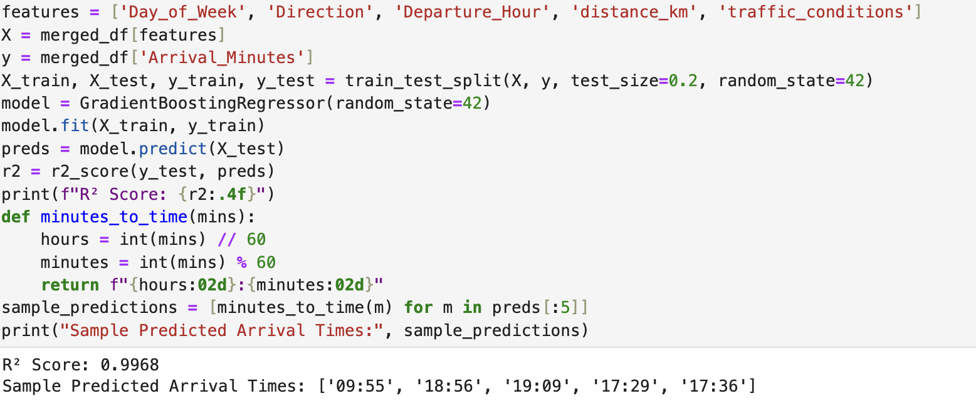
Model building - Demonstration

Slide 10
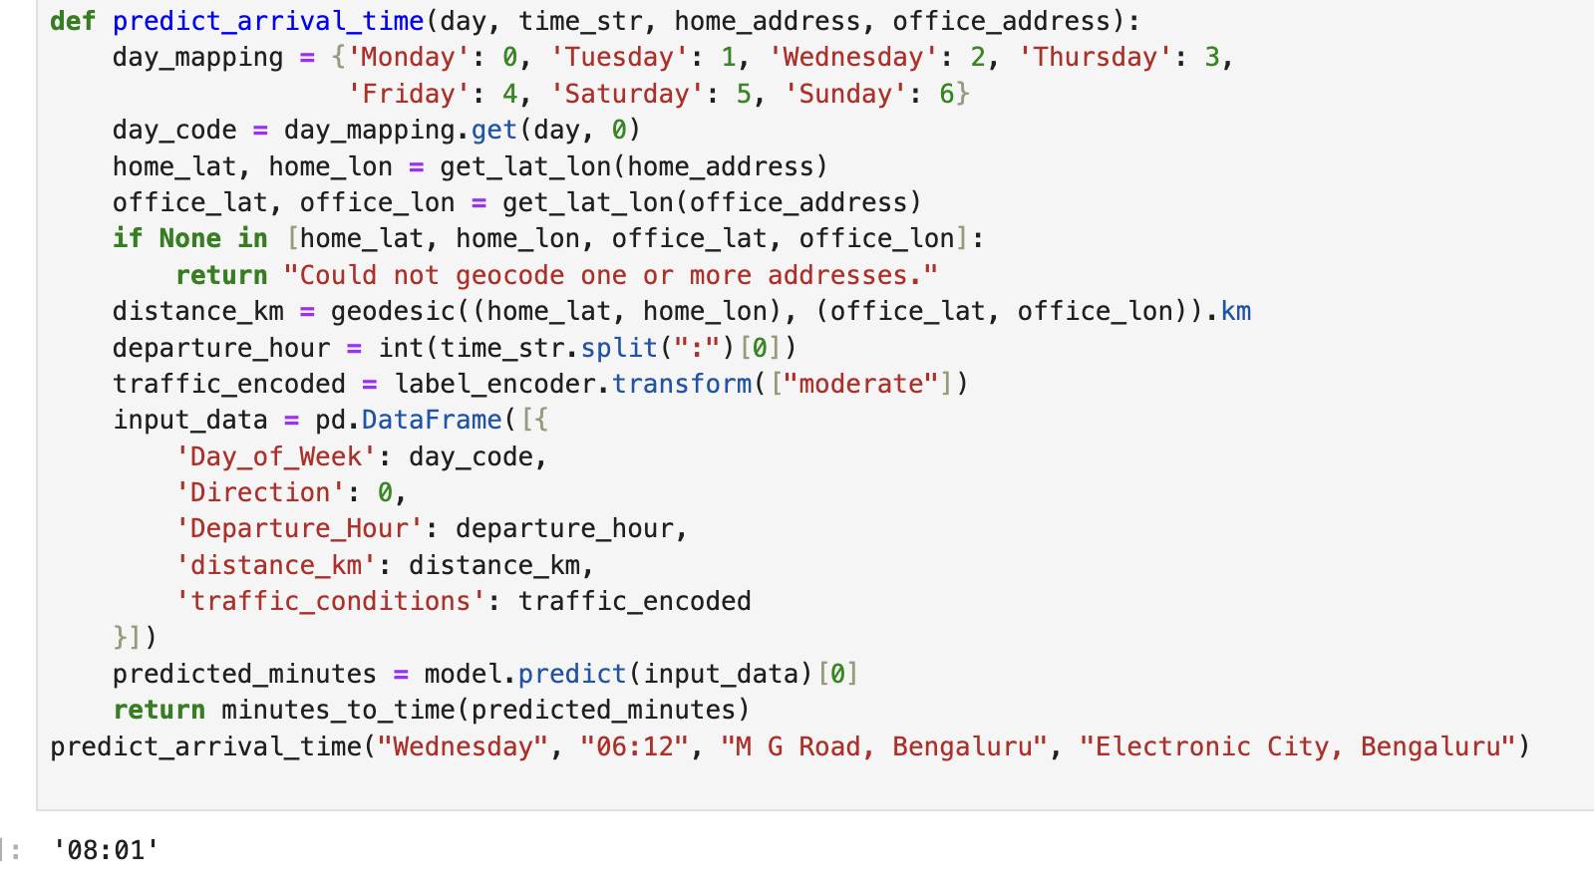
Using geopy library - Demonstration

Slide 11
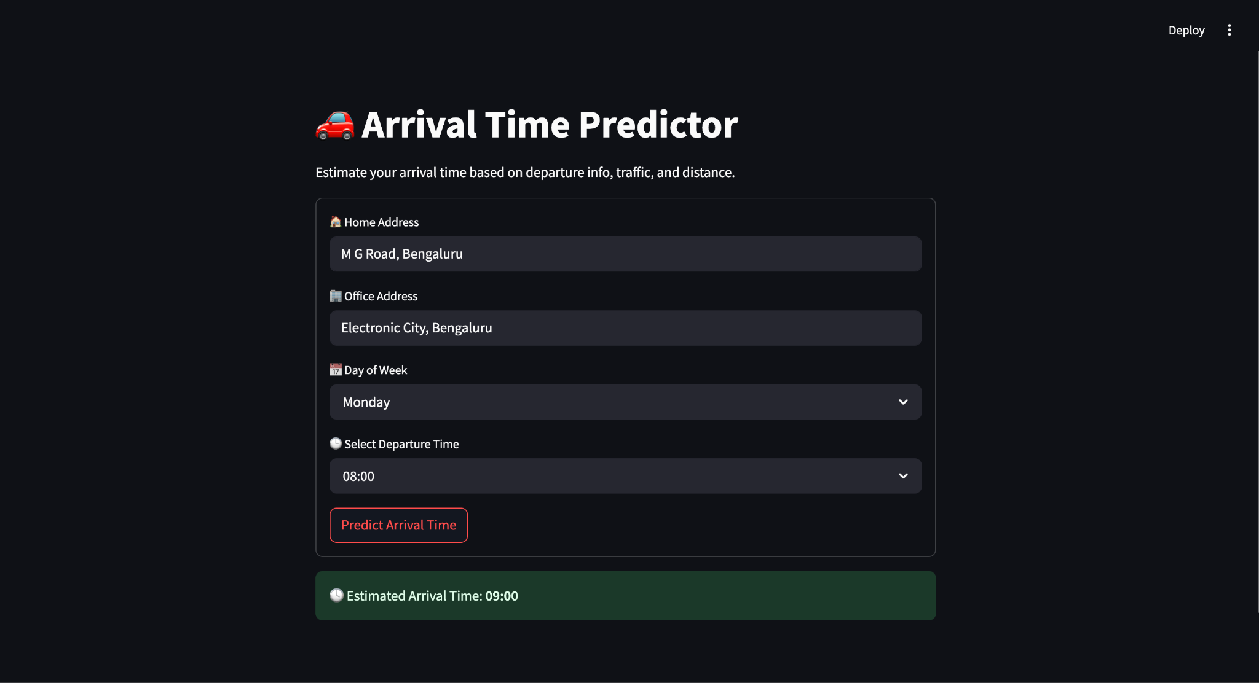
Web page - Demonstration

Slide 12
Conclusion
This project successfully demonstrates the feasibility of predicting commute travel time under simulated traffic patterns using regression models.
We have used the Random Forest model to achieve strong predictive performance, highlighting the importance of time-of-day, traffic conditions, and route characteristics in determining travel time.

