Slide 1
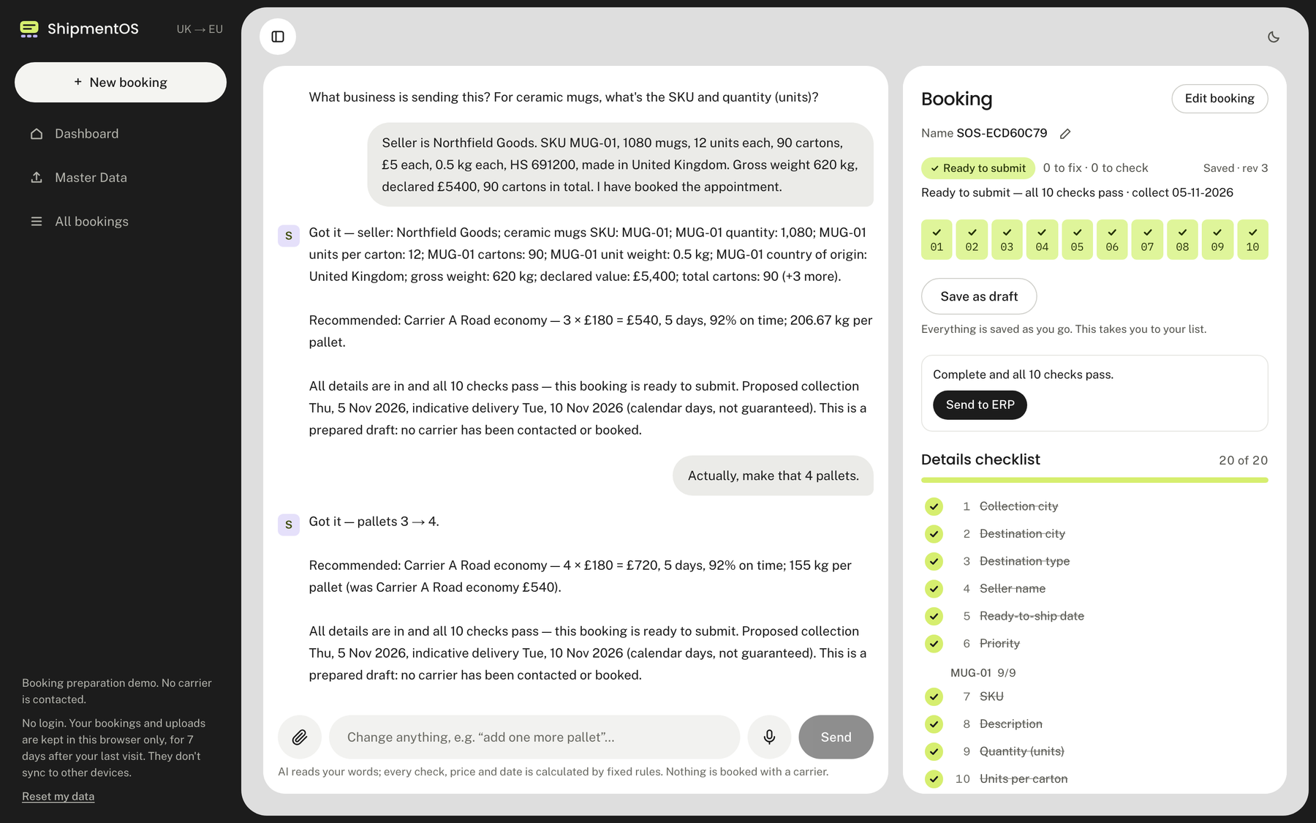
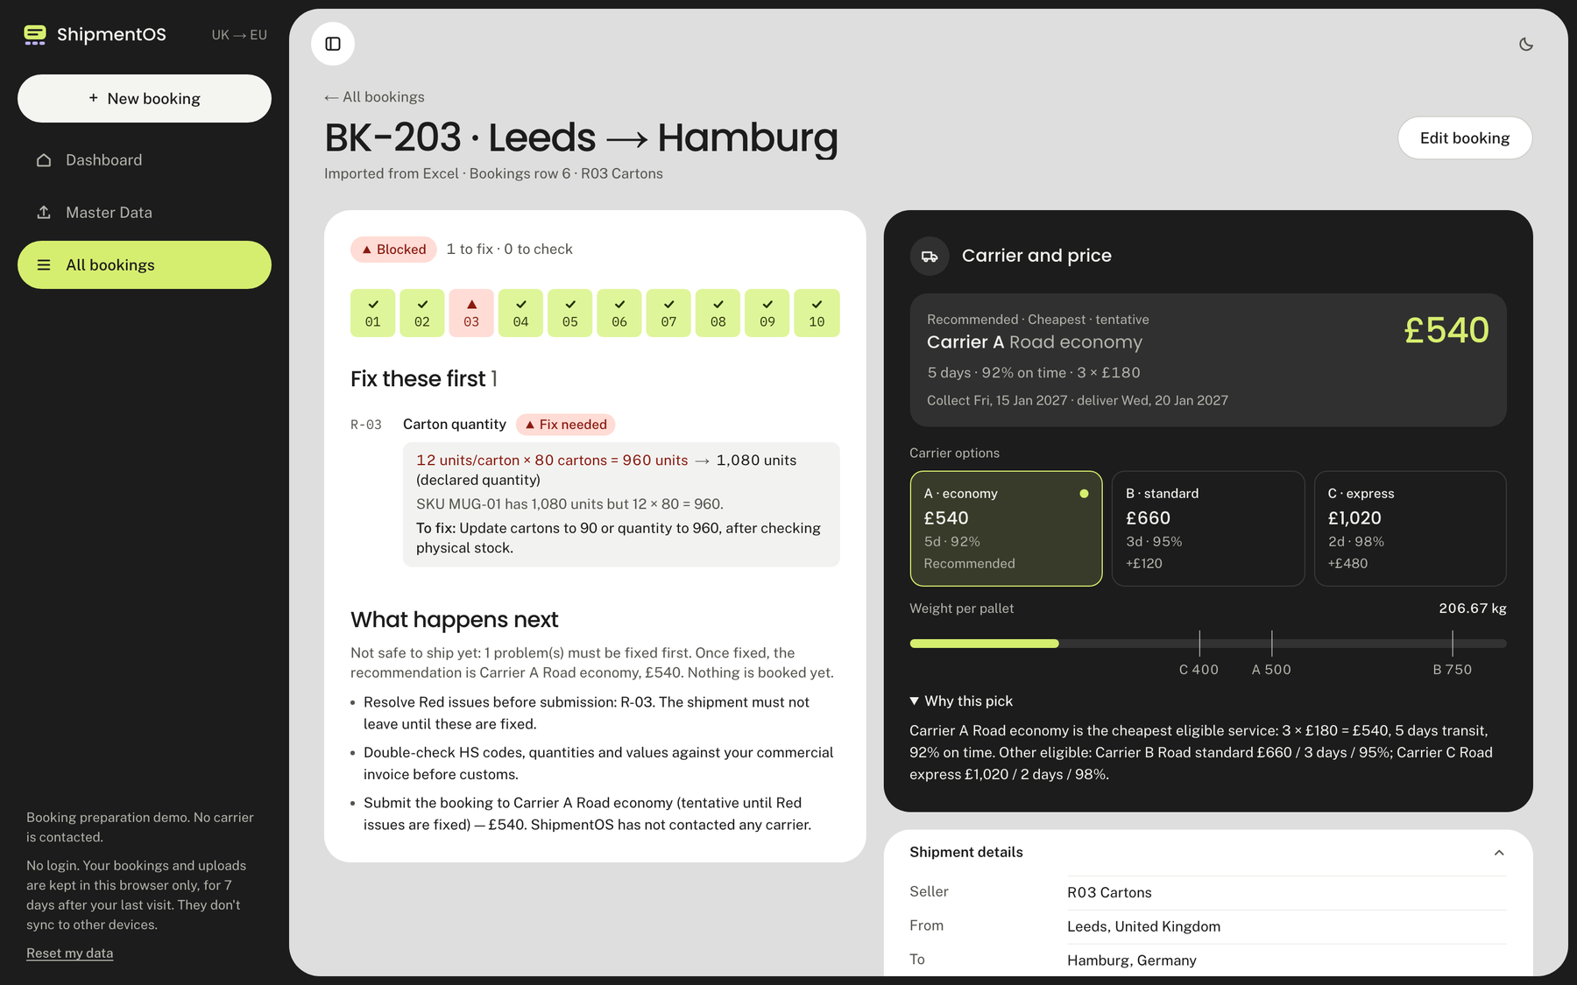
International shipping is complicated. Booking it shouldn't be.
INTRODUCING SHIPMENTOS
ShipmentOS simplifies booking, catches preventable mistakes before goods leave, and helps you choose the right carrier.
Ship smarter, not harder
Notes:
SAY: International shipping is complicated, and the forms are where it goes wrong. ShipmentOS lets a seller describe a shipment in plain words, checks it before it leaves, and recommends a carrier. These are real screens from our working product.

Slide 2
A small data error becomes an expensive surprise
Incorrect shipment information
Customs or warehouse issue
Delays and rework
Cost and disruption
e.g. a wrong quantity, missing customs code, mismatched value
Goods held, or units reported missing
Corrections and repeated coordination
Late stock, extra admin, an unsure seller
What the business feels
Inventory arrives later than expected
Manual fixes and repeat emails
More admin for the team
Fulfilment and restocking disrupted
Uncertainty for the seller
From the hackathon brief: sellers often only find out days later, when their stock is already stuck.
Notes:
SAY: One wrong number on a booking can mean goods held at customs or units missing at the warehouse. Then come delays, rework and a disrupted supply plan. The brief says sellers often only learn this days later, when stock is already stuck. We are not quoting cost figures, because we have not measured any; the point is that the problem starts small and is found late.

Slide 3
Where today's booking process breaks
1 Gather information
2 Fill many fields
3 Reconcile quantities
4 Check documents
5 Compare carriers
6 Submit
Dozens of linked details, easy to miss one
Units, cartons and totals must all agree
Customs codes and country of origin must be right
Cost, speed and reliability pull different ways
And nothing tells the seller something is wrong until the shipment is already moving.
Hardest for smaller sellers without a dedicated logistics team.
Notes:
SAY: Walk the journey left to right. Every dark step is a place where something interconnected can quietly go wrong: many fields, totals that must agree, codes that must be right, and a carrier choice with trade-offs. The seller gets no warning. Smaller sellers without a logistics team feel it most.

Slide 4





One platform, two simple ways to start
Talk to ShipmentOS
THE SAME OUTCOME EITHER WAY
Describe a shipment naturally and answer a few follow-up questions.
A clear shipment review
Ready, or needs attention
Specific corrections
Upload your shipments
What is wrong and how to fix it
Drop in your spreadsheet and check every booking at once.
Recommended shipping option
Matched to your priority
Pick either route. You never need to do both.
Notes:
SAY: Two ways in. Talk to ShipmentOS if you are booking one shipment; upload a spreadsheet if you already have many. You never need both. Either way you get the same three things: a clear review, specific corrections, and a recommended carrier.

Slide 5
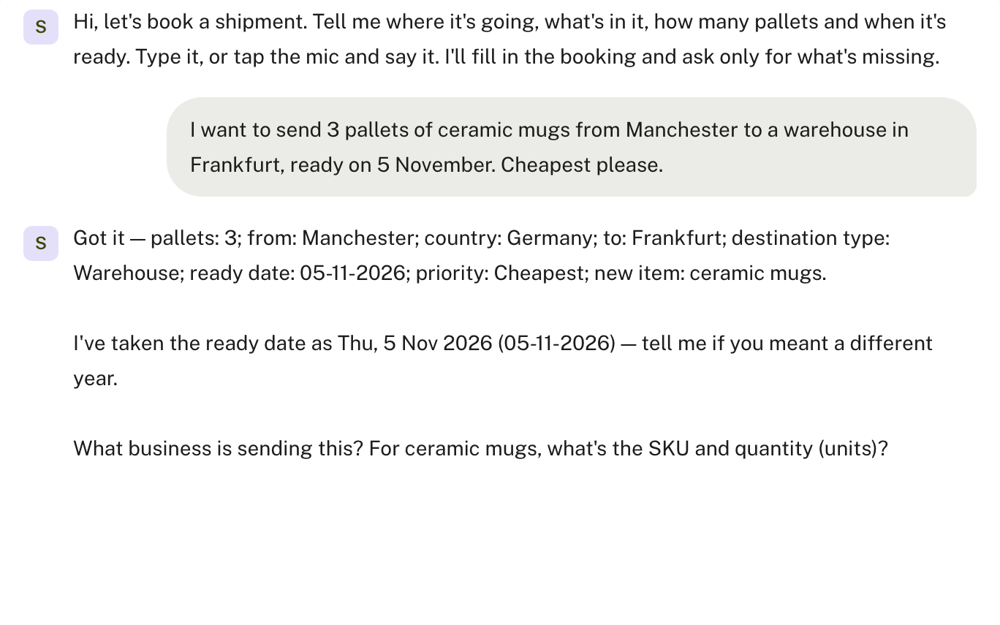
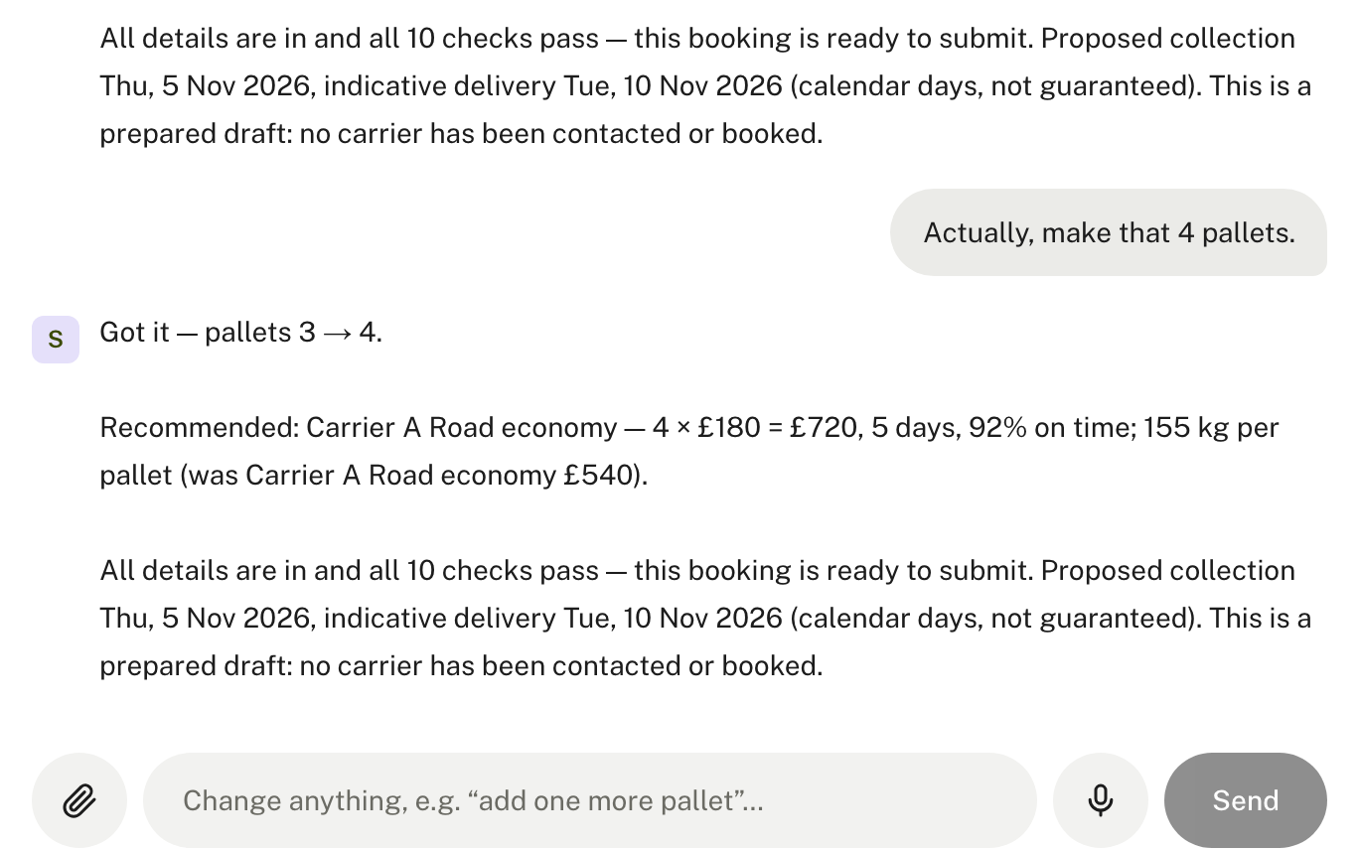
From a simple conversation to a complete booking
“3 pallets of ceramic mugs, Manchester to a warehouse in Frankfurt…”
“Actually, make that 4 pallets.” Price updates £540 → £720. Nothing is re-asked.
Less form-filling. More guidance.
Notes:
SAY: This is the real product. The seller types one sentence. ShipmentOS picks out what it can (route, warehouse, date, pallets), then asks only for what is missing. When the seller changes their mind, 'make that 4 pallets', the booking and price update from £540 to £720 and nothing is asked again. When all details are in it shows a booking ready for review. Example values are the hackathon's sample shipment.

Slide 6
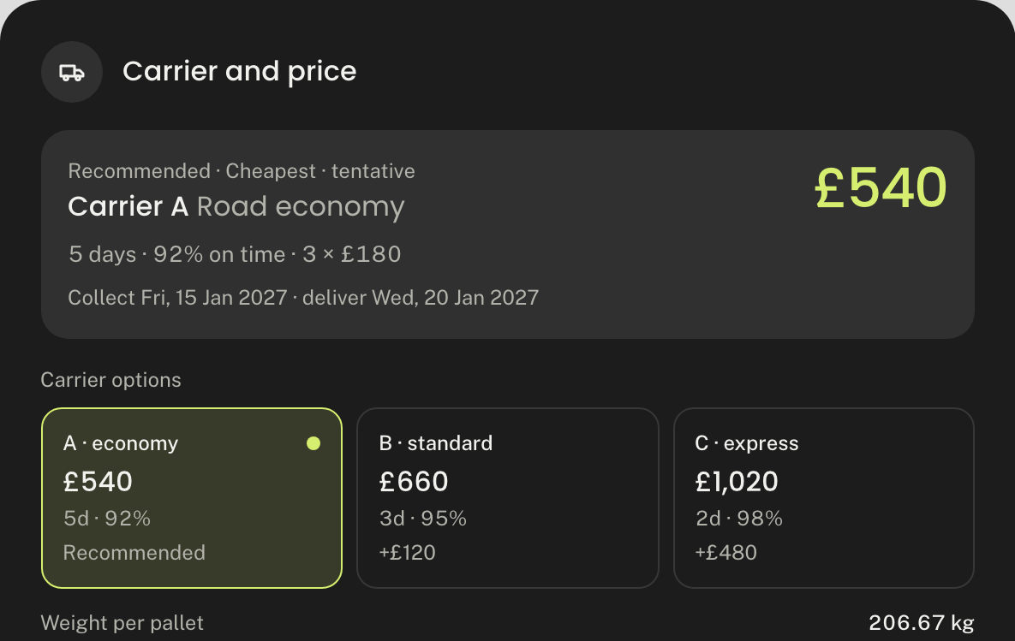
Find the mistake while it's still easy to fix
Choose shipping by what matters most
RED: fix before dispatch
AMBER: check this
Quantities do not add up
1,080
960
120
≠
units declared
12 per carton × 80
units unaccounted
The fix, in plain words: change cartons to 90, or the quantity to 960, after checking the stock.
You get a recommendation, not just an error message.
Cheapest
Fastest
Most reliable
Balanced
Example values from the hackathon sample data.
Notes:
SAY: Here is a mistake the system catches. The booking says 1,080 units, but 12 per carton times 80 cartons is only 960, so 120 units are unaccounted for. That is a red issue: it should be fixed before the shipment goes. ShipmentOS says exactly how: change the cartons to 90 or the quantity to 960, after checking stock. Amber means worth checking but not a blocker. On the right, the seller picks what matters: cheapest, fastest, most reliable or a balance, and sees the carrier options with price, days and on-time rate. Note: this checks booking information; it is not customs clearance.

Slide 7


What changes for the business?
BEFORE
WITH SHIPMENTOS
Manual booking effort
Guided booking creation
Confusing information requirements
Clear requirements
Errors found late
Issues found early
Repeated clarifications
Specific correction steps
Slow carrier comparison
Priority-based carrier pick
Disconnected records
One organised booking list
Operational efficiency
Risk reduction
Better decisions
Simpler workflows, less repeat admin
Inconsistencies caught before dispatch
Clear options with reasons
Expected benefits, not measured results.
Notes:
SAY: On the left, the process most sellers have today. On the right, what ShipmentOS changes. Group it into three outcomes: efficiency, lower risk, and better decisions. Be upfront: these are the benefits we expect from what the product does. We have not yet measured time saved or money saved.

Slide 8

From booking complexity to shipment clarity
WORKING TODAY, NO LOGIN
shipmentos-preflight.vercel.app
WHAT YOU CAN DO NOW
Book by conversation
Change details mid-chat
Check a whole spreadsheet
Red / Amber issue flags
Scan to try it
Carrier pick by priority
Revisit past bookings
FUTURE OPPORTUNITIES (NOT BUILT YET)
The best time to fix a shipment problem is before it leaves.
Real carrier connections
Automated documents
Shipment tracking
More routes
High-volume automation
Prepares and checks bookings. Does not contact carriers or replace customs clearance.
Notes:
SAY: This is live now, with no login; scan the code. Today it books by conversation, checks a spreadsheet, flags red and amber issues, recommends a carrier by priority and keeps your bookings. Next, if we keep building: connect to real carriers, produce shipping documents, add tracking and routes, and automate for high-volume shippers. Those are opportunities, not features today. Close: the best time to fix a shipment problem is before it leaves.

