Slide 1
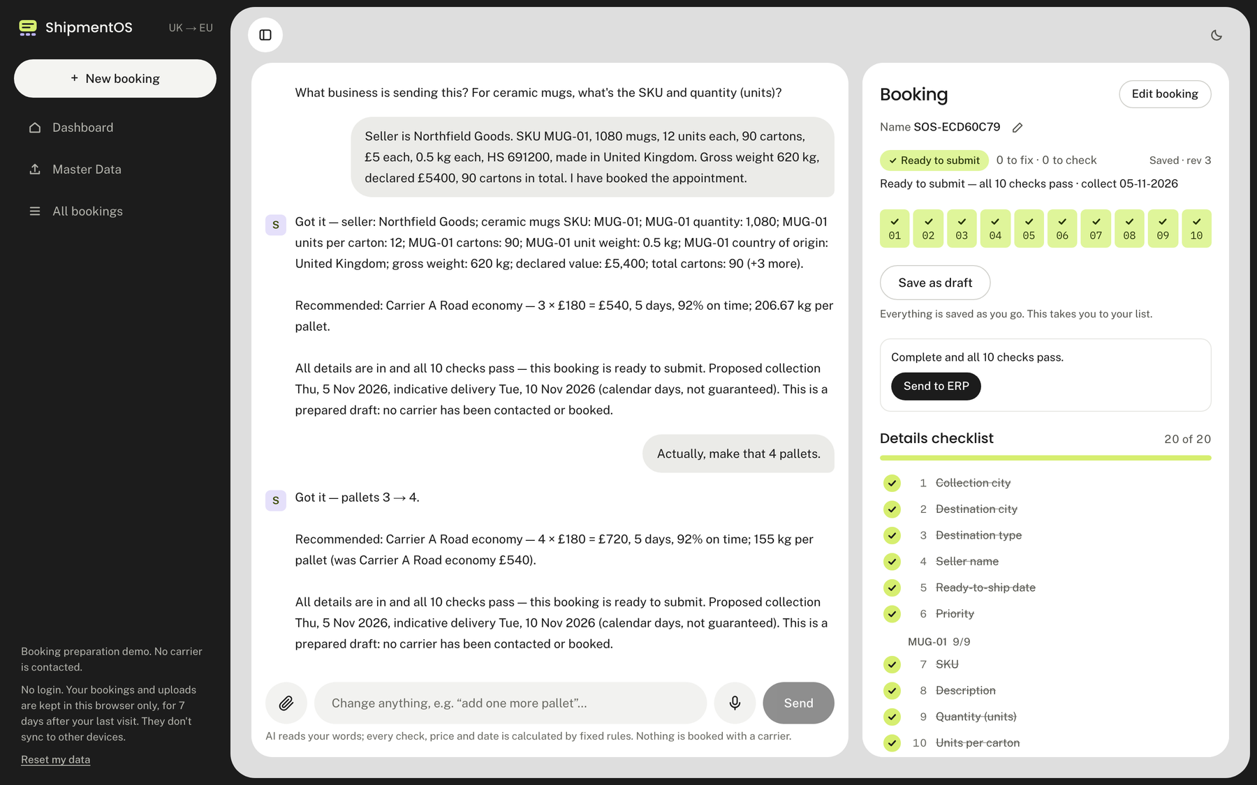
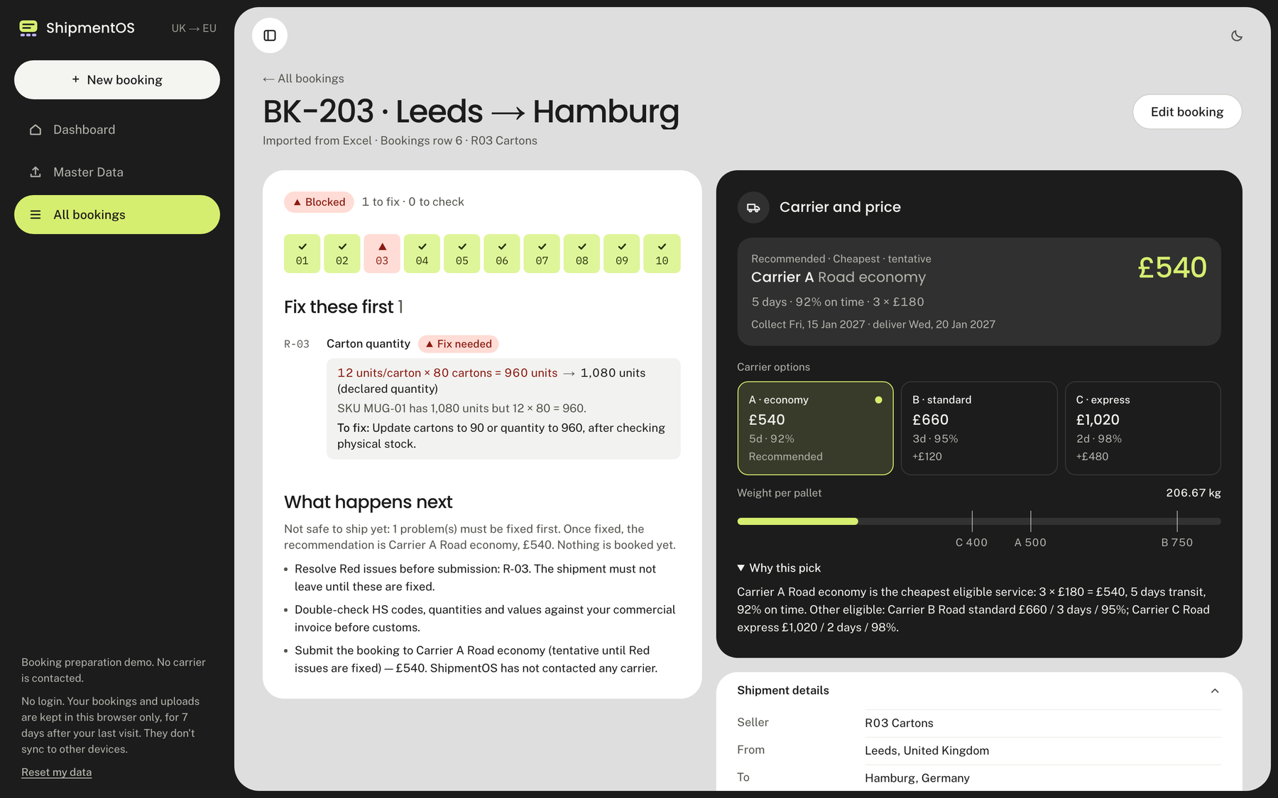


From shipment details to dispatch-ready decisions
INTRODUCING SHIPMENTOS
Describe a UK → EU pallet shipment in plain English, or upload an Excel workbook. ShipmentOS runs ten pre-flight checks and recommends a carrier before anything leaves the dock.
Conversational booking
Excel pre-flight
Ask only for what’s missing
Every booking in the file checked
Live product screens: chat booking (top), pre-flight result (bottom)
Notes:
PURPOSE: Establish what ShipmentOS is in ten seconds.
SAY: "Booking a cross-border shipment means long, confusing forms, and small mistakes in them are what get goods stuck at customs or units reported missing at the warehouse. ShipmentOS is two doors into one checking engine. Door one: you describe the shipment in a sentence and it asks only for what's missing. Door two: you upload an Excel workbook and every booking in it is checked. Either way you get what's wrong, how serious it is, how to fix it and which carrier to use, before anything leaves the dock."
POINT AT: the two screens on the right are the real deployed app, not mock-ups: a chat after the seller changed 3 pallets to 4, and the pre-flight result for a booking flagged by the carton rule.
EVIDENCE: all screens captured from the live deployment (Vercel production, commit 84d73ea). ShipmentOS is a booking-preparation and pre-flight tool; it does not contact carriers.

Slide 2
One small form mistake becomes a customs hold or a missing pallet
1 Gather the facts
2 Fill in the forms
3 Pick a carrier
4 After dispatch
R-01
R-03
R-05
Found days later
HS code blank or under 6 digits
1,080 units declared, but 12 × 80 cartons = 960
Pallet weighs more than the service accepts
Goods held at customs
R-09
R-02
Country of origin left empty
Declared value ≠ quantity × unit price
R-08
Warehouse delivery slot never booked
Units reported missing at the receiving warehouse
R-06
R-04
Lithium, aerosol or flammable goods slip through
Carton total ≠ sum of item cartons
Stock already stuck by the time the seller finds out
Brief
R-10
R-07
Which carrier? Cost, speed and reliability pull in different directions
Ready-to-ship date already in the past
Gross weight lighter than the goods
Case 2 brief
Rule IDs are the case rulebook (sheet 4). The carrier question comes from the brief’s ask for a recommended carrier based on the seller’s priority.
Notes:
PURPOSE: Make the problem concrete and tie it to the hackathon PDF.
SAY: "The case PDF puts it plainly: small mistakes in long, confusing booking forms cause most of the pain later: goods held at customs, or units reported missing at the receiving warehouse, and sellers often only find out days later when their stock is already stuck. Read across the journey. Early on, facts go missing: no HS code, no country of origin, a hazardous item nobody flagged. In the forms, the numbers disagree: this mug booking declares 1,080 units but 12 units a carton times 80 cartons is only 960. At the carrier step, a pallet can be heavier than the service accepts, or the warehouse slot was never booked, and picking the right carrier means trading cost against speed against reliability. Every red or amber tag on this slide is one of the ten rules in the hackathon rulebook."
NOTE: no statistics are quoted because none come from the case material. The consequences are the PDF's own wording.

Slide 3




Two ways in. One engine behind them.
Conversational booking
SHARED INTELLIGENCE LAYER
Describe the shipment in your own words. Change your mind any time.
No file needed
Structured booking
10 pre-flight checks
Carrier pick
Plain-English result
One schema, checked by Zod
Red or Amber, with the numbers
Route, weight, then seller priority
What’s wrong, the fix, what’s next
Excel upload
Drop a Bookings + Items workbook. Every row is checked.
Both doors end in the same evaluateBooking() call, so there are no duplicate rules to drift apart.
No chat needed
Pick either door. The same ten rules, carrier logic and explanations sit behind both.
Notes:
PURPOSE: Show the product concept and why one shared engine matters.
SAY: "There are two independent ways in. You can chat: describe the shipment and answer a couple of questions; no file needed. Or you can upload the Bookings and Items workbook; no chat needed. You never have to do both. Both doors feed the same layer: a structured booking, the ten rulebook checks, a carrier recommendation, and a plain-English result."
WHY ONE ENGINE (the key point): the hackathon tests the same booking from both directions: conversationally and via file. If each path had its own logic they could disagree. In ShipmentOS both paths produce the same canonical booking and call one evaluation function, so a booking gets the same verdict whichever door it came through, and every rule is written once.
ACCURACY NOTE: template-format Excel uploads are parsed and checked without any AI. Gemini only appears in the chat door (and in an optional fallback that reads non-template workbooks dropped into a chat).

Slide 4
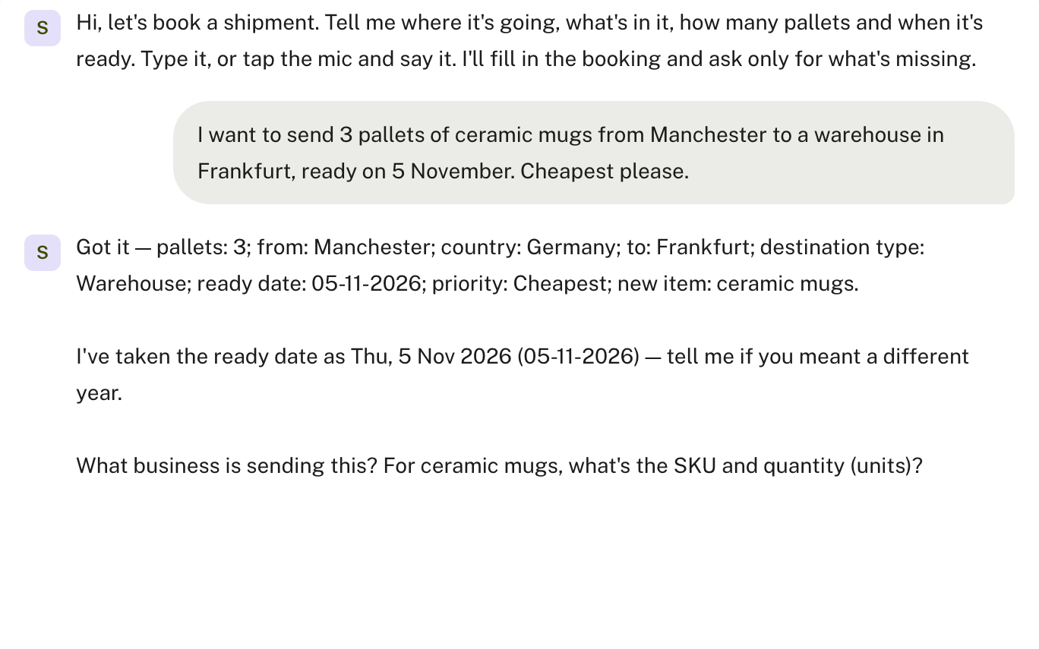
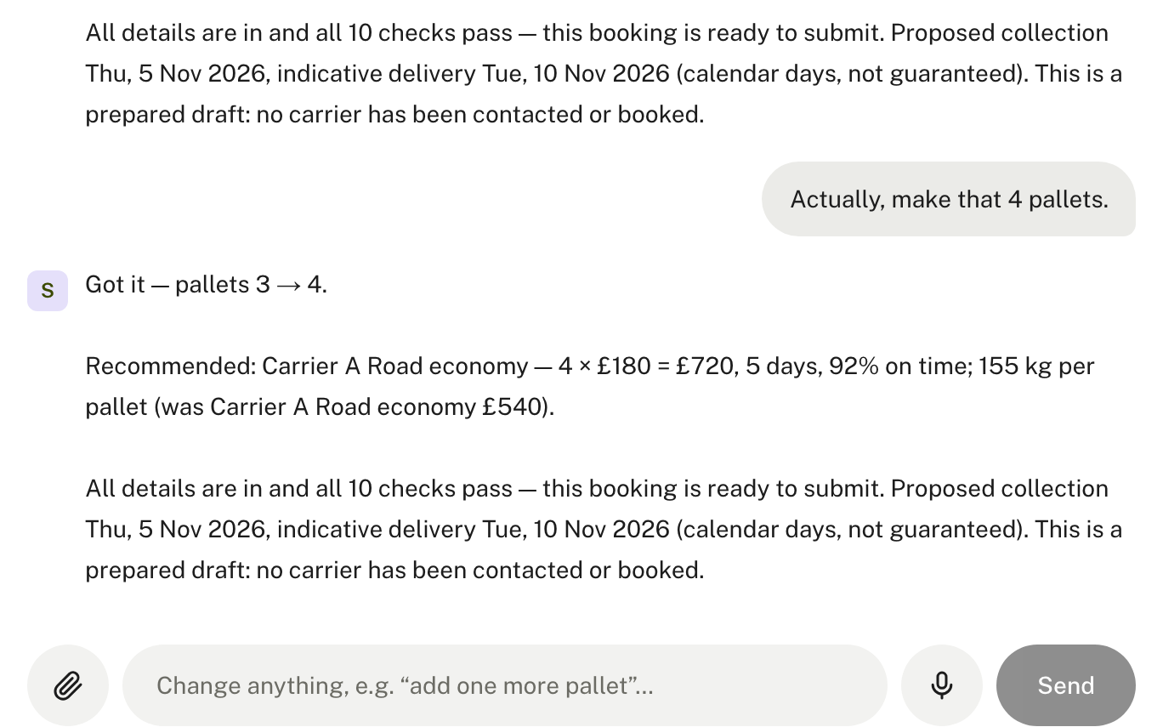
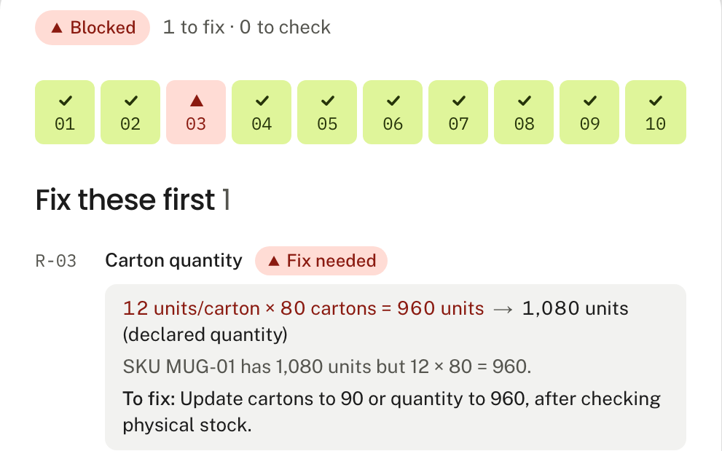
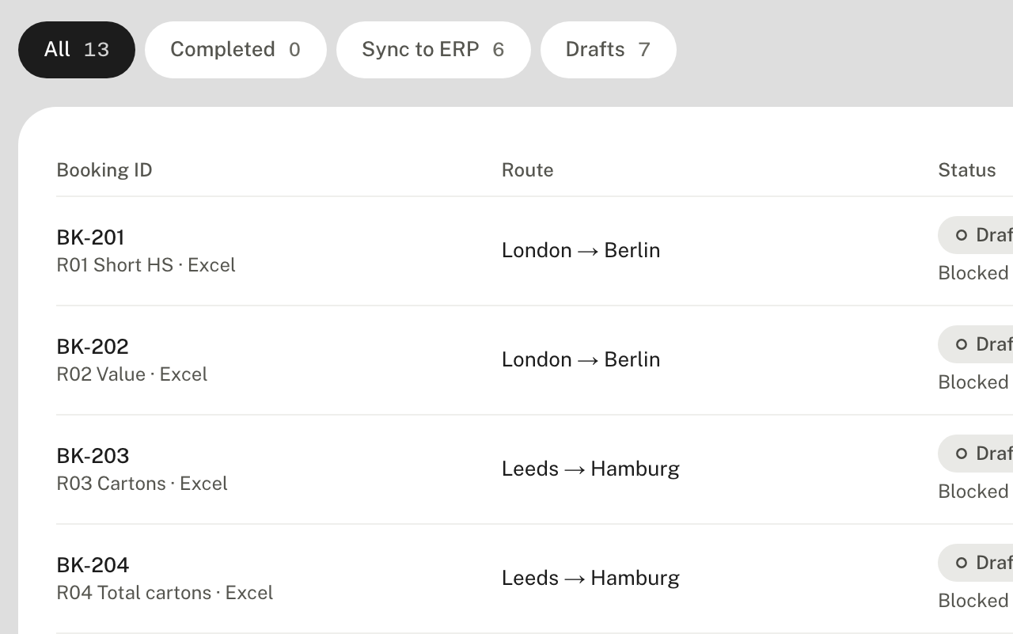
From one sentence to a reviewed booking
1
2
1
Describe it
One sentence in. It fills what it can, then asks only for what’s missing.
2
Change your mind
“Actually, make that 4 pallets.” Only pallets change: £540 → £720.
3
See the verdict
3
4
Ten live checks. Each Red or Amber shows the numbers and the fix.
4
Come back later
All bookings lists chats and Excel uploads with Drafts, Sync to ERP and Completed tabs.
Live deployment, commit 84d73ea. Chat example uses the case template’s BK-001 mug booking; the flagged booking is BK-203 from the repo’s planted-errors test workbook.
Notes:
PURPOSE: Let the judges see the real experience, following one coherent example.
DEMO STORY (matches the live demo script):
1. Describe it: the seller types "I want to send 3 pallets of ceramic mugs from Manchester to a warehouse in Frankfurt, ready on 5 November. Cheapest please." ShipmentOS pulls out the route, destination type, date, priority and pallets, notes it assumed the year, and asks only for the next missing details (seller, SKU, quantity).
2. Change your mind: after the details are in and all ten checks pass (Carrier A, 3 x £180 = £540), the seller says "Actually, make that 4 pallets." The reply is "pallets 3 → 4", the price recomputes to £720 (155 kg per pallet), and nothing else is re-asked.
3. See the verdict: for Excel files (or any chat booking) the result shows ten check tiles, which rule failed, the numbers, the fix and what happens next. Shown here: BK-203 from the planted-errors test workbook.
4. Come back later: the All bookings page lists chat and Excel bookings together with Drafts / Sync to ERP / Completed tabs and counts, a date filter and search; every row has Open and Delete, and any booking can be reopened and edited.
HONESTY NOTES: the BK-001 values (3 pallets, 90 cartons, 1,080 mugs, 620 kg, £5,400, Manchester → Frankfurt, 5 Nov 2026) are the example row from the case template. The "Send to ERP" button on the booking page logs the booking as completed inside ShipmentOS; it is not a carrier or real-ERP integration.

Slide 5



AI interprets the request. Deterministic code verifies the shipment.
AI ZONE: INTERPRETS ONLY
DETERMINISTIC ZONE: DECIDES
API route
Gemini
Zod + patch engine
TypeScript engine
Seller’s browser
Chat turn. Anonymous cookie session, no login.
Reads the sentence and returns typed patch operations. Never does the maths.
Validates each operation, then set / increment / add / remove.
10 rule checks, R-01 to R-10
Next.js 16 · React 19 · Tailwind CSS
Exact decimal arithmetic
Chat panel · Excel drop · booking page · All bookings
Carrier eligibility + ranking
API route
ExcelJS
Zod + normaliser
Route, weight, priority
Excel import. Template file, parsed with no AI.
Reads the Bookings and Items sheets and finds the header row.
Validates rows. Input problems kept apart from rule results.
Result returns here: status, fixes, carrier, next steps
Status, fixes, next steps
Same inputs, same verdict
Neon PostgreSQL via Drizzle ORM
bookings · items · chat messages · revisions · evaluations · rate card + rulebook (9 + 10 rows). One transaction per turn.
Consistent: same input, same verdict
Explainable: actual vs expected, plus the fix
Resilient: Excel and Edit form work without AI
Notes:
PURPOSE: Show how it works inside, and why the architecture was chosen.
SAY: "Gemini understands the seller's request. Zod validates its structure. Neon preserves the booking state. TypeScript independently verifies the shipment."
WALK THE DIAGRAM left to right:
- The browser is Next.js 16 and React 19 with Tailwind. It talks to Next.js API routes; there is no login, just an anonymous HttpOnly cookie that scopes everything to that browser.
- Chat door: the message goes to Gemini (gemini-3.5-flash), which returns a small list of typed patch operations (set, increment, add item, remove...). It does not compute totals, rule verdicts, carriers or dates. Zod validates every operation and malformed output is rejected, with one automatic repair retry; the patch engine then applies it to the booking.
- Excel door: ExcelJS reads the Bookings and Items sheets, Zod validates the rows, and problems with the file itself are reported separately from rule failures. No AI involved for template files.
- Both doors produce the same canonical booking. The TypeScript engine then runs the ten rules with exact decimal arithmetic, ranks the carriers and writes the plain-English result.
- Neon stores bookings, items, chat messages, numbered revisions and evaluations through Drizzle, in one transaction per turn. The rate card (9 rows) and rulebook (10 rows) are seeded from the case sheets; the app refuses to evaluate if they ever diverge from the checked-in copy.
WHY IT MATTERS: consistency (same input, same verdict), explainability (every finding shows actual versus expected and a fix), reliability (if Gemini is down, Excel and the Edit booking form still work).
VERIFIED AGAINST THE CODE: Next.js 16.4, React 19.3, Tailwind 4, Zod 4, ExcelJS, @google/genai, Drizzle, pg, Neon, Vitest, Playwright, Vercel (package.json, lib/ai/extract.ts, lib/domain/*, lib/db/schema.ts, docs/DEPLOYMENT.md). UI components are hand-built (native dialog), not a component library.

Slide 6
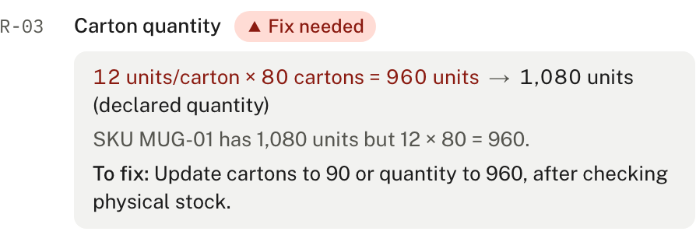
One booking. Ten checks. Clear fixes before dispatch.
THE CASE RULEBOOK
How the carrier is picked
R-03 RED
Carton quantity, BK-203
RED: must not ship until fixed
1
Route. UK to the destination country.
R-01
HS code, 6+ digits
1,080
960
2
Weight. Gross ÷ pallets must fit the service. Heavier ones are excluded before ranking.
≠
R-02
Declared value within 1%
R-03
Units/carton × cartons
units declared
12 units × 80 cartons
3
Priority. Cheapest, Fastest or Most reliable sort on one field. Balanced = 40% cost + 30% speed + 30% reliability. Ties: cheaper, faster, more reliable.
R-04
Total cartons add up
R-05
Pallet weight ≤ carrier max
To fix: update cartons to 90, or quantity to 960, after checking physical stock.
R-06
No lithium, aerosol, flammable
AMBER: risky, check it
Offers both directions and never edits the seller’s data. The booking is Blocked until fixed.
Example: 3 pallets, 620 kg, UK → Germany
Priority | Pick
Cheapest | A: £540 · 5 days
Fastest | C: £1,020 · 2 days
Most reliable | C: 98% on time
Balanced | B: £660 · score 0.65
R-07
Gross ≥ sum of unit weights
R-08
Warehouse needs a slot
R-09
Country of origin present
R-10
Ready date not in the past
Balanced scores: A 0.40, B 0.65, C 0.60.
Actual output from the live app
Notes:
PURPOSE: Showcase the core decision engine: ten rules, a concrete example, and how the carrier is chosen.
LEFT: the ten rules are exactly the case rulebook (sheet 4): five Red ("must not go until fixed") and five Amber ("risky, should be fixed or checked"). Every rule is always reported: pass, fail, or "not evaluable" when the inputs aren't known yet. A rule is never shown as passed just because data is missing.
MIDDLE (worked example, from the planted-errors test workbook, BK-203): the item declares 1,080 units. 12 units per carton times 80 cartons is only 960. R-03 fails, it is Red, so the booking is Blocked. The fix is specific and goes both ways: change cartons to 90, or change the quantity to 960, after checking physical stock. ShipmentOS never rewrites the seller's data silently. The panel at the bottom is the real output from the deployed app.
RIGHT (the actual ranking logic in lib/domain/carriers.ts):
1. Route filter: only services on UK to the destination country.
2. Weight filter: gross weight divided by pallets must not exceed the service's max kg per pallet. Ineligible services are removed BEFORE ranking, so a service that can't carry the load can never be recommended, however cheap.
3. Rank by the seller's priority. Cheapest = lowest total cost (pallets x price). Fastest = fewest transit days. Most reliable = highest on-time %. Balanced = 40% cost + 30% speed + 30% reliability, each scaled 0 to 1 across the eligible options. Tie-break: cheaper, then faster, then more reliable.
The Balanced weights are our own decision; the case only says Balanced means "no strong preference, best trade-off". Say so if asked.
NUMBERS (rate card from the case template): Germany A £180 / 5 days / 92% / 500 kg per pallet; B £220 / 3 days / 95% / 750 kg; C £340 / 2 days / 98% / 400 kg. For 3 pallets and 620 kg (206.67 kg per pallet) all three fit: A £540, B £660, C £1,020. Balanced scores work out at A 0.40, B 0.65, C 0.60, so Balanced picks B. At 1,800 kg (600 kg per pallet) A and C are excluded and B (£660) is the only option.
CAVEAT: this is booking-preparation checking, not customs clearance. R-06 is a phrase screen, not a regulatory dangerous-goods classifier.

Slide 7




Not a chatbot on a form: four decisions that change the outcome
DECISION
ORDINARY MANUAL WORKFLOW
SHIPMENTOS
Change a detail and you re-enter the form, then re-check every number by hand.
“Actually, 4 pallets” changes one field. Every check and the price recompute (£540 → £720). Retried requests apply once; stale edits get a conflict, not an overwrite.
Typed patches, not a restart
Whether a booking is “OK” rests on someone’s judgement, which is hard to audit.
Rules are plain TypeScript with exact decimal maths. Same input, same verdict, and each finding shows actual vs expected plus the fix.
Rules decide, AI never does
A chat flow and a spreadsheet flow each carry their own logic and can disagree.
Chat and Excel feed one evaluation function. A booking gets the same checks and the same carrier logic whichever door it used.
One shared engine
Work lives in a form or an email. Changes leave no trail.
Every change is saved to Neon as a numbered revision. Reopen any chat or upload from All bookings. An anonymous cookie, not an account, scopes the data to that browser.
Saved, versioned, no login
Notes:
PURPOSE: Show this is engineered, not merely a chatbot placed on top of a form. Each decision is tied to what it gives the user.
1. TYPED PATCHES, NOT A RESTART. Gemini returns operations like "increment pallets by 1", not a fresh booking. The app applies them to the saved draft, so "Actually, make that 4 pallets" keeps everything else. Each turn is saved atomically with a revision number; resending the same request applies once; a stale edit is rejected with a conflict instead of overwriting. (Test matrix scenario 22 and 24.)
2. RULES DECIDE, AI NEVER DOES. All arithmetic runs in exact integer math at 1/10,000 precision, so the 1% tolerance in R-02 is exact, not floating point. Findings carry actual and expected values and a concrete fix, which is what the judges asked for: "what is wrong, how serious it is, and how to fix it".
3. ONE SHARED ENGINE. Chat and Excel produce the same canonical booking and call the same evaluation function (lib/domain/evaluate.ts). Fixing a rule once fixes both doors.
4. SAVED, VERSIONED, NO LOGIN. The case requires that the link works without help or a login. ShipmentOS uses an anonymous HttpOnly cookie; only a hash of it is stored; sessions expire 7 days after the last visit; "Reset my data" deletes everything immediately. Bookings, messages, revisions and evaluations persist in Neon so a chat or upload can be reopened later.
No named competitors are compared; the left column is a generic manual process.

Slide 8

A working product you can open now
LIVE, NO LOGIN
shipmentos-preflight.vercel.app
github.com/saisiddharthnandhakumar/shipmentos-preflight
VERIFIED EVIDENCE
112
51
28
unit tests passing
integration tests passing
live smoke checks passed
Scan to open the live app
DEMONSTRATED TODAY
Chat booking
Mid-chat change
Excel upload
Book it in a sentence. Check it before it ships.
10 rule checks
Carrier ranking
Saved bookings
FUTURE OPPORTUNITIES (NOT BUILT)
Real carrier booking
Invoice generation
More routes
Shipment tracking
Customs integrations
A booking-preparation demo. No carrier is contacted. Not customs or dangerous-goods compliance.
Notes:
PURPOSE: Close with proof it exists, what was verified, and where it goes next.
SAY: "This is live right now: shipmentos-preflight.vercel.app, no login, and the repository is public. Scan the code to try it. On 26 October 2026 we ran 112 unit tests and 51 integration tests (route handlers against a Neon test branch), and a 28-check smoke test against the live production URL; all passed."
EVIDENCE (collected 26 October 2026 and re-runnable): 112 Vitest unit tests passed (10 files); 51 Vitest integration tests passed with 3 skipped (the 3 skipped are the opt-in live-Gemini test and are not counted), run against the isolated Neon dev branch with the deterministic fake extractor; 28 of 28 checks passed in scripts/smoke.ts against the production URL (run twice, the second time against commit 84d73ea) (public access, no secrets in client bundles, real Gemini extraction, +1 pallet to £720, idempotent retry, 409 on stale revision, both uploads, cross-session isolation). A Playwright end-to-end suite exists in tests/e2e but was NOT re-run for this deck. The unit test run used the local working tree, which has uncommitted changes that are not yet deployed.
WHAT WAS DEMONSTRATED: chat booking with follow-up questions, a mid-conversation change, Excel upload with planted errors, all ten rules with fixes, carrier recommendation by priority, and saved bookings that can be reopened.
FUTURE OPPORTUNITIES (explicitly NOT built): real carrier booking, commercial-invoice and document generation, more routes, shipment tracking, deeper customs integrations. Today ShipmentOS prepares and checks a booking; the seller still submits it to a carrier themselves.
LIMITS TO STATE IF ASKED: R-06 is a phrase screen, not a dangerous-goods classifier; indicative delivery is collection plus transit in calendar days, not a carrier schedule; history is per browser; no usage or accuracy numbers are claimed because none have been measured.
CLOSE: "Book it in a sentence. Check it before it ships."

