Slide 1

Customer Shopping Behaviour Analysis — End-to-End Analytics Project
A concise, professional portfolio report describing an end-to-end analytics workflow that transforms raw retail transaction data into actionable business insights using Python, MySQL, and Power BI.

Slide 2

Project Overview & Problem Statement
Retailers collect massive online and in-store transaction data but often struggle to convert it into strategic insights. This project analyzes customer shopping behavior to reveal spending patterns, discount impact, subscription effects, and product performance — enabling targeted actions to boost revenue and retention.

Slide 3

Objectives & Scope
Primary objectives
Clean and preprocess transactional data with Python (Pandas, NumPy).
Load sanitized data into MySQL for SQL-based business analysis.
Build interactive Power BI dashboards to visualize KPIs and segments.
Identify discount/subscription effects, top products, and customer segments.
Scope
Descriptive and diagnostic analytics across demographics, revenue, products, shipping, discounts, and segmentation. Predictive modeling is out of scope for this phase.

Slide 4



Tools & Technology Stack
Python
MySQL
Power BI
Git & Jupyter
Data cleaning, feature engineering, and exploratory analysis (Pandas, NumPy).
Data storage and SQL-driven business queries for revenue and segment analysis.
Interactive dashboards, KPIs, slicers for dynamic business exploration.
Version control and reproducible notebooks for development and documentation.

Slide 5

Dataset & Preparation
Key attributes
customer_id, age, gender, item_purchased, category, purchase_amount, location, subscription_status, shipping_type, discount_applied, previous_purchases, payment_method, review_rating, season, size, color.
Cleaning steps
Import with Pandas → dtype checks and structure validation
Handle missing values, remove duplicates, standardize categories
Engineered fields: age_group, purchase_frequency, loyalty_segment
Export cleaned CSV for MySQL and Power BI

Slide 6
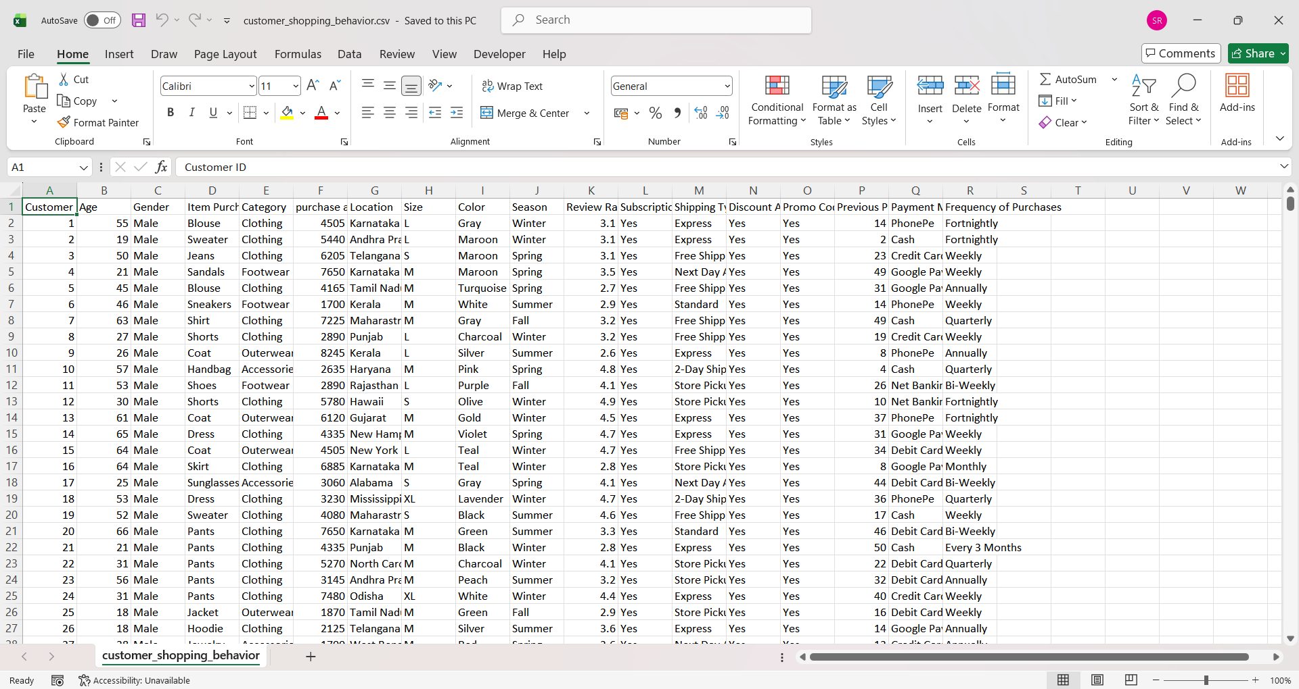
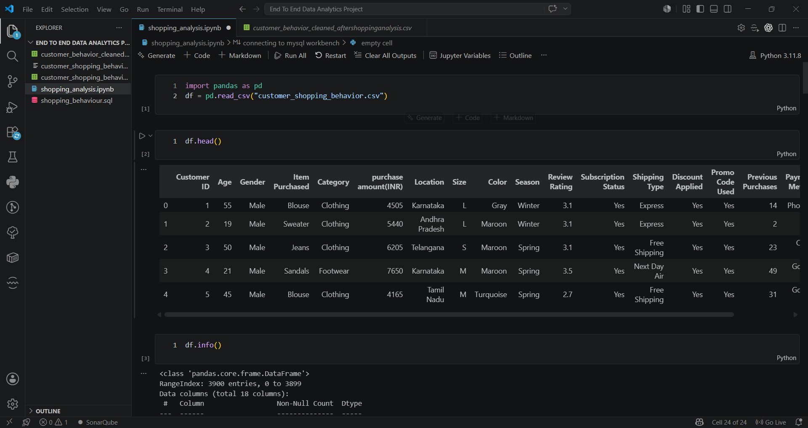
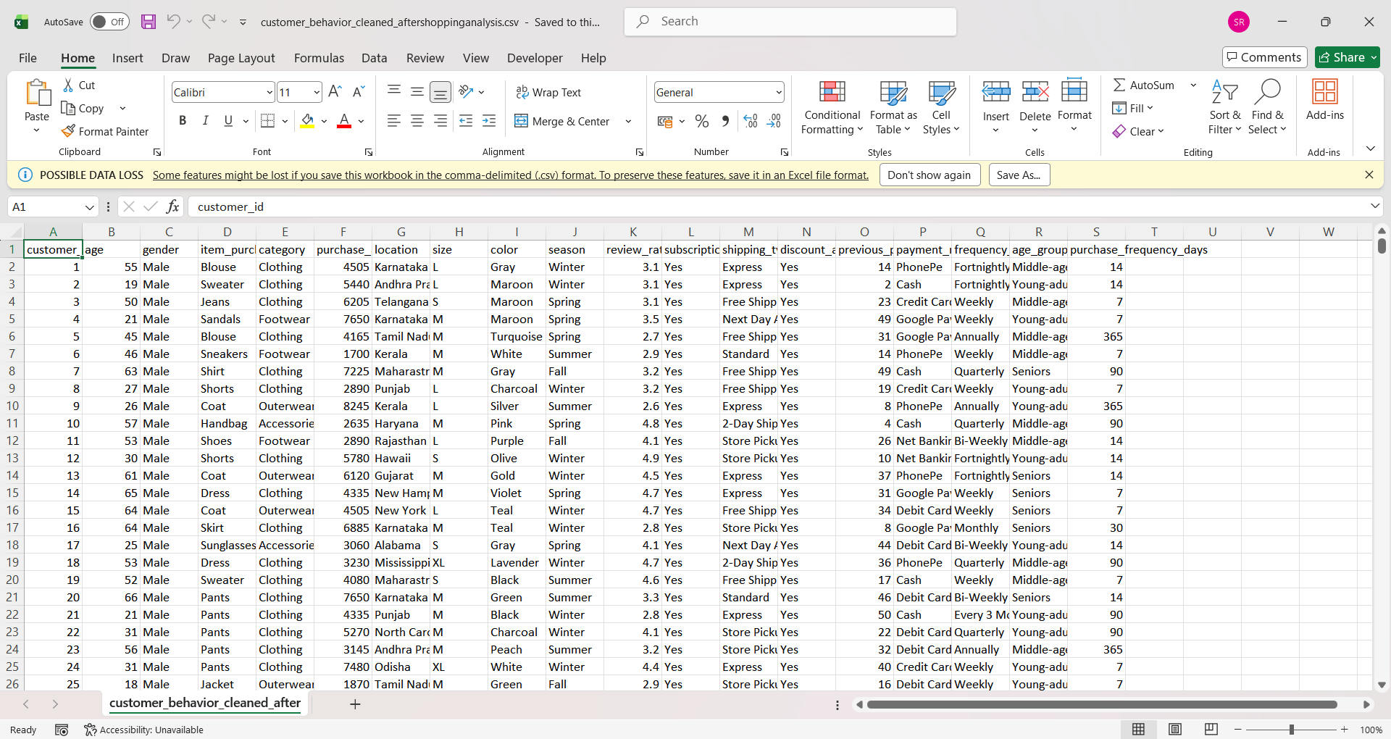

Slide 7

SQL-Based Business Analysis — Highlights
Revenue by Demographics
Subscription Value
Subscribers showed higher average spend and lifetime value compared to non-subscribers.
Male customers displayed higher aggregate revenue; Young Adults were the top age segment.
Discount Dynamics
Product Performance
Some customers continued to spend above-average even when discounts applied — high-value discount users.
Top-rated items (Gloves, Sandals, Boots, Hats, Handbags) and high-revenue categories (Clothing, Accessories).

Slide 8
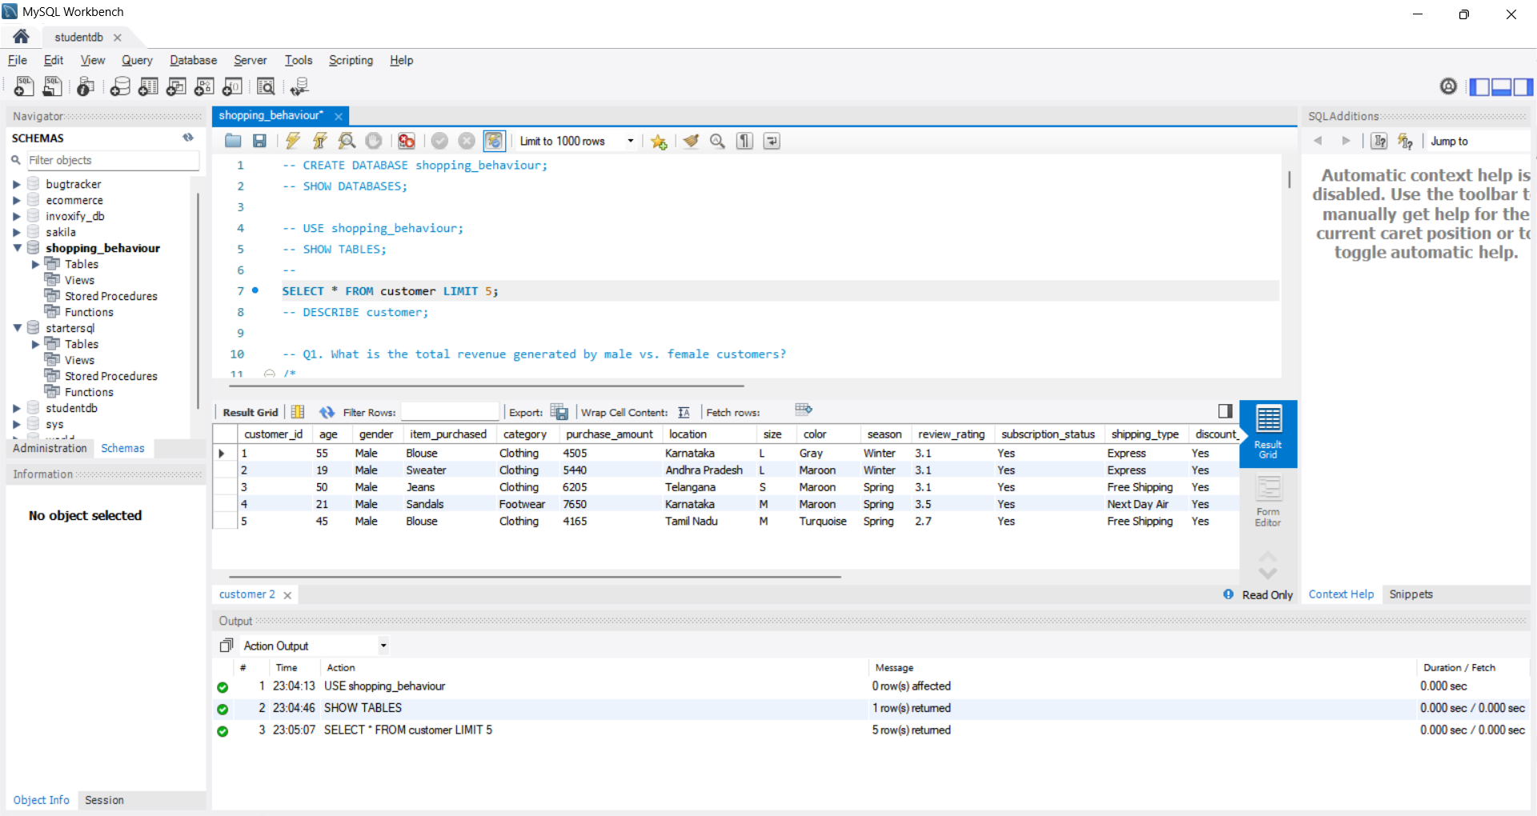

Slide 9

Customer Segmentation & Opportunity Map
Returning (2–10)
New (1 purchase)
Loyal (>10)
Segments guide engagement strategy: New customers need acquisition offers; Returning customers are prime targets for subscription conversion; Loyal customers receive retention & VIP programs.

Slide 10


Power BI Dashboard Design
Dashboard focus & features
KPI cards: Total customers, Avg. purchase, Avg. review rating
Visuals: Revenue by category, Revenue by age group, Subscription pie
Interactive slicers: Gender, Category, Subscription, Shipping
Design principle: One consolidated dashboard screenshot for portfolio clarity
Recommendation: Use one full-dashboard screenshot in portfolio for a professional, uncluttered presentation.

Slide 11
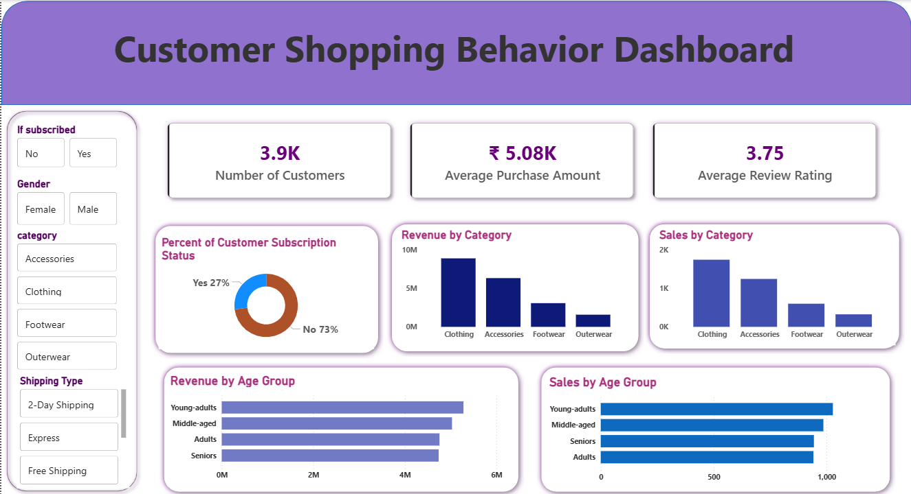

Slide 12

Key Findings
Revenue Drivers
Male and Young Adult customers drive the greatest revenue; Clothing & Accessories lead category revenue.
Discount Effects
Targeted discounts convert price-sensitive buyers; some discount users remain high-value.
Product Satisfaction
High-rated products correlate with repeat purchases — prioritize these for promotions.
Subscription Opportunity
Large non-subscriber population and repeat buyers present strong conversion potential.

Slide 13

Recommendations & Next Steps
Short-term actions
Run targeted subscription offers to repeat buyers; A/B test incentives.
Promote top-rated, high-margin products in email and on-site placements.
Refine discount strategy to protect margins while growing conversions.
Medium-term
Implement loyalty tiers for high-value customers and personalize experiences.
Use Power BI dashboard as a monitoring tool in stakeholder reports.
Future enhancements
Introduce predictive analytics (churn, CLTV) and recommender systems.
Integrate near–real-time data for operational monitoring.

