Slide 1
Confab
Anoop Reddy Yeddula
Sai Sindhu Muppaneni
Velgonda Laasya​

Slide 2
AGENDA
Motivation​
Issues and Solutions
​Features
Timeline & Implementation
​Results and Analysis
Future Plans

Slide 3
Motivation
A couple of days of vigorous brainstorming!

Slide 4
Matter in question & Response

Slide 5
Covid – Contactless communication
Severity of the problem – Online consultation
Lack of communication & Information Sharing – Patient engagement
Misplaced Files – Data-driven healthcare

Slide 6
FEATURES

Slide 7
Contactless
Schedule on your own time
Flexibility to chat
Filtered list of Doctors
Medical History

Slide 8
Timeline & implementation
One and half month
Android Studio

Slide 9
Results

Slide 10
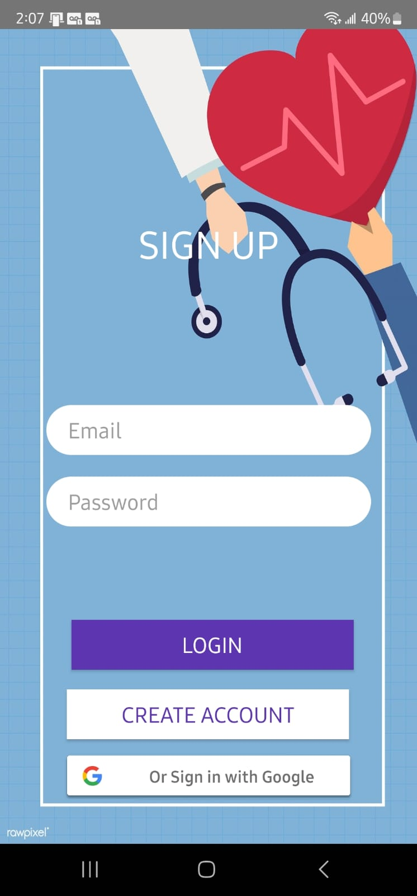
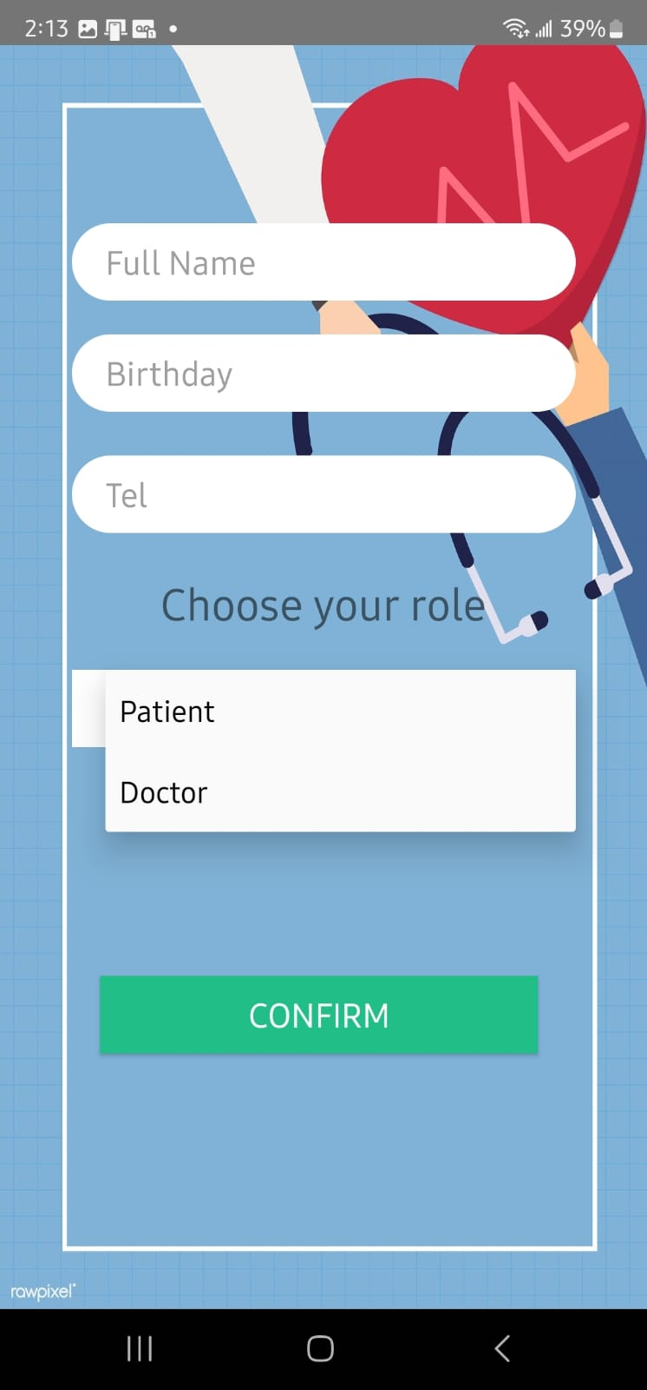

Slide 11
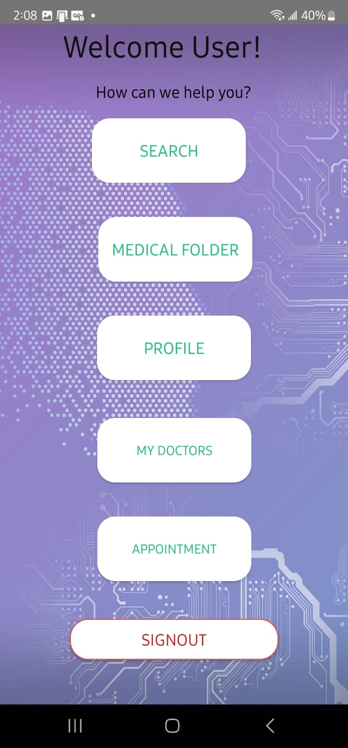
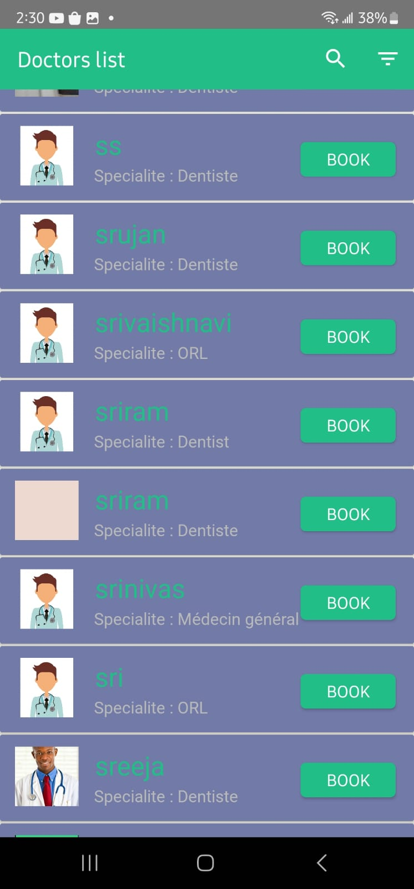
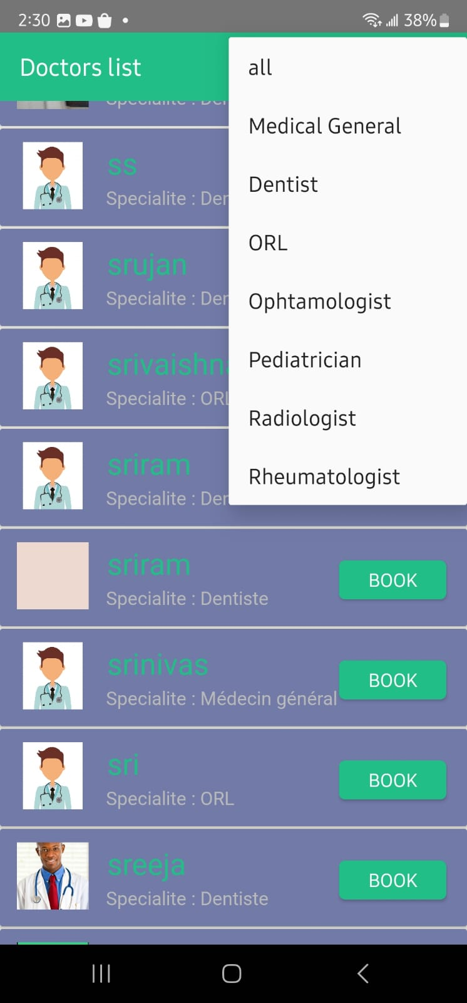

Slide 12
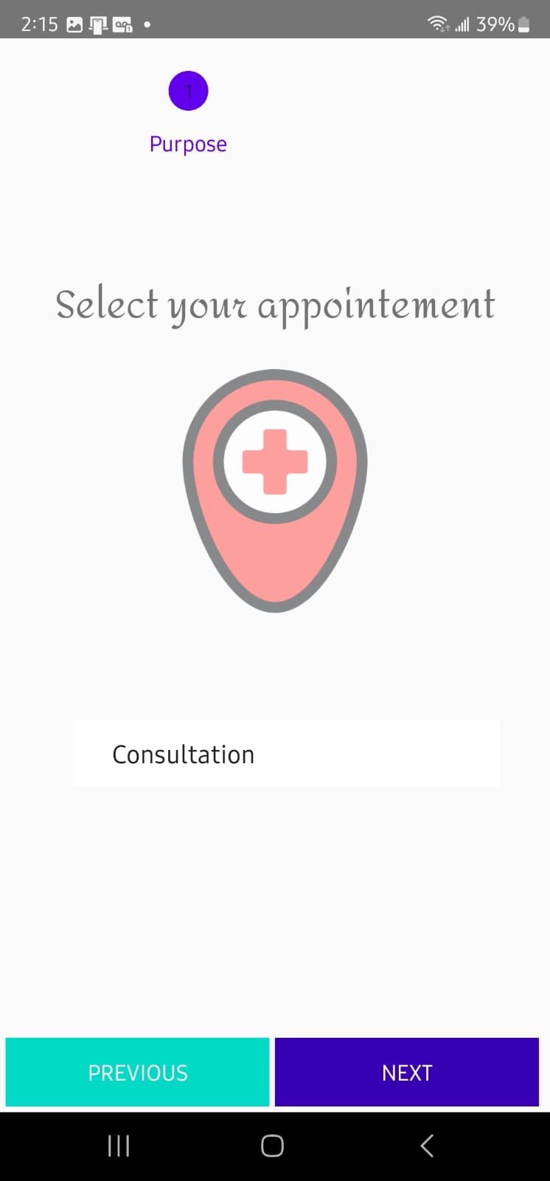
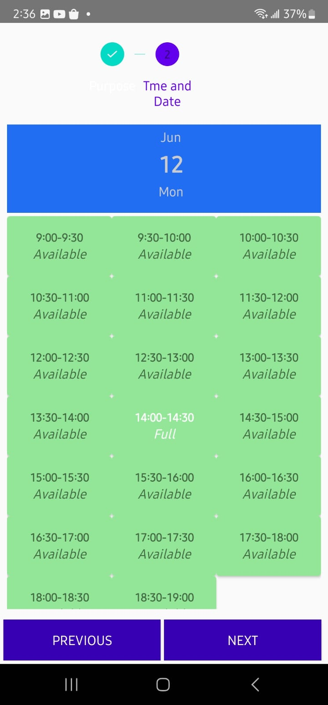
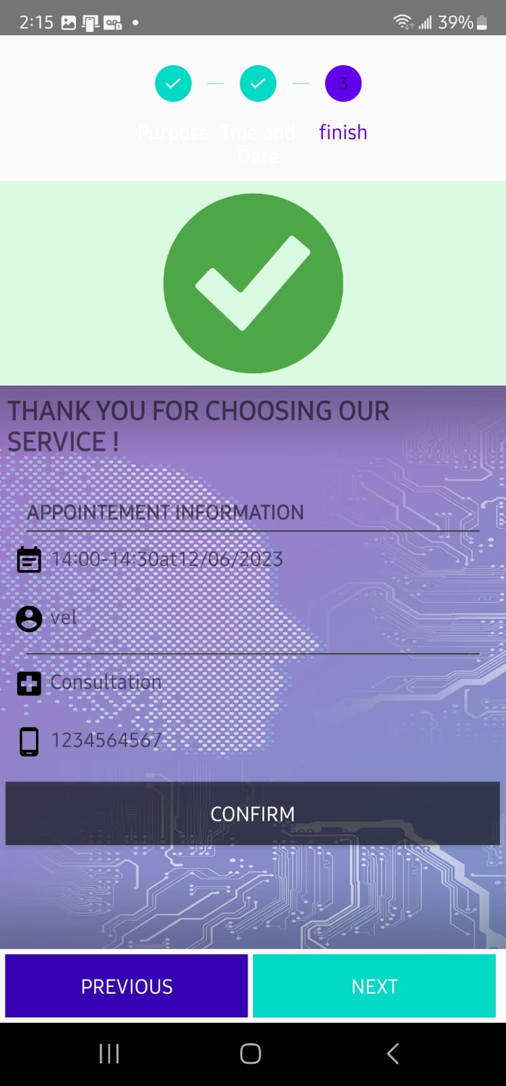

Slide 13
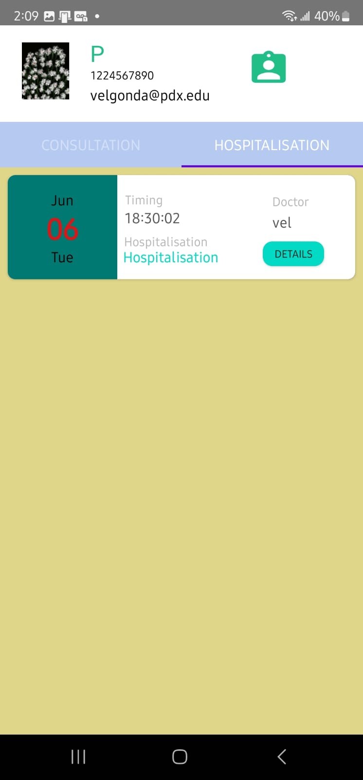
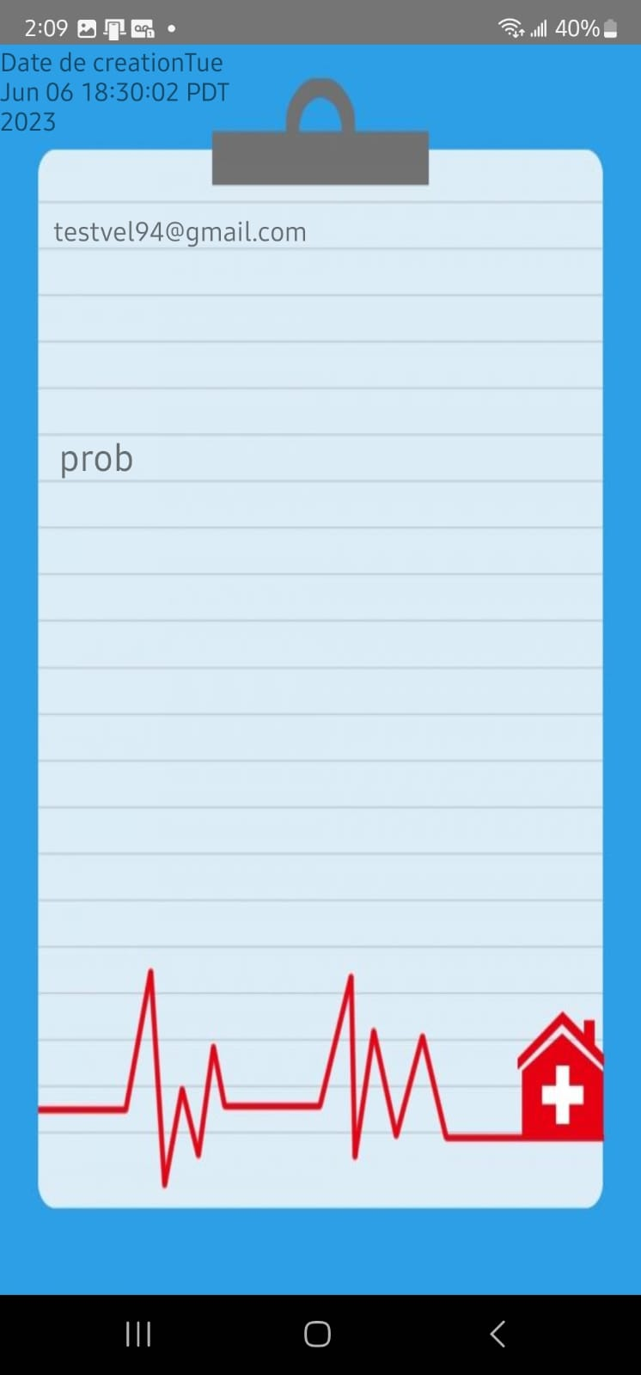

Slide 14
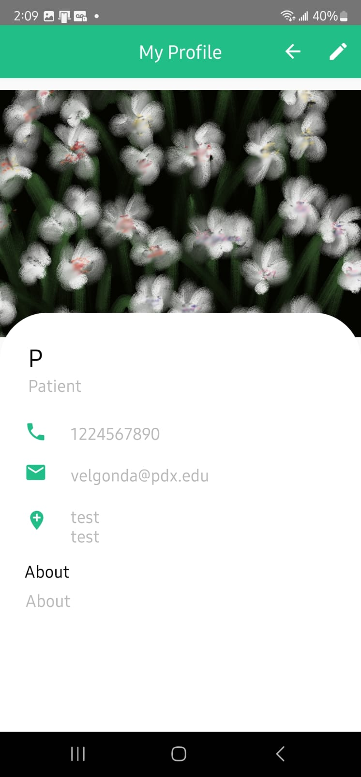

Slide 15
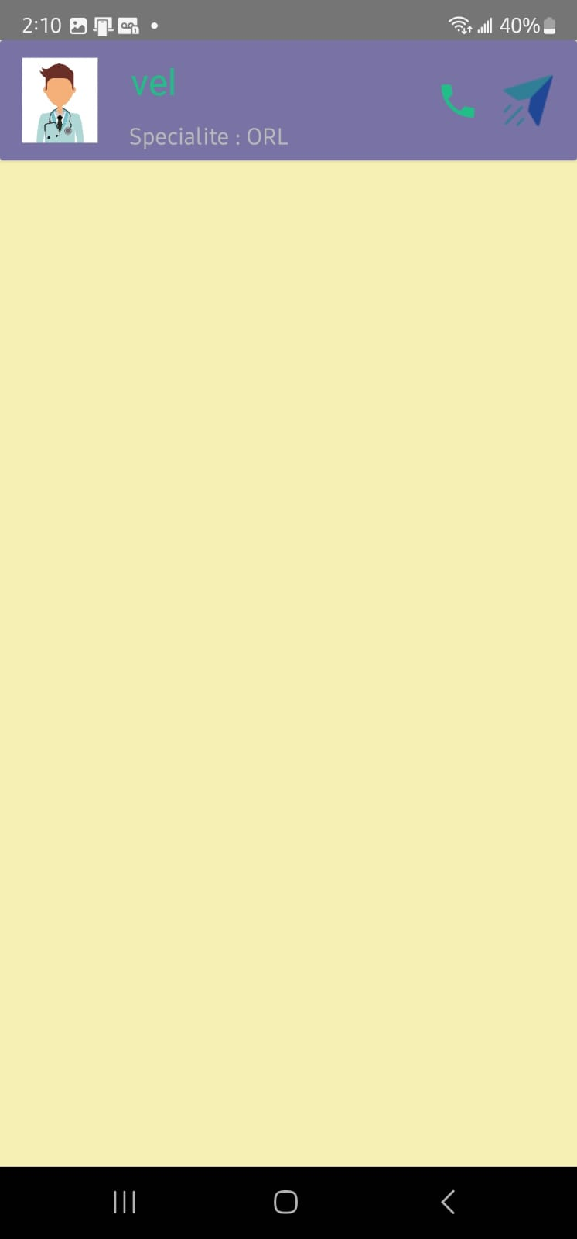
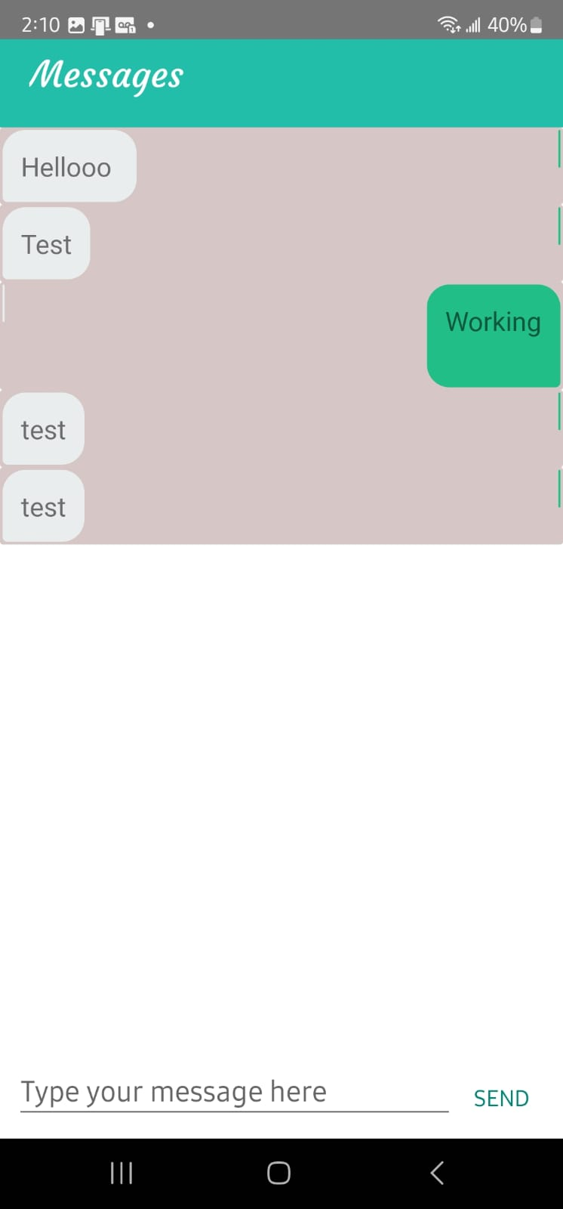

Slide 16
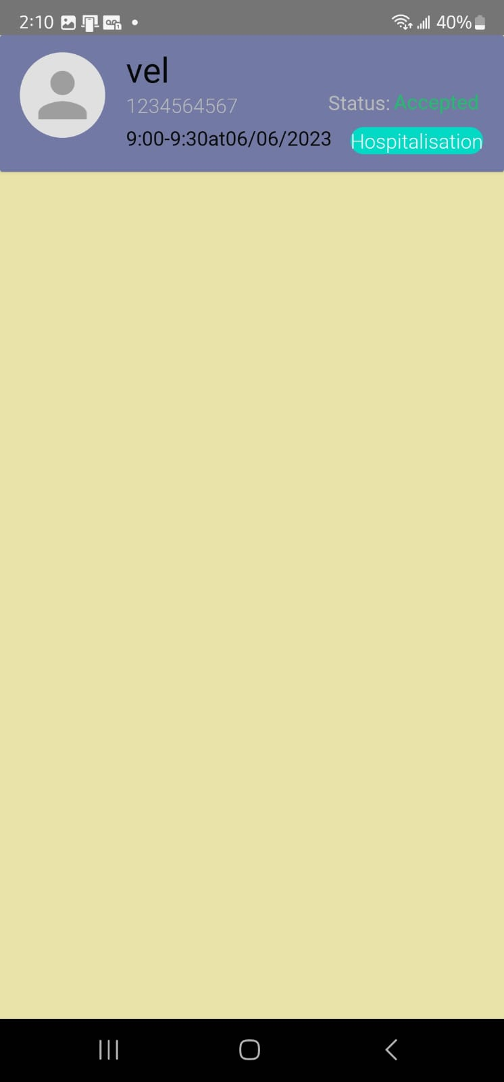

Slide 17
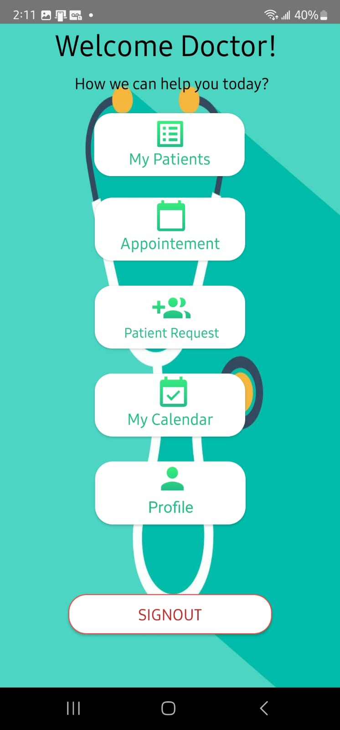
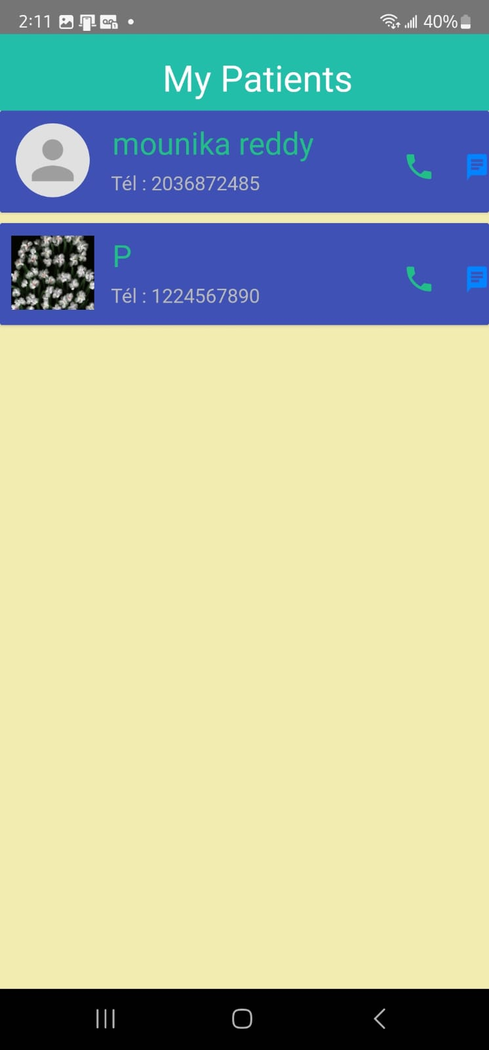

Slide 18
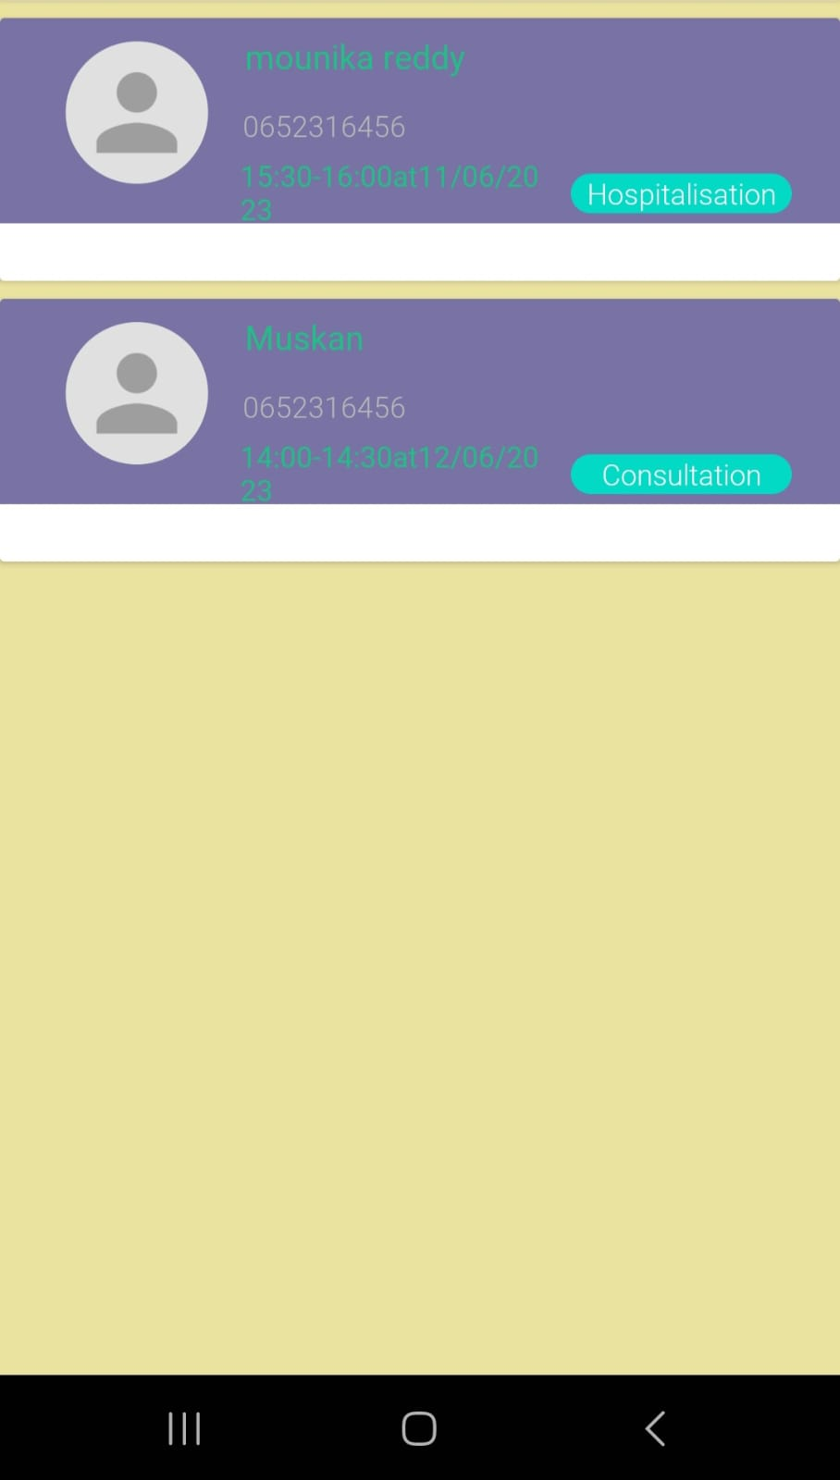

Slide 19
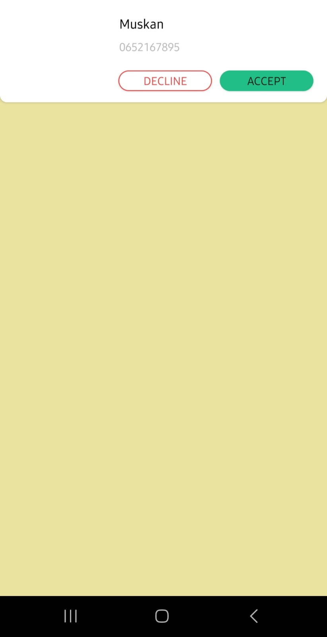

Slide 20
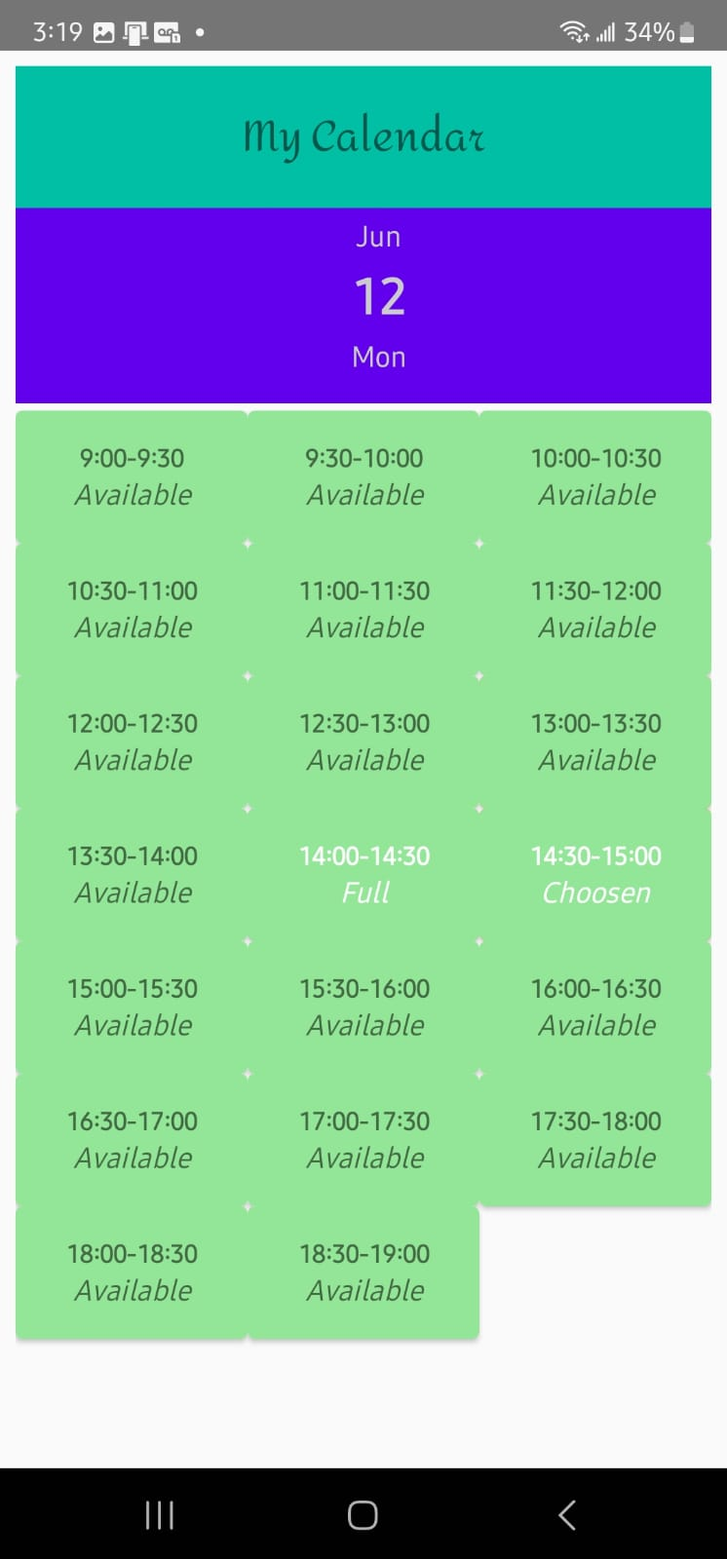

Slide 21





Future plans
Service
Data integrity & security
Unique id
Medicine history
Medical news
Patient Integrated Record System
Increase the reach of patients to doctors with minimal cost
Patient Integrated Record System
Foster holistically superior methodologies
Deploy strategic networks with compelling e- business needs

Slide 22
THANK YOU
Sai Sindhu Muppaneni
Anoop Reddy Yeddula
Velgonda Laasya

