Slide 1

SR University
Course : AI Assistant Coding
Instructor : Sallauddin Mohammed
Title : Car Rental System
Team Details : D. Sai Siri Reddy (2303A51236)

Slide 2
SR University
Introduction :
The Car Rental System is a full-stack web application that allows users to:
Browse available cars
Book cars with drivers
View booking history
The system also includes an Admin Panel to manage:
Cars
Drivers
Bookings

Slide 3
SR University
Objective :
Build a full-stack application using MERN stack
Provide seamless car booking experience
Implement authentication using JWT
Manage resources (cars, drivers) efficiently
Apply AI-assisted development for faster coding

Slide 4
SR University
Stakeholders :
Users: Book cars
Admin: Manage cars, drivers, bookings
Developers: Maintain system
Business Owner: Revenue from bookings

Slide 5
SR University
Technologies Used :
Frontend:
React.js
CSS (inline styling)
Backend:
Node.js
Express.js
Database:
MongoDB
Tools:
GitHub
VS Code
Authentication:
JWT (JSON Web Token)

Slide 6
SR University
AI Prompts Used :
Create a React car booking page with form and API integration”
“Fix 401 unauthorized JWT error in MERN app”
“Improve UI for car cards with premium styling”
“Create Admin dashboard with CRUD operations”
“Filter available drivers in booking system”

Slide 7
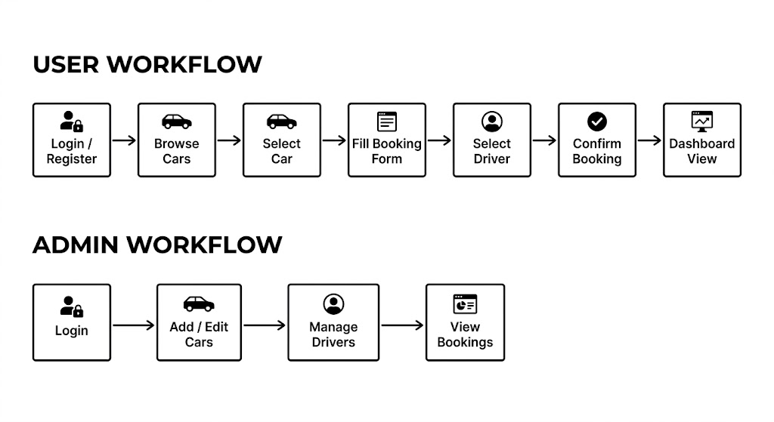
SR University

Slide 8
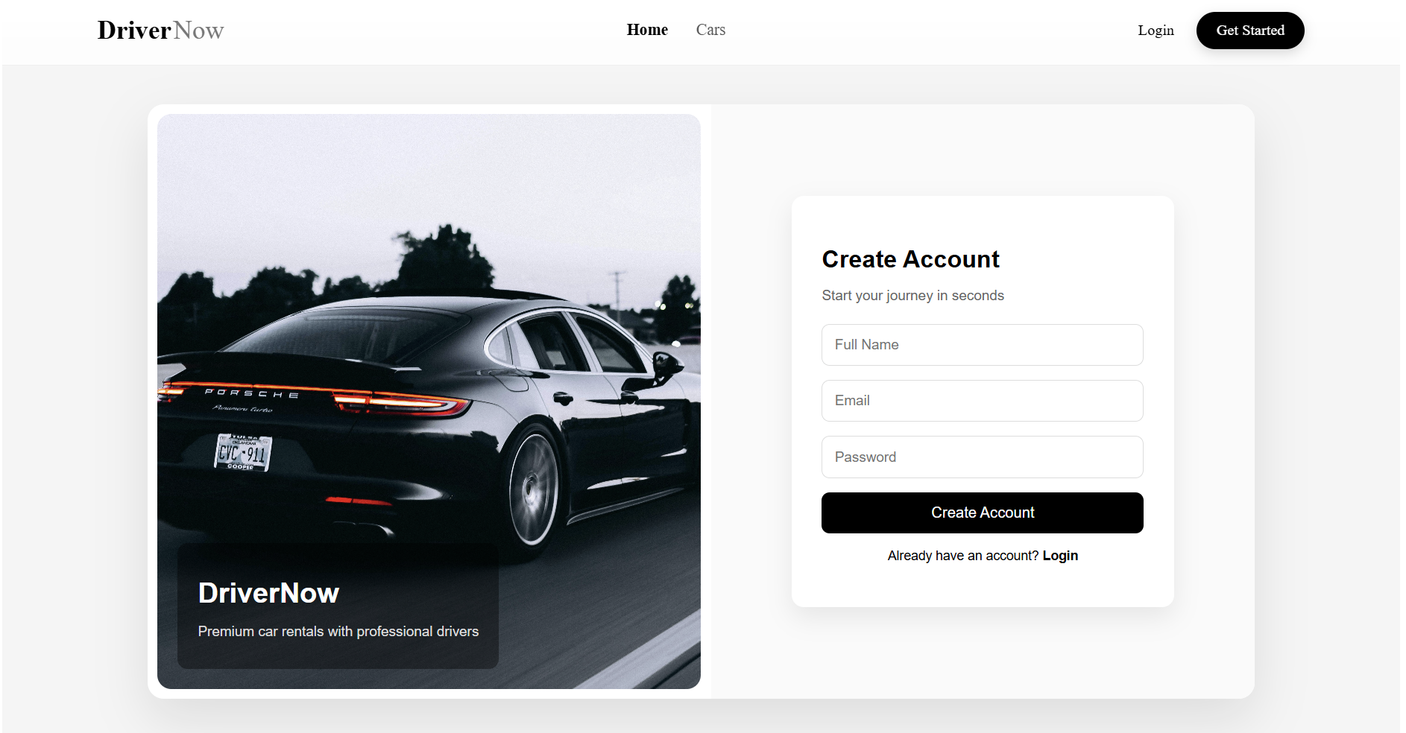
SR University

Slide 9
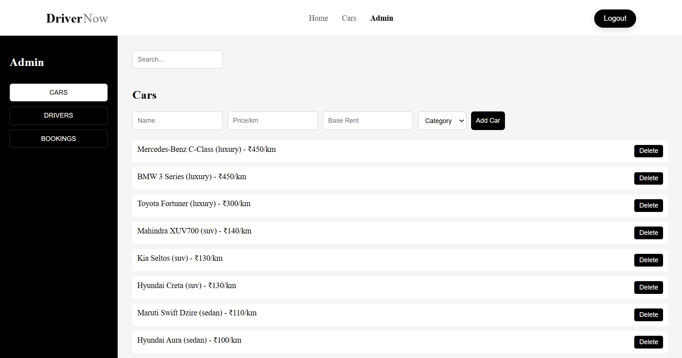
SR University

Slide 10
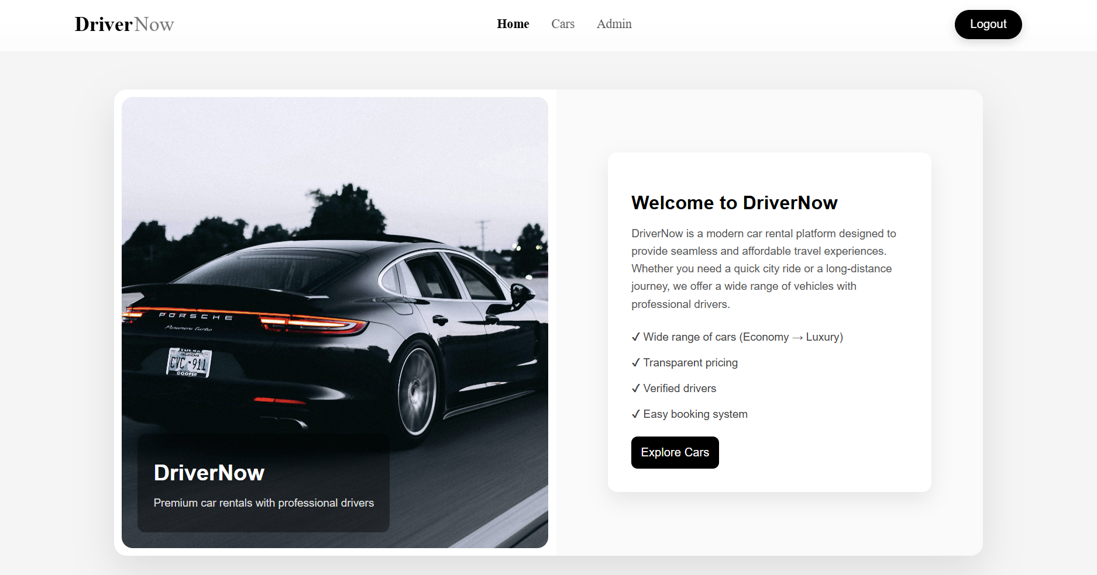
SR University

Slide 11
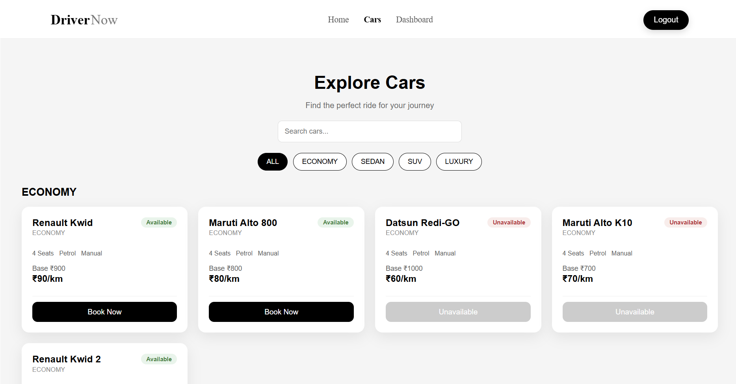
SR University

Slide 12
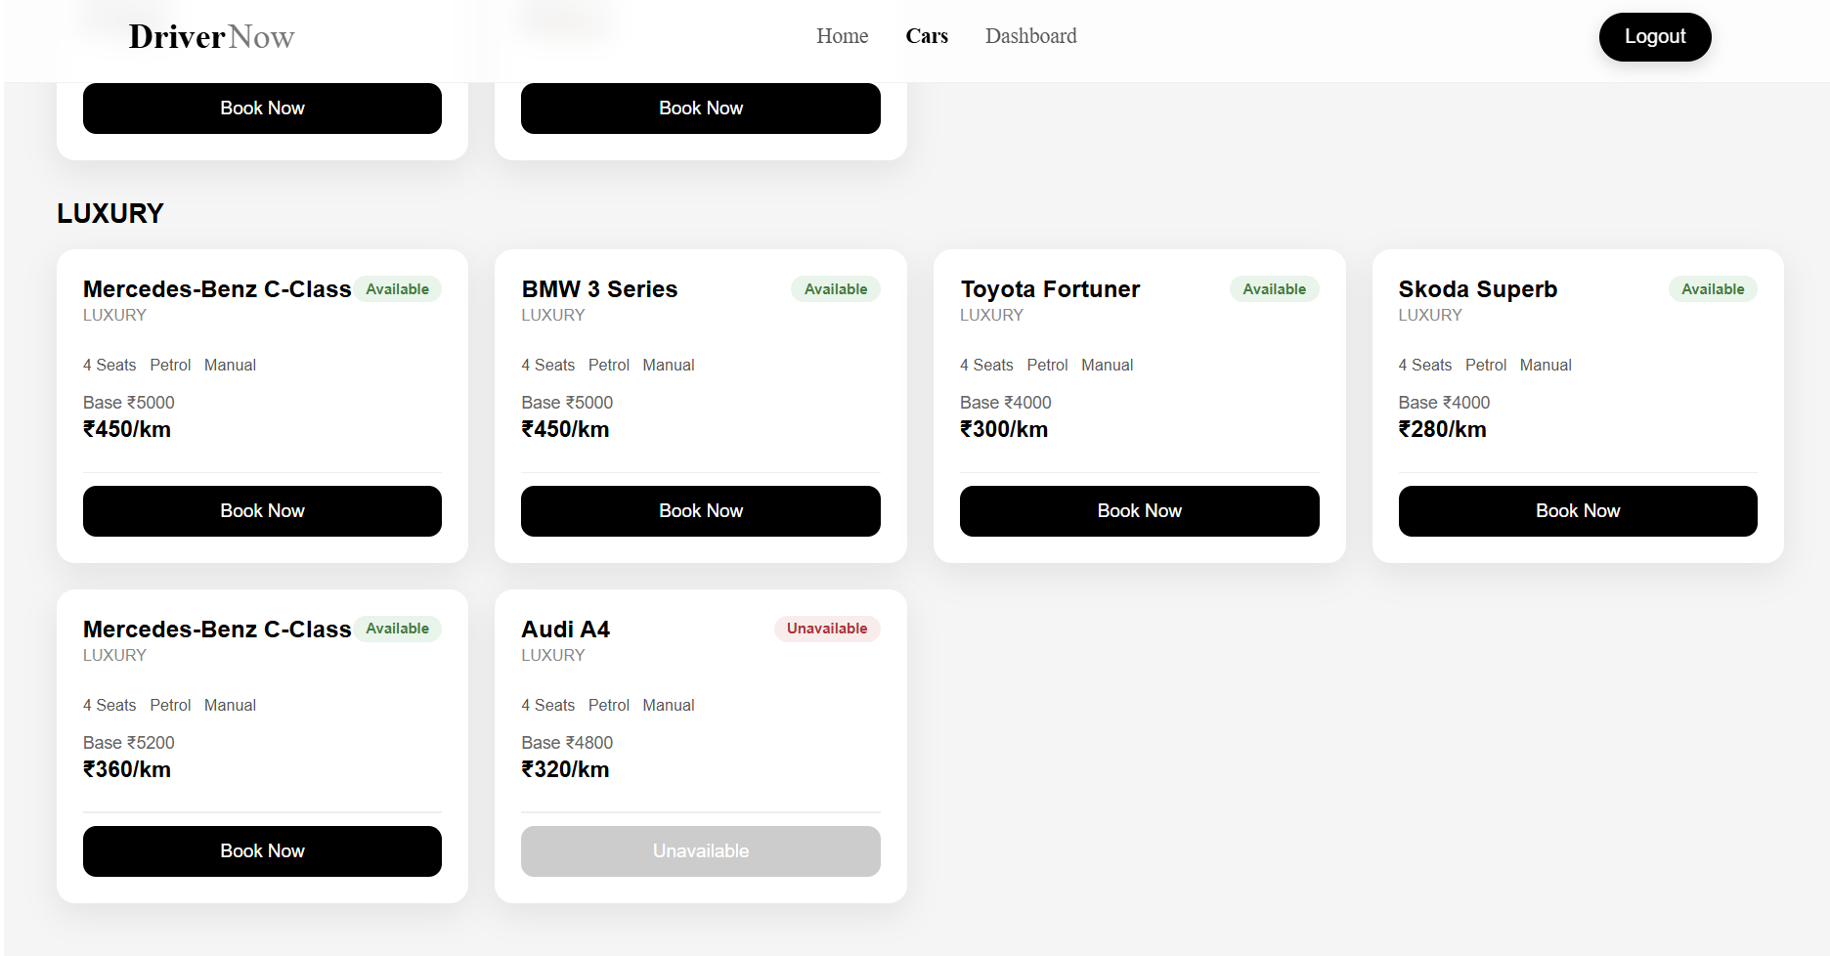
SR University

Slide 13
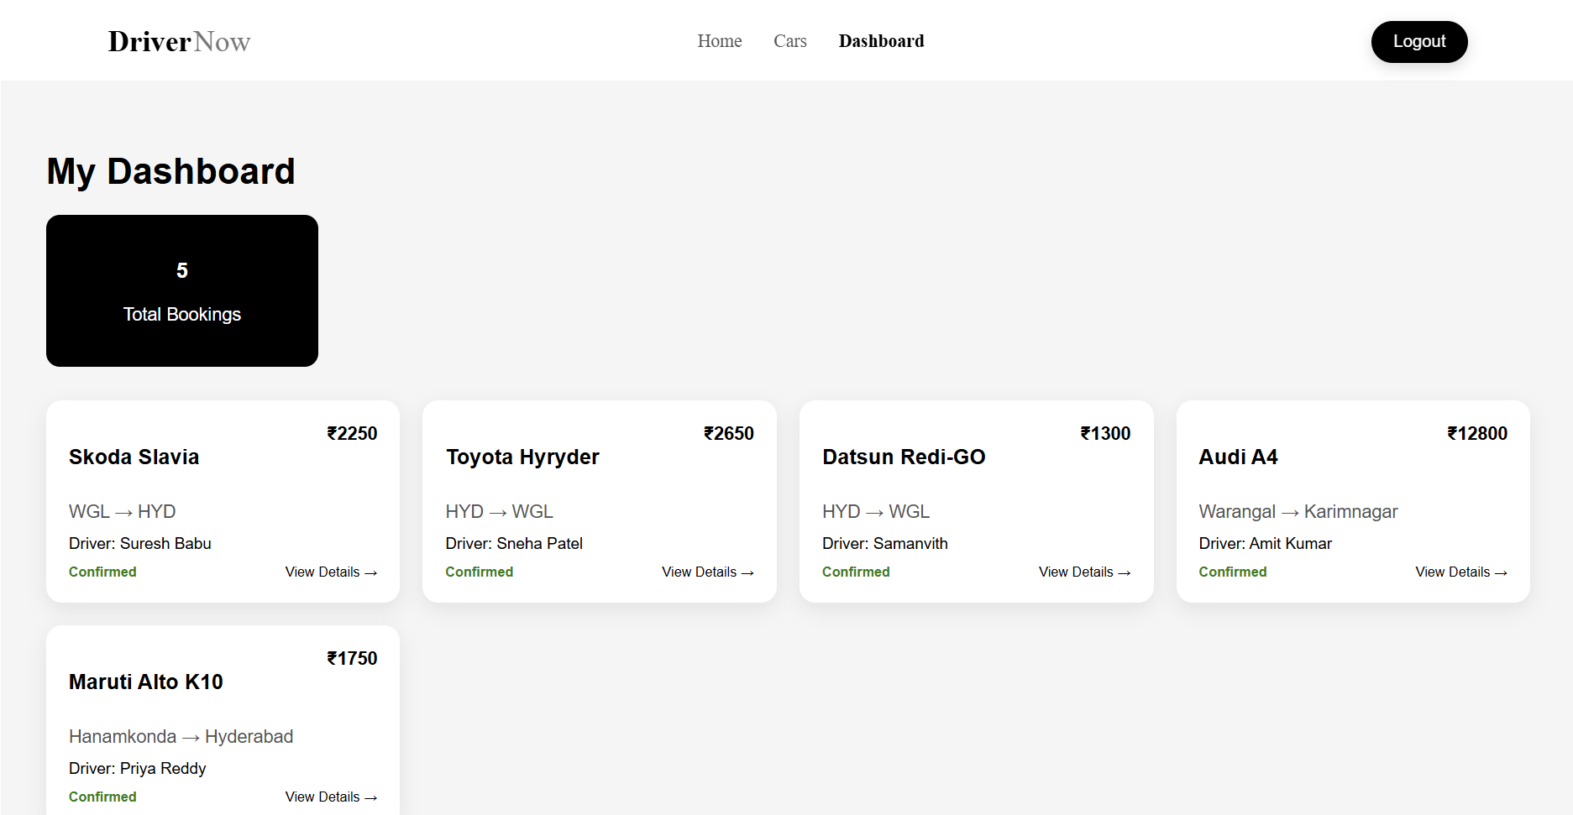
SR University

Slide 14
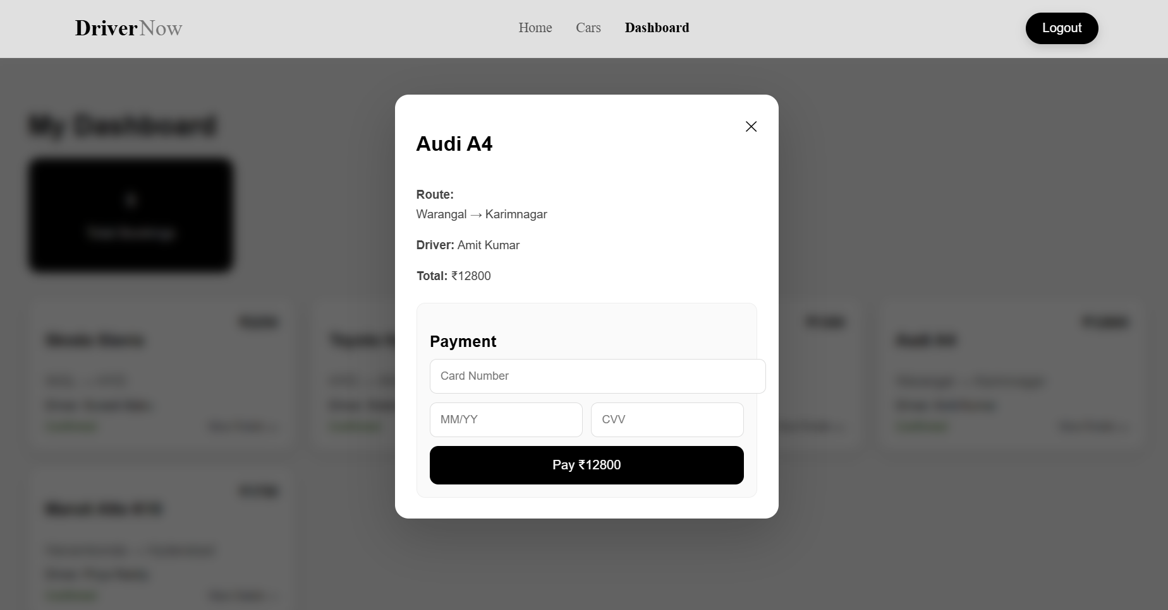

Slide 15
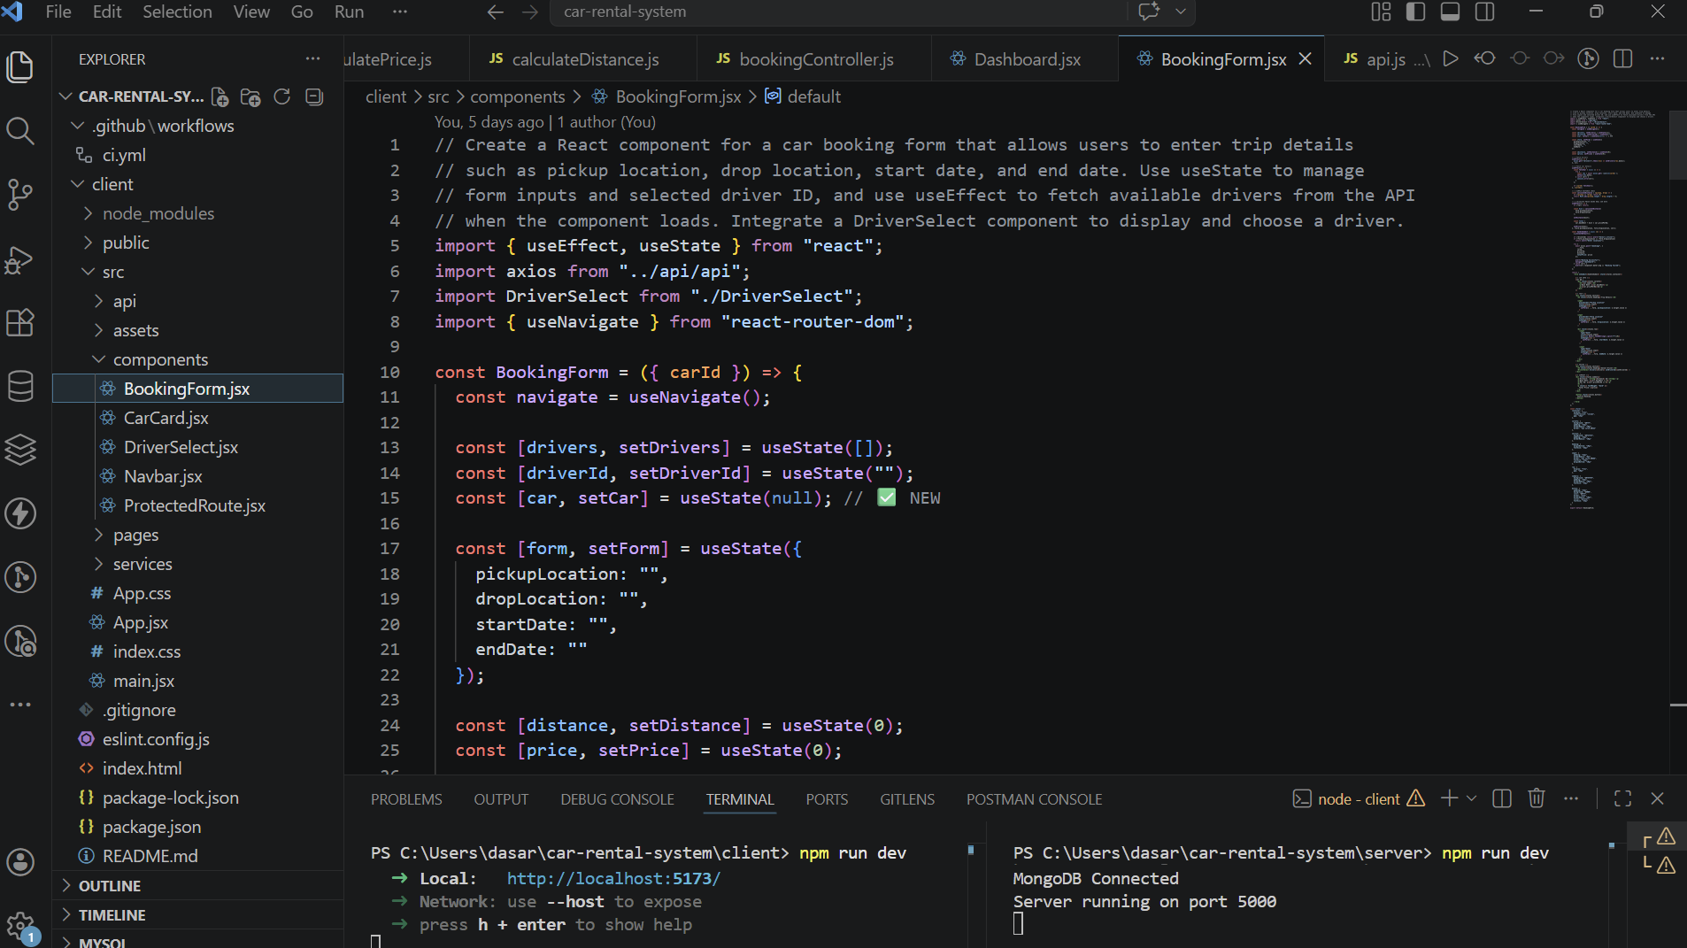
SR University
Proof Of AI Prompts :

Slide 16
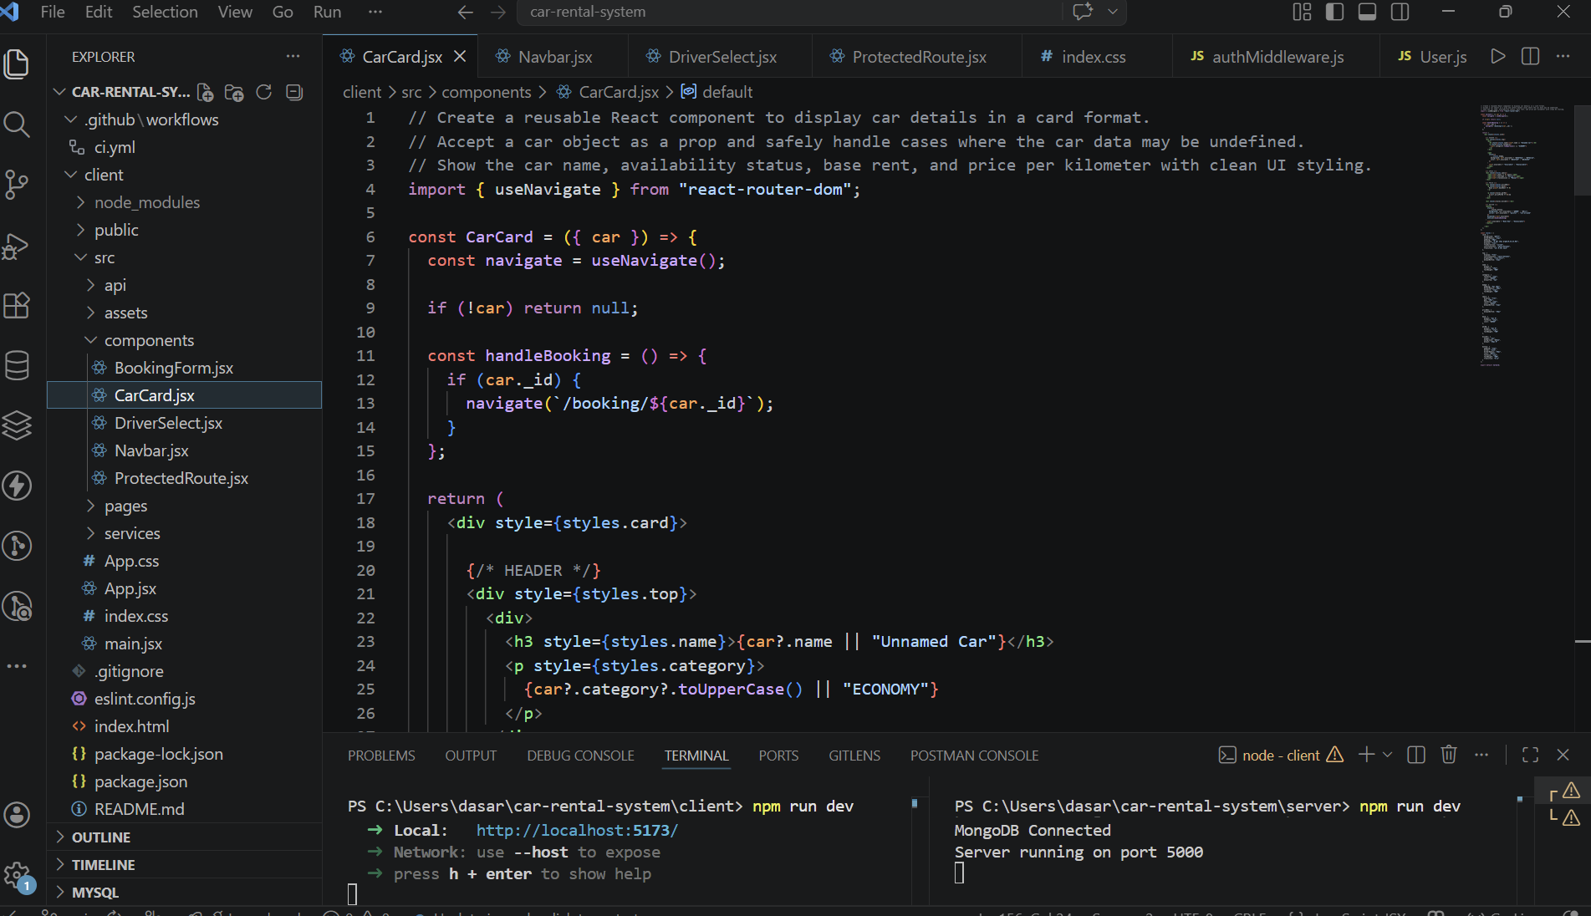
SR University

Slide 17
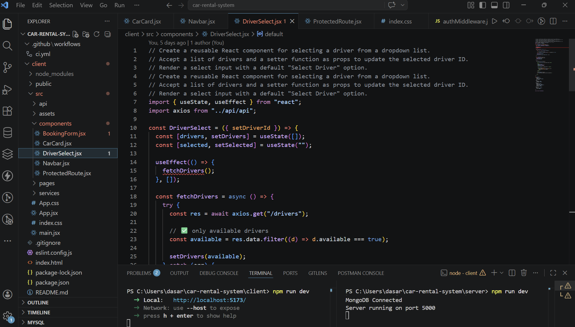
SR University

Slide 18
SR University
References
React Documentation
MongoDB Docs
Node.js Docs
Express.js Docs
ChatGPT (OpenAI)
Stack Overflow

Slide 19
SR University
Github Link
https://github.com/saisiridasari/Car-Rental-System

Slide 20
SR University
THANK YOU!

