Slide 1

WELCOME

Slide 2
project
3-TIER ARCHITECHTURE
WITH
AUTOMATIC CI/CD PROCESS
DESINGED BY
SAI SIVA
DEEPAK
ABHISHEK
SUDHEER KUMAR
LOKESH

Slide 3
Abstract
3-Tier Architecture with automatic CI/CD build process is a end to end build and deployment process.
Main aim of this project is to build and deploy application in 3-Tier Architecture .
The Special thing about this project is end to end automation of deploying war file into the tomcat servers using CI-CD DevOps tools.
DevOps is a conceptual framework for reintegrating development and operations of Information Systems.

Slide 4
Existing System
The current system of the project is manually deploying the builds to the DEV, QA and PROD environments.
Because of manual deployments there will be chance to have human errors.
In this system users hit the Jenkins job and that automates the building and deploying of the code.

Slide 5
Proposed System
The proposed system is end-to-end automation with DevOps Tools.
This system makes the users to work with Agile Methodology more efficiently.
It also reduce the work of developers to troubleshoot the deployment issues and focus on code.
Main aim of this project is to build and deploy application in 3-Tier Architecture with automatic CI/CD build process.

Slide 6
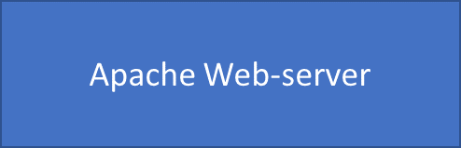



3-Tier Architecture
Internet
user
DNS
Load Balancer
(Ha Proxy)
Mod JK Connector (8009)
Mod JK Connector (8009)

Slide 7
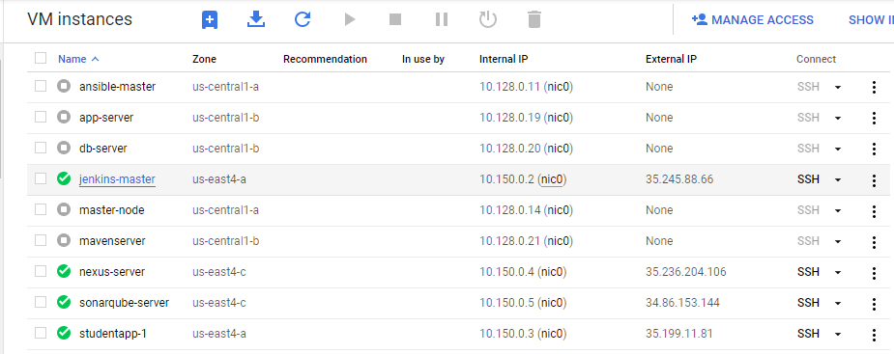
GCP SERVERS

Slide 8
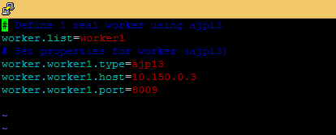
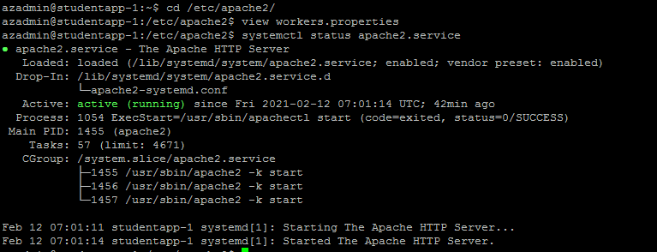
MOD-JK Connection in workers.properties

Slide 9
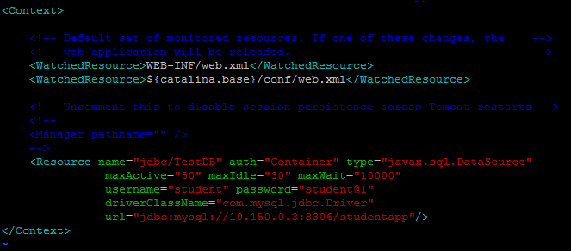
JDBC Connection in tomcat context.xml

Slide 10
Tools Used
GitHub
Maven
Jenkins
Nexus
Apache Tomcat server
Apache Web Server
Mariadb

Slide 11
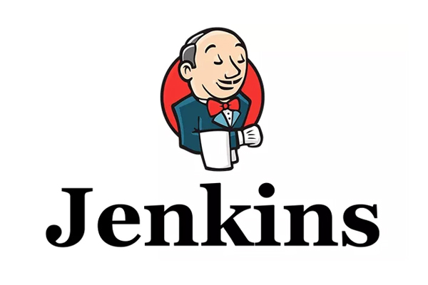
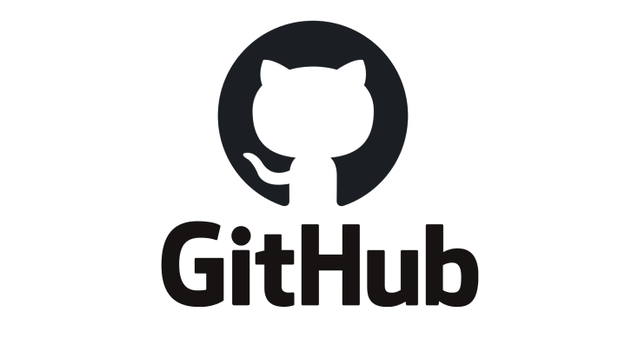
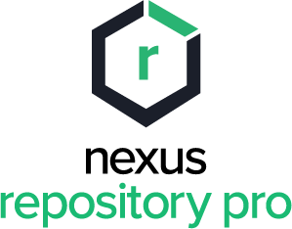
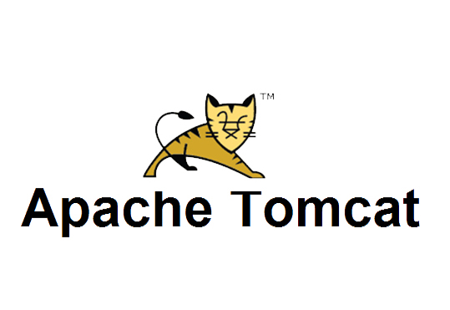
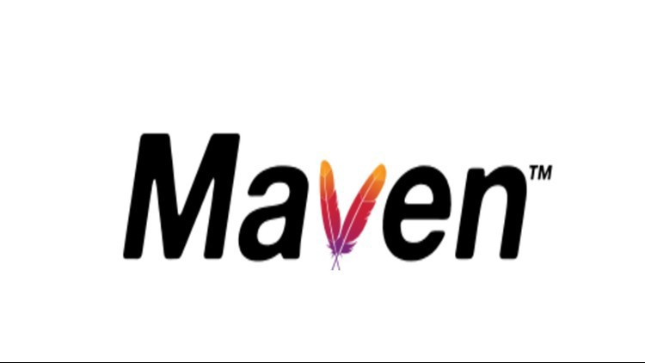
CI – CD PROCESS

Slide 12
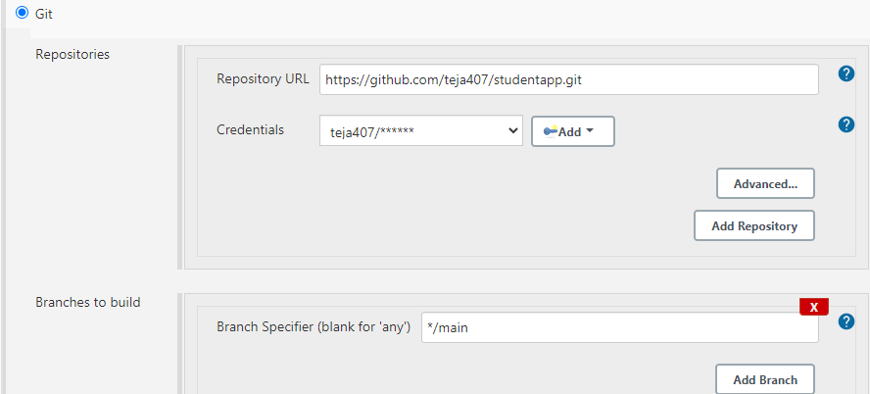
GitHub Configuration in jenkins

Slide 13
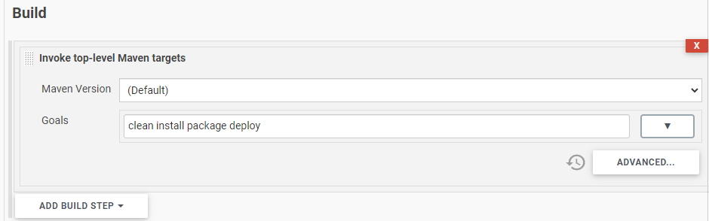
Maven Configuration in Jenkins

Slide 14
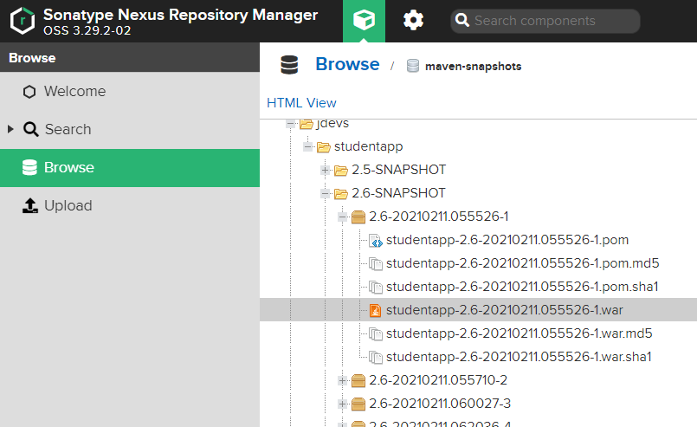
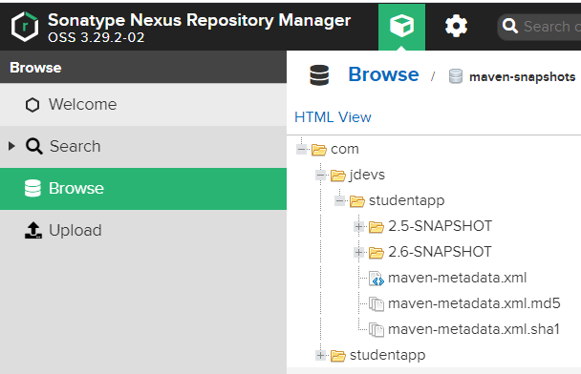
NEXUS REPOSITORY

Slide 15
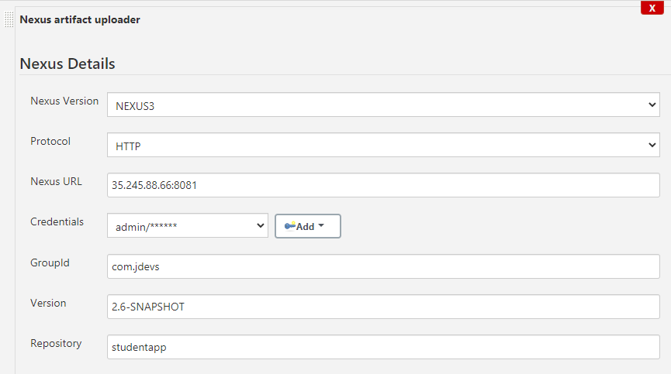
Pushing war file from Nexus

Slide 16
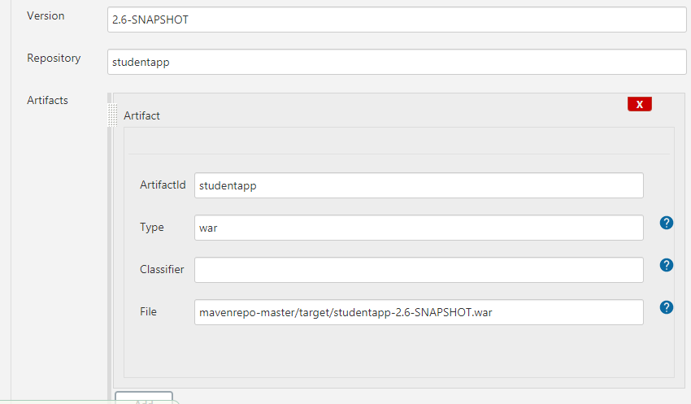
Pushing war file from Nexus

Slide 17
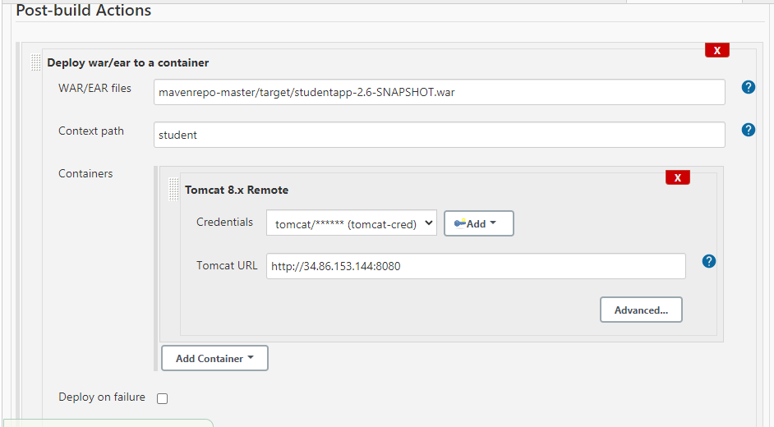
Deploy artifacts to Tomcat Container

Slide 18
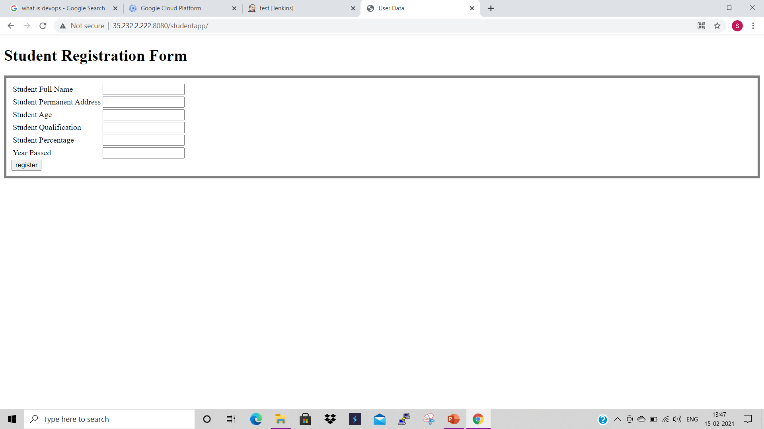
Student registration form

Slide 19
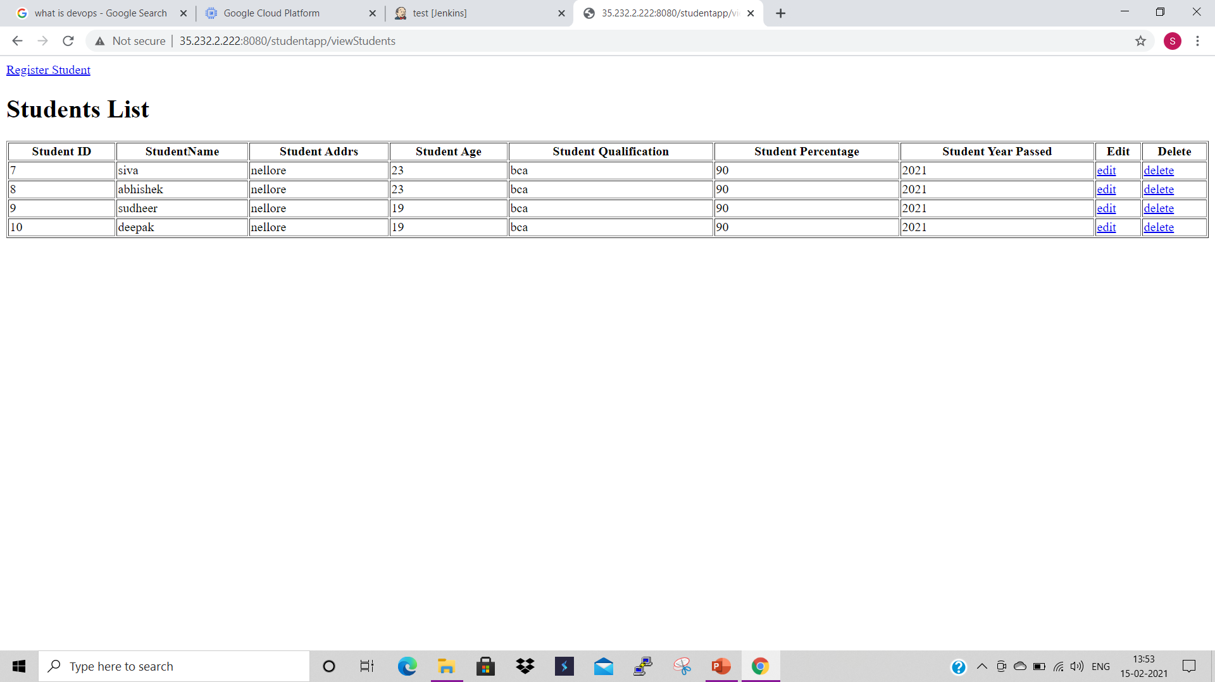
output

Slide 20
System Requirements
Hardware Requirements
Processor : 2VCPU’s
RAM : 4 GB
HDD : 10 GB
Software Requirements
Operating System : Linux/ Windows
Front End code : HTML
Backend code : JAVA
Server : Apache Tomcat 8.0
Database : MariaDB

Slide 21
CONCLUSION
DevOps is helping businesses in a tremendous way.
It's bridging the gap between developers' need for change and operations' resist to change and thus creates a smooth path for Continuous Development and Continuous Integration.
The point is to start somewhere and make small, meaningful changes. Measure the results and keep iterating. Take advantage of the same tools and workflows that dev and ops are using.

