Slide 1
NEURAL NEXUS / ARTIFICIAL INTELLIGENCE
AI-Powered
Smart Email Assistant
Generative AI for everyday email communication
College project presentation
01
Notes:
Introduce NEURAL NEXUS. This is a complete local full-stack application with real Gemini integration. Configure a valid API key before demonstrating live generation.

Slide 2
NEURAL NEXUS
Introduction
The intent is clear.
The wording takes work.
Students and professionals need to adapt email to the audience and situation.
Generative AI interprets context and proposes wording the user can review.
02
Notes:
Explain the everyday need: extension requests, follow-ups, scheduling and professional replies. This is a motivating use case, not a measured market claim.

Slide 3
NEURAL NEXUS
Problem statement
Writing from scratch takes repeated effort.
Grammar fixes alone do not resolve structure or tone.
A useful reply needs both context and the user’s intent.
Users need a clear result they can review and reuse.
03
Notes:
The goal is to support drafting and refinement while preserving user intent. The system does not read inboxes or send emails.

Slide 4
NEURAL NEXUS
Proposed solution and objectives
One workspace. Five AI operations.
Generate complete emails and relevant subject lines.
Correct, improve and adapt existing messages.
Draft replies from incoming content and intended response.
Keep the final review and sharing decision with the user.
04
Notes:
Each intelligent operation calls the real Gemini model through Python. There are no fixed email templates acting as an AI fallback.

Slide 5
NEURAL NEXUS
Existing approaches and proposed system
Approach | Typical workflow | NEURAL NEXUS adds
Manual writing | Compose and revise each email | AI drafts from natural-language intent
Static templates | Edit predefined wording | Context-sensitive generation
Basic correction | Fix surface language errors | Rewriting, tone and reply context
General chat | Repeat prompts and copy outputs | Dedicated tools and structured results
Conceptual comparison. Commercial AI tools may offer overlapping features.
05
Notes:
This compares common workflows, not named products or measured performance.

Slide 6
NEURAL NEXUS
System architecture
Browser UI
Python API
AI service
Gemini model
Forms and temporary drafts
Validation and safe routing
Dedicated task prompts
Structured AI generation
Validated JSON returns subject, body, intent and explanations.
API key stays on the server. The app has no database or email account access.
06
Notes:
Native editable architecture diagram. The backend uses a single official SDK request for each user-triggered operation and validates the output before returning it. Source: delivered app/main.py, app/services.py and app/schemas.py.

Slide 7
NEURAL NEXUS
Technology stack
Frontend
HTML, custom CSS, JavaScript modules
Backend
Python 3.12, FastAPI and Uvicorn
AI integration
Official Google GenAI Python SDK
Model
gemini-3.5-flash-lite, configurable
Quality
Pydantic, pytest and isolated DOM tests
07
Notes:
Model default verified against official documentation on November 1, 2026: https://ai.google.dev/gemini-api/docs/models/gemini-3.5-flash-lite . Official SDK: https://googleapis.github.io/python-genai/ . Availability and quota depend on the Google project.

Slide 8
NEURAL NEXUS
Main application modules
01
Email generation
Instructions become an email and subject
02
Grammar correction
Minimal edits preserve meaning
03
Writing improvement
Clearer, concise professional wording
04
Tone adjustment
Five choices for different audiences
05
Smart reply
Incoming context plus intended response
08
Notes:
All five modules call the real model. Subject generation, intent summaries and explanations also come from Gemini.

Slide 9
NEURAL NEXUS
AI is central to every workflow
Dedicated prompts
Structured results
Each task has a separate objective and preservation rules.
The response schema separates drafts, intent and suggestions.
One request per action
Visible AI behavior
Up to two alternatives. No automatic retries or fake fallback.
Loading states, model metadata and honest service errors.
09
Notes:
Structured output documentation: https://ai.google.dev/gemini-api/docs/structured-output . Explanations are concise generated summaries, not hidden model reasoning. Prompt boundaries reduce but do not eliminate model errors or prompt-injection risk.

Slide 10
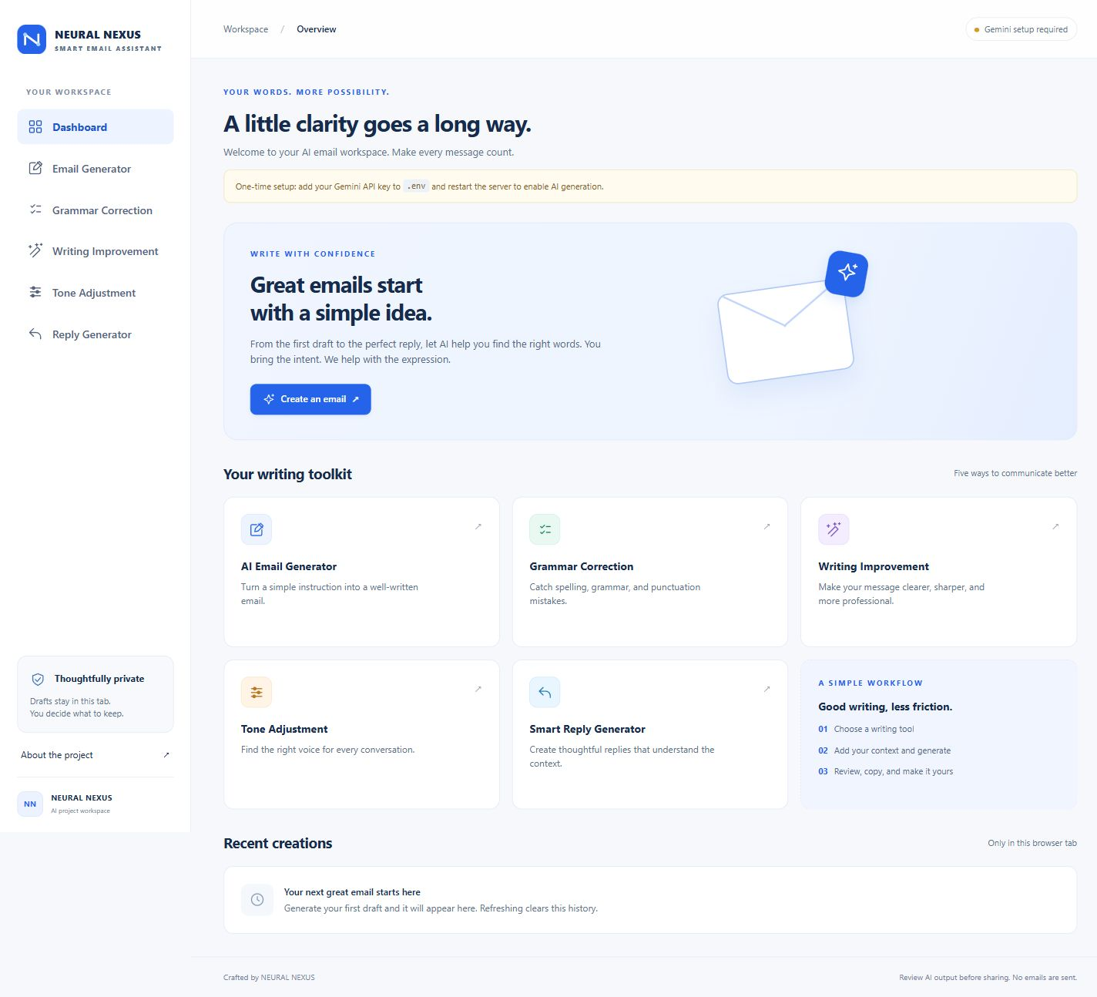
NEURAL NEXUS
The writing workspace
Five tools
Quick access
Recent creations
Actual application
No key configured
10
Notes:
This is an actual dashboard screenshot. Recent results stay in browser memory and disappear on refresh. The image is not evidence of live AI generation.

Slide 11
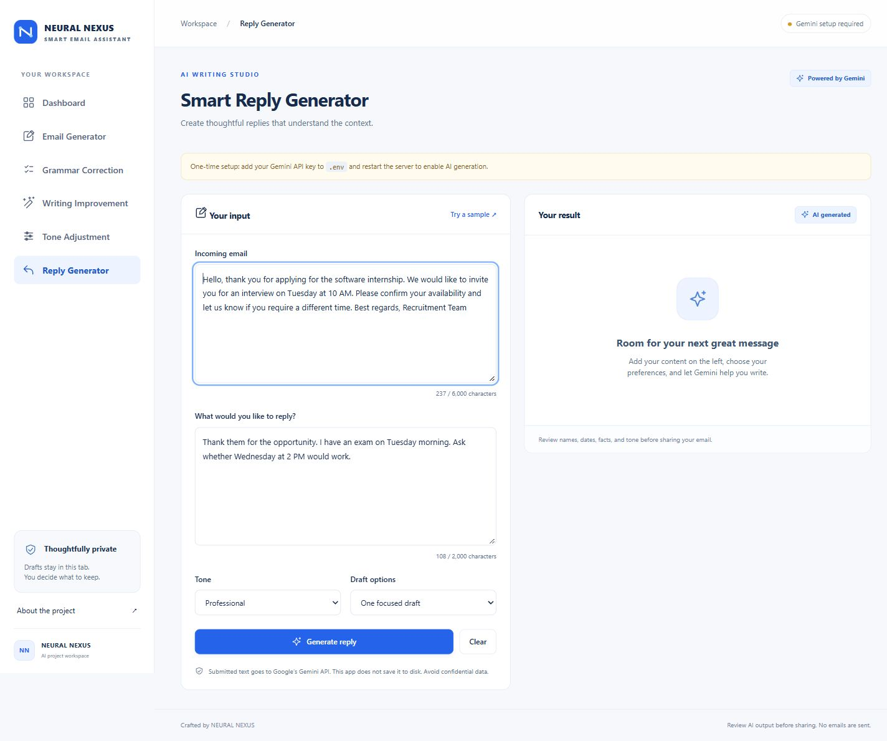
NEURAL NEXUS
Context-aware reply editor
Incoming email
+
Your intended reply
Actual sample input
Live output requires
a Gemini API key
11
Notes:
Explain why separate fields matter. The model must follow the user’s intent rather than simply accept a request in the incoming email. The screenshot is a real input state, not fabricated output evidence.

Slide 12
NEURAL NEXUS
Working demonstration flow
Generate
Ask a professor for an extension
Correct
Fix an email with multiple grammar errors
Improve
Remove repeated requests for project data
Transform
Convert a casual meeting request to Formal
Reply
Propose a different interview time
Then inspect AI metadata, compare drafts, copy and download.
12
Notes:
Before presenting: configure GEMINI_API_KEY in .env, restart and run scripts/live_demo.py. This makes five real requests and stops on failure. Check each response for preserved dates, meaning and intent. No live key was provided during construction, so live generation remains unverified. See documentation/DEMO_GUIDE.md.

Slide 13
NEURAL NEXUS
Benefits and verification
28
Focused writing support
Consistent tools, alternative drafts and explanations help users review their wording.
Python checks passed
Frontend behavior and responsive
screens also checked.
Small local setup
Live Gemini verification awaits a key.
Python, one API key and a browser.
13
Notes:
No measured productivity or accuracy claims. Python tests mock SDK responses only in tests. Isolated frontend tests verify result controls. The real app has no mocked mode. See documentation/TESTING.md.

Slide 14
NEURAL NEXUS
Limitations and future scope
Current limits
Future enhancements
Internet, model access and quota required
AI output needs human review
Drafts clear when the tab refreshes
Local demonstration deployment
Opt-in encrypted draft storage
Sentence-level change highlighting
Human-rated quality evaluation
Authentication for hosted access
14
Notes:
Future items are not implemented. Gmail access and sending are outside the agreed release. The local memory policy does not imply that Google has no retention: https://ai.google.dev/gemini-api/terms .

Slide 15
NEURAL NEXUS
Conclusion
A complete email workspace
with real AI at its core.
Five intelligent operations. A consistent interface.
Source, report and demonstration materials included.
Next step: configure your Gemini key and run the live demonstration.
15
Notes:
Close with the product scope and demonstrate actual generation after configuration. No API key was supplied during build, so no live AI results are claimed in this deck.

