Slide 1
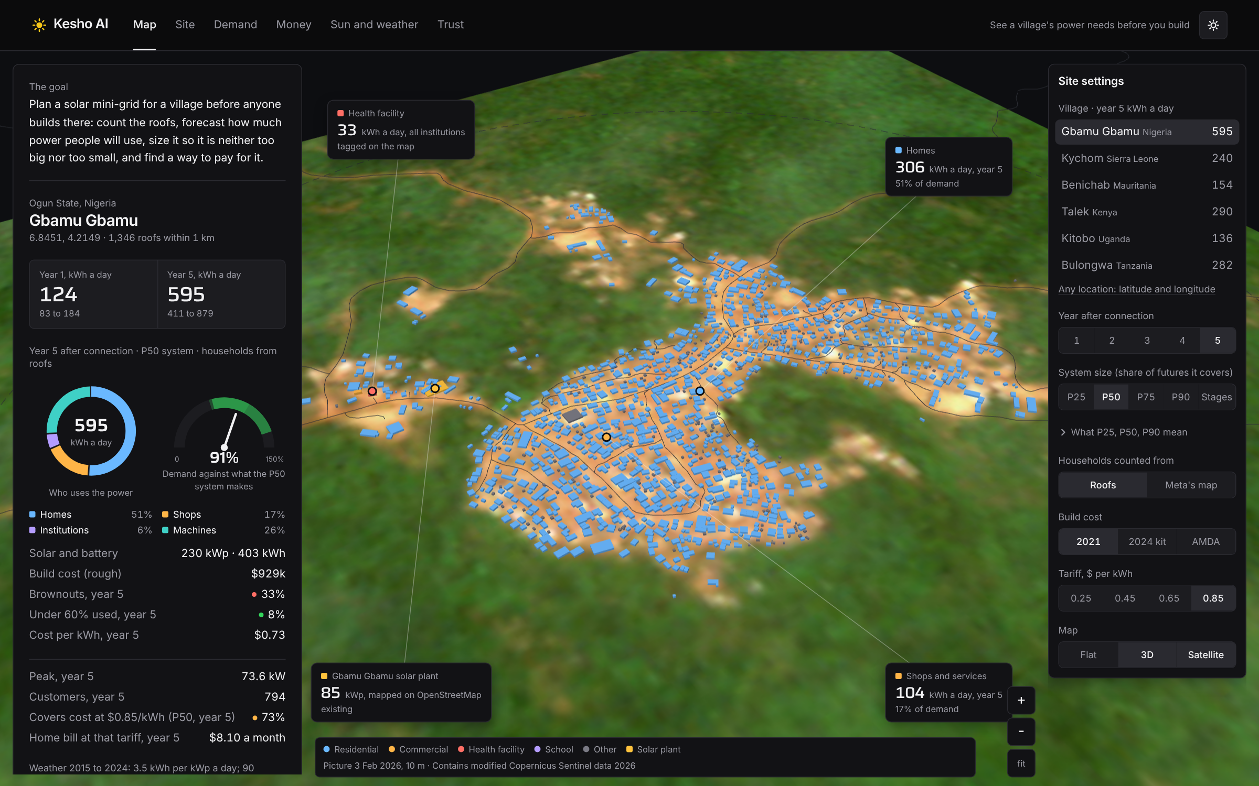
Kesho AI
GLOBAL ENERGY HACKATHON 2026 · INNOVATIVE & AFFORDABLE SOLUTIONS
Forecasts a village's power demand from satellite roofs and open data, then right-sizes and finances its solar mini-grid, for developers, lenders and electrification agencies
BRIEF
03 Predict mini-grid demand before building
TRACK
Digital Solutions and AI
Fereshteh Jafari
Sai Karri
Nworah Austin
TEAM
Notes:
About 20 seconds. We are Kesho AI, on Brief 03: predict mini-grid demand before building. Kesho means tomorrow in Swahili: we show a village's power needs before anyone builds, then size and finance the system. Open on the live site's Map view.

Slide 2

Villages get a mini-grid sized right the first time
IMPACT · 25% OF SCORE
2,888
households connected by year 5 across 6 villages in 6 countries, each with a P10 to P90 demand range
THE PROBLEM
490 million people need mini-grids by 2030: 217,000 grids, about $127 billion. At today's pace only about 44,800 get built, and each one is sized from guesses.
"Measured use runs 5 to 35 kWh per customer a month, and forecasts are often overstated." (ESMAP 2022)
37% → 15%
chance of brownouts by year 5: one P50 build vs Kesho AI's staged plan, with far less idle kit
$1.1M
saved at Gbamu Gbamu, Nigeria by sharing one plant with 14 settlements within 5 km
Notes:
About 1 minute. 490 million people need mini-grids by 2030, and every one is sized from guesses. Across our 6 villages in 6 countries, 2,888 households connect by year 5, each forecast with a range. One fixed P50 build has a 37% chance of brownouts by year 5 and sits mostly idle early; our staged plan holds brownout odds at 15% with far less idle kit. At Gbamu Gbamu, sharing one plant with nearby settlements saves about 1.1 million dollars. Figures are rough guides.

Slide 3

Demand, sizing and finance from open data
INNOVATION · 25% OF SCORE
TODAY
OUR APPROACH
ROOT CAUSE WE ADDRESS
Old census data and surveys asking people to guess use of power they have never had. One system is built for year 5, so it sits idle early and browns out later.
Count every roof from space, run 4,000 demand futures checked against metered sites within 1,000 miles, and build in stages that keep brownout odds under 15%.
No demand data before building, so sizing risk lands on the village and the lender.
HOW IT WORKS
1
Count and classify every roof from Google, Microsoft and OpenStreetMap, checked with fresh Sentinel-2 images
2
Forecast 5 years of demand with ranges, tested on 10 years of real weather and climate outlooks
3
Right-size in stages, price the wires or grid line, and find the grant or loan that pays back
Notes:
About 1 minute. Today: old census data and guessed surveys, and one system built for year 5. Our approach: count every roof from satellites, run 4,000 demand futures checked against metered sites within 1,000 miles, test them on 10 years of real weather, and build in right-sized stages. Root cause: there is no demand data before building, so the risk lands on the village and the lender.

Slide 4





It pays back without ongoing grants
SUSTAINABILITY & AFFORDABILITY · 25% OF SCORE
COST TO THE USER
WHO PAYS
HOW IT PAYS FOR ITSELF
$5 to $8 / month
Households pay per kWh; results-based grants (about $433 a connection) and concessional loans cover the build. Kesho AI finds the smallest grant needed.
Bills cover running costs and 1.2x the loan payment from year 2. Each stage is added only when meters pass 80% of what is installed.
household bill at $0.85 a kWh, year 5, against $5 to $20 families spend on kerosene, candles and batteries
WHO KEEPS IT RUNNING
ENVIRONMENTAL BENEFIT
PAYBACK
The operator's local technicians; battery and inverter renewal around year 11 is in the 20-year plan.
About 290 MWh a year of solar at Gbamu Gbamu (230 kWp) instead of kerosene and diesel generators.
4 to 6 years
Notes:
About 1 minute. Homes pay about 5 to 8 dollars a month at 85 cents a kWh, inside the 5 to 20 dollars families spend today on kerosene, candles and batteries. Results-based grants and concessional loans cover the build; Kesho AI finds the smallest grant needed. With staging, 2024 equipment prices and a 6% loan, the owner's money comes back in about 4 to 6 years at every village with no grant (assumptions labelled on the site). Local technicians run it; battery renewal at year 11 is in the 20-year plan.

Slide 5


A working prototype on six real villages
FEASIBILITY · 15% + SCALABILITY · 10%
PATH TO SCALE
PILOT
EXPAND
SCALE
Gbamu Gbamu, Nigeria: 794 customers, builds on the existing 85 kWp plant
Villages within 10 km, and REA and SEforALL sites in Nigeria and Sierra Leone
Any village in Africa: data covers the continent; bundling cuts cost per customer
OUR ASK
EVIDENCE IT WORKS
Gbamu Gbamu's real 85 kWp plant matches our year-2 demand (84 kWp)
Open data: checked on 2,225 tagged buildings
Risk: no meters yet.
Fix: one-day household count
A pilot developer, meter data from 50 to 200 sites, and an introduction to REA Nigeria
REA DARES (run by Nigeria's Rural Electrification Agency) and SEforALL's Universal Energy Facility are grant programmes that pay mini-grid developers for each home they connect.
Notes:
About 1 minute, then close. The prototype runs on six real villages from open data. At Gbamu Gbamu the plant actually built, 85 kWp, matches our year-2 demand. Honest risk: no meter data for these villages yet; a one-day household count and a meter-data trust fix it. Pilot at Gbamu Gbamu, expand to nearby villages and REA and SEforALL sites, then any village in Africa. Our ask: a pilot developer, meter data from 50 to 200 sites, and an introduction to REA Nigeria.

