Slide 1

Multi-omic Association Analysis with Kernel Machines
Bernard Ng
Department of Statistics, UBC

Slide 2
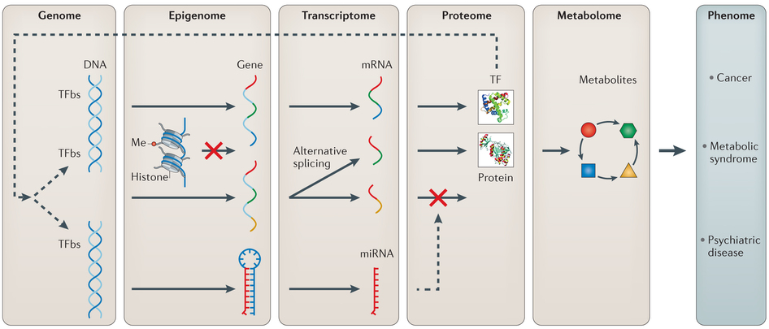
Overview
~10⁵
n
Methylation
~10⁴
n
Acetylation
Expression
~10⁶
~10⁴
n
SNP
n
(Ritchie et al., Nature Reviews Genetics 2015)

Slide 3
Our Questions of Interest
Which genes give rise to the phenotypes, i.e. high dimensional statistical inference?
Which aspects of those genes are key contributors to the phenotypes?
How do we study statistical interactions between genomic layers?
Are effects of upstream variables all mediated via gene expression?

Slide 4
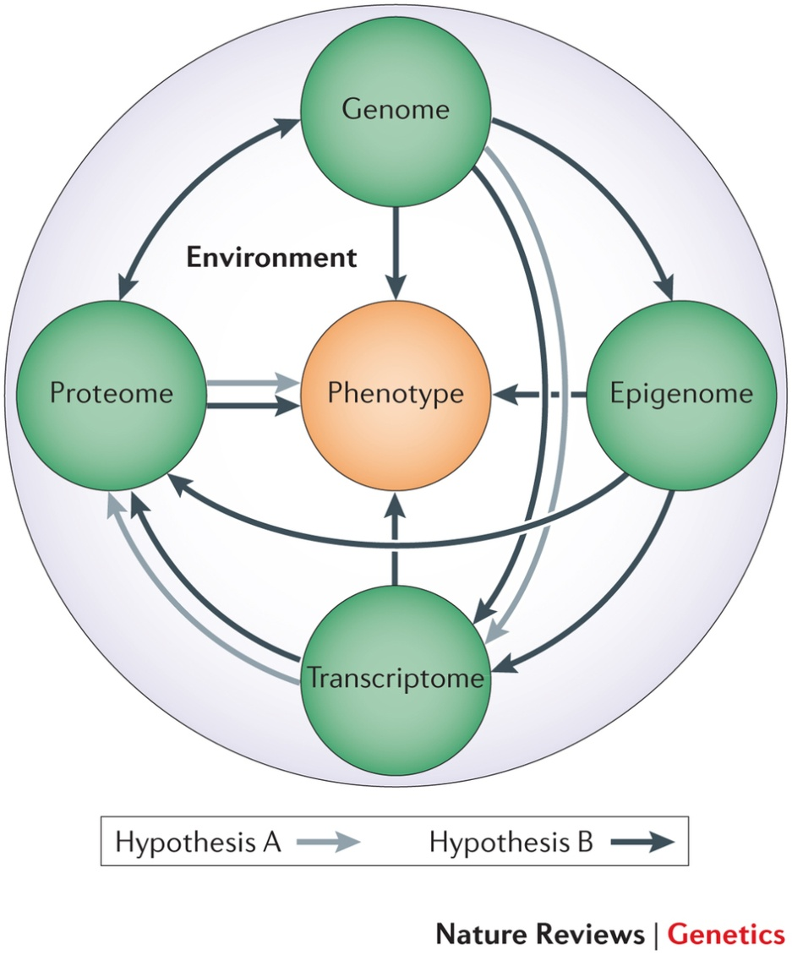
Analysis Strategies
Multi-stage
Meta-dimensional
(Ritchie et al., Nature Reviews Genetics 2015)

Slide 5
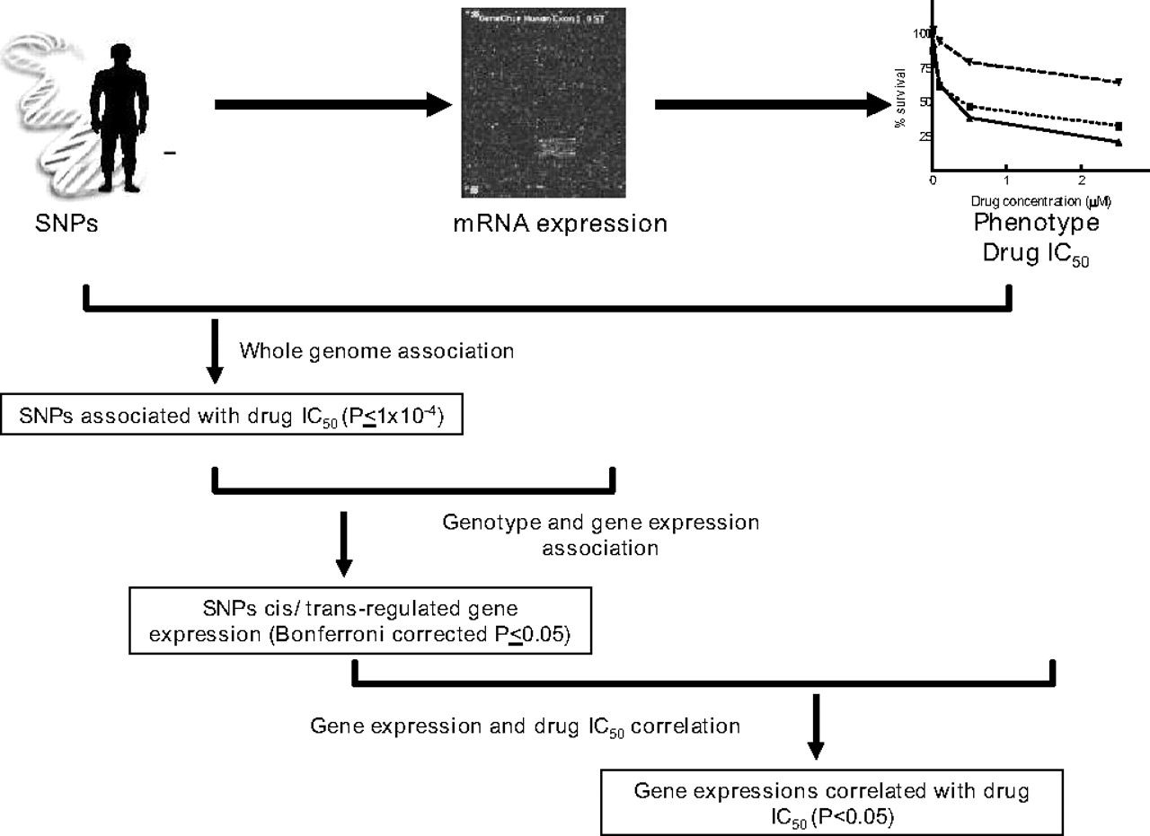
Multi-stage Analysis
Problem How to set p-value threshold?
(Huang et al., PNAS 2007)

Slide 6
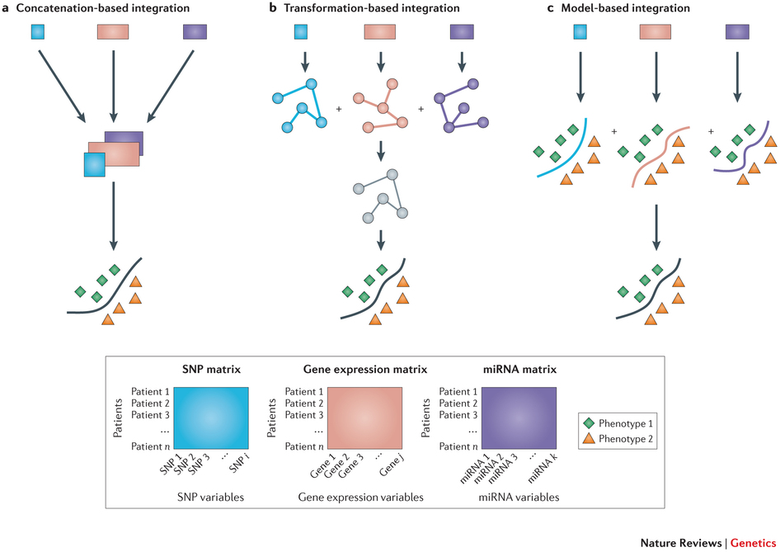
Meta-dimensional Analysis
(Ritchie et al., Nature Reviews Genetics 2015)

Slide 7
Concatenation-based Integration
X_{n × p}
y_{n × 1}
~10⁶
~10⁵
~10⁴
=
f
SNP
Methy
Acety
β
+
ε
Challenges
n << p
Correlated variables
For prediction, but inference?
Interactions?
(Montanari, 2013)

Slide 8
Transformation-based Integration
~10⁶
~10⁵
~10⁴
n
SNP
n
Methy
n
Acety
n
n
n
n
n
n
Challenges
Variable selection?
Integration method/choice of weights?
Inference?
Interactions?

Slide 9
Model-based Integration
~10⁶
~10⁵
~10⁴
SNP
Methy
Acety
Majority voting
1
0
1
1
Challenges
For prediction, but inference?
Interactions?

Slide 10
Interactions??

Slide 11
Classical Interaction Analysis
E.g. ~10⁶ SNPs x ~10⁵ Methylation probes = ~10¹¹ associations

Slide 12
Kernel Machines
Model (Liu et al., 2007)
Kernel Estimation
q
n
n
n
y
=
X
β
+
f
+
ε
Random Effect
f~N(0,τK)
Inference
H₀: τ = 0
Advantages
Dimension reduction
Statistical power gain
Challenges
Variable selection?
Interactions?

Slide 13
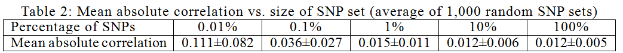
Curse of Dimensionality
n = 100
value of kernel elements
(Ng and Mostafavi, MLCB in NIPS 2015)

Slide 14
Kernel Machines
Model (Liu et al., 2007)
Kernel Estimation
n
n
y
=
X
β
+
f
+
ε
Gene i’s TSS
Random Effect
f~N(0,τK)
Inference
H₀: τ = 0
Advantages
Dimension reduction
Statistical power gain
Challenges
Variable selection?
Interactions?

Slide 15
Interaction Kernel Machines
Model (Ge et al., 2015)
Kernel Estimation
q
n
n
n
y
=
X
β
f_{G}
+
ε
f_{E}
+
+
f_{G×E}
+
l
n
n
n
Interaction Kernel
n
n
n
n
◦
n
n
Based on how the reproducing kernel of a tensor product of two RKHSs is the product of the two reproducing kernels

Slide 16
ROSMAP Project
Data
~500 Alzheimer's disease subjects
SNP, methylation, acetylation, expression, pathology
Confounds: age, sex, population structure, …
526214
Model
378
SNP
Main Effects
Expr, SNP, Methy, Acety
Interactions
SNPxMethy, SNPxAcety
413754
Methylation
y
=
X
β
ε
378
+
f
+
26384
378
Acetylation
Expression
13484
Variable Selection
378
n
n
3
Patho
378
TSS
100KB
100KB

Slide 17
Single Kernel Analysis Results
Global Cognitive Decline
FAM63A
PRUNE
EFCAB7
TRIM22
CDC42SE1
MLLT11
#Genes
Expr
SNP
Methy
Acety
SNPxMethy
SNPxAcety
Upstream
Kernel Machine
Mean
p < 0.05 with (dependent) FDR correction for all effects and interactions examined.
PCA

Slide 18
Single Kernel Analysis Results
Aβ
#Genes
ENTPD6
Expr
SNP
Methy
Acety
SNPxMethy
SNPxAcety
Upstream
Kernel Machine
Mean
p < 0.05 with (dependent) FDR correction for all effects and interactions examined.
PCA

Slide 19
Single Kernel Analysis Results
τ
#Genes
PLCB2
NMD3
C15orf52
MAP3K6
RP11-64K12.2
PPP1R12A PPP2R3C
RP11-173D9.3
FAM177A1
PSMD3
COQ5
MED24
SLC25A33
Expr
SNP
Methy
Acety
SNPxMethy
SNPxAcety
Upstream
Kernel Machine
Mean
p < 0.05 with (dependent) FDR correction for all effects and interactions examined.
PCA

Slide 20
Multikernel Machines
Model
Kernel Estimation
n
y
=
Expr
f_{SNP}
f_{SNP×Methy}
f_{SNP×Acety}
n
K_{q}
X
β
+
+
f_{Methy}
f_{Acety}
+
ε
+
+
+
100KB
100KB
Random Effect
Upstream Variables
f_{q}~N(0,τ_{q}K_{q})
Inference
H₀: τ_{q} = 0, for a specific q

Slide 21
Multikernel Machines
Model
Kernel Estimation
n
y
=
Expr
f_{SNP}
f_{SNP×Methy}
f_{SNP×Acety}
n
K_{q}
X
β
+
+
f_{Methy}
f_{Acety}
+
ε
+
+
+
100KB
100KB
Random Effect
Upstream Variables
f_{q}~N(0,τ_{q}K_{q})
Inference
H₀: τ_{q} = 0, for all q

Slide 22
Quantitative Results
Number of Significant Associations at p < 0.05 with dFDR
Expr | LMM | Mean | PCA
GCD | 69 | 33 | 35
Aβ | 15 | 1 | 1
τ | 0 | 0 | 0
Upstream | LMM | Mean | PCA
GCD | 6 | 1 | 0
Aβ | 9 | 0 | 0
τ | 0 | 0 | 0
Mediation Analysis
y = [X|E]β + {f_{S} + f_{M} + f_{A} + f_{SxM} + f_{SxA}} + ε
y = Xβ + {f_{S} + f_{M} + f_{A} + f_{SxM} + f_{SxA}} + ε
E = Xβ + {f_{S} + f_{M} + f_{A} + f_{SxM} + f_{SxA}} + ε

Slide 23
Quantitative Results
(Ritchie et al., Nature Reviews Genetics 2015)

Slide 24
Quantitative Results
Number of Significant Associations at p < 0.05 with dFDR
Expr | LMM | Mean | PCA
GCD | 69 | 33 | 35
Aβ | 15 | 1 | 1
τ | 0 | 0 | 0
Upstream | LMM | Mean | PCA
GCD | 6 | 1 | 0
Aβ | 9 | 0 | 0
τ | 0 | 0 | 0
Mediation Analysis
y = [X|E]β + {f_{S} + f_{M} + f_{A} + f_{SxM} + f_{SxA}} + ε
y = Xβ + {f_{S} + f_{M} + f_{A} + f_{SxM} + f_{SxA}} + ε
E = Xβ + {f_{S} + f_{M} + f_{A} + f_{SxM} + f_{SxA}} + ε

Slide 25
Conclusions
Few existing multi-omic analysis approaches model the interactions between genomic layers.
Kernel machines enable interactions to be analyzed while increasing statistical power.
Found some genes with significant associations with pathology only when interactions considered.
Genetic and regulatory effects not all mediated via gene expression.

Slide 26






Acknowledgements
Dr. Philip de Jager
Dr. Sara Mostafavi
Dr. David A. Bennett

Slide 27

Funded Grad/Postdoc Positions
Mostafavi Lab

