Slide 1

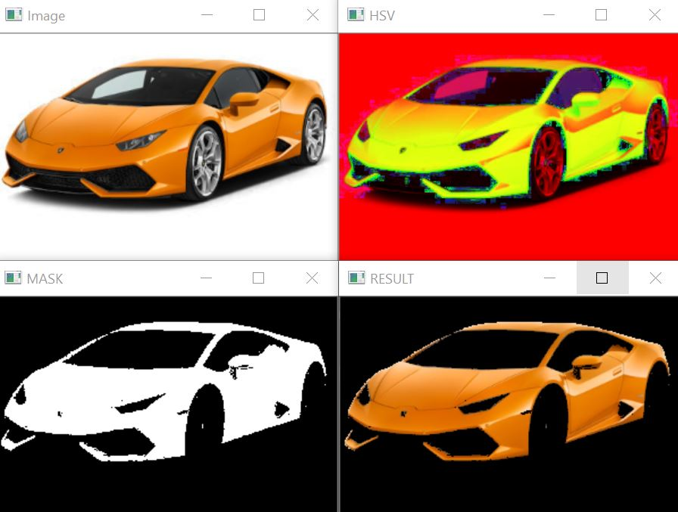

Slide 2
Prerequisites :
Computer Vision library i.e. , OpenCV :
OpenCV process the image for identifying objects.
It is a open source library for image processing and Machine learning etc.
NumPy module in Python :
Supports working with multidimensional arrays(-n dimensional).
The wide range of values from the trackbars are stored and processed using this NumPy module.

Slide 3
Abstract :
The main objective is to develop a prototype which can detect different colors by using the fundamentals of computer vision.
Initially we train an image in which we need to detect the colour.
HSV conversion – black & white mask – color mask.
Trackbars are created & used for setting the respective values of color to be detected.
Hue, saturation, value are used for detecting color.

Slide 4
Overview :

Slide 5
Color Detection :
A color detection algorithm identifies pixels in an image that match a specified color or color range. The color of detected pixels can then be changed to distinguish them from the rest of the image.
The array of boxes used for representation of an object is known as “PIXEL”
Color image = Red * Green * Blue (RGB).

Slide 6
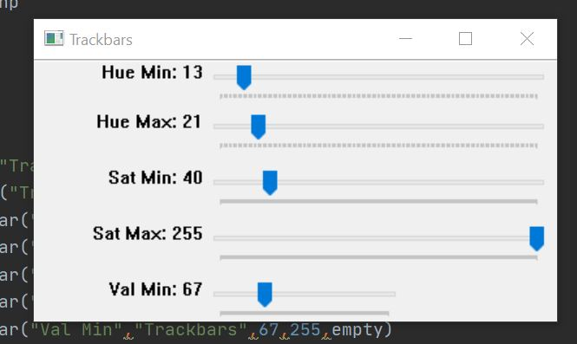
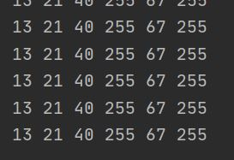
Trains an image to detect the color
(Reading of I/P Image)
BGR to HSV conversion
Black and White Masking
Color Mask
(Generating the detected portion)

Slide 7
Applications :
Image editing Apps.
Drawing Apps.
For driver less cars to Detect traffic signals.
For pick and place of colored objects using robotic arm.

Slide 8
THANK YOU

