Slide 1


K.S. INSTITUTE OF TECHNOLOGY BANGALORE – 560109
34th CSI Karnataka Student Convention (Online)
22nd & 23rd December 2020
Title: Intuitive Perception –Lip Reading using Machine Learning
Paper ID: CSIAMSPID013
Presenter Name: Spoorthi V
Author Names:1.Roopashree N
2.Sai Sneha S V
3.Spoorthi V
4.Dr. Swathi K
Affiliation :KS INSTITUTE OF TECHNOLOGY

Slide 2
Contents
Introduction
Literature review
Problem identification
Objectives
Methodology
Results
Conclusions
References
2

Slide 3
INTRODUCTION
Machine Learning is widely used for lip reading and for improving speech recognition.
Visual lip-reading plays an important role in human-computer interaction in noisy environments
Possible applications: help people with hearing disabilities, surveillance systems, etc.
Typical lip-reading systems face several challenges due to variances in the inputs.
several different words can be spoken with almost indistinguishable lip movements.
The use of Deep Learning and deep neural networks has revolutionized the quality of automated lip-reading systems, resulting in more accurate models.

Slide 4
LITERATURE SURVEY
Improving Speaker Independent Lipreading with Domain Adversarial Training (2017): Michael Wand and Jurgen Schmidhuber:
worked on a lipreading system which yields an end-to-end trainable system
The model was based on a stack of feedforward and LSTM (Long Short-Term Memory) recurrent neural networks
The main goal was to push the network to learn an intermediate data representation which is domain-agnostic
Largescale visual speech recognition: Brendan Shillingford and all
constructed the largest existing visual speech recognition dataset.
Their approach was first to combine a deep learning-based phoneme recognition model with production-grade word-level decoding techniques.

Slide 5
Lip Movements Generation at a Glance: Lele Chen, Zhiheng Li, Ross K. Maddox, Zhiyao Duan and Chenliang Xu
devised a method to fuse audio and image embeddings to generate multiple lip images.
proposed a novel correlation loss to synchronize lip changes and speech changes.
Lip Reading Sentences in the Wild: Joon Son Chung, Andrew Senior, Oriol Vinyals and Andrew Zisserman
They developed a Watch, Listen, Attend and Spell (WLAS) network.
used a curriculum learning strategy to accelerate training and reduce overfitting.
the dataset developed is established from thousands of hours of BBC television broadcasts
Their model can operate over dual attention mechanism
They have an image encoder, audio encoder and character decoder in place to achieve lipreading.

Slide 6
PROBLEM STATEMENT
This project mainly aims at preprocessing a video sample which would then be systematically cropped, and the required features would be extracted and then fed to an artificially intelligent system to map variable-length sequences of video frames to text sequences, and it is trained end to end.

Slide 7
OBJECTIVES
To predict the words spoken by the speaker accurately.
To recognize the sentences not only for a single video but for the whole dataset
To place the tracker around the lip region accurately.
To normalize the video samples so that uniformity is maintained.
To decode the text spoken by the speaker correctly.

Slide 8
METHODOLOGY
Module 1 - Pre-Processing
Input: Video in RGB color format.
Output: Set of frames in greyscale
Module 2 - Face detection and cropping
Input: Still frames of grayscale images.
Output: Faces with ROI cropped
Module 3- Feature extraction and normalization
Input: ROI images
Output: Normalized frames ready with features extracted.
Module 4 - Text classification and decoding
Input: Image data containing normalized frames.
Output: Predicted text played in parallel to the video.

Slide 9
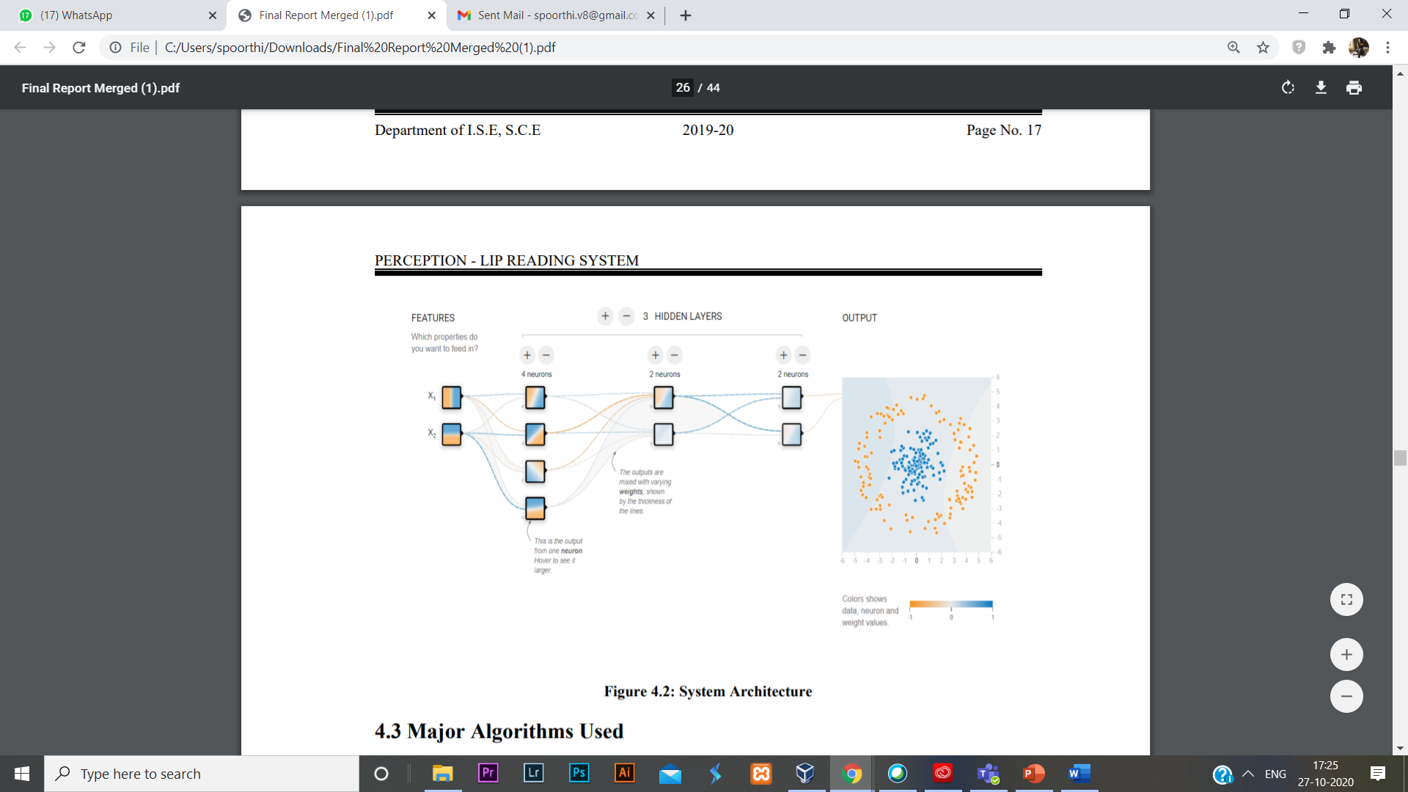
SYSTEM ARCHITECTURE
The architecture of the proposed system is based on working of a CNN.
The system makes use of an input layer, three hidden layers and an output layer.
The features extracted from each initial layer is fed into the next layer.

Slide 10
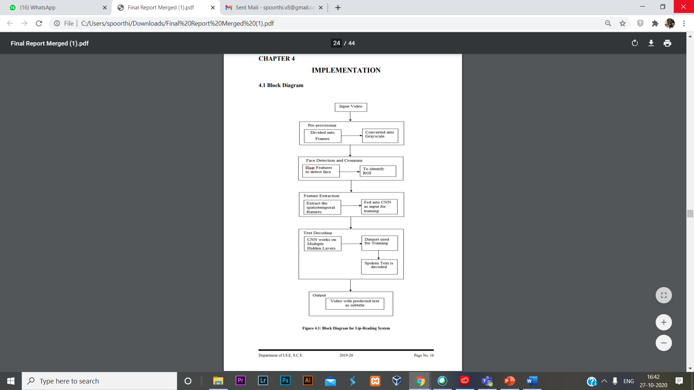
Flowchart
10

Slide 11
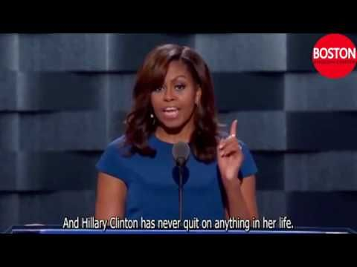
RESULTS
We plan to develop a desktop application.
Input: Video of a speaker
Output: Video with subtitles playing in parallel to the speaker.
Estimated accuracy: 60% to 70%

Slide 12
CONCLUSION
We propose Intuitive Perception, a trained model which will be capable of translating silent video sample to a subtitled video.
We plan to employ a trained CNN
This system may be employed in various fields like forensics, film processing, aid to the disabled community, security, etc.

Slide 13
REFERENCES
Assael, Y.M., Shillingford, B., Whiteson, S., de Freitas, N.: Lipnet: Sentence-level lipreading. Under submission to ICLR 2017, arXiv:1611.01599 (2016)
Almajai, S. Cox, R. Harvey, and Y. Lan. Improved speaker independent lip-reading using speaker adaptive training and deep neural networks. In IEEE International Conference on Acoustics, Speech and Signal Processing, pp. 2722–2726, 2016.
Michael Wand and Jurgen Schmidhuber, Improving Speaker Independent Lipreading with Domain Adversarial Training. The Swiss AI Lab IDSIA, USI & SUPSI, MannoLugano, Switzerland, arXiv:1708.01565v1 [cs.CV] 4 Aug 2017.
Abadi, M., Agarwal, A., Barham, P., Brevdo, E., Chen, Z., Citro, C., Corrado, G.S., Davis, A., Dean, J., Devin, M., et al.: TensorFlow: Large-scale machine learning on heterogeneous distributed systems. arXiv preprint arXiv:1603.04467 (2016).
Chung, J. S.; Zisserman, A. Lip Reading in the Wild. In Asian Conference on Computer Vision, 2016.

Slide 14
Viola, P.; Jones, M. Rapid object detection using a boosted cascade of simple features. In Proceedings of the 2001 IEEE Computer Society Conference on Computer Vision and Pattern Recognition. CVPR 2001, volume 1, 2001, ISSN 1063-6919, pp. I–511–I–518 vol.1, doi:10.1109/CVPR.2001.990517.
Brendan Shillingford, Yannis Assael, Matthew W. Hoffman, Thomas Paine, Cían Hughes, Utsav Prabhu, Hank Liao, Hasim Sak, Kanishka Rao, Lorrayne Bennett, Marie Mulville, Ben Coppin, Ben Laurie, Andrew Senior and Nando de Freitas, LARGE SCALE VISUAL SPEECH RECOGNITION. DeepMind & Google.
Lele Chen, Zhiheng Li, Ross K. Maddox, Zhiyao Duan and Chenliang Xu, Lip Movements Generation at a Glance. Wuhan university and University of Rochester.
Joon Son Chung, Andrew Senior, Oriol Vinyals and Andrew Zisserman, Lip Reading Sentences in the Wild. Department of Engineering Science, University of Oxford 2Google DeepMind
G. Bradski and A. Kaehler. Learning OpenCV: Computer Vision with the OpenCV Library. O’Reilly Media, 2008.
Najwa Alghamdi, Steve Maddock, Ricard Marxer, Jon Barker and Guy J.Brown,A corpus of audio-visual Lombard speech with frontal and profile views, Submitted to JASA-EL.

Slide 15
Thank You!
15

