Slide 2


Slide 7
PROJECT TITLE
Slide 6
INTUITIVE PERCEPTION:
SPEECH RECOGNITION USING MACHINE LEARNING
Slide 5
Slide 4
Slide 3
Slide 2
Slide 1

Slide 3
Slide 7
OVERVIEW OF THE PROJECT
Human lip-reading is a challenging task. It requires not only knowledge of underlying language but also visual clues to predict spoken words.
Lipreading is the task of understanding speech by analyzing the movement of lips. Alternatively, it could be described as the process of decoding text from visual information generated by the speaker’s mouth movement.
Now-a-days, with the help of deep learning it is possible to translate lip
sequences into meaningful words.
Our proposed Automated Lip-Reading System:
• Surveys the state of the art in the area of image and video recognition.
• Design and implement a real-time system capable of lip reading from video.
• Train the networks on a lipreading dataset, so that they can operate as lipreading systems.
• Evaluate the accuracy on simplified word classification task.
• Explore the possibility to recognize sentences in real-time.
• Build a prototype that present capabilities of deep learning algorithm.
Slide 6
Slide 5
Slide 4
Slide 3
Slide 2
Slide 1

Slide 4
Slide 7
PROJECT GOALS
Slide 6
To predict the words spoken by the speaker accurately.
To recognize the sentences not only for a single video but for the whole dataset.
To place the tracker around the lip region accurately.
To normalize the video samples so that uniformity is maintained.
To decode the text spoken by the speaker correctly
Improving the accuracy of existing systems
Slide 5
Slide 4
Slide 3
Slide 2
Slide 1

Slide 5
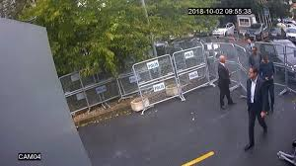
Slide 7
PROJECT APPLICATIONS
Useful at Crime Scene Investigation.
Slide 6
Slide 5
Slide 4
Slide 3
Fig: CCTV FOOTAGE
Slide 2
Helpful for a person with poor Audibility
Slide 1

Slide 6
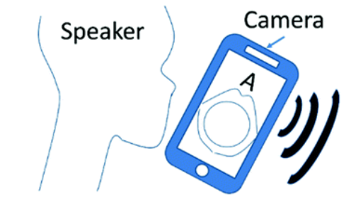
Slide 7
Mobile Phone Security
Slide 6
Slide 5
Slide 4
Slide 3
Slide 2
Fig: Lip-Reading System for Smartphone security
Slide 1

Slide 7
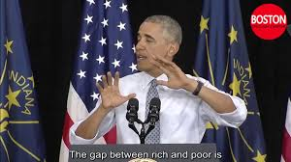
Slide 7
To Generate Subtitles
Slide 6
Slide 5
Slide 4
Slide 3
Slide 2
Fig: Lip-Reading System generating subtitles
Slide 1

Slide 8

Slide 7
MINIMUM HARDWARE REQUIREMENTS
❖ System : Intel Core i7 9750H
❖ Speed : 4.5 GHz
❖ Hard Disk : 20 GB
❖ Monitor : LED/LCD Display
❖ RAM : 8 GB
❖ Keyboard : Standard Windows keyboard
❖ Mouse : Optical mouse
MINIMUM SOFTWARE REQUIREMENTS
❖ Operating System : Ubuntu/Windows 10 Home
❖ Platform : Python
❖ Frontend : Python interface
Slide 6
Slide 5
Slide 4
Slide 3
Slide 2
Slide 1

Slide 9
Slide 7
REFERENCES
Slide 6
https://www.researchgate.net/publication/326412569_Large-Scale_Visual_Speech_Recognition
https://papers.nips.cc/paper/858-lipreading-by-neural-networks-visual-preprocessing-learning-and-sensory-integration
Slide 5
Slide 4
Slide 3
Slide 2
Slide 1

