Slide 1

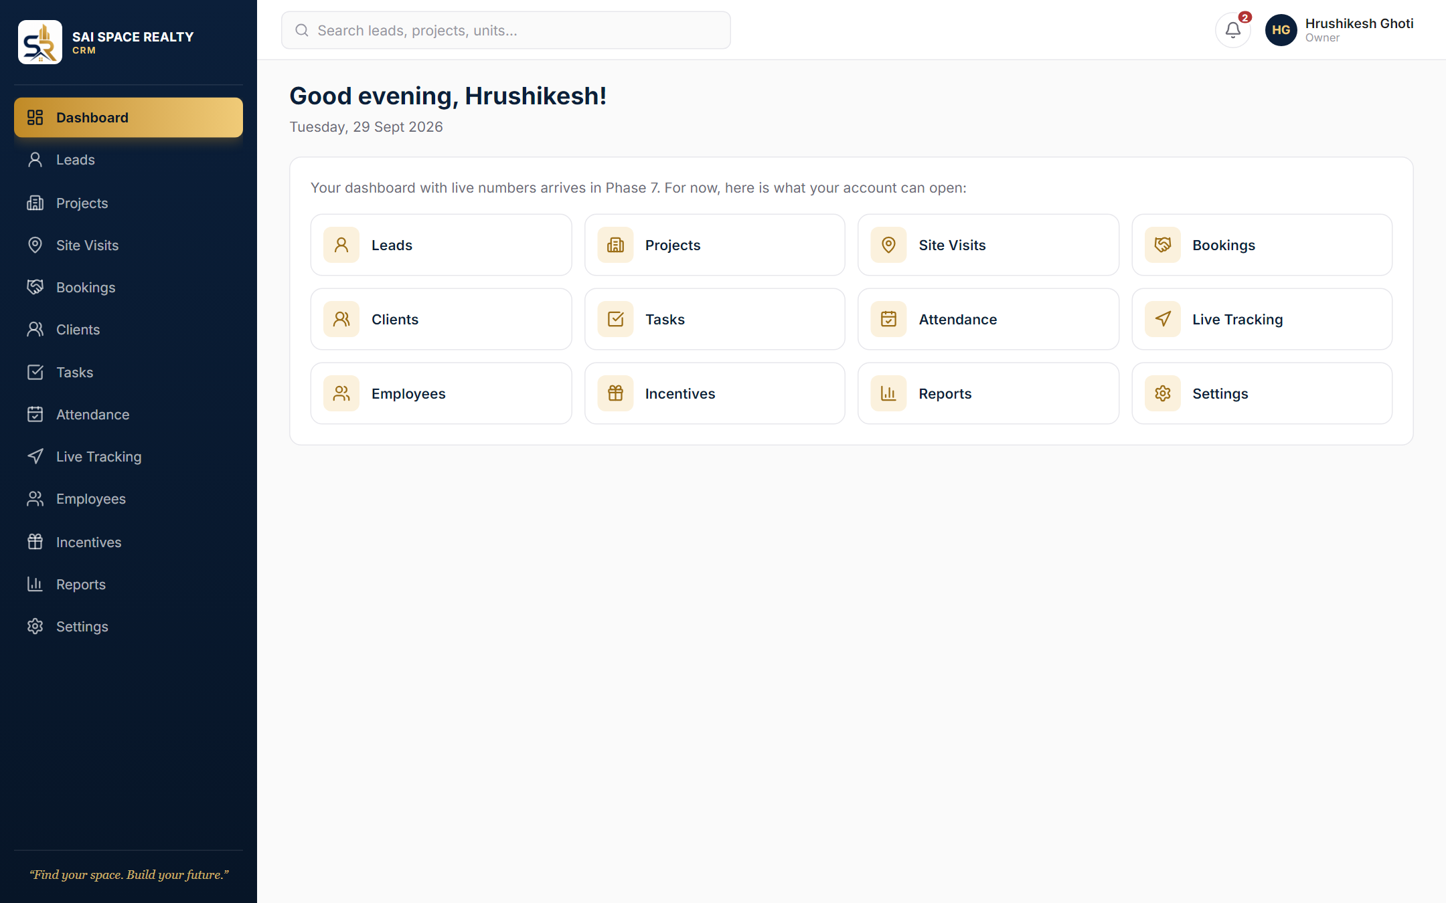
How the CRM looks
Sai Space Realty CRM · Phase 1 screens
Real screens from the current build, shown with sample data. Works on computers and phones.
Notes:
A walk through the screens built so far: sign-in, the main layout, and employee accounts. Names and numbers are sample data.

Slide 2
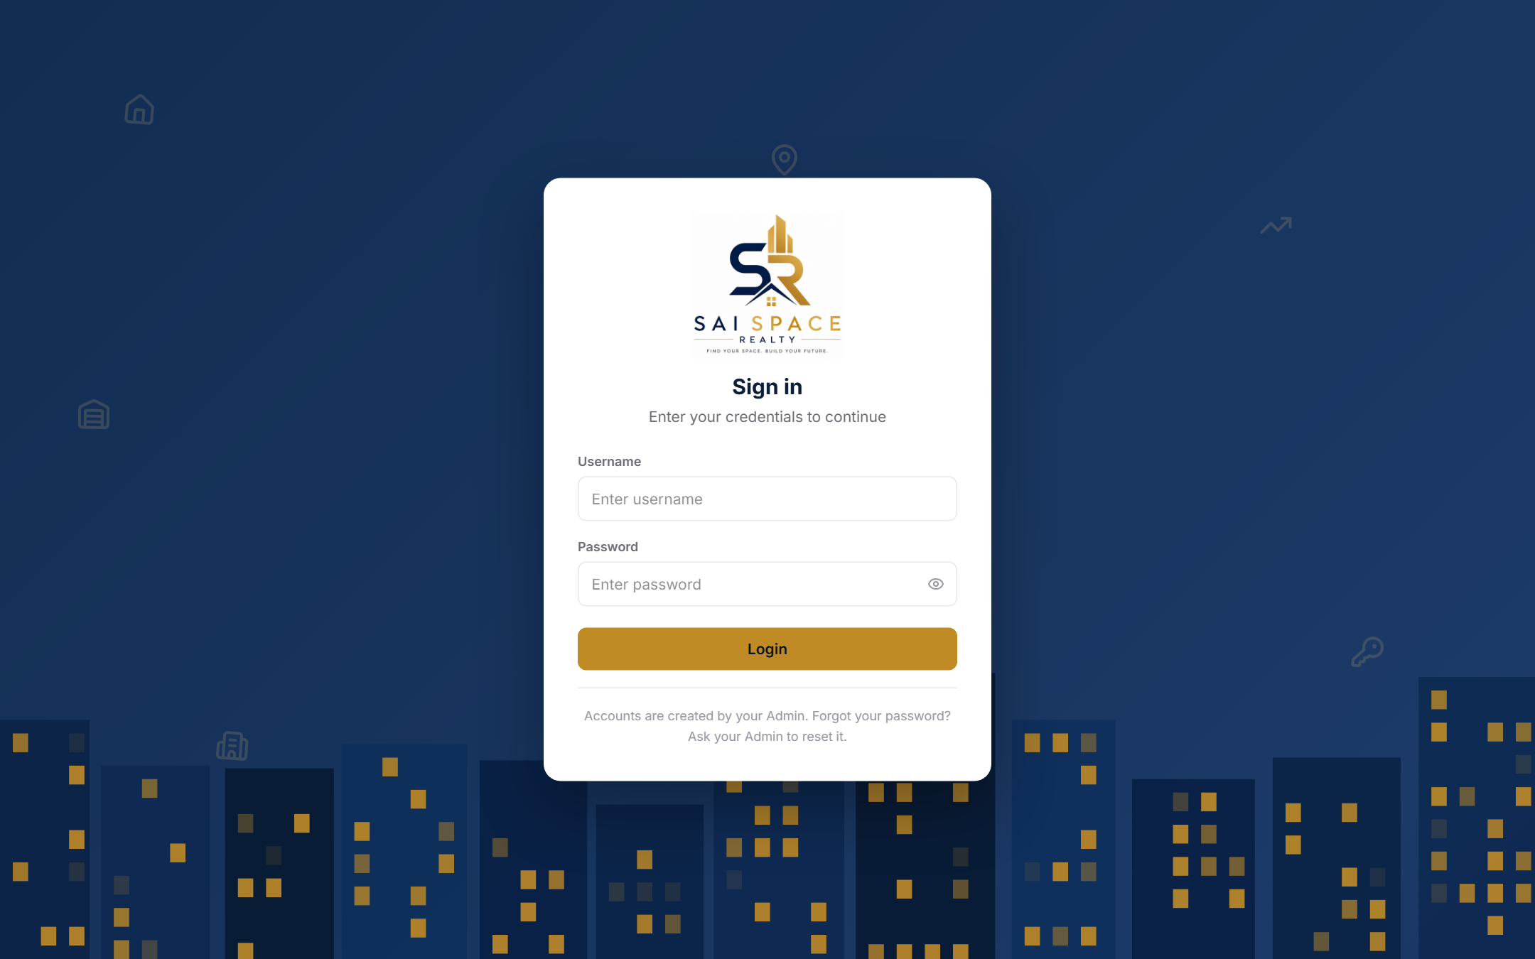



Sign-in screen
The first thing every user sees
Branded welcome
Animated night skyline in Sai Space navy and gold
Username and password
Accounts come only from the Admin; no public sign-up
Protected
Locks after 5 wrong tries; clear, friendly error messages
Sample data · 2
Notes:
Shown as it looks once connected to the live server. No demo logins exist; five wrong passwords lock the account for 15 minutes.

Slide 3
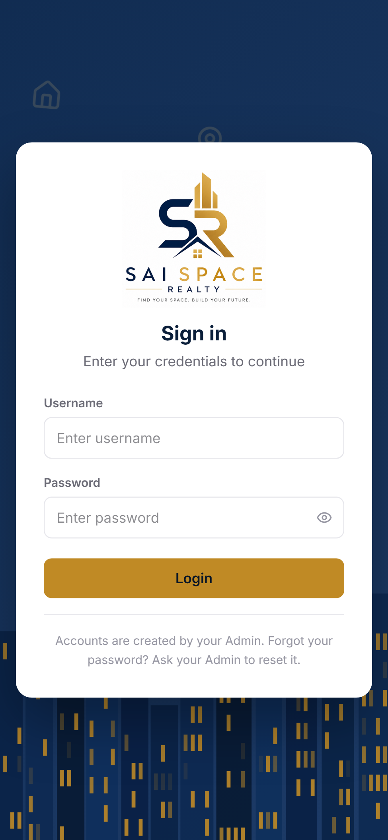
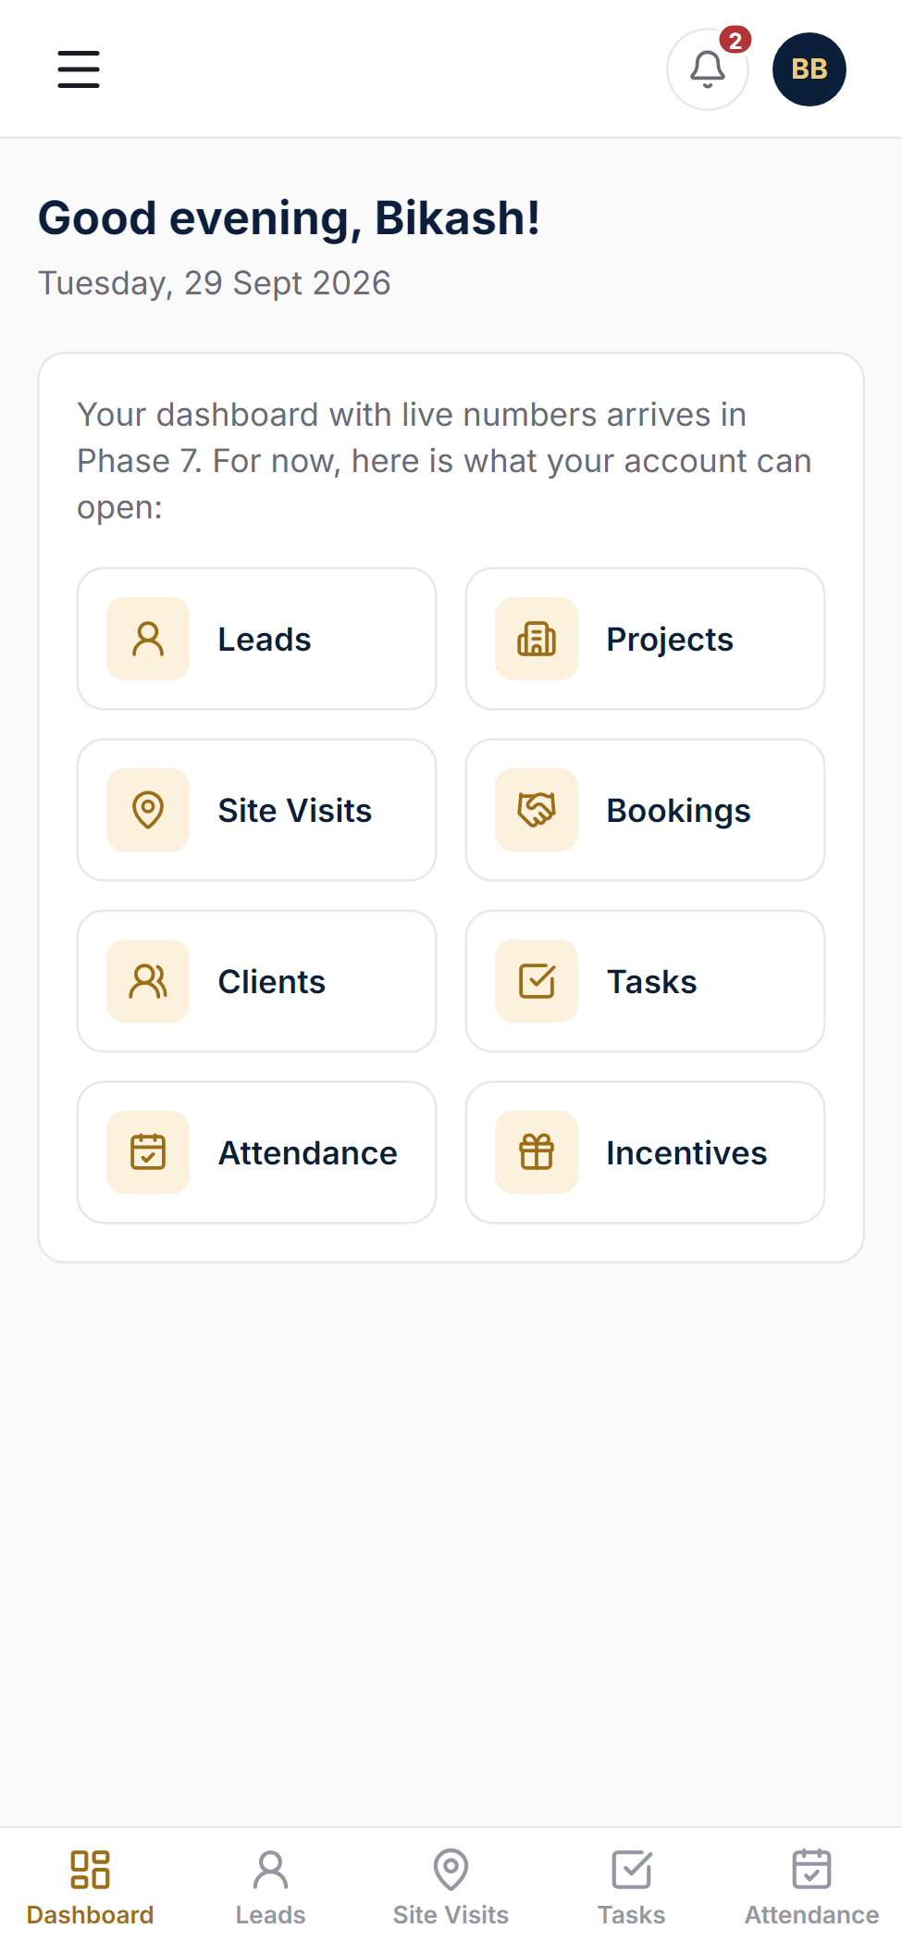
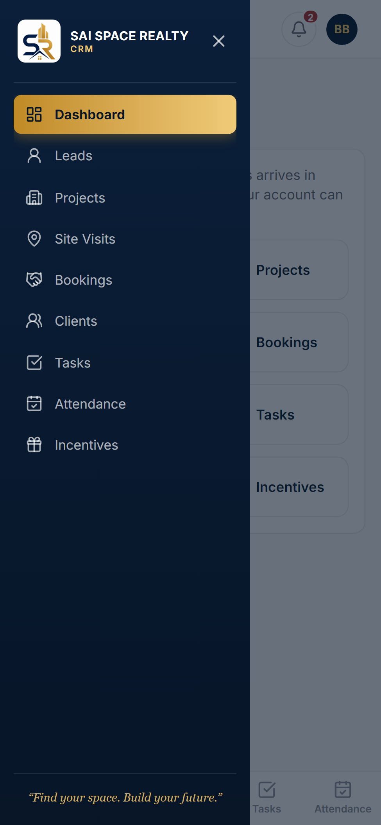
Made for phones too
Field staff can add it to the home screen and use it like an app
Sign-in
Dashboard with bottom tabs
Slide-out menu
Sample data · 3
Notes:
On phones the menu becomes a slide-out drawer and the main pages sit in a bottom tab bar. Chrome or Safari: Add to Home Screen.

Slide 4
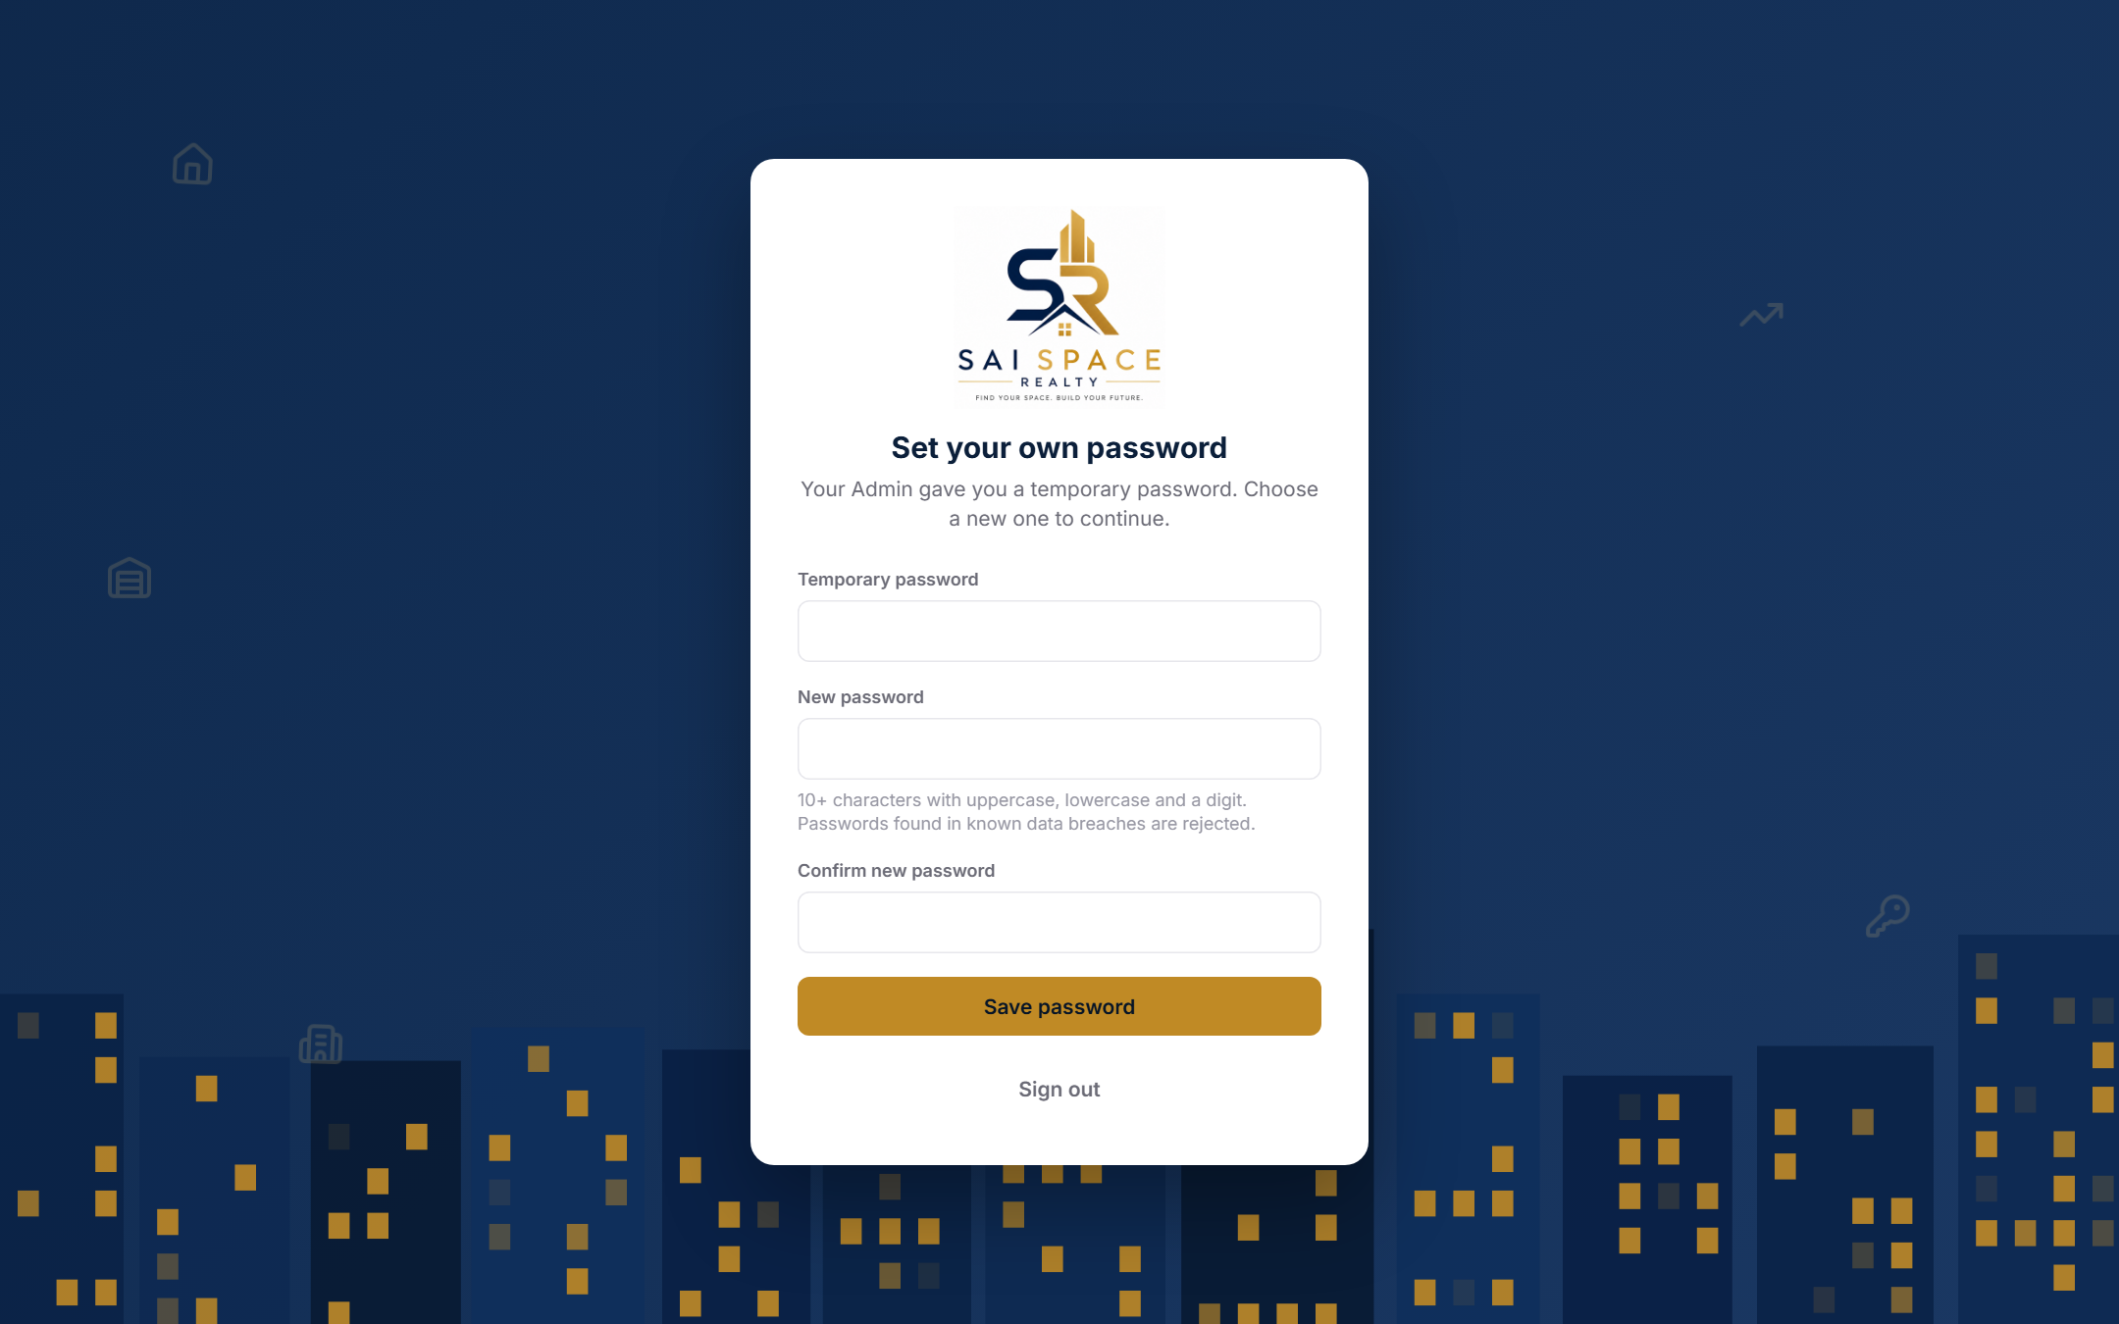



First sign-in: own password
Temporary passwords from the Admin must be replaced
Choose a new password
Needed before anything else opens
Clear rules
10+ characters, upper and lower case, a digit
Breach check
Passwords seen in known data leaks are refused
Sample data · 4
Notes:
Owner and Admin also scan a QR code with an authenticator app at this stage (not shown; it needs the live server).

Slide 5



Dashboard
Home page after sign-in
Navy and gold sidebar
Every page this person may open; gold marks where you are
Shortcut tiles
One tap to each module
Live numbers next
Sales, pipeline and team stats arrive in Phase 7
Sample data · 5
Notes:
The dashboard will show live figures in Phase 7. Today it greets the user and lists their pages.

Slide 6
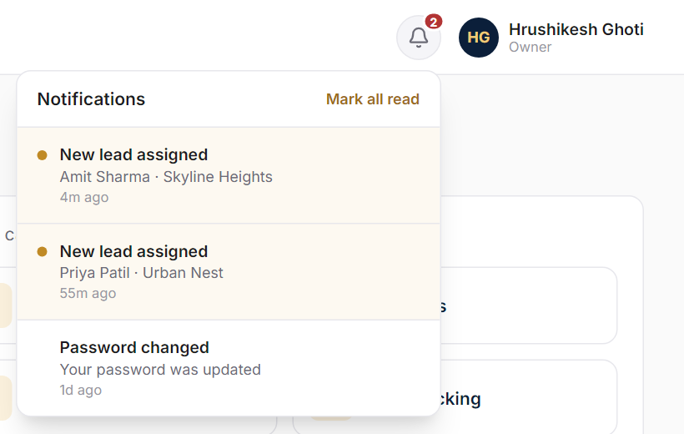
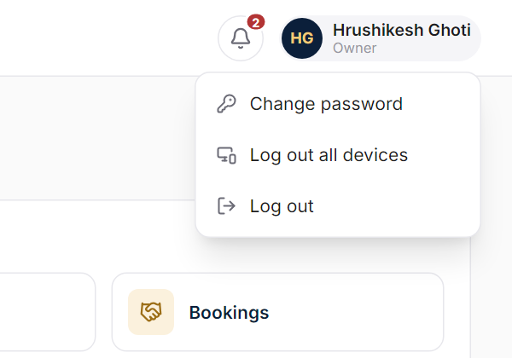
Notifications and account menu
Top-right corner of every page
New-lead alerts with an unread count; Mark all read clears them
Change password, Log out, or Log out all devices
Sample data · 6
Notes:
Log out all devices is for a lost phone or a shared computer.

Slide 7
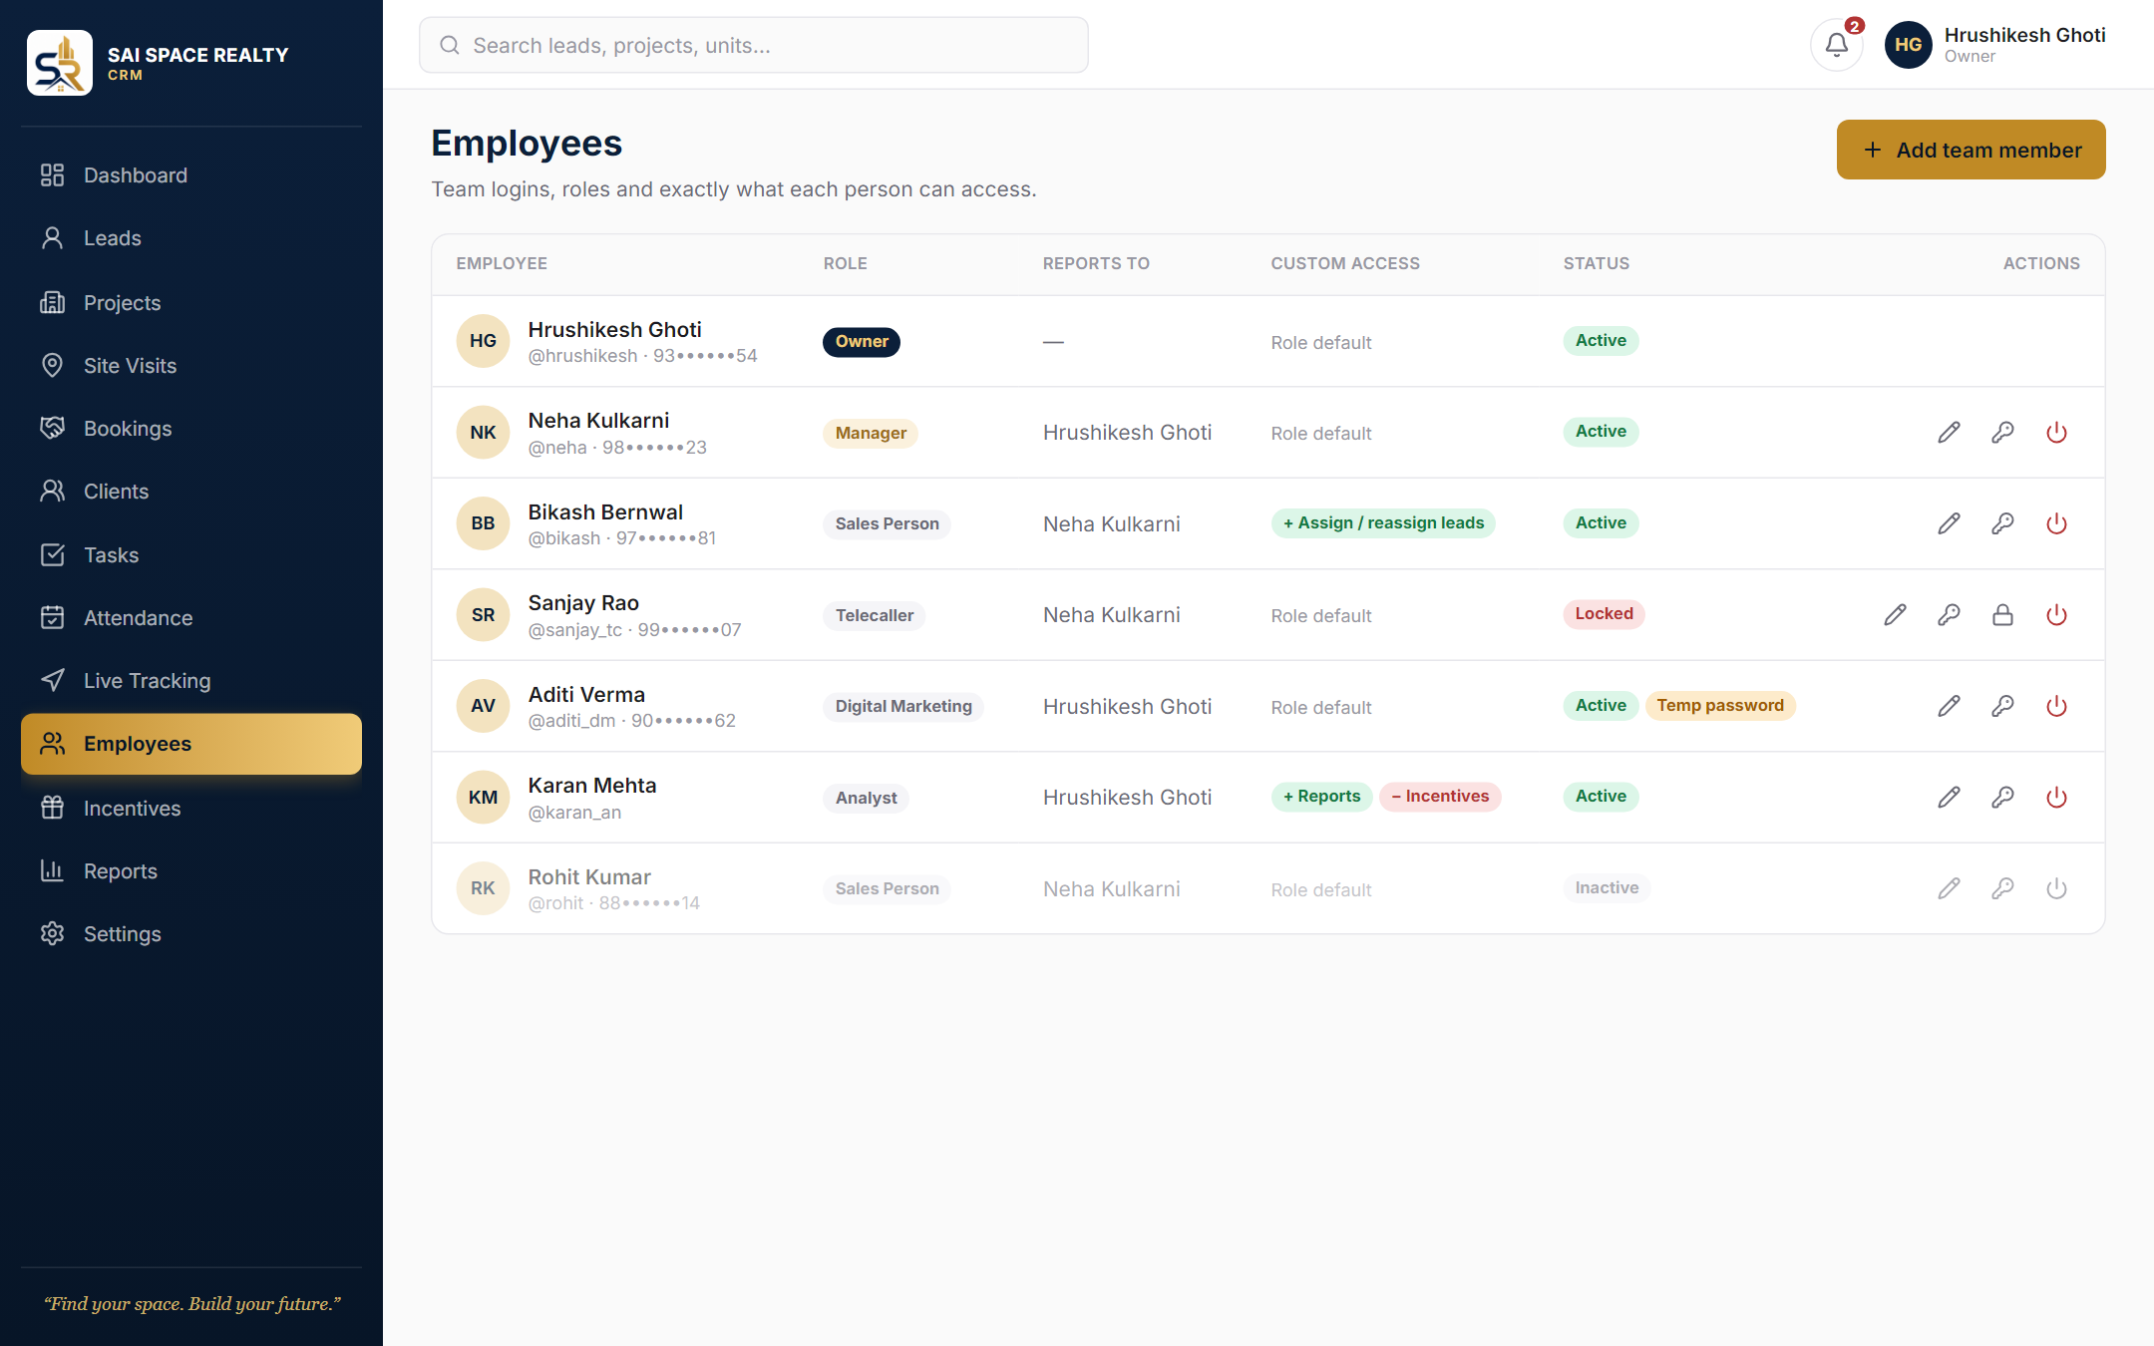



Employees
The Admin’s control panel for logins and access
Whole team at a glance
Role, manager, custom access and status per person
Phones masked
98••••••23 — full numbers are stored encrypted
Status badges
Active, Locked, Inactive, Temp password
Sample data · 7
Notes:
Icons on each row: edit, reset password, unlock (when locked) and deactivate.

Slide 8
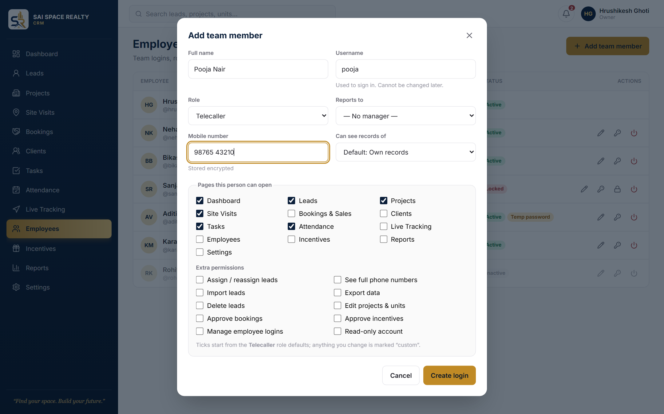


Add a team member
One form creates the login and sets exact access
Role presets
Pick a role and its default pages are ticked
Fine-tune per person
Tick or untick any page; changes marked custom
Temporary password
Generated and shown once to share privately
Sample data · 8
Notes:
Only the Owner can create Admins. Nobody can change their own access.

Slide 9
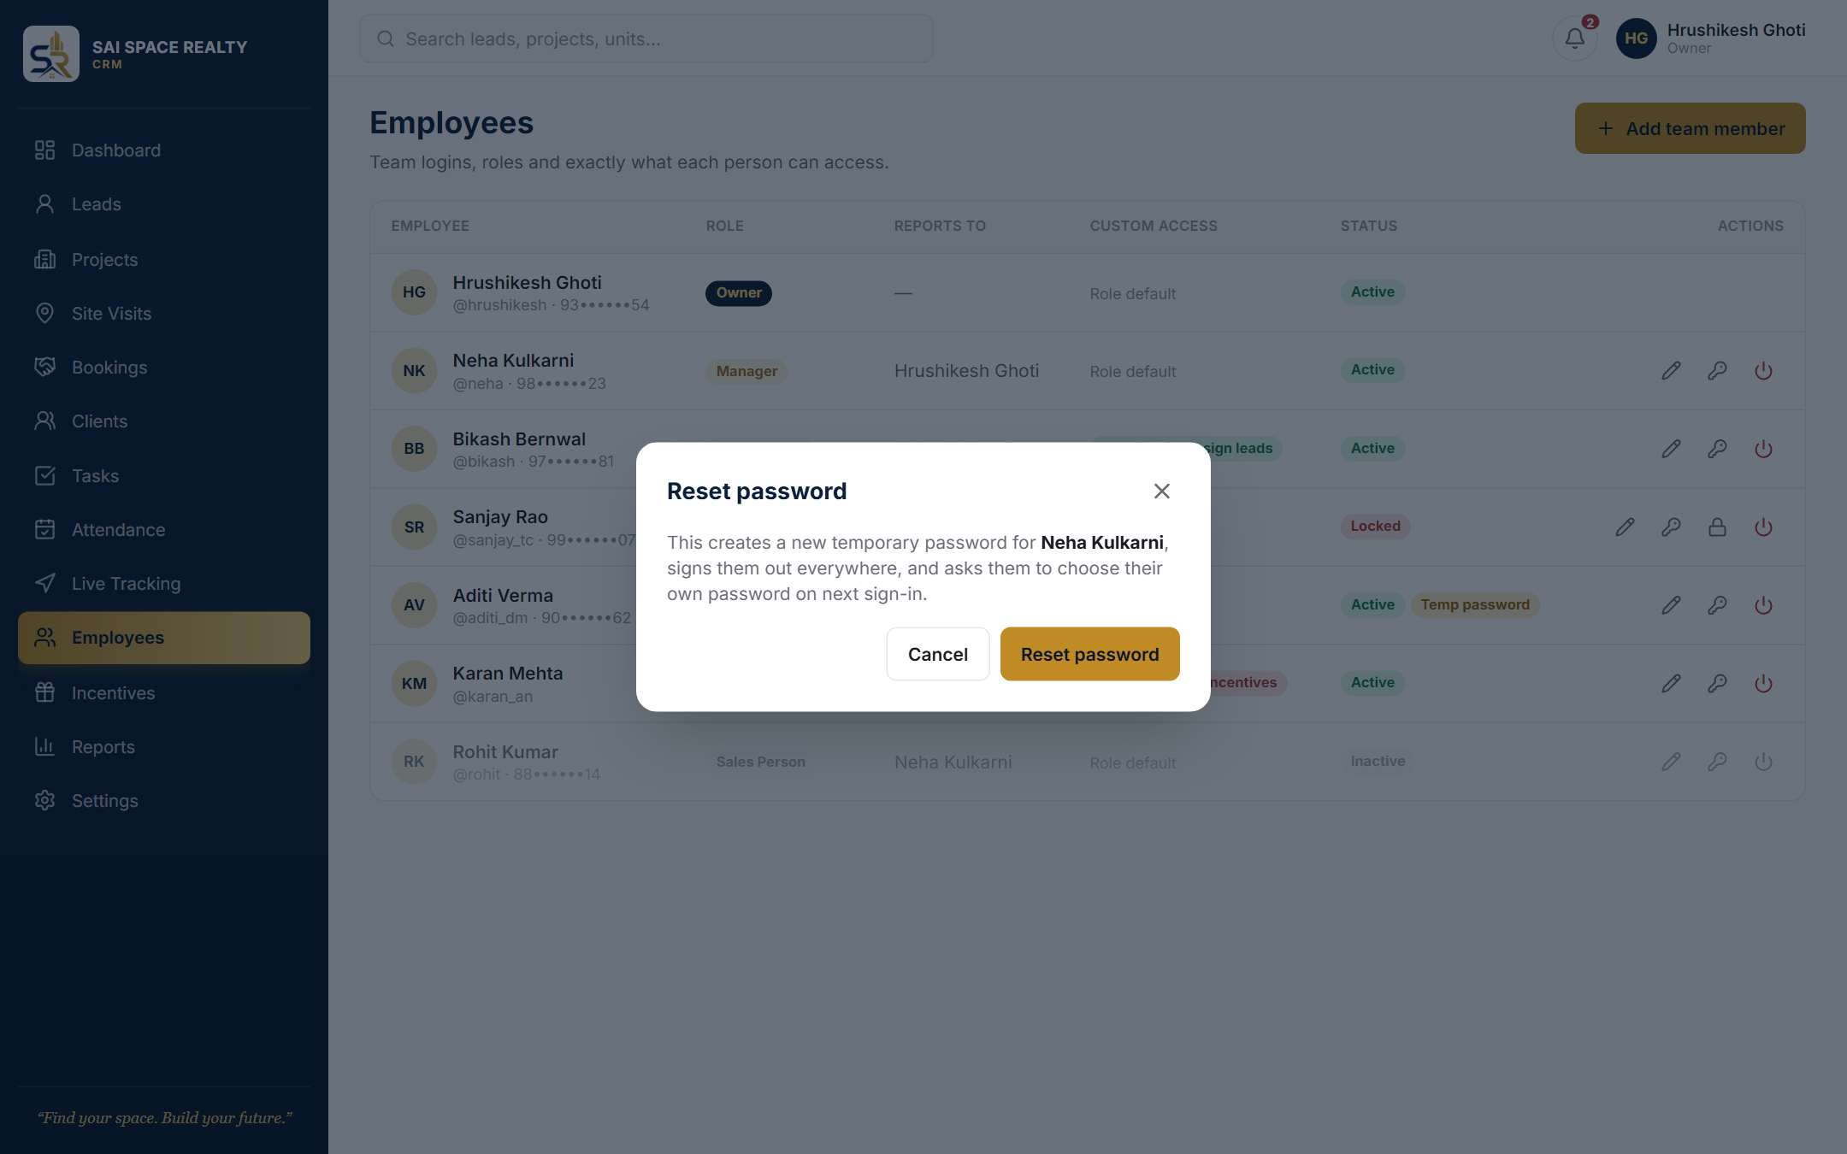



Reset a password
For staff who forget their password
New temporary password
Employee sets their own at next sign-in
Signed out everywhere
All old sessions end immediately
Logged
Every reset is recorded in the audit log
Sample data · 9
Notes:
There is no self-service reset, on purpose: resets go through the Admin.

Slide 10
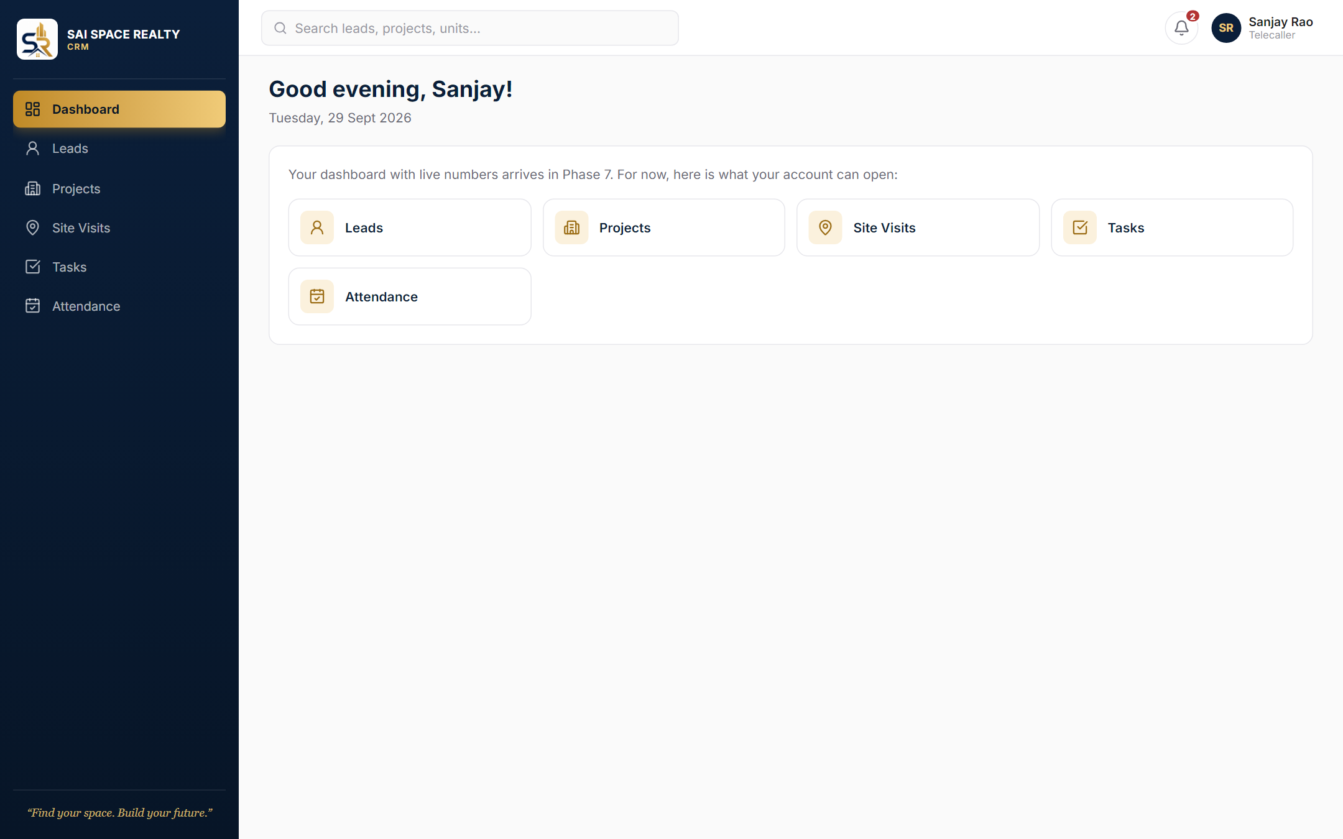
Each role sees its own menu
Same CRM, different access — enforced by the database, not just hidden
Owner 13 pages
Telecaller 6 pages, own leads only
Sample data · 10
Notes:
Left: the Owner. Right: a Telecaller, who only sees Dashboard, Leads, Projects, Site Visits, Tasks and Attendance.

Slide 11
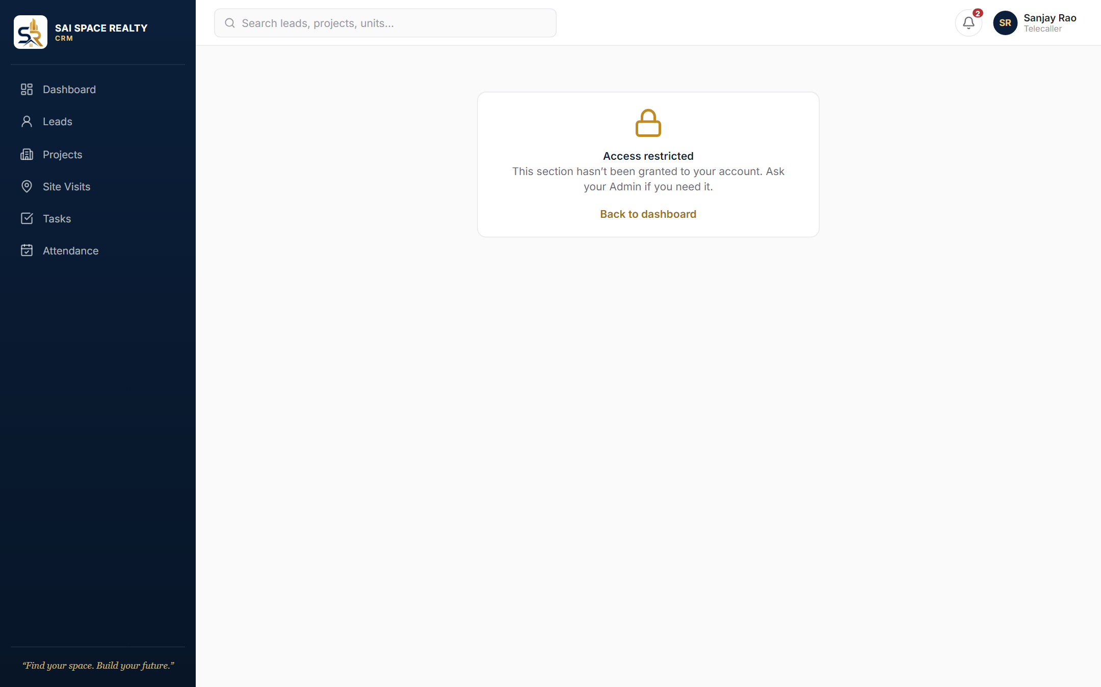
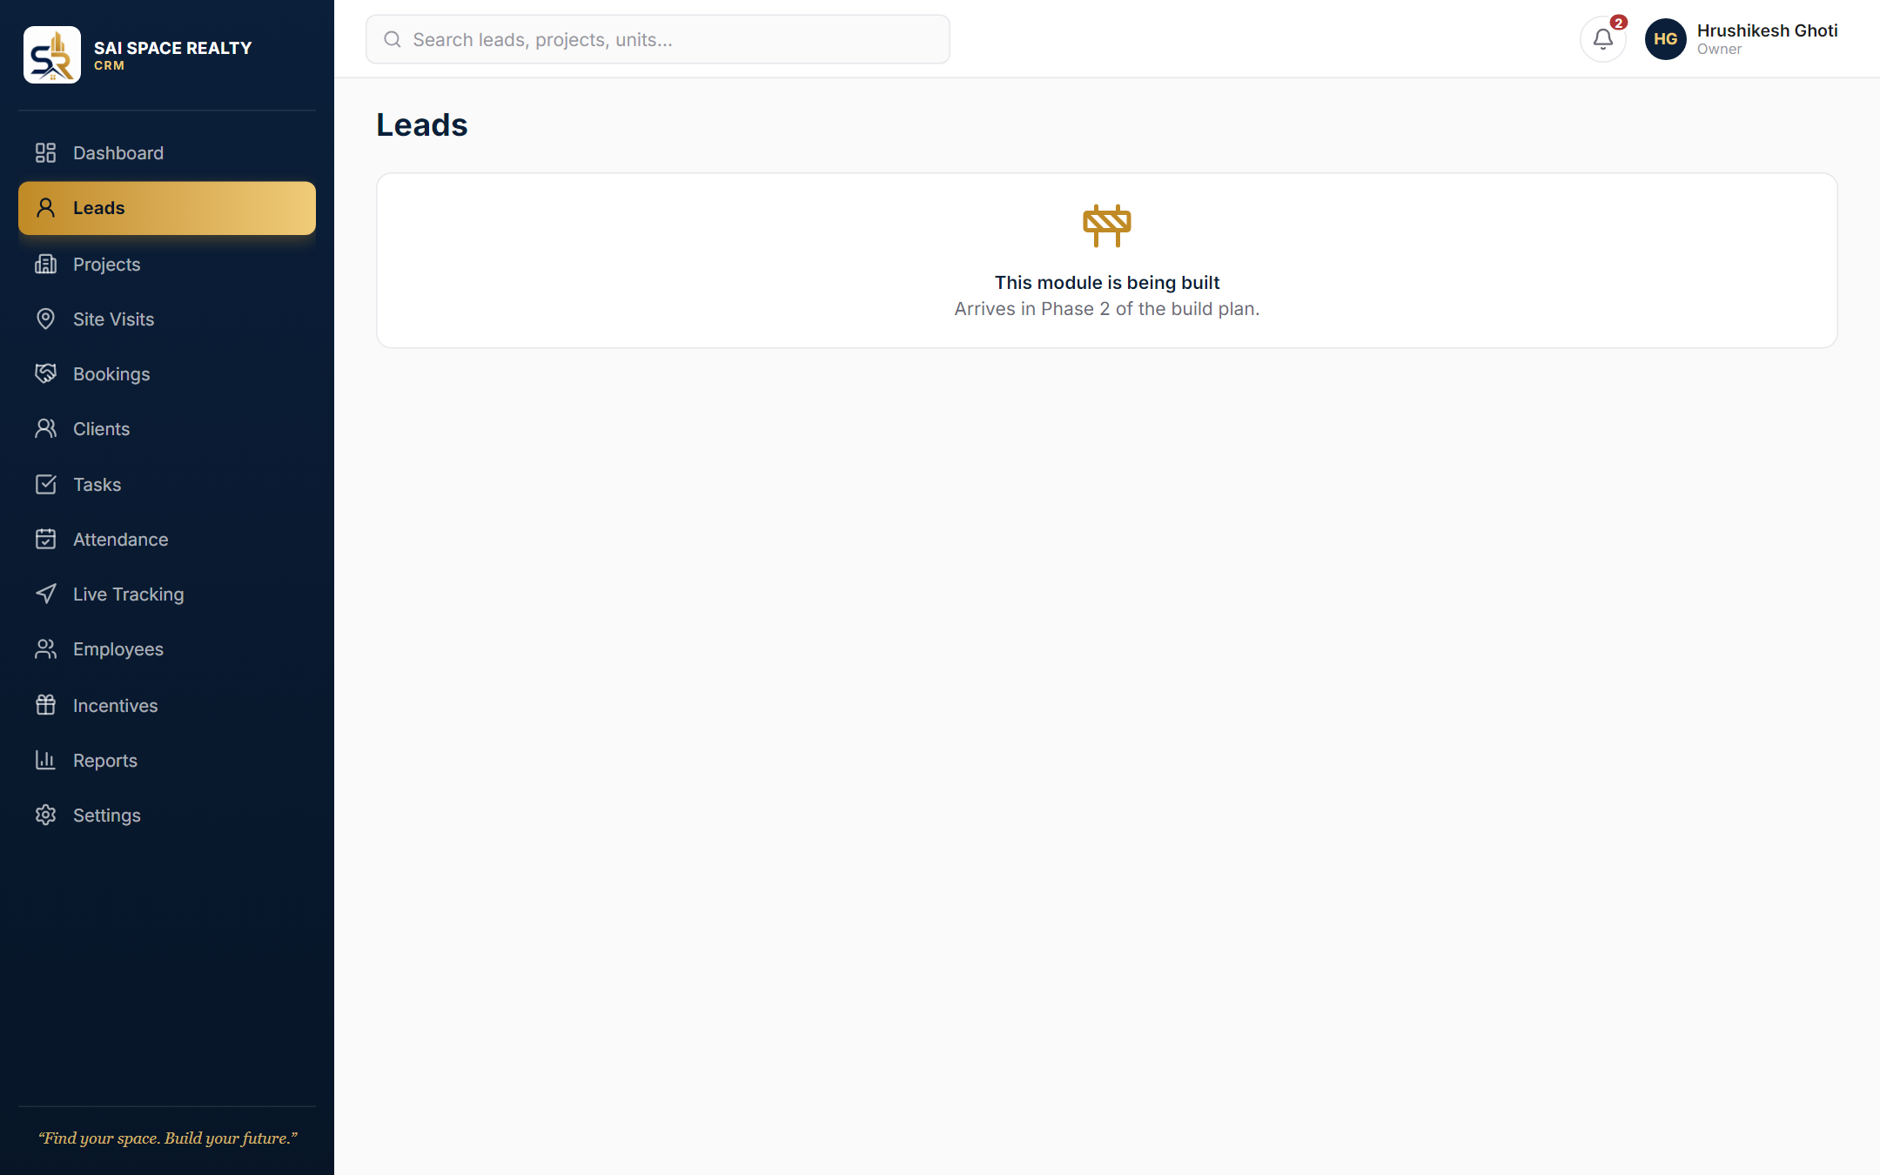
Clear messages, never a broken page
What users see for pages they lack, or pages still being built
Access restricted ask the Admin to grant it
Being built shows which phase delivers it
Sample data · 11
Notes:
Leads arrives in Phase 2; the "being built" page names the phase for every module.

Slide 12
Next up: Leads
Kanban pipeline · follow-ups · call and WhatsApp · Excel import
All screens shown with sample data. The live CRM goes online once the cloud database is set up.
Find your space. Build your future.
Notes:
Phase 2 builds the Leads module. These screens will be updated as each module ships.

