Slide 1

Detecting Financial Fraud Using Machine Learning
An Interactive Fraud Detection System

Slide 2
Problem Statement
Financial fraud causes billions in annual losses.
- Detecting fraud in real-time is a major challenge.
- Our goal: **Build a machine learning model** to identify fraudulent transactions.

Slide 3
Dataset Overview
Source
Source: Simulated banking transactions dataset
Type
Features include: type, amount, oldbalanceOrg, newbalanceOrig, etc.
Target
Target variable: isFraud (1 = fraud, 0 = not fraud)
Challenge
Challenge: Highly imbalanced dataset (fraud cases < 0.1%)

Slide 4
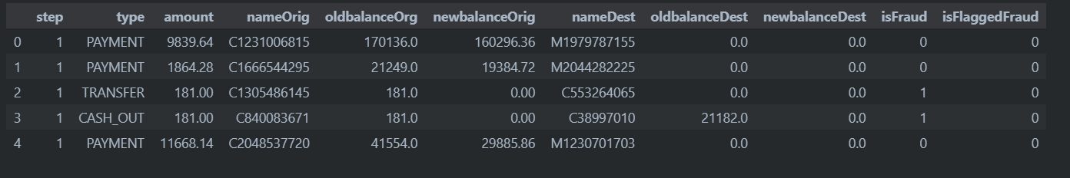
Dataset

Slide 5
Model Pipeline Architecture
Preprocessing: Label encoding, feature scaling, handling class imbalance
Model: Random Forest Classifier (Ensemble method, handles imbalance & overfitting well)
Chosen for its robustness, interpretability, and handling of nonlinear patterns

Slide 6
Class Imbalance Challenge
Fraudulent transactions are **rare (< 0.1%)**
Used techniques like:
- SMOTE (oversampling minority class)
- Class weights (Random Forest)

Slide 7
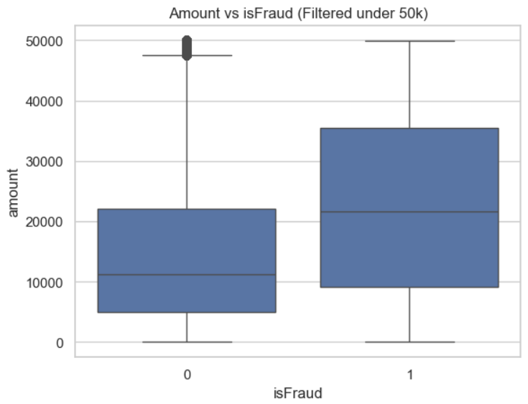
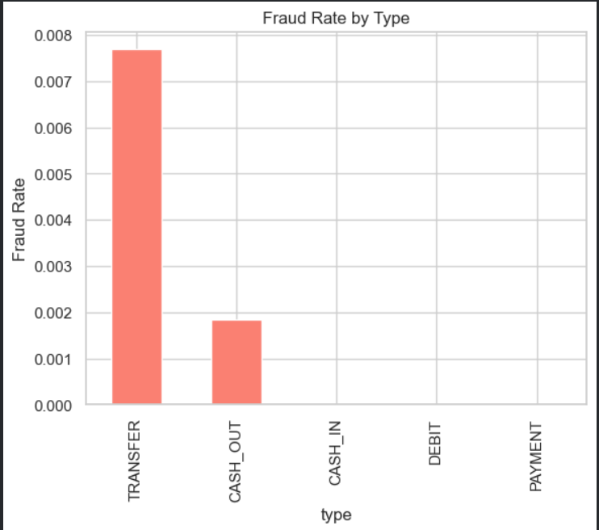
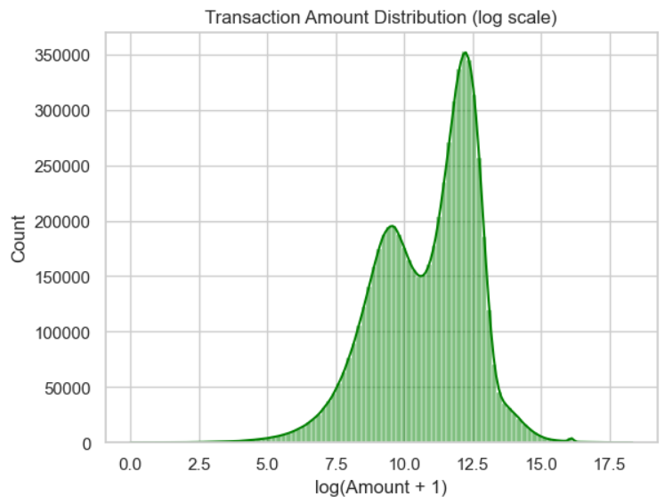
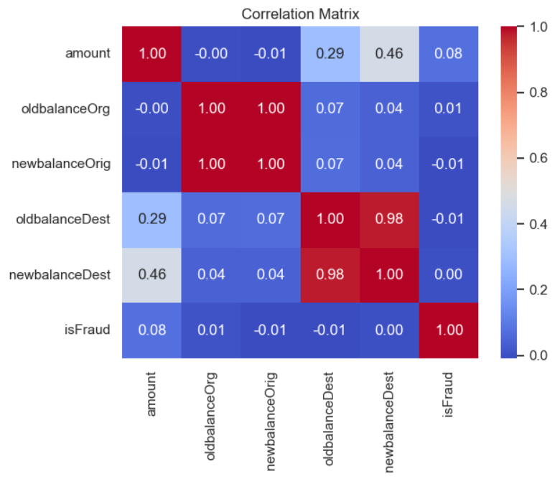

Slide 8
Model Training & Evaluation
Train/Test Split: 80/20
Metrics: Accuracy – 99%, Precision – 90%, Recall – 95%, F1-Score – Balanced metric for fraud detection, ROC-AUC - Measures classifier performance across thresholds
Emphasis on high recall and balanced precision

Slide 9
Live Demo - Streamlit UI
Built using Python + Streamlit for easy interaction
User inputs: transaction type, amount, balances
Output: Prediction with color-coded fraud warning
Simple and intuitive interface for real-time use

Slide 10
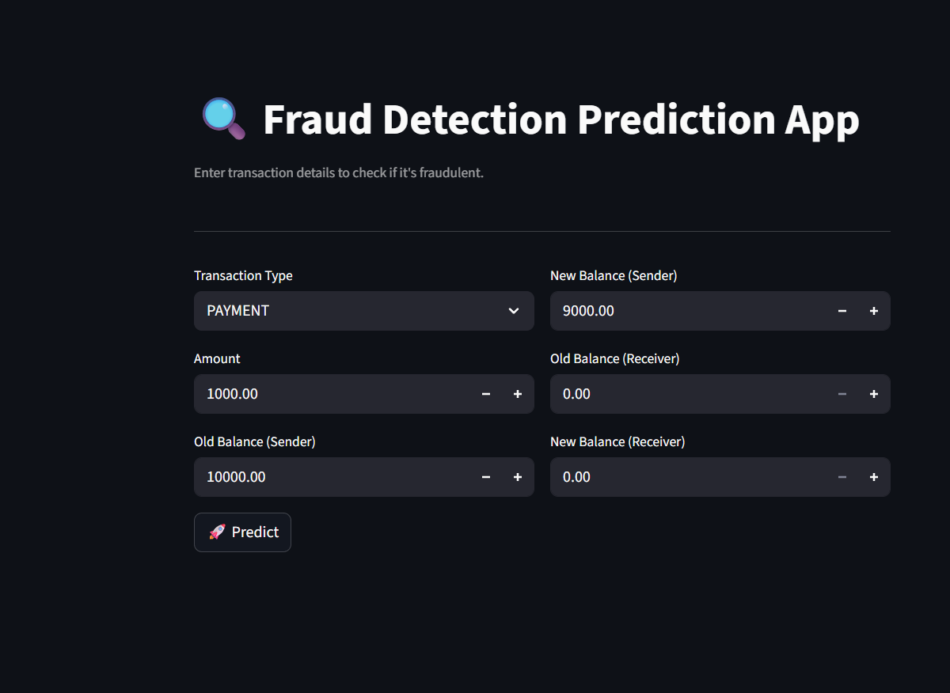

Slide 11
Model Interpretability
Feature importance from Random Forest model
1
Top factors: amount, oldbalanceOrg, transaction type
2
Scope for SHAP/LIME integration for better insights
3

Slide 12
Limitations & Future Scope
Synthetic dataset may limit real-world generalization
Fraud cases are extremely rare – imbalance remains a challenge
Future: Integrate REST APIs, test with live data, explore deep learning models

Slide 13
Project Assets
Model File: fraud_detection_pipeline.pkl
Streamlit App: fraud_detection.py
Notebook: Analysis_model.ipynb (contains all training & evaluation steps)

Slide 14

Q&A / Discussion
Questions about model choices, preprocessing, or deployment?
Let's discuss metrics, dataset bias, and fraud detection strategy.

