Slide 1
Online Restaurant Order
Sravanthi Kandati
@saisravanthi1 on GitHub

Slide 2
Description
My project will be an Online Restaurant order that will allow users to order food online. The users will be able to create an account,login,see menu and select menu items to add to cart and place an order,can see the pickup time. The users can see restaurant details like location, Contact number in contact us.The admin will be able to login,add and remove the menu items, add the categories.

Slide 3
Features
As an Admin, intially i want to register with username , password and verify password.
As an Admin, I want to login to the website so that i can see the orders and user information.
As an Admin, I want to add items to the menu.
As an Admin, I want to remove items from the menu.
As an Admin, I categorize the menu items.

Slide 4
Planning - User Stories
Admin can register with username , password and verify password.
Admin can login to the website so that he can see the orders and user information.
Admin add items to the menu.
Admin remove items from the menu.
Admin catogerize the menu items.

Slide 5
Planning - Database
Model Classes/Tables:
Admin
Category
Menu
User

Slide 6
Technology Stack
Java
Springboot
Thymeleaf
Mamp
Bootstrap
CSS

Slide 7
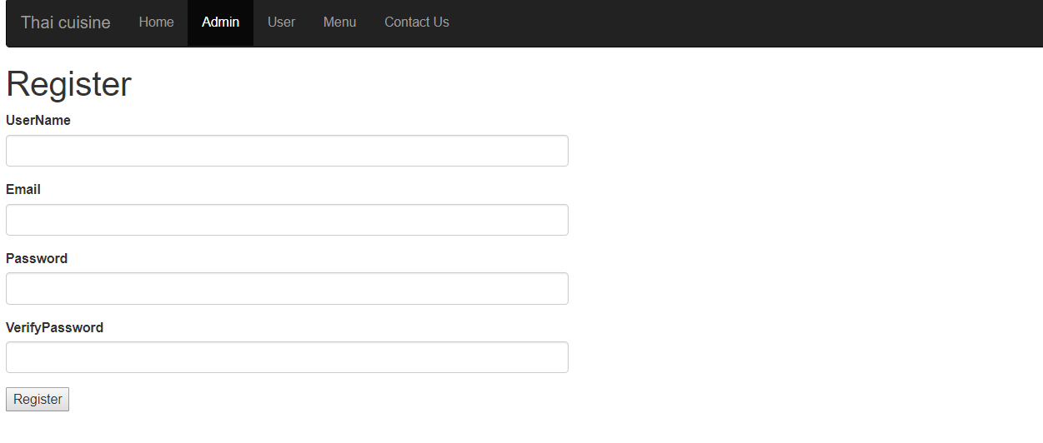
DEMO
Registration

Slide 8
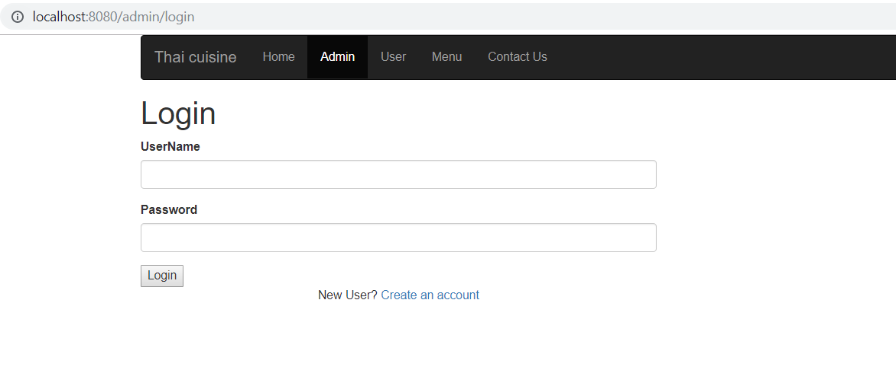
Login Screen

Slide 9
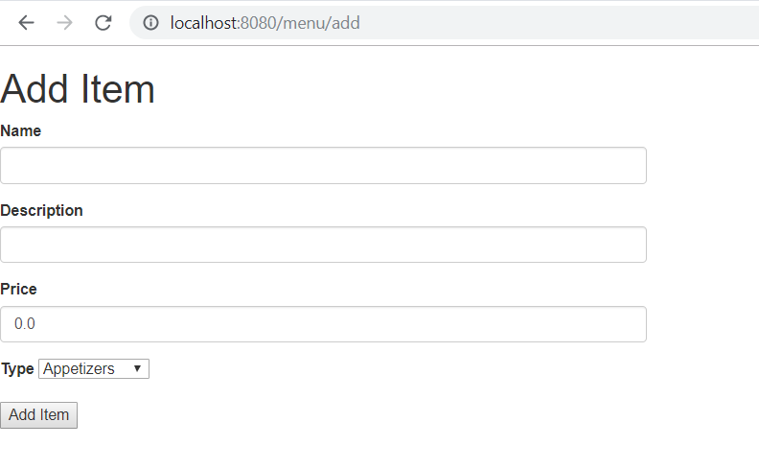
Add Menu Screen

Slide 10
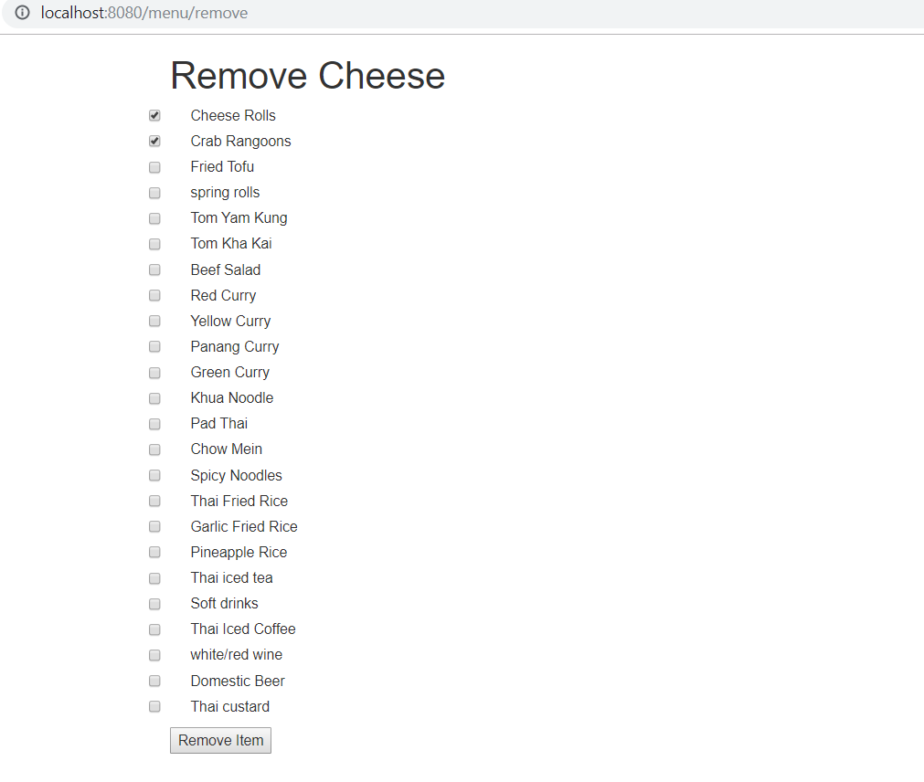
Remove Menu Screen

Slide 11
What I Learned
Spring Security
Thyme leaf
Bootstrap

Slide 12
What’s Next
Deploying the Application
Implementing stripe API which allow users to pay online.
Notes:
Be specific! If you mention another feature describe why that features is necessary, or what problem it solves. If you mention changing the UI mention specific technologies, or libraries you will use to do that. If you mention a technology, or feature you don’t know yet tell them how you plan on learning it.

