Slide 1
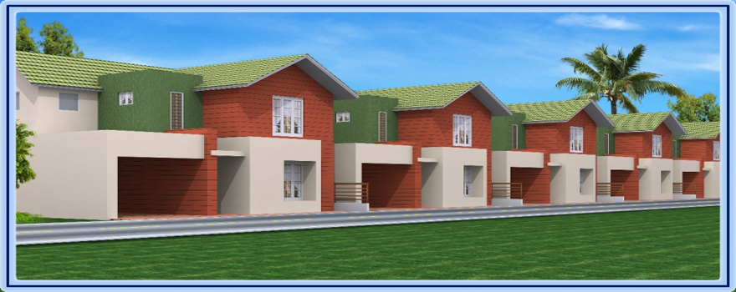
Analysis of house price

Slide 2
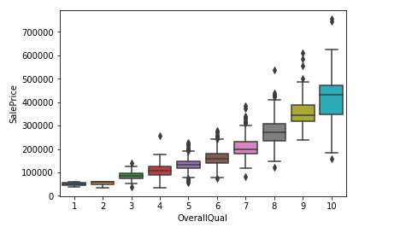
Compared to all the columns ,OverallQual column is highly correlated with target variable when compared with other variables
Which column is highly affecting the sales price

Slide 3
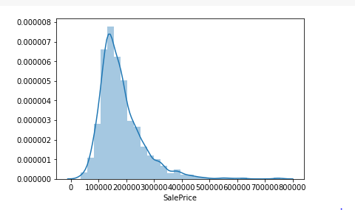
Distribution of target variable
Data is slightly skewed towards right but that might be the genuine case as there will be very less houses with such huge price or there might be a chance for outliers as well

Slide 4
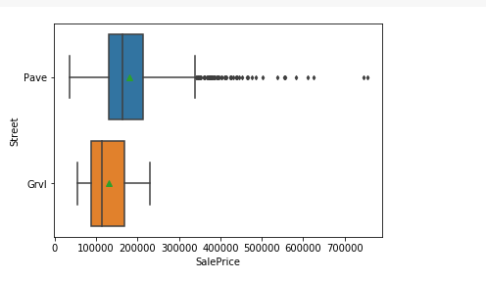
Relationship of variable street with price
Two types are there in street and pave is more costly compared and is having outliers as well

Slide 5
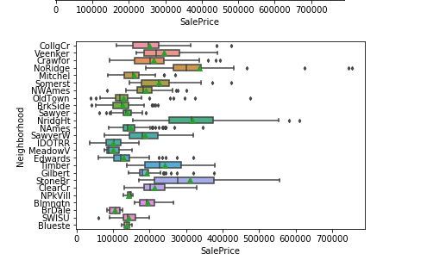
Relationship of variable Neighborhood with price
So many categorical data is there in this column and stoneBr and Nridght is correlating with price

Slide 6
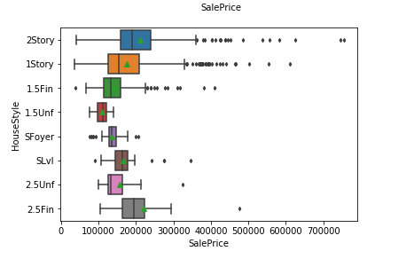
Relationship of variable House style with price
2story is costly compared to others and are having so many outliers as well

Slide 7
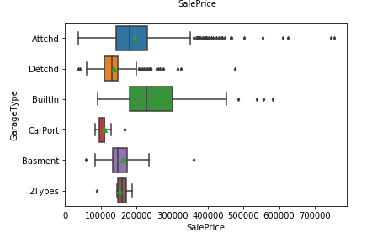
Relationship of variable Garage Type with price
Range of Bullitin is more compared to others and is high price compared to others and Attchd is having so many outliers

Slide 8
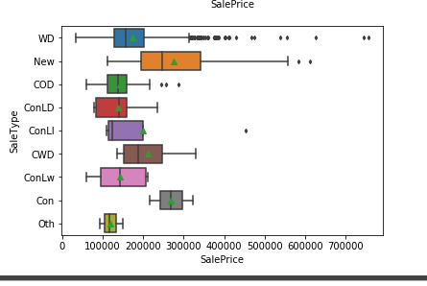
Relationship of variable Sale Type with price

