Slide 1
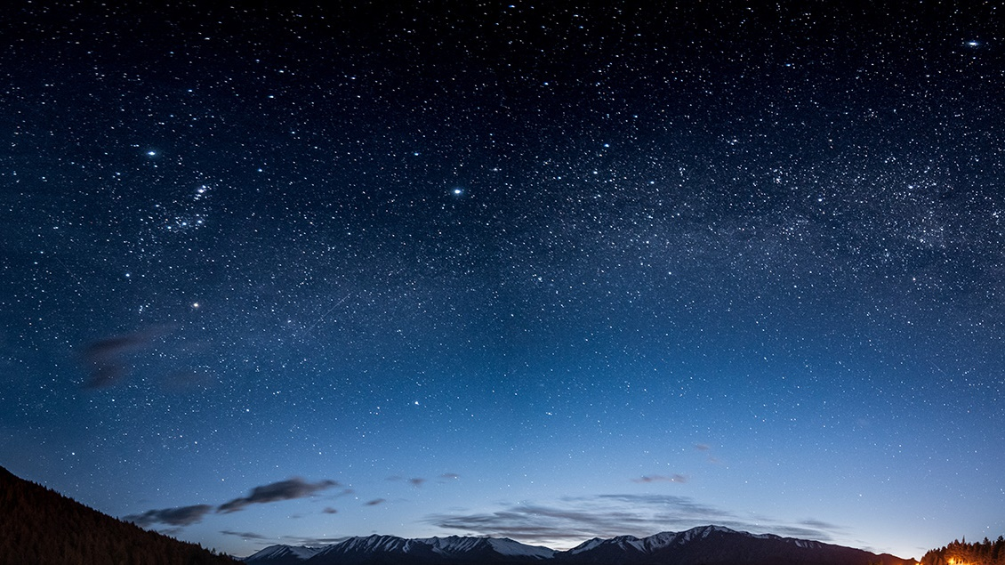
PRACTICAL APPLICATIONS OF DEEP LEARNING
FINAL PROJECT
Team 10
V. Saisri : PES1201701763
Apeksha G. : PES1201701562
Shreya V. Deexit : PES1201701648
Yogya Ch. : PES1201701144

Slide 2

PROBLEM STATEMENT
The poor prognosis associated with most infarcts creates a sense of urgency for developing an AI aid in identifying the possible occurrence or in finding the accurate location of already existing infarct.
This project:
Finding the location of Acute Infarcts for a given MRI image.

Slide 3
DATA AUGMENTATION
INFERENCING
LOADING DATA
WORKFLOW
EXECUTABLE FILE
PREPROCESSING
CREATE .PB FILE
PLOTTING DATA
SPLITTING DATA
MODELING
FINE TUNING

Slide 4
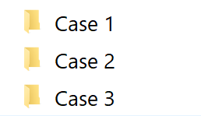
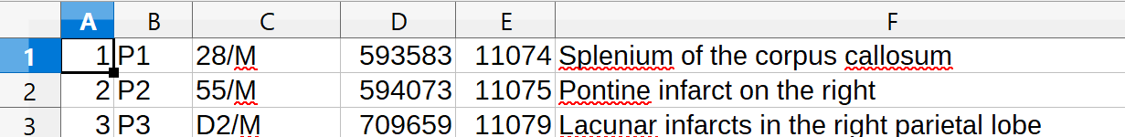
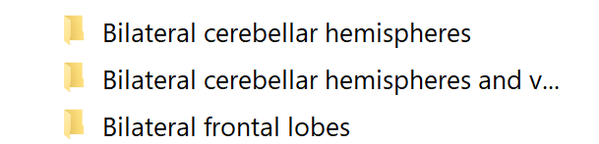
DATA GATHERING
Data Given to us as 50 cases along with a document with corresponding location
We wrote a code to arrange data in the following format in a folder name Cleaned_Data which was further used

Slide 5
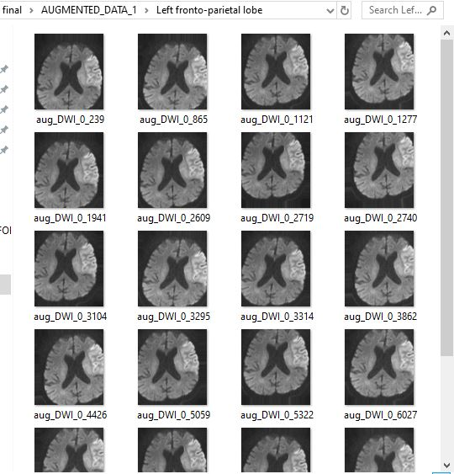
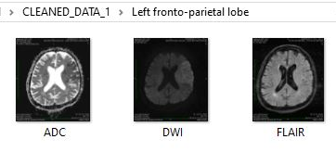
DATA AUGMENTATION
rotation_range=7,
width_shift_range=0.1,
height_shift_range=0.1,
brightness_range=(0.001, 0.9),
horizontal_flip=False,
vertical_flip=False,
fill_mode='nearest'
Cleaned Data
Augmented Data

Slide 6
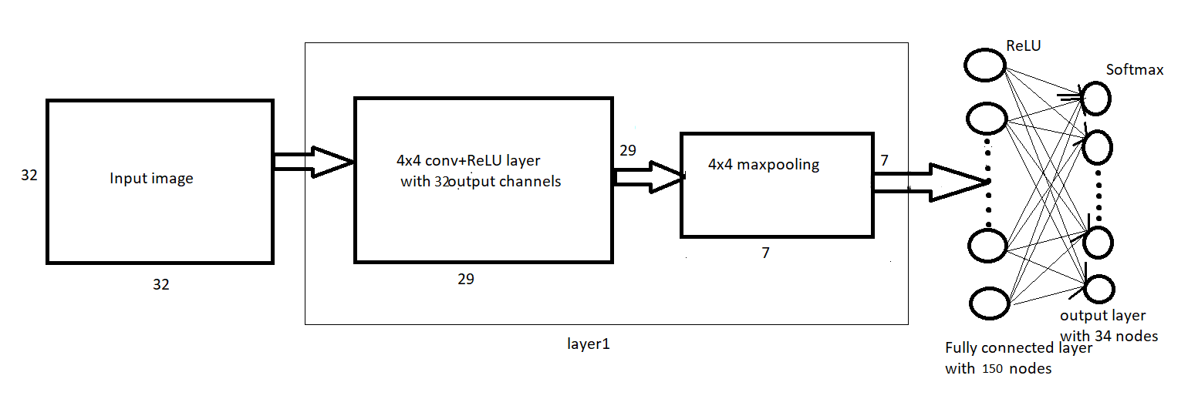
CNN ARCHITECTURE
optimizer='adam', loss='categorical_crossentropy'
Notes:
Adam - faster

Slide 7
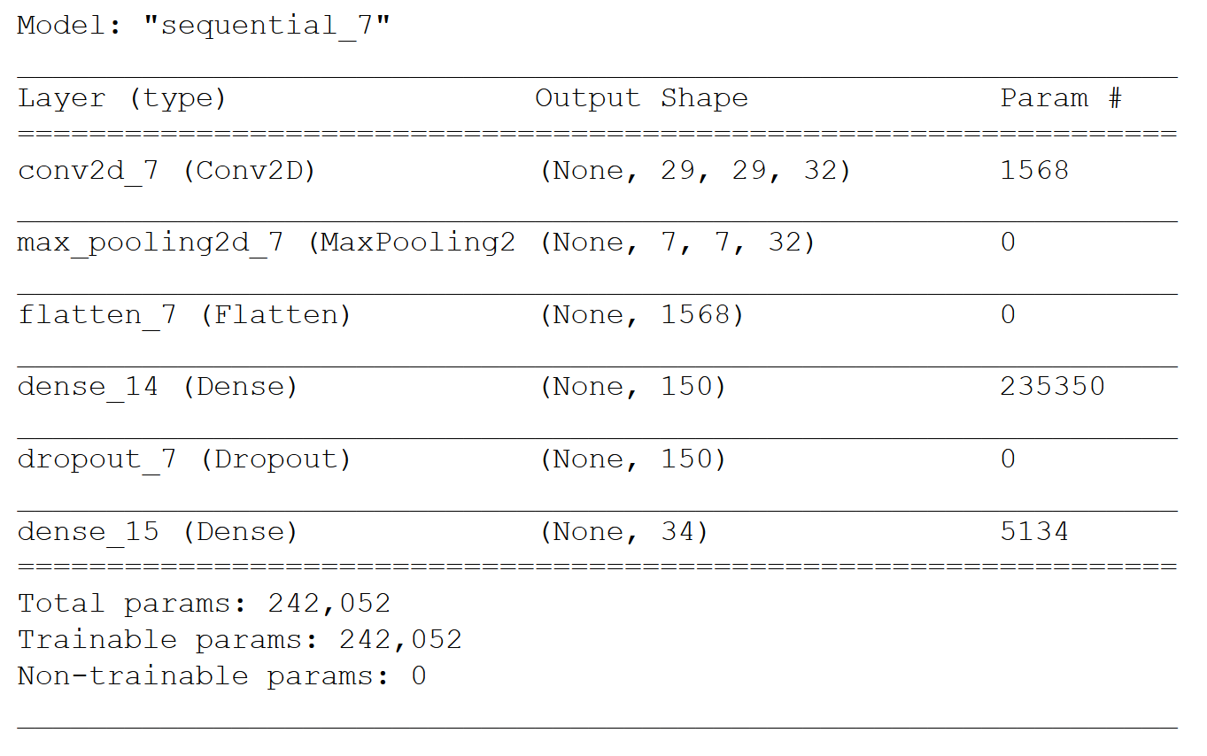

Slide 8
TRAIN AND TEST
Training :
Number of epochs: 40
Batch size: 21
Optimizer: Adam
Loss: categorical_crossentropy
Testing :
We used 28 test cases to evaluate the model
The top three probabilities were printed
20%
Validation
(194)
Evaluate model
Training
(772)
Fit train model
80%
DATASET
(966)

Slide 9
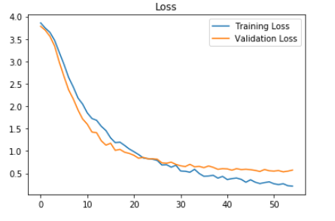
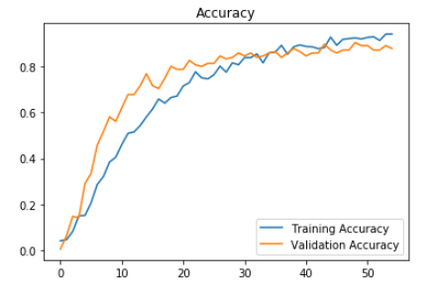
ACCURACIES AND TWEAKS
To prevent the model from overfitting:
Early stopping
Dropout layer
42%
Test Accuracy
92%
Train Accuracy
95%
Validation Accuracy
Graph of train and validation loss before using early stopping

Slide 10
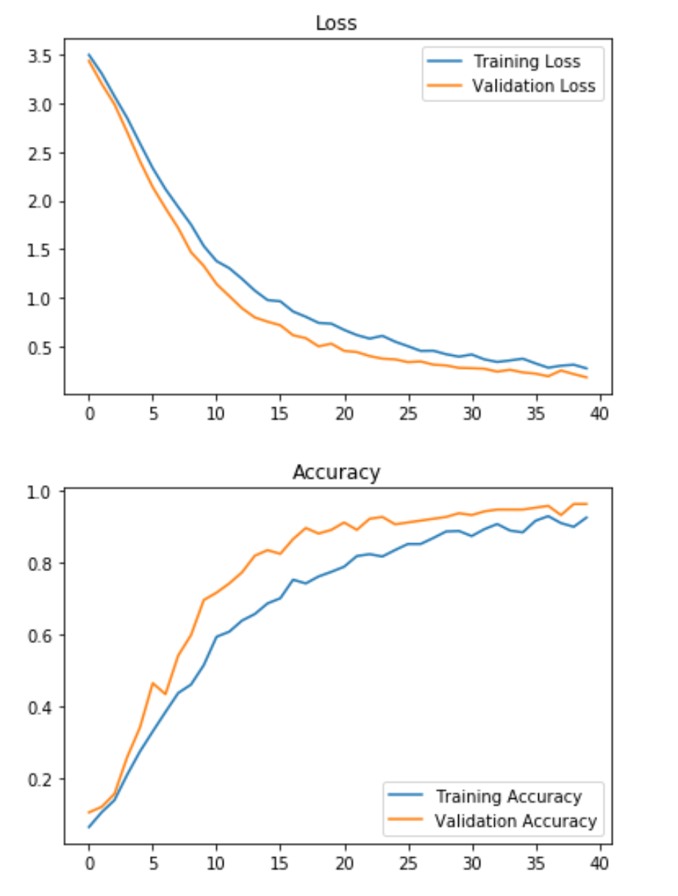
Graph after using early stopping thereby preventing overfitting

Slide 11
INTEL MODEL OPTIMIZER
1. Configuring the model optimizer
2. Freezing the Keras model
3. To convert the model into protoBuf format.
4. Running model optimizer to generate .xml and .bin files
Problem faced in step 4: Input -1 found. Cannot optimize model
Reason and Solution:
There are situations when the input data shape for the model is not fixed, like for the fully-convolutional neural networks. In this case, for example, TensorFlow models contain -1 values in the shape attribute of the Placeholder operation. Inference Engine does not support input layers with undefined size, so if the input shapes are not defined in the model, the Model Optimizer fails to convert the model. So, we had to specify “--input shape”
Notes:
Protocol Buffers is a method of serializing structured data.
Freezing a model is typically synonymous with exporting a model. We need to do this because models are trained in RAM, and RAM is volatile - to use the model in another program instance, you need to save it to disk.
Installing model optimizer files and its prerequisites for tensorflow models
used the mo_tf .py file that is installed using step 1. Passed the .pb file as input and generated .xml and .bin files which are required for inference.
Used TensorFlow’s write_graph function to convert to .pb file
Freezed the state of a session into a pruned computation graph by using Tensorflow and Keras backend modules.

Slide 12
SCRIPT TO RUN THE MODEL WITH INTEL OPENVINO
Inference image with path
Inference.py
Device the model s running on
Location of the infarct
.xml file along with path
Reading the model
Setup Device
Allocating input and output blobs
Load model to plugin
Pead and preprocess input images
Infers
Notes:
Need to pre process as as openvino expects in CHW format. Thus transpose HWC to CHW.
Blob is a library for computer vision to detect connected regions in binary digital images.

Slide 13
OBSERVATIONS / CONCLUSION
Large dataset required to train DNN
Data Augmentation
Preprocessing place a major part in building best model. It should be same for both training and testing set .
Grouping of classes improved the predictions.
Correlation between training and testing dataset gave us high testing accuracy but low accuracy on unseen data.So testing and training set should be not be correlated.
Overfitting is major issue which should be taken care of.
Dropout layers -> deccorelates the weight.
Early stop -> form of regularization.

Slide 14
FUTURE SCOPE
A CNN might be very successful in recognizing the different elements in an image but not be sensitive to the arrangement of the entities.
Therefore,
After looking at the observations we decided it will be better to use PCA for feature extraction before CNN.
OR,
Using CNN to learn sequence-to-label mapping, with a DenseNet based auto-encoder for feature extraction

Slide 15

THANK YOU!

