Slide 1
Dr. VENKANNA ISAMPALLI
Konisetty sai sri akhil : - 26220080123
Shahsank veerendra:- 2620030587
k. Lakshman : - 2620030523
Sai Balaji :- 2620090090

Slide 2
01
Design and Simulation of
Traffic Lights Using Sequential Logic Circuits
Digital Electronics Project
Green → Yellow → Red → Repeat
1

Slide 3
Introduction
02
Traffic lights control vehicle movement at road intersections.
Real traffic signals follow a fixed sequence of states.
A sequential logic circuit can generate this sequence automatically.
The circuit uses memory elements, a clock, and combinational logic.
Simulation helps verify the timing and state transitions before hardware implementation.
2

Slide 4
Basic Working Principle
03
Each traffic-light condition is treated as a state.
The clock signal determines when the controller changes state.
Flip-flops store the present state.
Combinational logic determines the next state.
The output logic activates the appropriate traffic-light LED.
Key idea: The controller behaves like a small finite-state machine.
3

Slide 5
State Sequence
04
S0: Green
S1: Yellow
S2: Red
S3: Red + Yellow
After S3, the controller returns to S0 and the cycle repeats.
4

Slide 6
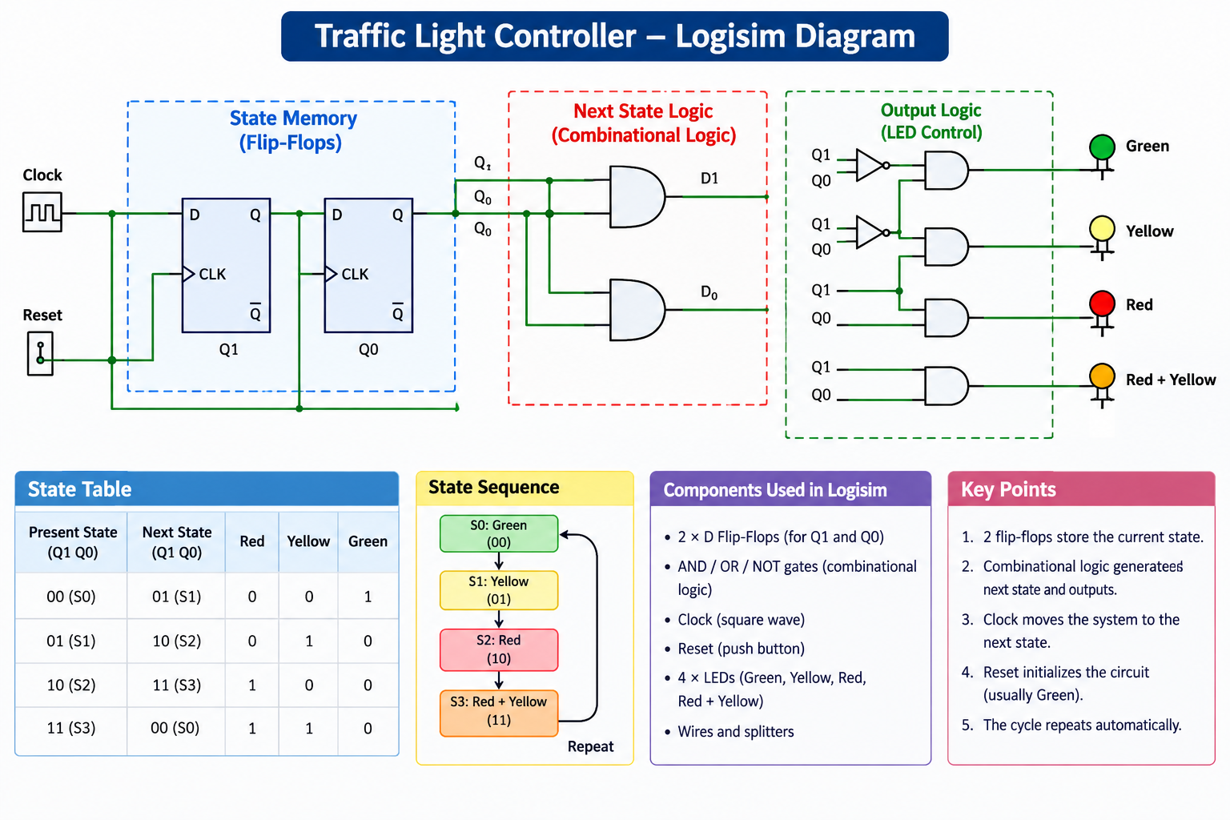

Slide 7
State Table
05
Present State | Q1 Q0 | Next State | Red | Yellow / Green
S0 | 00 | S1 | 0 | Green = 1
S1 | 01 | S2 | 0 | Yellow = 1
S2 | 10 | S3 | 1 | —
S3 | 11 | S0 | 1 | Yellow = 1
5

Slide 8
Conclusion
06
A traffic-light controller is a practical application of sequential logic.
Flip-flops provide memory; logic gates generate the required outputs.
Simulation verifies correct state transitions and timing.
Advantages: reliable, easy to test, and adjustable timing.
Applications: road intersections, pedestrian crossings, and industrial signaling.
Future improvement: vehicle sensors and adaptive timing.
06

