Slide 1

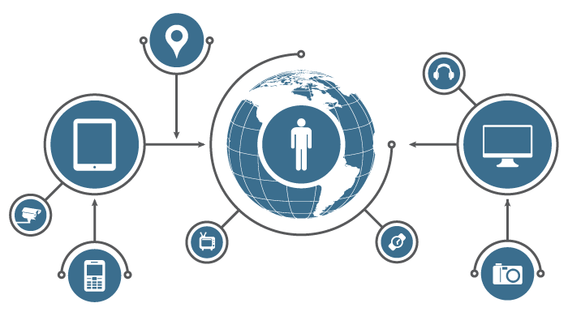
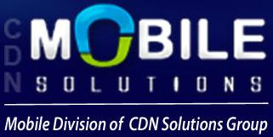
Welcome to The World of Internet of Things
All Information Which You Want To Know About
Internet of Things
Created By
CDN Mobile Solutions
Mobility Division of CDN Solutions Group

Slide 2
What You Are Going To Know
What Is Internet of Things
Applications of Internet of Things
Challenges of Internet of Things
Future of Internet of Things

Slide 3
What is Internet of Things
The Internet of Things (IoT) is a computing concept that describes a future where everyday physical objects will be connected to the Internet and be able to identify themselves to other devices. We can say that IoT is a network of physical objects which embedded with software, electronics, sensors and connectivity to enable it to achieve greater value and services by exchanging data with the manufacturer, operator or connected with other devices.
IoT is expected to offer advanced connectivity of devices, systems, and services that goes beyond machine-to-machine communication and covers a variety of protocols, domains, and applications

Slide 4
Applications of Internet of Things
Enviornmental Monitoring – There are several IoT medical devices, able to keep record of remote health monitoring, blood pressure, heart rate, sugar and major changes in your body.
Transportation – IoT enables smart parking, smart traffic control, electronic toll collection systems, vehicle control, logistic management and road safety assistance.
Medical Systems – You can get more accurate information of air quality, water quality, soil conditions and atmospheric changes. IoT devices in this application typically span a large geographic area and can also be mobile.

Slide 5
Applications of Internet of Things
Manufacturing – IoT enable rapid manufacturing of new products, real-time optimization of product manufacturing, dynamic response of product demand.
Energy Management – With the help of IoT electronic appliances you can save energy and reduce energy consumption in your home or office.
Infrastructure Management – Big projects of urban and rural infrastructures like highways, bridges, railway tracks IoT can play an important role

Slide 6
Challenges of Internet of Things
Security – Security is a major challenge of IoT. If we are applying IoT in major parts of our life then it has become more important that security should be of very high level. For example, what good is a smart home if anyone can unlock your doors?
Presence Dedection – It is tough to find that when an IoT device goes offline and when an IoT device comes back online. So, it is an another challenge for IoT technology and it is very important to find the status of all IoT devices. It helps us to monitor well.
Signaling – In IoT connections, signaling is crucial phase for collecting and routing data between IoT devices or between IoT device and server. In that way, IoT data streams comes into play. It should be 100% sure that stream of data is going to arrive at its destination every time.

Slide 7
Challenges of Internet of Things
Bandwidth – In addition to security and signaling, bandwidth usage is an another challenge for Internet of Things connectivity. On a cellular network, bandwidth is expensive and it becomes more complex when hundreds of thousands of IoT devices sens/receives signals to the server.
Power Consumption – When hundreds of IoT devices send or receive data between one another, then it takes a lot of power consumption as well as CPU consumption. So, you can't use 100% IoT devices with low power consumption and minimal battery drain.
Complexity – IoT application development is still very complex for the developers as well as experts. It is also the major challenge for the IoT application developers. IoT will be very effective with less complexity.

Slide 8
Future of Internet of Things
According to the Pew Research Center, “By 2025, there will be a global, immersive, invisible, ambient networked computing environment built through the continued proliferation of smart sensors, cameras, software, databases, and massive data centers in a world-spanning information fabric known as the Internet of Things."
Pew Research Center released this statement after the detailed overview which was based on the thoughts of the almost 1600 technology experts and IoT experts. So, by 2025 Internet of Things and wearable tech will start to play a major impact globally. Obviously our daily life will also affected by this revolutions of Internet of Things. It means the world will become “smart world” to live with high level technology.

Slide 9
Future of Internet of Things
But, some impacts of IoT we can see soon in near future. Lets check out that type of devices.
Smart Couches – How will you feel when your couch heats up so that you have a warm place to sit down and the same concept applies to the dining chairs.
Smart Fridges -- Imagine if your fridge could analyze what is in it, and then build you a shopping list based on your previous food-buying habits. or even order the groceries for delivery on its own or if it could sense when you're going to be home from the GPS signal on your phone and put a frozen pizza in the oven through a little door in the side.

Slide 10
Future of Internet of Things
Smart Cars – Imagine a car that can sense when you are about to exit the mall and drive up to the curb with heated seats and music playing, to pick you up.
Smart Plates, Bowls and Cups – Smart plates, bowls and cups will help to improve diets and make waves in the health system as well. These are able to track what we're eating? It surely cheap your health insurance.
Smart Toothbrushes -- One day, our toothbrushes will be able to detect the healthiness of your teeth, telling the user when it is time to go to the dentist. Even it will go one step further with some more extra ordinary features.

Slide 11
Share Your IOT Concept With CDN
CDN Mobile Solutions started to develop and explore Internet of Things applications as well as support their clients to implement and execute concepts related to Internet of Things.
If you have any concept in your mind related to IoT and want to execute it so you can get in touch with us @ cdnmobilesolution@gmail.com
You can check our IoT portfolio by visiting
https://www.cdnmobilesolutions.com/mobile-app-development-services/internet-of-things/

Slide 12
Get In Touch With US
CDN Mobile Solutions
Unit 304, Princes Business Skypark
A.B. Road, Indore, (M.P.) - 452001, India
Skype: cdnindia | Email: info@cdnmobilesolutions.com
Tel: +91 731-4035927 / +1-347-293-1799 / +61 286078309
Fax: +91 731-4215508
Website: http://www.cdnmobilesolutions.com

Slide 13
Find Us On Social Media
Facebook: https://www.facebook.com/cdnmobilesolutions
Twitter: https://twitter.com/cdnmobilesol
Google Plus: https://plus.google.com/+Cdnmobilesolutions
LinkedIn: https://www.linkedin.com/in/cdnsolutionsgroup
You Tube: https://www.youtube.com/cdnsoftwaresolutions
Just Like/Follow Us On Social Media Platforms & Get Latest Updates and News

Slide 14
Thank You..!

Slide 15




