Slide 1
Internet of Things: 50 Billions Devices Jam
Prabhas Chongstitvatana
Chulalongkorn University
July 2015

Slide 2
IoT = Internet of Everything
M2M
Next information revolution

Slide 3
1% of physical world is connected to Internet
Huge potential
Potentials
innovative business process
operational efficiency
new customer services

Slide 4
What is IoT
Network of Physical Objects
embedded systems with electronics, software, sensors
enable objects to exchange data with manufacturer, operator, other devices through network infrastructure

Slide 5
allow remote control
direct integration computer + physical world
Result: automation in all fields

Slide 6
Applications
Media
Environmental monitoring
Infrastructure management
Manufacturing
Energy management
Medical and health care systems
Building and home automation
Transportation

Slide 7
A bit of history
The term "Internet of Things" is coined by Kevin Ashton 1999.
Early example, 1982, Coke machine at Carnegie Mellon University was connected to internet: report its inventory and temperature

Slide 8
Applications (cont.)
Media IoT + Big Data
= target advertisement to customized content
Infrastructure management
monitoring structural condition, scheduling maintenance
Waste management
Safety management
Example: German Airport Problems

Slide 9
Applications (cont.)
Manufacturing
monitoring product demand
real-time manufacturing production
manage supply chain network

Slide 10
Large Scale examples
Smart city
Songdo, South Korea
Santander, Spain
10,000 sensors: parking search, environmental monitoring etc.
San Francisco Bay area
wireless sensors data network
New York waterways

Slide 11
Detailed examples
Padova Smart City Project, Italy
wearable: Pedometer data

Slide 12
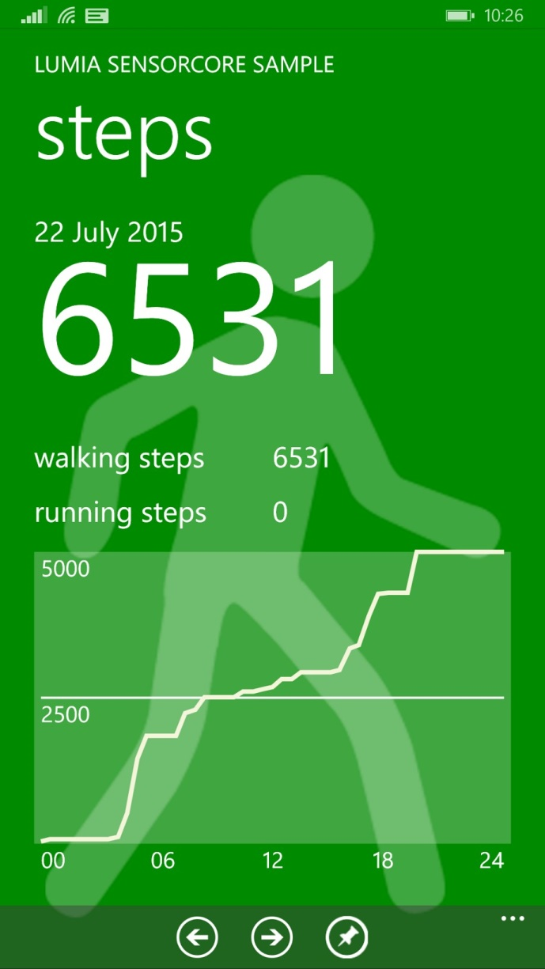
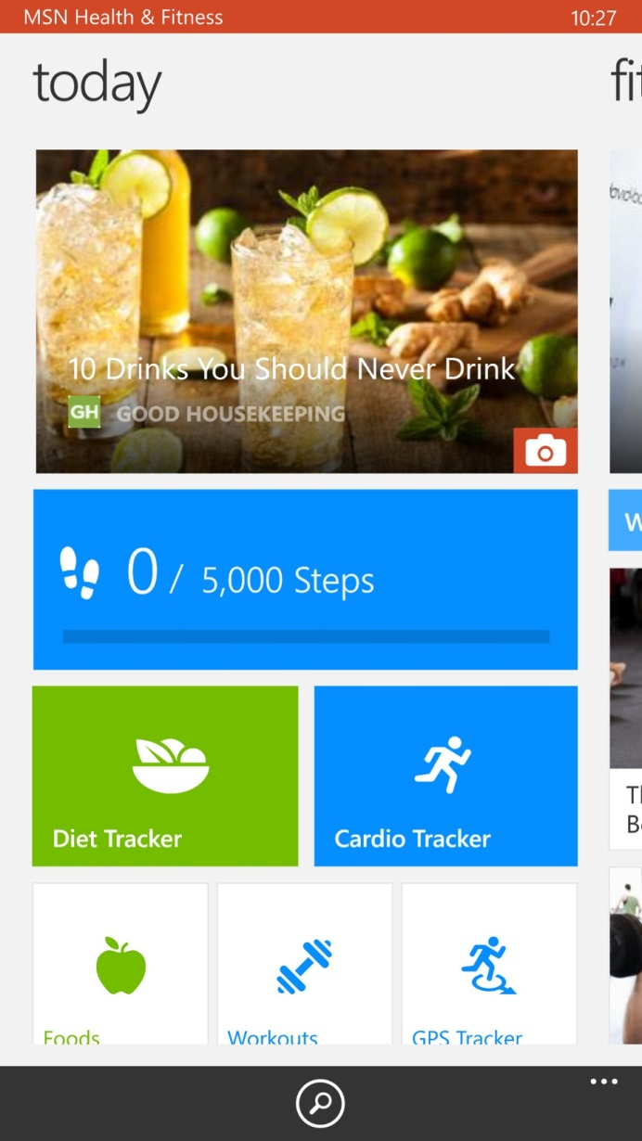
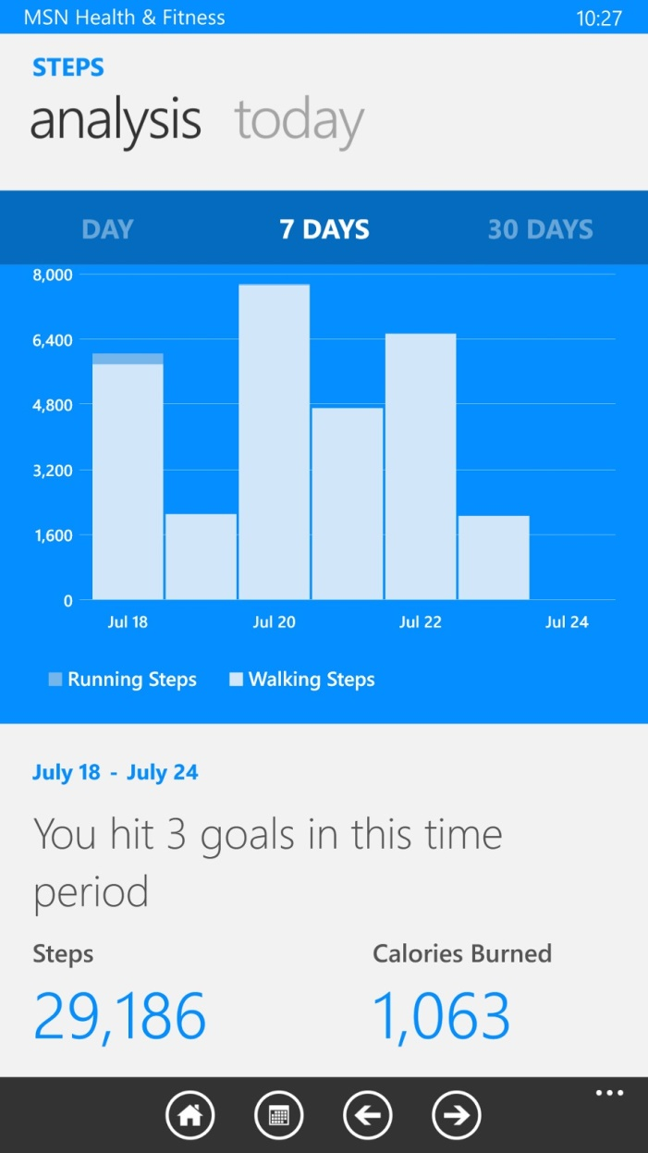

Slide 13
Berlin Brandenburg International Airport
600 million euros project
schedule to be opened in June 2012, now expected to be completed in 2017
“Just months before the scheduled June 2012 opening, the terminal was a mess. Careless workers stepped on and shattered glass being installed by other companies. Heavy equipment rolled across the terminal floor, scratching expensive tiles. Tempers flared; small contractors complained they weren’t getting paid and threatened to walk off the job.”

Slide 14
Technology roadmap
50-100 Trillion objects,
each person carries 1000-5000 trackable objects
computer manage and inventory objects and people
transform daily life
bottom up, convergence of data from IoT into applications, web-of-things

Slide 15
Impact
Civic engagement
Privacy, autonomy and control
technology <> just tools
technology = active agent
IoT = Human augmentation (Tim O Reilly)
data-driven decision making

Slide 16
Impact (cont.)
Security
cyber attack in Physical world
spy on people in their own homes
Increase in electronics waster 10x

Slide 17
Trending
Cisco IoT Grand Challenge
IoT World Forum in Dubai

Slide 18
References
Zanella, Andrea; Bui, Nicola; Castellani, Angelo; Vangelista, Lorenzo & Zorzi, Michele. "Internet of Things for Smart Cities". IEEE Internet of Things Journal, VOL. 1, NO. 1, FEBRUARY 2014.
https://en.wikipedia.org/wiki/Internet_of_Things
http://www.bloomberg.com/news/features/2015-07-23/how-berlin-s-futuristic-airport-became-a-6-billion-embarrassment
this presentation link
http://bit.ly/1IlLNoe
Or search : “Prabhas Chongstitvatana”

