Slide 1
The Engineer
Communicator
Instructor(s)
Date
E-mail (s)
12 March 2014 Version 1
Notes:
2 to 7 minutes
Allow 2 minutes to introduce the topic and instructor(s).
Provide some background on yourself and introduce the topic. And thank them for participating in the session.
If the class size is not too large, then allow an additional period for self introductions (name, year in school). This should be no more than 5 minutes. Total 2 to 7 minutes.
Room Set-up, Preparation and Materials
Ideally, if you have control of the room arrangement, round tables would be the best set-up to allow for a group exercise. But if you are in a classroom set-up that does not allow for any changes you will have to conduct the session as is. Find out the room set-up so you can plan ahead.
To conduct the session you will need:
Projection screen, projector and extension cords (most classrooms have built in a/v systems)
Laptop (with remote if possible)
1 Flip chart, markers and masking tape
Handout materials
Paper and pens for the participants (optional for the group session)
An assistant – this could be one of the student organizers or a volunteer from the audience
This person’s role is to record responses on the flip charts and then tape the flip charts to the wall during the session (You want to remain free to facilitate the session

Slide 2
Learning Objectives
Goal: To Use Written and Oral Communications Skills to further academic and professional success
To acquaint students with the different academic communications requirements
For students to obtain knowledge and skills in the academic communications areas
For students to become more effective communicators
To prepare students for the communications requirements in the workplace
Notes:
1 minute
State the main goal of the session is to help students further their academic success by becoming better communicators. You can then list the main learning objectives of the session:
To acquaint students with the different academic communications requirements
For students to obtain knowledge and skills in the academic communications areas
For students to become more effective communicators
To prepare students for the communications requirements in the workplace

Slide 3

“As an engineer, my job is just to develop the best technical solution. So why do I need communications skills? “
“This is a common view from engineers. What are your thoughts?
Notes:
3 – 5 minutes
This slide is meant as an introduction. The quotes are animated on the mouse. Click or advance.
Ask the students their thoughts on the quote. Do they agree or disagree? Ask them why?
Have a co-presenter or an assistant track the comments on a flip chart.

Slide 4
Engineers as Communicators:
The Perception
The fact is, many engineering students and practicing engineers prioritize technical skills over communication skills
That is a mistake and they will find out communication skills are every bit as essential as technical skills if engineers want to be fully effective in their jobs and have successful careers
Notes:
1 minute
Depending on their reaction from the previous, that will guide you on how to approach this slide.
If they agreed with the quote, they join many in the perception that engineering is just about technical competence. Emphasize the points on the slide.
If they disagreed with the quote that are enlightened and know the importance of good communication skills and that information will help ensure they will have a successful career. This leads into the next slide.

Slide 5

Engineers as Communicators:
The Reality
The reality is that in the engineering fields that effective communication skills are crucial to success in the workplace.
In a recent survey conducted by ASME (American Society of Mechanical Engineers) of both society members and nonmembers in engineering related positions, respondents said:
  “Communication skills — such as business writing, technical writing, public speaking, and presentation preparation — are crucial for success as engineers work in and among more varied groups.
Notes:
1 minute
Because the reality is that in engineering, effective communication will be crucial to your success. And that realization many engineers face as they begin their careers.
In fact, there is a saying that, “In engineering, you’ll only go as far as your communications skills will take you.”
And a recent survey conducted by ASME confirmed that. The respondents indicated that communications skills are crucial for success

Slide 6
Views on the Importance of Communication
“COMMUNICATION – the human connection – is the key to personal and career success.” Paul J. Meyer, Businessman and Motivational Speaker
“Good COMMUNICATION does not mean that you have to speak in perfectly formed sentences and paragraphs. It isn't about slickness. Simple and clear go a long way.” John Kotter, Harvard Professor and “Leading Change” Expert
"Developing excellent COMMUNICATION skills is absolutely essential to effective leadership. The leader must be able to share knowledge and ideas to transmit a sense of urgency and enthusiasm to others. If a leader can't get a message across clearly and motivate others to act on it, then having a message doesn't even matter." Gilbert Amelio, President and CEO of National Semiconductor Corp.
Notes:
2 minutes
And it’s not hard to find similar views on communication from prominent individuals, because being a good communicator translates into everything we do, both personally and professionally. And Paul Meyer’s quote is reflective of that. (Paul Meyer was a successful businessman who became a leading motivational speaker)
And we also see in John Kotter’s quote that in the end, good communication is not about being perfect, it’s about being simple and clear. (Jon Kotter is a Harvard professor, author and an expert on leading change)
Finally, the last quote really sums it up and I want to stress the part that a leader must “be able to share knowledge and ideas.” Just substitute “leader” with “engineer.” Because it really applies.
You can be the most technically gifted engineer, but if you are unable to share your knowledge, display enthusiasm and try to get others to act on your ideas, it wont matter that you developed a brilliant design. Being a good engineer means being a good communicator.

Slide 7
Communications 101
Student communication requirements have applications in the workplace
And the three typical activities required include:
School | Workplace
Reports | Project Reports, Proposals
Presentations | Design Reviews, Customer Briefings, Status Updates
Papers | Peer Reviewed Papers
Notes:
2 minutes
And that brings us to the focus of today’s session. We’re in a great position as students because communication skills can be learned and developed. That gives us the advantage of time. And it serves two purposes because by becoming better communicators as students, we’ll do better academically and at the same time we’ll be ready to enter the profession as effective communicators.
That’s because many of the requirements we have as students translate into the workplace.
In school, there are three types of activities that you may become involved in:
Reports – The report may be one found in a lab class (electronics, chemistry, physics, etc.), or it may be on a research project, book review, or any other number of formal written reports required by the professor.
Presentations – There are a number of classes that may require an oral report. Again, it could be the results of a lab activity, a research project, a book review, or a senior capstone project.
Papers – Any number of classes can require a written paper. In addition, there are many opportunities for students to write a paper based on class projects or other development activities and have the paper presented at a conference or included in a professional journal.
And you can see that in each case, there is a similar requirement in the workplace. In today’s session, we will concentrate how you can improve your communications skills to satisfy the school requirements in the four areas that are mentioned.

Slide 8

Reports
Format may be dictated by Professor
  It that is the case, be sure to follow the professor’s format
Title Page
Summary
Introduction/Background
Discussion/Actions
Conclusions
Recommendations
Appendices/Data
Notes:
1 minute
Let’s start by discussing reports. This will focus on the general content found in a report and on this slide you can see the typical components. A complete and well prepared report will cover each of these areas and we’ll spend a discussing each.
It’s important to note that many times you are provided with a format or template to follow. If that is the case, be sure to follow it! (The second line is animated to change color to highlight the point. Just click the mouse)
In school, it might impact your grade if you don’t follow the format. And this is really important when you become a practitioner. In many cases clients require set formats for submitting proposals. If you don’t follow the format you might not win the contract. That’s more impactful than a bad grade.
But if there is no set format, sticking to these content areas will ensure you have a complete report.
Title Page
Summary
Introduction/Background
Discussion/Actions
Conclusions
Recommendations
Appendices/Data

Slide 9

Reports (2)
Title page
  The subject of the report, i.e.
  “EE-100 Lab Report 11 – AC Measurements”.
  Student Name(s)
  Date of Report
  Class name
Notes:
1 minute
I know it seem obvious, but title pages sometimes are forgotten or they are not complete.
Typically you want to have the report subject, a list of the student name(s), the date and the class name.
The title is usually centered on the page and the student name(s), the date and the class name are placed in the lower right corner. But again, follow any format or template provided by the professor.

Slide 10
Reports (3)
Summary/Abstract
  No more than one page
  Includes a brief introduction, actions taken, results, and conclusions
  Usually written last
Introduction/Background
  Two or three paragraphs describing the background of the report content, i.e., a discussion of the experiment and the expected results
Notes:
3 to 5 minutes
The Summary/Abstract is intended to provide a short synopsis of the report, the results, and any conclusions/recommendations. It’s your entire report in one page or less. In business it is sometimes referred to as an executive summary.
A general guideline for an abstract is to have 4 sections or areas of focus: the problem being addressed; what methods were used to solve the problem; the major results obtained; and the overall conclusions or recommendations.
The abstract, although it comes first logistically, always should be written last. Question – Why are abstracts written last?
Get student involvement. Ask for the reasons an Abstract is written last. You can document these on a flip chart.
See how close they came to the reason abstracts are written last.
Abstracts are written last because it is the essence of your report and it draws from the information from all of the other sections of the report. You will be better able to develop an abstract once the other sections are written. And it is acceptable to actually pull wording from other sections and place them into the abstract.
The introduction/background is a short description of what this report is about. It is about the “Why.” For example, if this is a lab experiment you would describe what you were actually trying to accomplish and the general outcome that was expected.

Slide 11
Reports (4)
Discussion/Actions
  A discussion on the activities associated with the experiment or the design solution, i.e., selection of test equipment, components, wiring requirements, measurements/test points, and any anomalies noted
  It should be of sufficient detail that someone else could replicate the results
Notes:
1 minute
This is the meat of the report and it should describe the main activities or actions you undertook. You can include key milestones as well as any equipment that was used.
One result of any lab should be the ability to repeat the result given sufficient detail in this report. The ability to describe how the result can be replicated is a key skillset you will need in the workplace.
Also keep in mind drawings, equipment lists, and data tables should be summarized in this section, but not in total detail. Use the appendices to go into detail. Getting into the weeds will distract the reader.
This is the section where you build your trust with the audience. How well you describe what took place will go along way in people trusting your conclusions and recommendations.
Finally, be sure to site any portions of text or photos that come from outside sources. And be aware of copyrights. With the internet today it’s easy to access information. In most cases if a photo is used for educational purposes it is allowed. But be safe and check.

Slide 12

Reports (5)
Conclusions
  Was the lab or project completed successfully?
  Did you solve the problem?
  Were the results achieved as expected?
  Given any anomaly, what was the cause?
Recommendations
  Based on the results, are there any recommended changes, additions, or other suggestions for projects?
Notes:
1 minute
Conclusion
This is the "so what" part of your report. "So what" refers to what the results mean in the long run. You need not include how you drew your conclusions, only the final conclusions. And you should be decisive. This needs to be written in a way that links to the results, so the reader knows what results led to what conclusions.
Also remember that all experiments or projects will not be totally successful. When there are results that do not fit the predicted outcome you need to be able to convey what were the underlying causes? Can the anomaly be explained due to faulty equipment, faulty procedures, or other reasons? Be sure to report your findings.
Recommendations
Remember that the purpose of the report is to describe a project’s expected outcomes, solve a problem or take advantage of opportunities. Your recommendations are about how those goals can be accomplished. Therefore, the quality of the content must be good you must use clear language and the recommendations must connect to the results.

Slide 13
Reports (6)
Appendices/Data
  May be included as required to provide complete information on the experiment or project
  Supports and validates your conclusions
  May include such items as:
    Equipment used, including model and serial numbers
    Drawings and diagrams
    All data taken in chart form
Notes:
1 minute
Appendices are for information that is not essential to explain your findings, but that supports your analysis (especially repetitive or lengthy information), validates your conclusions or pursues a related point should be placed in an appendix (plural appendices).
This area of the report also has the bulk data needed for anyone else to be able to replicate the experiment or project, with anticipation that their results will be the same.
If you do have an appendix or appendices, you can refer to them in the body of the report.
In wrapping up this section, remember that written reports will be heavily reviewed. Be sure to have several other student colleagues proof read the document for errors. It should also flow well, just like the abstract in a linear fashion: An introduction into the problem; the discussion and report on your actions/steps; the conclusions and the recommendations.

Slide 14
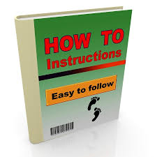
Communication Exercise
Notes:
10 – 12 minutes
This is an exercise for the entire group.
Materials
• One sheet of paper (8-1/2 x 11) for each participant
• One sheet of paper for the facilitator
Before going into the next section on presentations, I wanted to conduct a little communication exercise. During the discussion on reports, we talked about the section where you described what took place. That was an important part of the report because it enables people to replicate what you did. Being able to communicate that type of information effectively is necessary for every type of communication, not just reports, but in presentations, papers and even just verbally between to or more people. So this demo is to meant to show you the challenges in being an effective communicator.
So let’s start.
Directions
After giving each participant one sheet of paper, offer the following directions, pausing
after each instruction to give the group time to comply (complete the activity yourself
using your own sheet of paper).
1. Pick up your sheet of paper and hold it in front of you. Close your eyes and listen carefully to my directions. The rules are: (1) no peeking and (2) no
questions.
2. The first thing I want you to do is to fold your sheet of paper in half. (Pause)
3. Now, tear off the upper right hand corner. (Pause)
4. Fold the paper in half again and tear off the upper left hand corner of the sheet. (Pause)
5. Fold it in half again. (Pause)
6. Now tear off the lower right-hand corner of the sheet. (Pause)
After all tearing is complete, say:
Now, open your eyes and unfold your paper. If I did a good job of communicating and you did a good job of listening, all of our sheets should look exactly the same!
Hold your sheet up for everyone to see. Ask participants to compare their sheets. Ask why no one’s paper matched yours exactly?
You will probably get responses such as, “You didn’t let us ask any questions!” or “The way you gave us directions wasn’t clear!”
Part of the communication process (and being a good communicator) is recognizing that people may need to receive information in different ways in order to be successful. Remember that someone reading your report or paper can’t ask you any questions. So you need to become a better communicator to avoid a misinterpretation of what your wrote or what you said.
Remember, I never said in the directions that I wanted all your papers to look alike at the end. But what if I had made that the objective? What suggestions do can you think of that would have improved my directions?
Track the results on a flip chart. Gauge your time and how much discussion you want before going onto the next session.
To close:
Think about the suggestions that were made and when you are writing or developing a presentation, think about the audience. What will you need to include so the audience receives and understands the information as you intended? Now let’s move on to Presentations.

Slide 15
Presentations
A presentation might involve doing an oral report on your written report, reporting on the status of a project or design, or even involve persuading an audience to align to your viewpoint
Making an effective presentation involves two important communications skills:
  Public speaking
  Being able to visually present information
Notes:
1 Minute
At some point in your student career and certainly when you become a practitioner, you will be required to make a presentation in front of an audience.
And presentations can have many different objectives. The goal might be just to impart information, meaning providing a status report, like a design review or doing an oral presentation on your written report. Or they can involve trying to persuade the audience. Maybe the project manager want’s to hear about your design and determine if it’s the right path, so you must present in the information in a way that persuades an audience.
And there are two critical communications skills necessary to deliver an effective presentation:
Public Speaking and Being able to visually present information. We’re going to spend a little time on each, but let’s start with public speaking.

Slide 16

Presentations
Public Speaking
Surveys show that most people fear death less than speaking in front of other people
Fear of public speaking even has a name, glossophobia and that about 75% of people suffer from it
Notes:
1 Minute
Just mention public speaking and the reaction you get from most people can best be illustrated by this one well know painting (The image is animated to so click to have it enter and follow it with the text)
And it really is true that most people fear death less than public speaking. It even has it’s own name glossophobia. Jerry Seinfeld used to joke that at a funeral, most people would rather be lying in the casket than delivering the eulogy.
But as we stated before, you can be the most technically gifted engineer, but if you can communicate your concepts, you will not be very effective or very successful. So even though you may fear it, you’re going to have to do it. So we’ll spend a little time to help you prepare and hopefully if you do fear public speaking, you can get used to it and even excel at it.

Slide 17

Presentations
Public Speaking (2)
Focus on single, well-defined topic
  Speak about what you know
Know your audience
  Tailor your presentation to the main audience
Always start by introducing yourself and the topic
Body language / slow down
Use “tone of voice” to emphasize the point being made
To avoid “ums” pause between thoughts
Notes:
1 Minute
Read through the points and add some commentary
Focus on single, well-defined topic (If you are not an expert on your topic you are going to have trouble building trust)
Speak about what you know
Know your audience (Audiences only pay attention to stories and ideas that are immediately relevant to them. Consider what decision you want them to make, then build an appropriate case. )
Tailor your presentation to the main audience
Always start by introducing yourself and the topic (They want to know who you are and what you’re speaking about)
Body language/slow down (Be open, use your hand for emphasis and don’t talk too fast)
Use “tone of voice” to emphasize the point being made (Modulate your voice, monotone will put the audience to sleep)
To avoid “ums” pause between thoughts (Ums are killers and people can hear them more than the content. If you pause between points, that works better than trying to bridge them with an “Um”

Slide 18

Presentations
Public Speaking (3)
Have thoughts in order before talking
  Plan, Plan, Plan and Practice
Focus on the audience
  Don’t read the slides
Don’t try to memorize the slides, you want to be natural
If you do not know the answer – say so
  Don’t try to impress audience with technical terms
Repeat when necessary
When done with a point, stop talking
Time management – know your time limit
  Typically 1 slide per minute
Notes:
1 Minute
Read through the points and add some commentary
Have thoughts in order before talking (Outline your talk and the main points you will cover)
Plan, Plan, Plan and Practice (Do some practice runs, being prepared will ease you fears)
Focus on the audience (Look at and engage the audience)
Don’t read the slides (The audience can read)
Don’t try to memorize the slides, you want to be natural
If you do not know the answer – say so (don’t try to con an audience. You will loose their trust)
Don’t try to impress audience with technical terms
Repeat when necessary (When you want to emphasize something repeat it)
When done with a point, stop talking
Time management – know your time limit (Find out before hand how much time you have. Going past your allotted time will damage the impact of you presentation and people might leave)
Typically 1 slide per minute (A practice session is a good way to time your presentation)

Slide 19
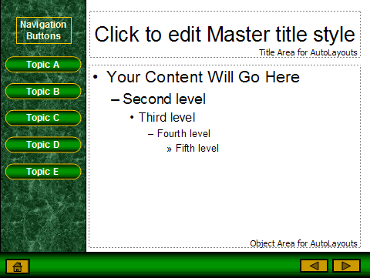
Presentations
The Content
Title slide
The Problem/Objective
History
Analysis
Causes
Review
Results
Conclusions/Recommendations
Notes:
1 Minute
Now let’s address the content of your presentation.
Presentations are similar in content to formal reports. The primary difference in the two is that the report is a formal written document, while the presentation is a capture of key points to be explained by the speaker (the subject-matter-expert).
Note the similarity between the report and presentation subjects. One major point of difference is that there are no appendices included in a presentation. Such information may be referenced to the report covering the same material in detail.

Slide 20
Presentations
Content (2)
The presentation is a bulleted list to lead the discussion, not a copy of the report
You as the speaker will fill in the blanks for the audience
Build a Story
Keep it Relevant
Use facts not opinions
Limit mathematical equations on the slide
Limit content – simplicity wins
  8 to 10 words per line
  6 to 8 lines per slide
Notes:
1 minute
Read through the points and add some commentary
And here are some guidelines in developing the content of your slides
Remember that the presentation is a bulleted list to lead the discussion, and is not a copy of the report
It should highlight key points
You as the speaker will fill in the blanks for the audience – Use the notes section of power-point to develop your script
Build a Story – add context and meaning, like the written report tell your story in a linear manner
Keep it Relevant – audiences pay attention to things that have meaning to them, so focus on what your audience cares about
Use facts not opinions – be decisive, verifiable and me memorable
Limit mathematical equations on the slide
Limit content – simplicity wins
8 to 10 words per line
6 to 8 lines per slide

Slide 21
Presentations
Content (3)
Font size should be at least size 18
Use color sparingly (particular colors may have specific meanings to the audience)
Data charts may be included (restricted to the font size noted)
Use real examples for illustration
Pictures are worth 1000 words
If you are using embedded videos or online links, test them
Limit animation for technical conference presentations
Notes:
1 minute
And lets talk about the slide formatting
Read through the points and add some commentary
Font size should be at least size 18
Use color sparingly (particular colors may have specific meanings to the audience)
Data charts may be included (restricted to the font size noted)
Use real examples for illustration
Pictures are worth 1000 words
If you are using embedded videos or online links, test them
Limit animations for technical conference presentation'. Most IEEE, ACM and other conferences suggest not to add animations to the technical presentations. Students often spend more time on animations then actual content and lose focus.
On the 5th bullet, photographs, note the following:
For example, if a circuit is being examined, then the presentation may include a copy of the circuit for illustration. If, in addition, the purpose of the circuit is to demonstrate the differences that can be found in test instrument selection between analog and digital instruments, then a picture of the two may be appropriate.

Slide 22
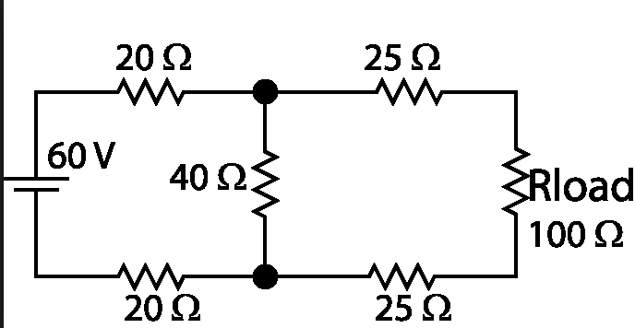
Circuit Example
Notes:
1 minute
(Optional slide graphic example)
Simple circuit which will be used to demonstrate the measurement differences between analog and digital multimeters.

Slide 23
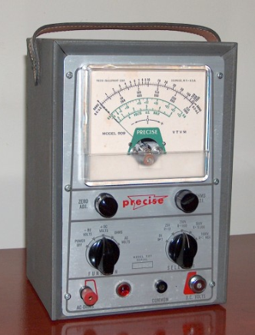
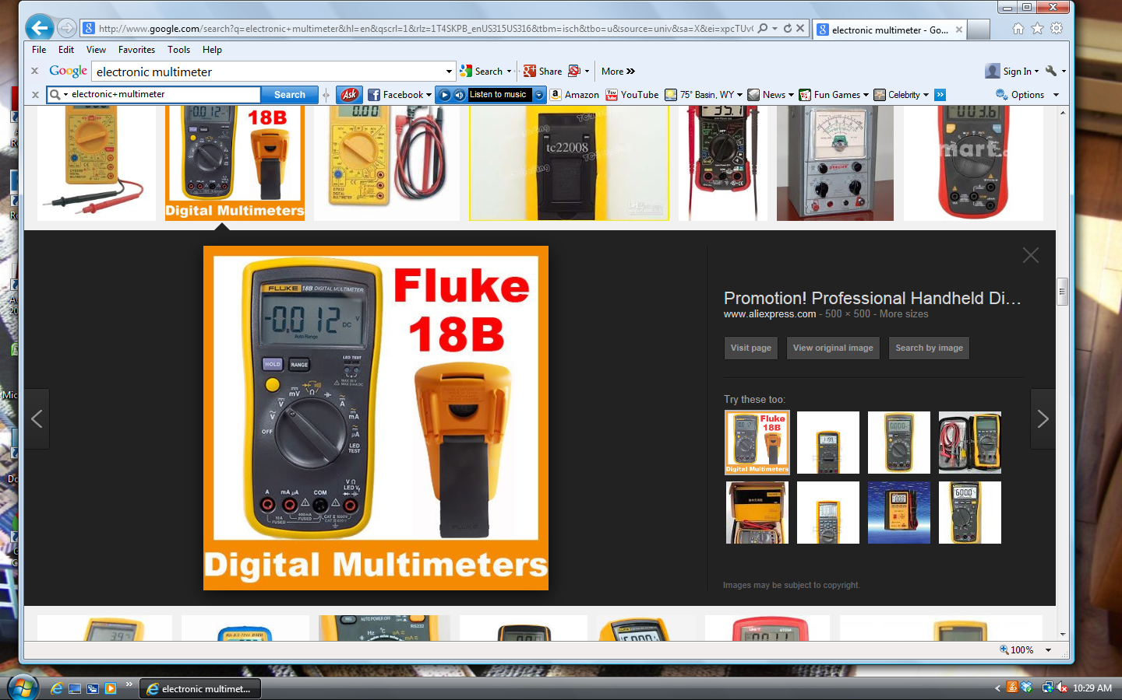
Instrument Examples
Notes:
1 minute
(Optional slide graphic example)
The analog meter on the left depends on the operator alignment of the needle on the scale. A mirror surface is sometimes included to assist the operator’s view. The digital meter on the right provides a multi-decimal direct reading.

Slide 24
Presentations
Content (4)
Handouts
  Almost always appropriate
  Handing out at the beginning allows audience to take notes on the material
    The downside on handing them out at the beginning may cause problems with the “look ahead” syndrome
  Ensure that you have enough for entire audience
  Audience exercises should not be handed out until you are ready to conduct that portion of the presentation
Notes:
1 minute
If there is data or reference material you want the audience to have, put it in a handout. Don’t use your slide deck as a repository.
There are pros and cons for handing out materials at the beginning. Audiences tend to look through materials and not pay attention. But there will be times you want the audience to have the materials while the presentation is going on. Make the decision that is based on your objectives.

Slide 25
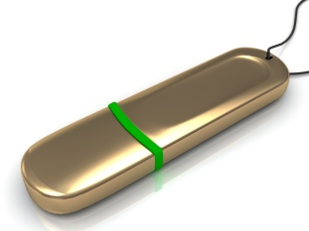
Student Papers
Similarity to reports, but intent is publication
And there are many publications looking for papers from students and practitioners
  Commercial, Engineering, Scholarly
Most publications are looking for either scholarly papers (research oriented) or technology papers (state of the art, practical)
Many professors will assist the author(s) for inclusion on the author list
Capstone Projects, Thesis, and Dissertations make good resources for papers
  A project report can be converted to a paper
Notes:
1 minute
Let’s now close out our discussion with a review of student papers. Papers in many ways are similar to reports, but the intent is publication. As students, we have many opportunities to have papers published. You might submit a paper to a technical conference or a technical journal. Note that for a technical conference the paper might be published in the conference proceedings and you might be required to present your paper at the conference.
But the big difference is that the subject of a technical paper must have a justification to be published. The publications are looking for research oriented papers, papers on the state of the art or a new practical application. What they are looking for is something original. So while a report can be converted to a paper, it’s unlikely that a lab report would rise the level of a technical paper. But in areas where we do original work, like with a capstone project or a thesis there are opportunities to get those papers published.

Slide 26
Student Papers (2)
Papers closely follow reports in structure
Note that the paper format may be dictated by a national standard or by the organization that is sponsoring the conference or journal
References are required and are listed at the end of the paper
Papers are most often peer reviewed by at least one person
Notes:
1 minute
Papers do follow a similar structure to reports with an abstract, introduction, description and conclusions. But the format of the paper will depend on the publisher and in some cases could be dictated by standards such as the American Psychological Association (APA), the Modern Language Association (MLA), or the Chicago Manual of Style.
IEEE and other technical societies have set standards for papers they publish, so before writing the paper you should be familiar with the publisher’s requirements. These papers must include citations and references. And these papers are all peer-reviewed, meaning one or more experts in the field will review your paper to assess it’s worthiness for publications.
They will be looking for well written papers, but a key component will be the technical competence and originality of the paper.

Slide 27

Student Papers (3)
Paper Writing Tips
Your paper needs to convince the audience of three key points: that the problem is interesting, that it is hard, and that you solved it
Stay on point and keep it brief
Use the active voice whenever possible
Provide the facts and let the audience make the judgment
Avoid the use of “will”
Use figures and examples whenever possible
Never use the “first person”
When describing an action that occurred in the past, use past tense
Notes:
1 minute
Here are just a few tips to help you with your paper writing. And these tips can help you in all of your writing.
Run through the tips. Some might need examples. For example the Active voice means the subject is doing the action. “Brian is holding the pen.” versus “The pen is being held by Brian.”

Slide 28
Student Papers (4)
Technical papers are a great way to develop your technical competence and communication skills and they also contribute to your professional résumé
IEEE offers many options for getting papers published:
  https://www.ieee.org/publications_standards/publications/authors/paper.html
And there are also IEEE Student Paper Competitions:
  https://www.ieee.org/membership_services/membership/students/awards/awards_regional.html
Notes:
1 minute
Papers are a great way for you to develop your technical competence and your communications skills. And the added plus is that getting a paper published helps you establish your technical credentials. Explore the opportunities through IEEE. There are many avenues through competitions as well as conferences.

Slide 29
Other Tactics to Improve Your Communications Skills
Take a technical writing class
Take a public speaking class
Take a creative writing class
Read (a variety of books and newspapers)
Volunteer for IEEE-HKN or IEEE (Many positions require writing skills)
Notes:
1 minute
Cover these points as additional ways to improve communications skills.

Slide 30
Suggested Readings
Cross, A. (2000). Talking Business – Strategies for Successful Presentations, Prentice-Hall, Canada.
Floyd, R.E. (2006). “...but Johnny Can’t Write!”, IEEE Professional Communications Society Newsletter, September 2006.
Riordan, D. G. (2005). Technical Report Writing Today – 9th Edition, Houghton Mifflin, Boston.
Notes:
1 minute
Just refer the participants to these suggested readings. Can be done as a handout as well.
(Be sure to mention completion of the evaluation form. Thank them for their honest feedback and that it will be used to improve the program.)

Slide 31
Summary
Effective communications skills are required if you are going to succeed academically and also to prepare you for the requirements of the engineering workplace
The three academic communications requirements are: Reports, Presentations and Papers
Always start with the templates or formats required by the professor
Plan, Practice and Refine when it comes to all of your communications
Continue to explore options to develop and improve your communications skills

Slide 32

Questions
Notes:
Time Remaining
Ask for questions.

Slide 33

Contact Information
Name (s)
E-mail
Phone
Notes:
1 minute
List all of the speakers/presenters.
(Be sure to mention completion of the evaluation form. Thank them for their honest feedback and that it will be used to improve the program.)

