Slide 1
Flipkart Scraping
Web Scraping Flipkart Laptop Listings Using
Python

Slide 2
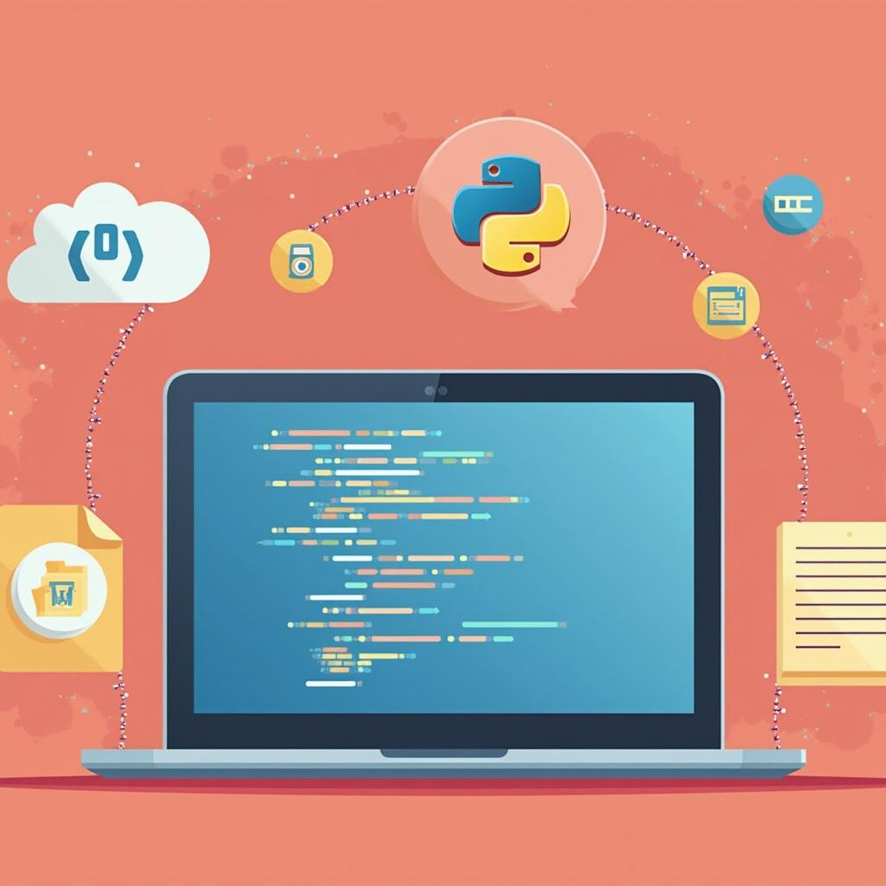
Introduction
This presentation covers the extraction of structured data from Flipkart’s laptop listings using Python. It focuses on the web scraping process, methodology, and key technical steps to collect and manage relevant product information efficiently and accurately.

Slide 3
01
Web Scraping Process

Slide 4
Understanding Web Scraping
Web scraping is the automated process of retrieving data from websites. It involves sending requests to web pages, parsing the HTML content, and extracting relevant information. This technique helps convert unstructured web data into structured datasets for analysis and decision-making.

Slide 5
Workflow and Methodology
The workflow includes sending URL requests, parsing the obtained HTML using libraries like BeautifulSoup, extracting specific laptop details, validating the data for consistency, and storing it locally. Pagination is controlled to handle multiple pages with delays to respect server limits and ensure smooth data collection.

Slide 6

Pagination and Data Handling
To manage multi-page scraping, the process navigates through 10 Flipkart pages with controlled delays between requests to avoid IP blocking. This ensures smooth data retrieval. Data handling involves extracting key laptop attributes consistently and validating entries to maintain accuracy and completeness despite varying HTML structures across pages.

Slide 7
02
Technical Considerations

Slide 8
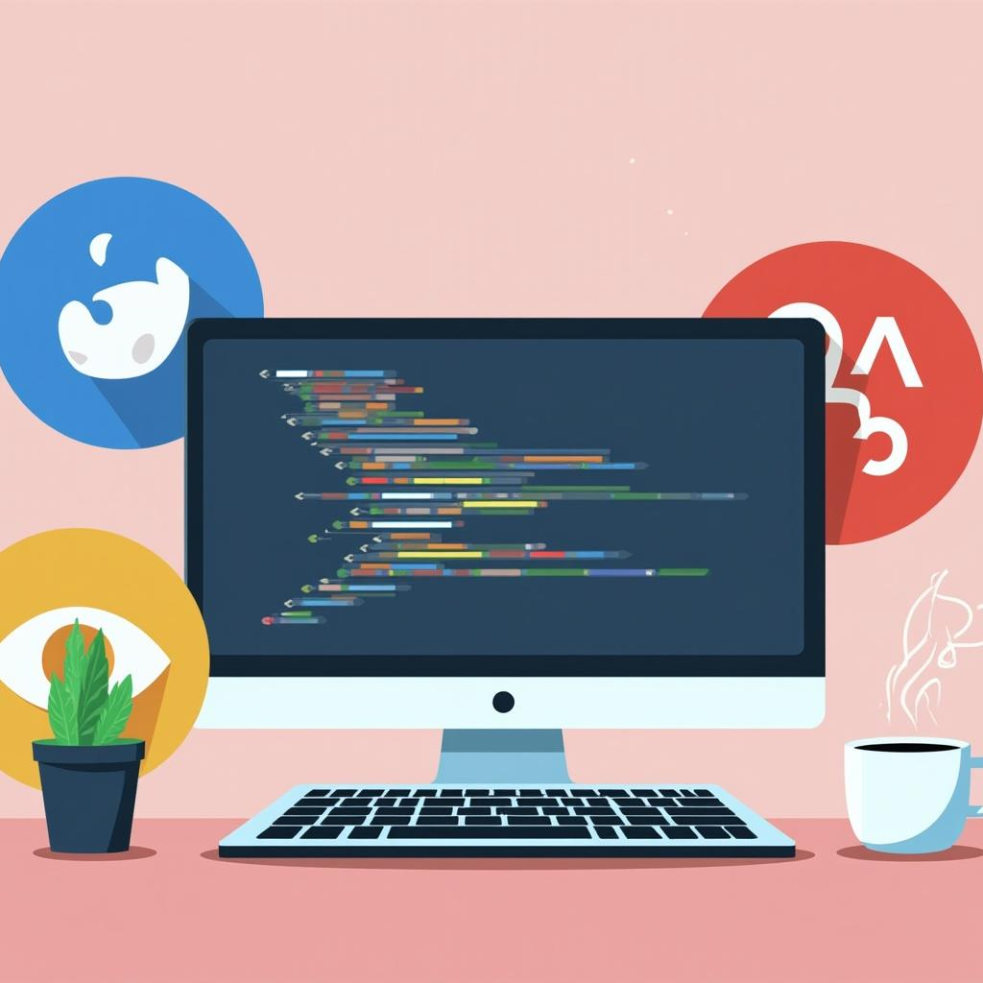
Tools and Technologies Used
The project uses Python for scripting, with Requests to send HTTP calls and BeautifulSoup for parsing HTML. Pandas assists in organizing and storing data in structured formats such as CSV files. These tools combine to provide an efficient and flexible scraping environment.

Slide 9
Data Quality and Challenges
Challenges include handling inconsistent HTML tags, missing fields, and dynamic content generation. The website’s structure may change, complicating extraction. Additionally, some data is location-specific, requiring techniques to manage such variability without compromising data integrity.

Slide 10
Output Management and Usage
Extracted laptop details are saved locally in structured files suitable for further analysis. This output supports market research or pricing insights. Proper file management ensures data is accessible, well-organized, and ready for integration with analytical tools.

Slide 11

Conclusions
This project offers practical experience in real-world web scraping, showcasing how to overcome dynamic content challenges and ensure data quality. The methodology and tools demonstrated provide a robust foundation for extracting and managing structured e-commerce data efficiently.

Slide 12
Thanks!
Do you have any questions?
saisrikarccbp@gmail.com
+91 9390480266
Please keep this slide for attribution

