Slide 1
FUNDAMENTALS OF
WEB DEVELOPMENT

Slide 2
Web Designing is an essential skill for future web and full-stack developers.
The course offers a fun hands-on learning experience compared to traditional programming.
Students gain confidence by writing real code and building websites.
It improves logical thinking, creativity, and problem-solving skills.
Regular practice, patience, and curiosity help in mastering modern web technologies.

Slide 3
Session Objectives
Understand Internet basics
Internet vs Web
Client–Server model
HTTP & HTTPS protocols
Importance of secure communication

Slide 4

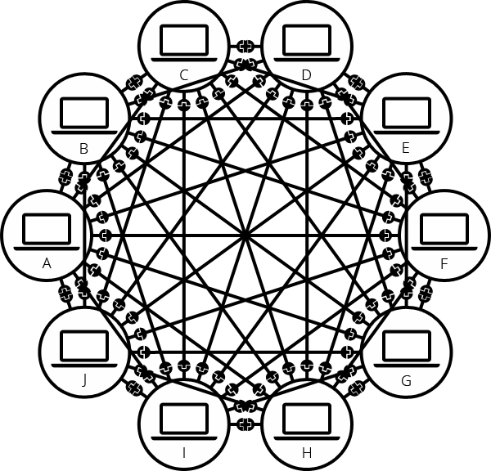
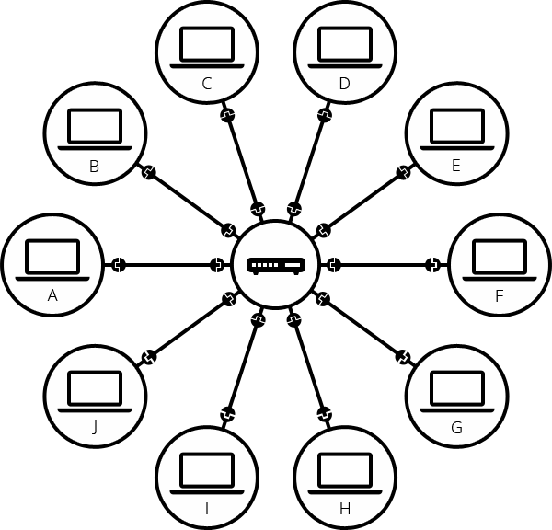
What is the Internet?
Simple network
Network of 10 computers
Interconnection of computers using a Switch

Slide 5
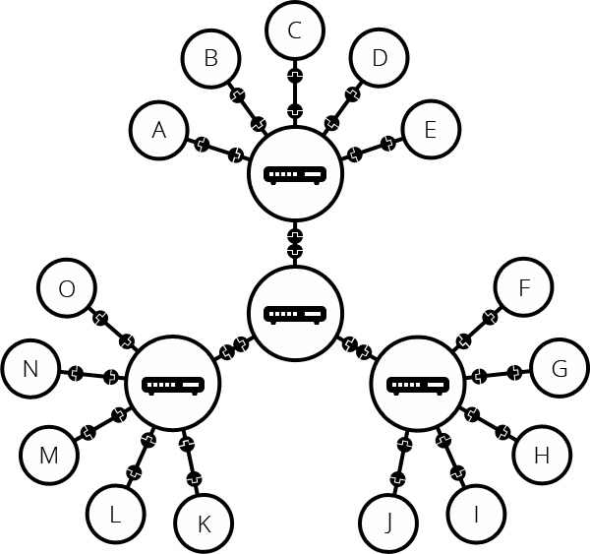
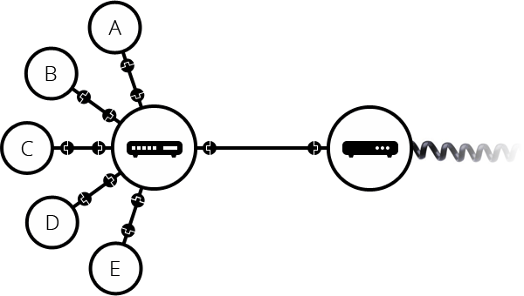
What is the Internet?
A network of networks
Systems connected using switch
Commercial router in your home is combination of a switch, a router and a modem, all in one device
Systems connected to modem

Slide 6
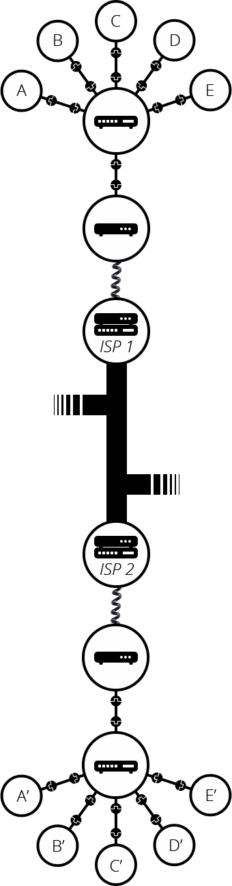
What is the Internet?
Uses cables, Wi-Fi, routers, ISPs

Slide 7
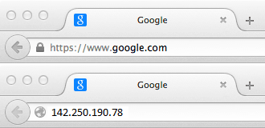
What is the Internet?
Finding Computers : “IP address”
Gmail.com - 142.250.190.29
Outlook.com - 40.100.156.148
Facebook.com – 157.240.229.35

Slide 8
IP Address / Domain Name
• instagram.com → 157.240.229.174
• twitter.com (x.com) → 104.244.42.1
• linkedin.com → 108.174.10.10
• amazon.com → 176.32.103.205
• flipkart.com → 163.53.78.130
• ebay.com → 66.135.195.87
• youtube.com → 142.250.190.46
• netflix.com → 52.26.14.173
• spotify.com → 35.186.224.47
• github.com → 140.82.121.4
• stackoverflow.com → 151.101.1.69
• wikipedia.org → 208.80.154.224

Slide 9
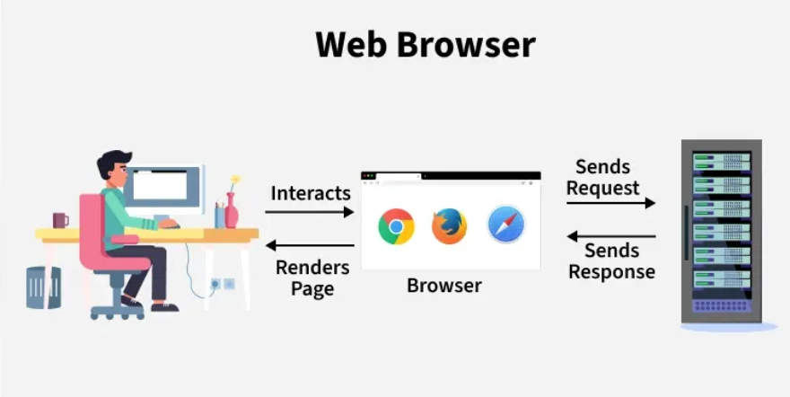
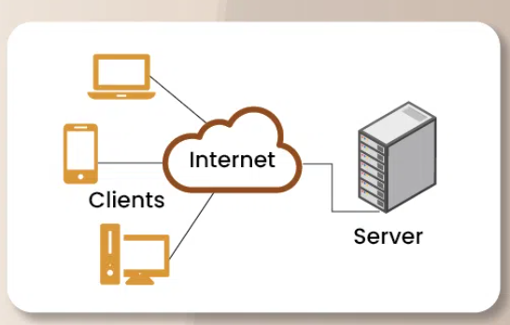
Client – Server Model
Client (Browser)
↓ Request
Server
↑ Response

Slide 10
Internet vs World Wide Web
Internet:
Is a technical Infrastructure which allows billions
of computers to be connected all together.
Among those computes, some computers( called web servers) can send messages to web browsers.
World Wide Web:
Web is a place on the internet where websites live to access by the users.
Web is a service on the internet to run web sites

Slide 11
Web Fundamentals
Webpage:
A document that can be displayed in a web browser, such documents written the HTML language.
Website:
A collection of web pages grouped together into a single source, with links connecting them together.
Web server:
A computer that hosts a website on the internet
Web Browser:
A software that responds to requests over the internet to perform a function or provide data

Slide 12
Web Fundamentals
Search Engine:
A web service that helps you find other web pages, such as google, bing etc.
URL, an address system that keeps track of Web documents
HTTP, a transfer protocol to find documents when given their URLs
HTML, a document format allowing for embedded hyperlinks

Slide 13
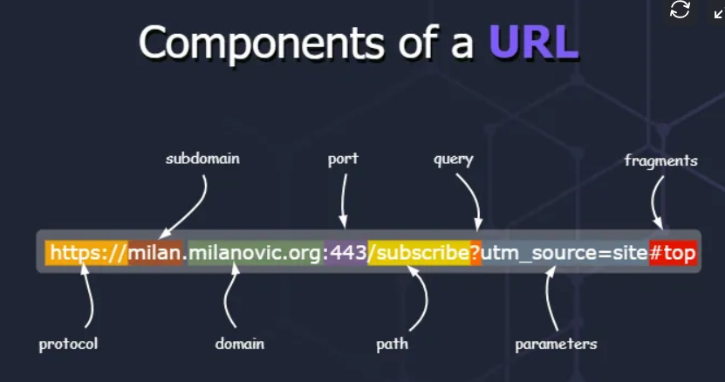
URL

Slide 14
Client – Server Model
Client (Browser)
↓ Request
Server
↑ Response

Slide 15
What is HTTP and HTTPS?
HyperText Transfer Protocol
Rulebook for communication
Stateless protocol
Uses request & response

Slide 16
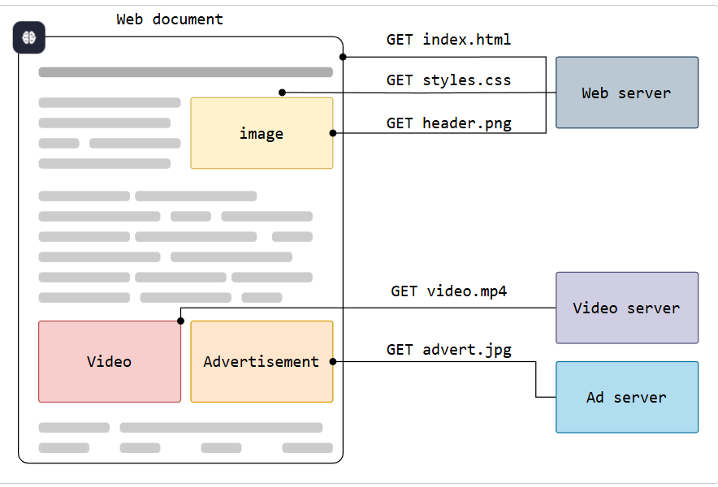
Overview of HTTP

Slide 17
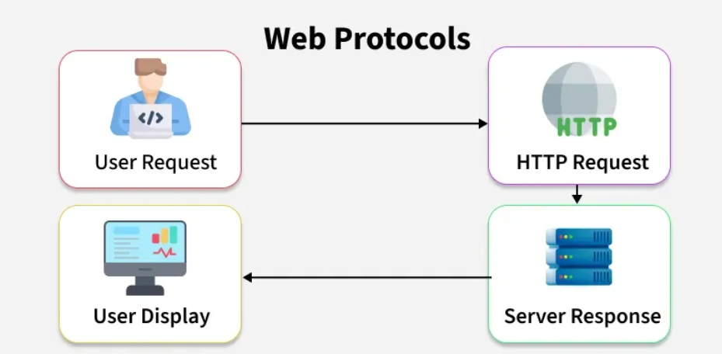
HTTP Request–Response
Client → HTTP Request → Server
Client ← HTTP Response ← Server

Slide 18
HTTP Request
HTTP requests are messages sent by the client to initiate an action to the server
HTTP request includes
Start Line
URL
HTTP Method
GET
POST
PUT
DELETE
HTTP Version
Headers
Body

Slide 19
HTTP Response
HTTP Responses are messages sent by the server as an answer to the client requests.
HTTP Response includes
Status Line
HTTP version
Status Code
1XX
2XX
3XX
4XX
5XX
Status Test
Headers
Body

Slide 20
Status Text
200 OK
204 No response
301 Moved permanently
401 Unauthorized
403 Forbidden
404 Not Found

Slide 21
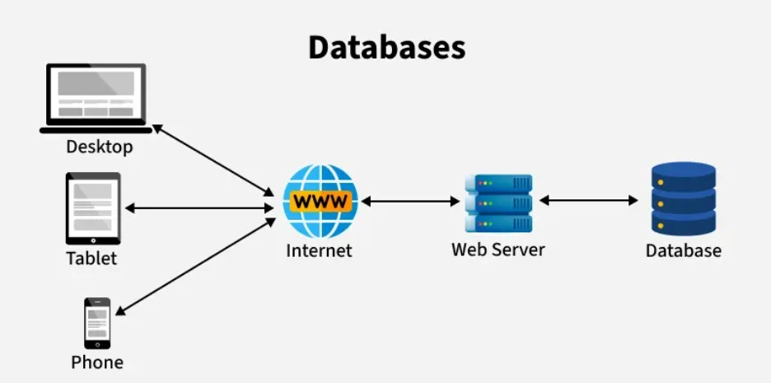
Why HTTPS is Important?
Protects passwords
Secure payments
Mandatory for modern websites

Slide 22
Application Development
Front End Development
Technologies : HTML, CSS, javascript
javascript Frameworks : react.js, Angular, Vue.js
Back End Development
Full Stack Development

Slide 23
Back-end development
Back-end development handles server-side logic:
👉 processing requests
👉 interacting with databases
👉 authentication & authorization
👉 business logic
👉 APIs that connect front end ↔ databaseB

Slide 24
Back-end Technologies
1. Technologies: java, python, javascript, php, c#
2. Frameworks : Springboot, Hibernate, Django, Flask, Express.js, NetJs
3. MYSQL, SQL Server, MongoDB, Cassandra
4. API & Communication : REST API, SOAP, GraphQL
5.Authorization & Security: JSON web Tokens, HTTPS.
6. Servers & Deployment: Web server – Apache, Containers –Docker, Cloud platforms – AWS, IBM, Azure,
CI/CD – GitHub Actions, Jenkins
7. Version Control and Code Management: Git, GitHub, postman (API Testing), Swagger(API Documentation)

Slide 25
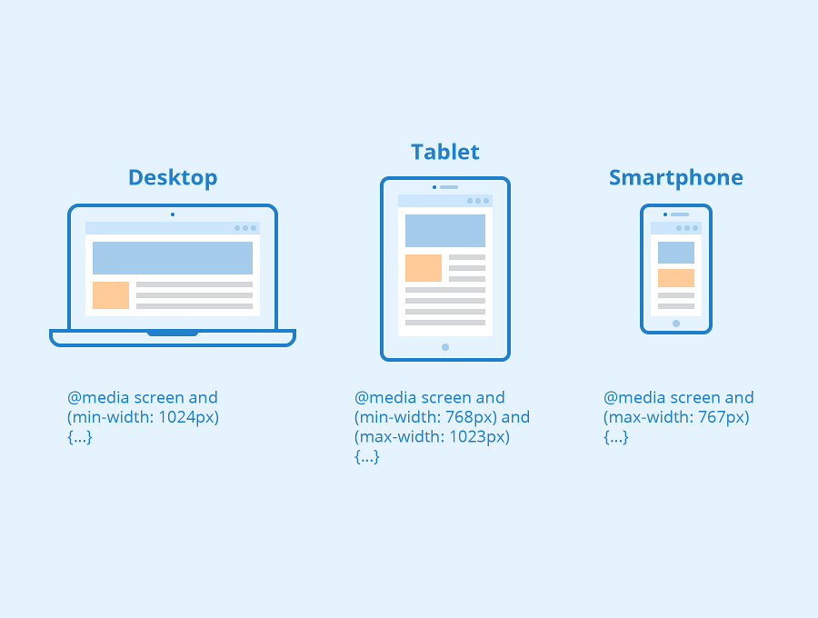
Responsive Web Development
Responsive web development ensures that the same webpage layout adapts automatically to different screen sizes (mobile, tablet, desktop).

Slide 26
Technologies used
CSS Media Queries
Flexible grids (Flexbox, CSS Grid)
Relative units (% , vw, vh)

Slide 27
Dynamic Web Development
Dynamic web design creates webpages where content changes based on user actions, data, or time.
Technologies Used
JavaScript (DOM, AJAX)
Server-side languages (PHP, Node.js, Python)
Databases (MySQL, MongoDB)

