Slide 1
Chapter 2
Browsers, Hosting, and Domains

Slide 2
Browser Basics
A web browser is a software application used to access, retrieve, and display web pages from the internet.
Examples:
Chrome
Firefox
Safari
Edge
Opera

Slide 3
Browser Basics
Responsibilities of Browser
Send requests to web server
Receive html, css, javascript images
Render content visually
Execute Javascript
Ensure security ( HTTPS)

Slide 4
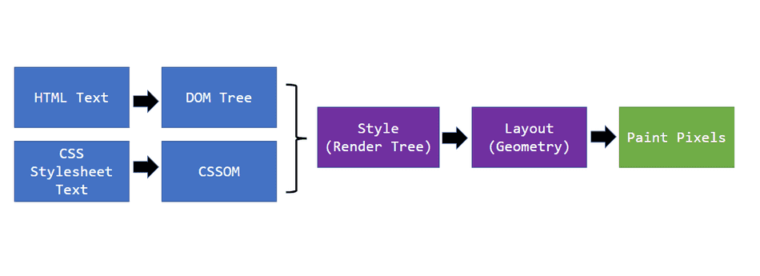
Rendering and steps
Process of converting HTML, CSS, JS into visual output.
HTML → DOM
CSS → CSSOM
DOM + CSSOM → Render Tree
Layout → Paint

Slide 5
Rendering Steps
1. HTML Parsing
Browser reads HTML line by line , Builds DOM (Document Object Model) tree
2. CSS Parsing
Reads CSS files and styles, Creates CSSOM (CSS Object Model)
3. Render Tree Creation
Combines DOM + CSSOM, Includes only visible elements
4. Layout (Reflow)
Calculates size and position of elements, Determines where elements appear on screen
5. Painting
Colors, borders, images are drawn
6. JavaScript Execution
JS can modify DOM/CSS, May trigger reflow or repaint

Slide 6
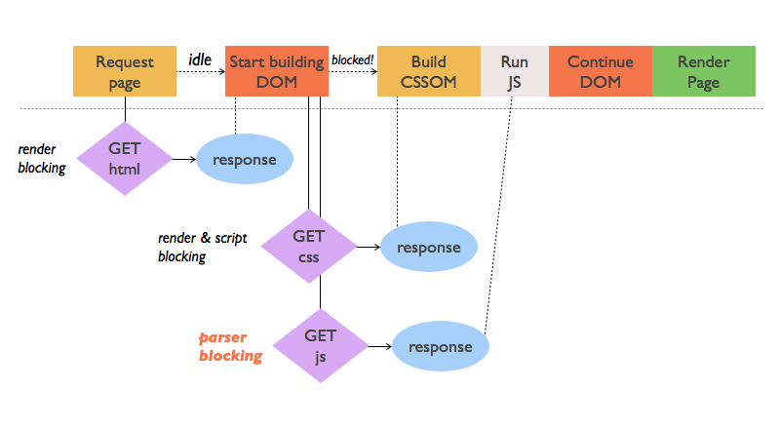
Rendering Steps

Slide 7
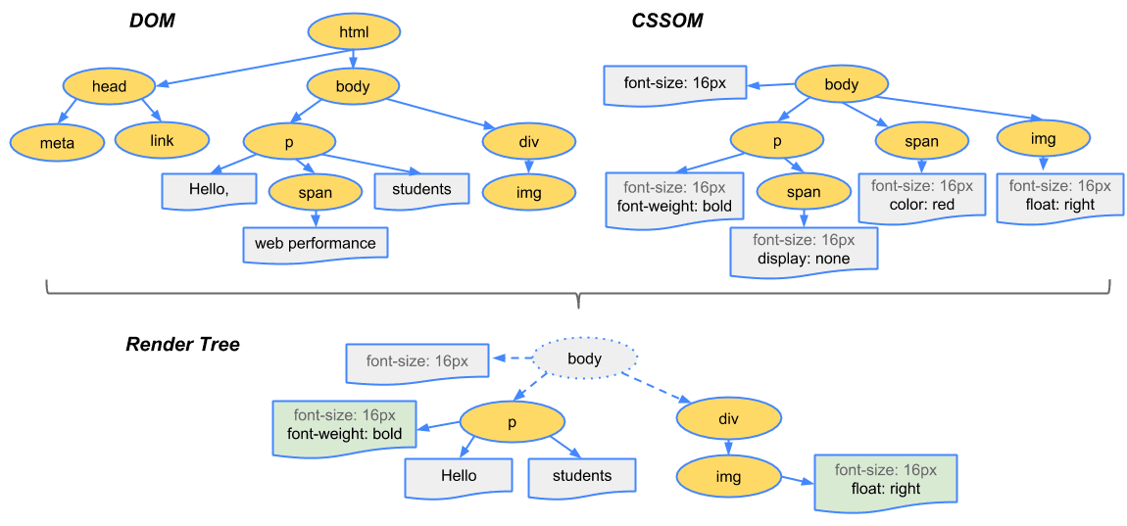
Rendering Steps

Slide 8
Developer Tools
Developer Tools (DevTools) are built-in tools in browsers used to inspect, debug, and optimize web pages.
How to Open DevTools
Right click → Inspect
Keyboard:
F12
Ctrl + Shift + I

Slide 9
DevTools Tabs
1. Elements
2. Console
3. Network
5. Sources
6. Application

Slide 10
1. Elements Tab
View & edit HTML and CSS, Live changes (temporary), Useful for layout debugging
2. Console Tab
Displays JavaScript errors, Run JS commands, Debug scripts
3. Network Tab
Shows all files loaded, Measures loading time, Helps find slow resources
4. Sources Tab
View JavaScript files, Add breakpoints, Debug step-by-step
5. Application / Storage
Cookies, Local Storage, Session Storage

Slide 11
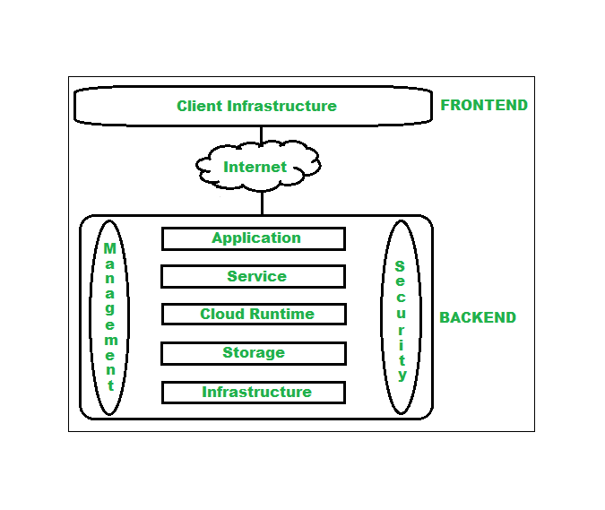
Web Hosting
Web hosting is a service that stores website files on a server and makes them accessible via the internet.
Websites must be available 24/7
Servers provide storage, bandwidth, security

Slide 12
How Web Hosting Works
Website files stored on server
User enters domain name
Browser requests server
Server sends website data
Browser displays page

Slide 13
Hosting Types
Hosting Type Description
Shared Hosting Multiple websites (Hostinger, Godaddy) share one server
VPS Hosting Virtual private (AWS EC2) resources
Dedicated Hosting One server for one (Bluehost) website
Cloud Hosting Uses multiple servers
(AWS cloud, IBM, Azure)

Slide 14
Realtime Examples
Shared Hosting → College websites, personal blogs
VPS Hosting → Startup websites, learning management systems
Dedicated Hosting → Banking systems, large e-commerce websites
Cloud Hosting → Netflix-like apps, scalable enterprise systems

Slide 15
Domain Concepts
Human-readable website address
Structure of a Domain Name (www.klh.edu.in)
Protocol: https
Subdomain: www
Domain name: klh
TLD: .in SLD: .edu

Slide 16
Types of Domains
Top-Level Domains (TLDs):
.com – Commercial
.org – Organization
.edu – Education
.gov – Government
.in – India

Slide 17
DNS
Converts domain names into IP addresses
Example:
google.com → 142.250.195.14
Acts like the internet phonebook

Slide 18
Domain Registration
Domains are purchased from registrars
Valid for limited years, Must be renewed periodically
Popular Domain Registrars
GoDaddy
Namecheap
Google Domains
Bluehost
Hostinger
BigRock

Slide 19
Summary
Browser, Rendering, DevTools, Hosting, Domains, DNS

