Slide 1
Cardio Wave Net
Heartbeat classification from ECG wavelet scalograms with a compact 2-D CNN
The problem
Our approach
Since mid-review
▪ Arrhythmia diagnosis needs beat-by-beat review of long Holter ECGs (~100,000 beats/day).
▪ Manual review is slow and tiring; rare abnormal beats are easy to miss.
▪ Cut each beat around its R-peak and convert it to a CWT scalogram (time x frequency image).
▪ Classify it with CardioWaveNet into the 5 AAMI EC57 classes: N, S, V, F, Q.
▪ Scaled from 4 records to all 48 MIT-BIH records.
▪ Designed, trained and evaluated CardioWaveNet; built a Streamlit demo.
Presented by: P Sai Sri Ram
Cardio Wave Net · ECG beat classification
1 / 11
Notes:
Arrhythmias are abnormal heartbeats. A 24-hour Holter recording contains around 100,000 beats, so manual review is slow. CardioWaveNet automates beat-level classification: each beat becomes a CWT scalogram, and a compact 2-D CNN assigns one of the 5 AAMI classes. At mid-review I used 4 records; for this review I scaled to all 48 records, trained and evaluated the model, and built a live demo.

Slide 2
Literature Review
From hand-crafted features to CNNs on beat images and scalograms
Study | Method | Relevance to CardioWaveNet
de Chazal et al., 2004 (IEEE TBME) | Hand-crafted morphology + RR-interval features, linear discriminant classifier | Set up the inter-patient (DS1/DS2) protocol; features need expert design
Kiranyaz et al., 2016 (IEEE TBME) | Compact 1-D CNN, patient-specific training | Small CNNs learn features directly from beats; cheap enough for real time
Acharya et al., 2017 (Comput. Biol. Med.) | 9-layer 1-D CNN, 5 AAMI classes, synthetic data to balance classes | ~94% accuracy; shows class imbalance must be handled explicitly
Kachuee et al., 2018 (IEEE ICHI) | Deep residual 1-D CNN on MIT-BIH, 5 AAMI classes | ~93% average accuracy; learned features transfer to MI detection
Jun et al., 2018 (arXiv) | Each beat drawn as a 128x128 grayscale image, VGG-style 2-D CNN | 2-D CNNs on beat images work well; motivates our 128x128 input
Wang et al., 2021 (Entropy) | CWT scalograms + 2-D CNN, with RR-interval features | Closest to our work: scalograms expose time-frequency patterns to a CNN
This work: CardioWaveNet | CWT (Morlet) scalogram, 4-block 2-D CNN with GAP, ~107k parameters | All 48 records, AAMI 5-class, class-weighted loss, live Streamlit demo
Cardio Wave Net · ECG beat classification
2 / 11
Notes:
The field moved from hand-crafted features (de Chazal) to 1-D CNNs (Kiranyaz, Acharya, Kachuee) to 2-D CNNs on beat images and scalograms (Jun, Wang). We follow the 2-D scalogram line but keep the network compact.
References:
de Chazal P, O'Dwyer M, Reilly RB. IEEE TBME 51(7):1196-1206, 2004.
Kiranyaz S, Ince T, Gabbouj M. IEEE TBME 63(3):664-675, 2016.
Acharya UR et al. Computers in Biology and Medicine 89:389-396, 2017.
Kachuee M, Fazeli S, Sarrafzadeh M. IEEE ICHI 2018.
Jun TJ et al. arXiv:1804.06812, 2018.
Wang T et al. Entropy 23(1):119, 2021.
Moody GB, Mark RG. IEEE EMB Magazine 20(3):45-50, 2001 (MIT-BIH).

Slide 3
Dataset & Beat Classes
MIT-BIH Arrhythmia Database mapped to the AAMI EC57 standard
Class | Meaning | MIT-BIH labels | Images used
N | Normal (incl. bundle branch block) | N, L, R, e, j | 9,056
S | Supraventricular ectopic | A, a, J, S | 2,779
V | Ventricular ectopic | V, E | 7,235
F | Fusion of normal + ventricular | F | 802
Q | Paced / unclassifiable | /, f, Q | 8,037
Total |  |  | 27,909
MIT-BIH at a glance
▪ 48 half-hour, two-channel ambulatory ECG recordings from 47 subjects
▪ 360 Hz sampling, 11-bit resolution
▪ ~110,000 beats annotated by two or more cardiologists
▪ Channel 0 used (modified lead II in most records)
▪ Mid-review: 4 records. Now: all 48 records
▪ Normal beats are kept 1 in 10 at extraction (N is ~80% of all MIT-BIH beats).
▪ Remaining imbalance is handled with a class-weighted loss (slide 8).
Cardio Wave Net · ECG beat classification
3 / 11
Notes:
AAMI EC57 groups the MIT-BIH beat labels into 5 classes, which is the standard way to report results so they are comparable across papers. The image counts in the table come straight from the generated scalogram folders.

Slide 4



Methodology: ECG Beat to Scalogram
Every beat becomes a 128x128 time-frequency image
MIT-BIH ECG
48 records · 360 Hz
Beat window
-100 / +150 samples
around R-peak
CWT
Morlet wavelet
scales 1-63
Scalogram
|coef| scaled 0-255
128x128 PNG
CardioWaveNet
2-D CNN
5 AAMI classes
N · S · V · F · Q
Why a CWT scalogram?
Example scalograms
▪ FFT: shows which frequencies exist but loses when they occur.
▪ STFT: one fixed window cannot resolve both the sharp QRS and slower waves.
▪ CWT: multi-resolution. Short wavelets (small scales) resolve the sharp QRS; long wavelets (large scales) capture slower components.
▪ Morlet: a smooth oscillating wavelet that resembles QRS morphology; widely used for ECG scalograms.
Normal
Supraventricular
Ventricular
Rows = scale, columns = time. Window: 100 samples (278 ms) before the R-peak keeps the P wave; 150 samples (417 ms) after keeps the ST segment and T wave.
Cardio Wave Net · ECG beat classification
4 / 11
Notes:
Each beat is cut 100 samples before and 150 after the annotated R-peak, about 0.7 s in total, which covers P wave, QRS and T wave at normal heart rates. The CWT with a Morlet wavelet gives a time-frequency image: sharp, high-frequency QRS energy shows at small scales, slower content at larger scales. Magnitudes are min-max scaled to 0-255 and resized to 128x128.

Slide 5
CardioWaveNet Architecture
4 convolutional blocks + global average pooling + small classifier head
Input
128×128×1
÷255 rescale
Block 1
Conv 3×3, 16
ReLU → BN
MaxPool 2×2
64×64×16
Block 2
Conv 3×3, 32
ReLU → BN
MaxPool 2×2
32×32×32
Block 3
Conv 3×3, 64
ReLU → BN
MaxPool 2×2
16×16×64
Block 4
Conv 3×3, 128
ReLU → BN
(no pool)
16×16×128
Global Avg
Pool
128
Dropout 0.4
Dense 64
ReLU
Dense 5
Softmax
N S V F Q
Feature extractor (4 conv blocks)
Classifier head
106,693 parameters
≈0.43 MB of weights: trains on a laptop CPU, real-time inference
Receptive field 38×38 px
≈206 ms of the beat: wide enough for a wide ventricular QRS
GAP instead of Flatten
Flatten + Dense(64) alone would need 2.1 M weights (≈20× the whole model)
Cardio Wave Net · ECG beat classification
5 / 11
Notes:
Input scalograms are rescaled to 0-1. Each of the first three blocks is a 3x3 convolution, ReLU, batch normalisation and 2x2 max pooling, halving the resolution while doubling the filters. Block 4 has no pooling, keeping a 16x16 map. Global average pooling turns 16x16x128 into 128 numbers, followed by dropout 0.4, a 64-unit dense layer and a 5-way softmax. Total 106,693 parameters; this can be verified with `python model.py`.

Slide 6
Why This Architecture? (1) Feature Extractor
Design derived from the input image and ECG physiology
▪ Why a 2-D CNN? A scalogram is an image whose diagnostic cues are local shapes: the QRS energy blob, its width and frequency spread. Convolutions share weights and tolerate small R-peak misalignments.
▪ Why 3×3 kernels? Two stacked 3×3 layers see a 5×5 region with 18 instead of 25 weights per channel pair, plus an extra non-linearity (VGG principle).
▪ Why 16→32→64→128? Each pooling halves resolution, so filters double to keep capacity balanced: edges early, whole-beat patterns late.
▪ Why 4 blocks? Chosen from the receptive field (table).
Receptive field vs. ECG physiology
Depth | RF (px) | ≈ Time | What fits inside
Block 1 | 3 | 16 ms | Slopes, sharp edges
Block 2 | 8 | 43 ms | Wave fragments (R upstroke)
Block 3 | 18 | 98 ms | A normal QRS (80-100 ms)
Block 4 (used) | 38 | 206 ms | Wide ventricular QRS (>120 ms) + context
Block 5 (not used) | 78 | 424 ms | Most of the beat; +0.3 M params (≈4× model)
1 px on the time axis = 250 samples ÷ 128 px ÷ 360 Hz ≈ 5.4 ms.
4 blocks = the shallowest network whose receptive field covers a wide ventricular QRS; a 5th block costs ~4× the parameters for context the task does not need.
Cardio Wave Net · ECG beat classification
6 / 11
Notes:
Receptive field is computed with r_out = r_in + (k-1)*j_in and j_out = j_in*s. After block 3 a unit sees about 98 ms, roughly a normal QRS. Ventricular beats have wide QRS complexes above 120 ms, so we need block 4, which sees about 206 ms. A fifth block would see 424 ms but almost quadruple the parameters. These are theoretical receptive fields; the effective field is smaller and centred, which is another reason not to go shallower than 4 blocks.

Slide 7
Why This Architecture? (2) Head & Regularisation
Each choice compared with the obvious alternative
Design choice | Alternative | Why we chose it
Global Average Pooling | Flatten + Dense | Flatten gives 32,768 features → 2.1 M weights in one layer for ~19,536 training images. GAP gives 128 features (8,256 weights): less overfitting, position-tolerant.
BatchNorm after every conv | No normalisation | Keeps activations well-scaled so Adam can use lr = 1e-3, converges in fewer epochs, adds mild regularisation.
Dropout 0.4, head only | None / everywhere | Overfitting risk concentrates in the dense head; conv layers are already regularised by BN and weight sharing.
Compact custom CNN (~0.1 M) | ImageNet ResNet-50 (~25 M) / VGG-16 (~138 M) | Scalograms are 1-channel, non-natural images; modest dataset; must train on a CPU and run live in Streamlit.
Softmax + sparse cross-entropy | Sigmoid / one-vs-rest | AAMI classes are mutually exclusive; labels are stored as integers 0-4.
Evidence for the design (formal ablation planned for the final review)
① Receptive field sized to QRS physiology ② ~107k parameters suits ~19,536 training images ③ Learning curves monitored for overfitting (slide 9) ④ Follows proven CNN-for-ECG designs (Kiranyaz 2016, Jun 2018, Wang 2021)
Cardio Wave Net · ECG beat classification
7 / 11
Notes:
I have not run an ablation study yet, so I justify each choice by reasoning and evidence. GAP versus Flatten is the biggest one: Flatten would put 2.1 million weights in a single layer, about 20 times the whole model. Batch norm stabilises training. Dropout sits only in the head. Transfer learning from ImageNet was not used because scalograms are single-channel and look nothing like natural photos, and those models are 200 to 1000 times larger. The planned ablation is listed on the final slide.

Slide 8
Training Strategy
Handling class imbalance and avoiding overfitting
▪ Split: stratified 70 / 15 / 15 (train / val / test), fixed seed 42; the test set is never seen during training.
▪ Imbalance, step 1: keep 1 in 10 normal beats at extraction.
▪ Imbalance, step 2: 'balanced' class weights w_c = n / (K · n_c): rare classes cost more when misclassified, without duplicating images.
▪ Optimiser: Adam, lr 1e-3, batch 64, up to 30 epochs.
▪ Callbacks: EarlyStopping on val loss (patience 5, restore best), ReduceLROnPlateau (×0.5 after 2 flat epochs), ModelCheckpoint keeps the best model.
▪ This run: Run train.py to fill in the training summary.
Class weights (≈, from image counts)
Class | Images | Weight
N · Normal | 9,056 | 0.62
S · Supraventricular | 2,779 | 2.01
V · Ventricular | 7,235 | 0.77
F · Fusion | 802 | 6.96
Q · Paced/unknown | 8,037 | 0.69
Why not oversampling / SMOTE?
Duplicated or synthetic scalograms risk memorisation; weighting the loss is free and leaves the data untouched.
Cardio Wave Net · ECG beat classification
8 / 11
Notes:
Class weights are computed by scikit-learn's 'balanced' rule. Early stopping restores the epoch with the lowest validation loss, and the learning rate is halved whenever validation loss stalls for two epochs.

Slide 9
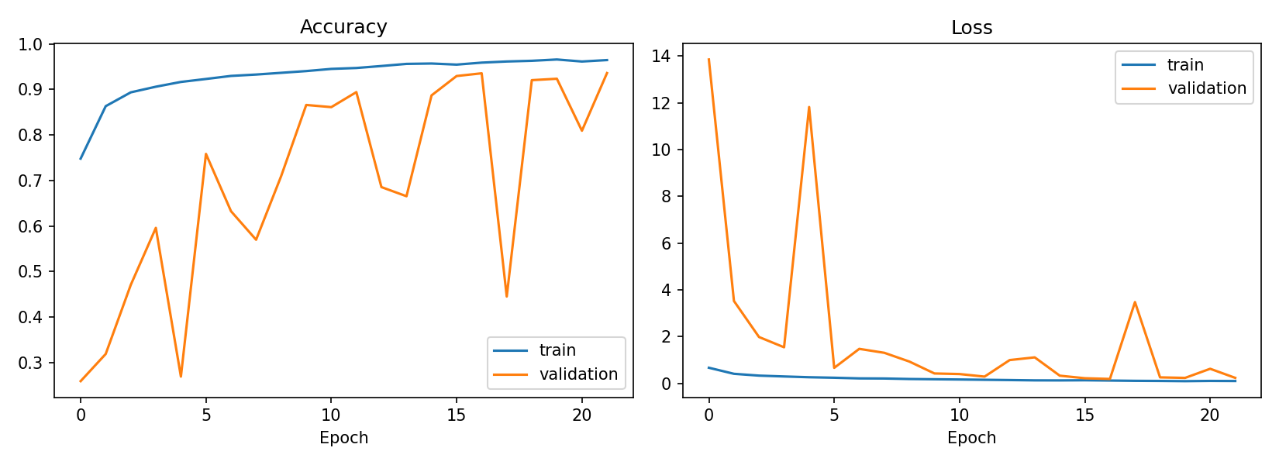
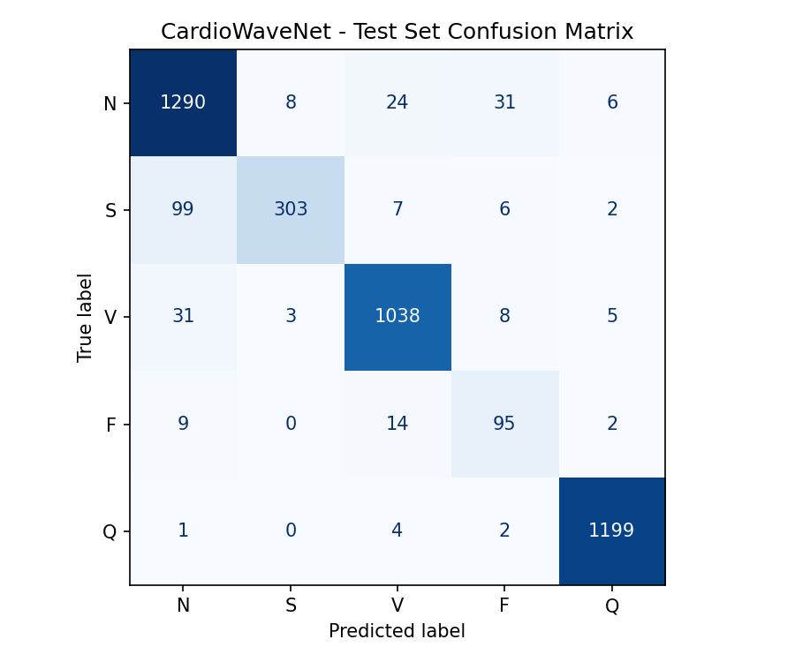
Results: Learning Curves & Confusion Matrix
Held-out test set (15%), never used for training or model selection
What the curves show
▪ Run train.py to fill in the training summary.
▪ Learning curves monitored for overfitting (slide 9).
▪ Run evaluate.py to fill in the confusion analysis.
Cardio Wave Net · ECG beat classification
9 / 11
Notes:
Left: accuracy and loss for training and validation. Training accuracy can sit below validation accuracy because dropout is active during training. Right: the test confusion matrix; the diagonal is correct predictions. S beats look like N beats in shape; what separates them is prematurity (RR interval), which a single-beat image cannot see, so S-N confusion is expected.

Slide 10
Results: Per-class Test Metrics & Demo
Macro-F1 is the headline metric for imbalanced classes
Class | Precision | Recall | F1 | Support
N · Normal | 0.902 | 0.949 | 0.925 | 1359
S · Supraventricular | 0.965 | 0.727 | 0.829 | 417
V · Ventricular | 0.955 | 0.957 | 0.956 | 1085
F · Fusion | 0.669 | 0.792 | 0.725 | 120
Q · Paced/unknown | 0.988 | 0.994 | 0.991 | 1206
93.7% Test accuracy
0.885 Macro F1
0.937 Weighted F1
▪ Strongest class: Q (F1 0.991). Weakest: F (F1 0.725, only 120 test beats).
▪ Macro-F1 weights every class equally; accuracy is dominated by the large classes.
Live demo: streamlit run app.py
▪ Random beat of any class or an uploaded scalogram → predicted class, confidence and probability chart.
Cardio Wave Net · ECG beat classification
10 / 11
Notes:
Report macro-F1 first: because N, V and Q dominate the test set, plain accuracy can look high even if the rare F class is poor. Then switch to the Streamlit demo: pick a random V beat, show the prediction and probabilities, then open the Model performance tab.

Slide 11
Conclusion, Limitations & Future Work
Conclusions
Limitations
Future work
▪ Full pipeline on all 48 MIT-BIH records: R-peak window → CWT scalogram → CNN → AAMI class.
▪ CardioWaveNet: 4 conv blocks + GAP, ~107k parameters; depth set by a QRS-sized receptive field.
▪ Held-out test: accuracy 93.7%, macro-F1 0.885.
▪ Interactive Streamlit demo for single-beat inference.
▪ Beat-level random split: beats of the same patient appear in train and test, so scores are optimistic vs. inter-patient testing.
▪ No ablation study yet; design justified by analysis and literature.
▪ Single beat, single lead: no RR-interval (rhythm) context, the main cue for S beats.
▪ F class is tiny (802 images).
▪ Inter-patient evaluation with the de Chazal DS1/DS2 split.
▪ Ablation: 3 / 4 / 5 blocks, GAP vs Flatten, with/without BN and dropout.
▪ Add RR-interval features as a second input branch.
▪ Grad-CAM on scalograms to explain decisions; wider CWT scale range for slow P/T waves.
Thank you
Cardio Wave Net · ECG beat classification
11 / 11
Notes:
Be upfront about the split: a random beat-level split lets neighbouring beats of the same patient land in both train and test, which inflates scores. Most papers reporting 98-99% use this setup; the stricter inter-patient DS1/DS2 split is the next step, together with the ablation study and RR-interval features.

