Slide 1
What kind of payment
network are we?
R$ 35
median transaction
A portfolio review of the Elo card ledger, merchant base
and promotions programme | Q4 Strategy Offsite
SURYA TEJA THATAVARTI | SAMPATI RAO HIMANSHU RAO | MARURI SAI RAMA LINGA REDDY
BODDU HIMA VENKATA GANESHA SAISRIRAM | U V MADHAV RAO
TEAM ERROR 404
Notes:
SPEAKER 1 (0:00-0:40)
Good morning. We were asked one question: based on this data, what kind of payment network is Elo, and where should that point the Q4 promotions programme.
Our answer, in one number, is on the right: the median Elo transaction is thirty-five Reais. That is a lunch, not a television. Everything we recommend follows from that.
I'll cover how we got the data into a usable state, then hand over.

Slide 2
1
Before any analysis: three problems in the data
535,000 usable records once 948,575 blank Excel rows were stripped. Three problems still changed the numbers.
99
63
2,611
extreme records (0.1%) pulling the average ticket from R$88 to R$272 - trimmed from all value figures
merchant IDs listed twice with conflicting details - left in, they double-count ~5,000 transactions
transactions with instalments coded -1: payment type unknown, so kept out of instalment figures
Then we made the money readable
purchase_amount is normalised and unreadable. We adopted the Kaggle community's de-normalisation (raddar, 2019):
BRL = purchase_amount / 0.00150265 + 497.06
Validated twice. The distribution itself - minimum R$0.01, median R$35, no negative amounts - and an independent Benford's Law test on the leading digits, which returns a Mean Absolute Deviation of 0.0086: acceptable conformity. A wrong offset would distort it.
Honest limit: the two transaction files are different card samples - only 16 cards overlap - so every new-merchant finding is a portfolio-level comparison, never a within-card before/after.
Notes:
SPEAKER 1 (0:40-1:50)
First, the audit. Once we stripped the blank rows Excel had added to the new-merchant file, we had 535,000 usable records. Three problems in them would have changed our numbers.
Ninety-nine records - one in a thousand - were dragging the average ticket from eighty-eight Reais to two hundred and seventy-two, so every value figure is trimmed at the 99.9th percentile.
Sixty-three merchant IDs appear twice, and the two records disagree - on sales range, purchase volumes, even merchant group. Left in, a merchant join would double-count about five thousand transactions. We kept the first record of each.
And 2,611 transactions carry an instalment count of minus one and no category_3 - the payment type is unknown, so we leave them out of every instalment figure rather than guess.
The important step is at the bottom. purchase_amount is normalised, so nobody can read it. We used the affine de-normalisation the Kaggle community published for this dataset, and validated it ourselves, twice: by the result - no negative money, a median of thirty-five Reais, a coherent retail distribution - and with a Benford's Law test on the leading digits, which conforms with a mean absolute deviation of zero point zero zero eight six.
One honest limit before we go on: the two transaction files are different card samples, sixteen cards in common. So we compare windows, not the same card before and after.
Over to [Speaker 2].
[If asked about the file size: the new-merchant file has 1,048,575 rows, but 948,575 are empty rows of commas that Excel padded out to its sheet limit. All 100,000 real transactions are there - nothing was lost.]

Slide 3
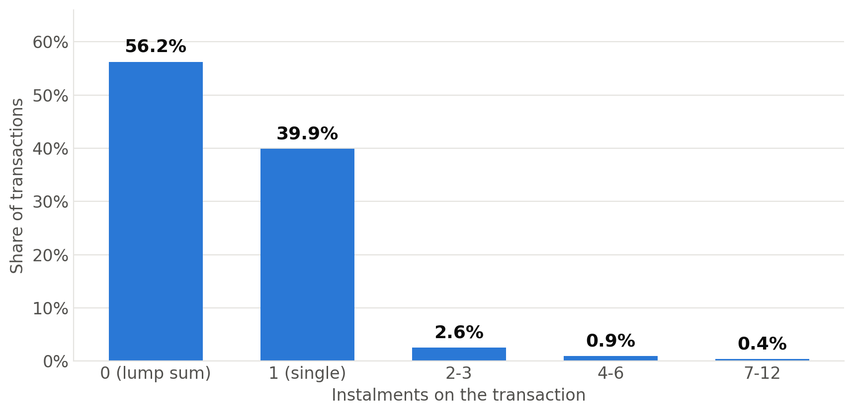
2
Elo is not an instalment network
96% of transactions settle in a single payment - in the country where parcelado defines the card market.
The identity answer: a high-frequency, small-ticket, everyday-spend network. Median ticket R$35, 63% of transactions under R$50, a lunchtime peak. It is the card for fuel, groceries and pharmacy - not for financing a television.
Notes:
SPEAKER 2 (1:50-3:00)
This single chart answers the Board's identity question.
In Brazil, parcelado - splitting a purchase across monthly instalments - is the defining behaviour of the card market. On our ledger it is almost absent. Fifty-six per cent lump sum, forty per cent single payment. Everything from two instalments up is under four per cent.
Put that next to a thirty-five Real median and a lunchtime transaction peak and the identity is settled: Elo is a high-frequency, small-ticket, everyday-spend network.
That matters because everything a promotions team is tempted to do - big-ticket instalment offers, electronics tie-ups - is aimed at a network we are not.

Slide 4
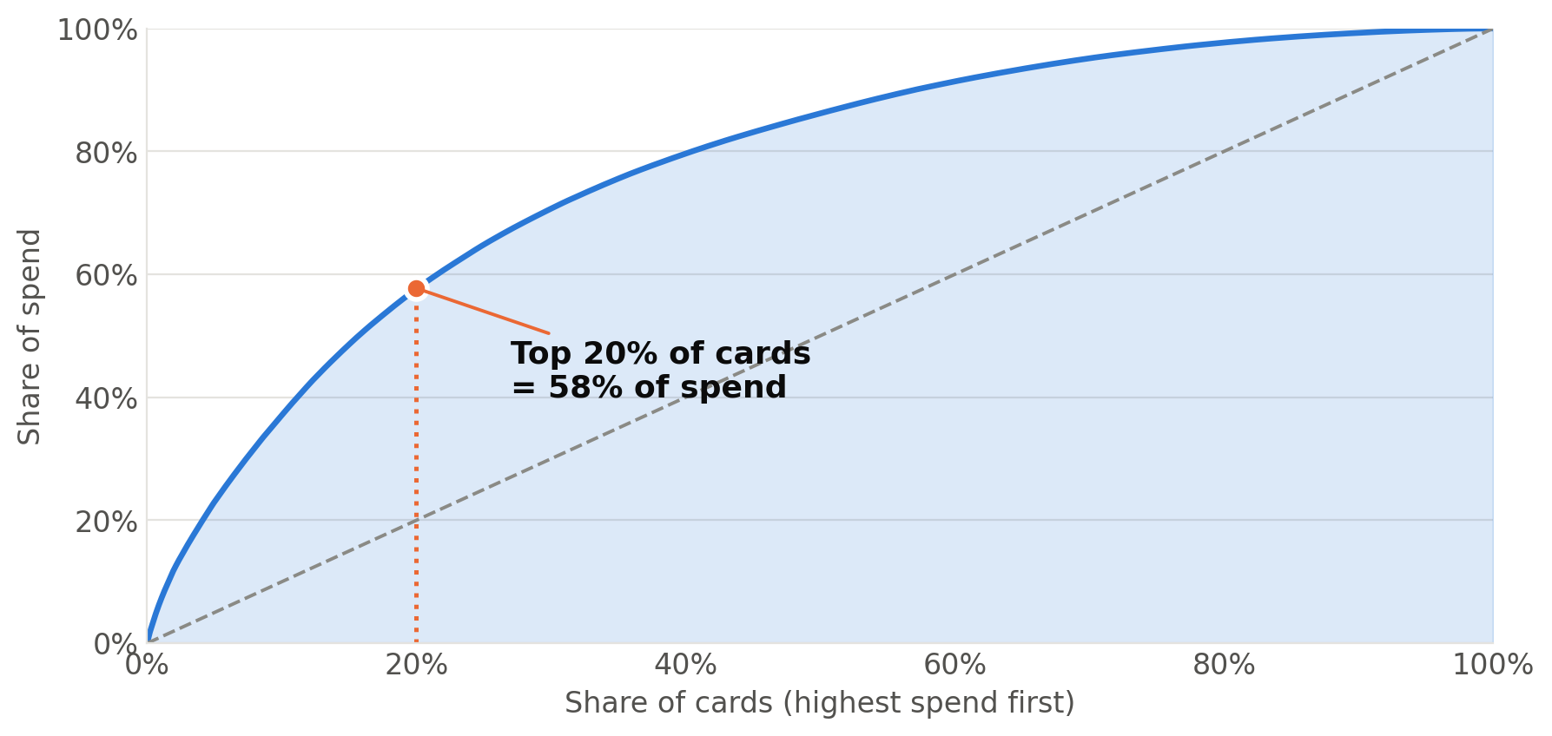
2
A fifth of the cards are the network
Top 20% of cardholders carry 58% of spend. The bottom half carry 14%.
SEGMENT
CARDS
SPEND
Core Everyday
37%
72%
Retain, defend top-of-wallet
Big-Ticket Narrow
13%
13%
Reactivate - 43 days since last use
Explorer Light
14%
7%
Discovery offers - 74 merchants, R$41 ticket
Gini 0.54 (95% CI 0.51-0.56). A k-means on the same variables also finds four distinct groups.
Occasional
36%
9%
Last call on the budget
Retention is not the problem - targeting is. 74% of an activation cohort is still transacting twelve months on. But 191 cards - 41% of the base, holding 31% of spend - are now past three times their own normal gap between active days.
Notes:
SPEAKER 2 (3:00-4:05)
Who actually transacts on our cards? The curve on the left says the portfolio is a steep Pareto: the top twenty per cent of cards carry fifty-eight per cent of spend, the bottom half carry fourteen.
So a promotions programme run as a broadcast spends most of its budget on cardholders who contribute almost nothing.
Splitting on value per month and merchant breadth gives four groups. Core Everyday is the network: a third of the cards, seventy-two per cent of the money, thirty-five transactions a month across a hundred and fifteen merchants, and the lowest decline rate. They don't need a discount - they need defending.
Big-Ticket Narrow is high value but last seen forty-three days ago - that is the reactivation target. Occasional is a third of the cards and nine per cent of spend.
The Gini coefficient is zero point five four, with a ninety-five per cent interval of zero point five one to zero point five six, so the concentration is not a sampling accident. And a k-means on the same variables also finds four distinct groups, so the structure is in the data, not in where we drew the line.
One more thing on the box at the bottom: retention is not the problem - seventy-four per cent of an activation cohort is still transacting a year later. But a hundred and ninety-one cards, holding thirty-one per cent of spend, are now past three times their own normal gap between active days. That is a targeting problem, and we come back to it in the recommendations.
Over to [Speaker 3].

Slide 5
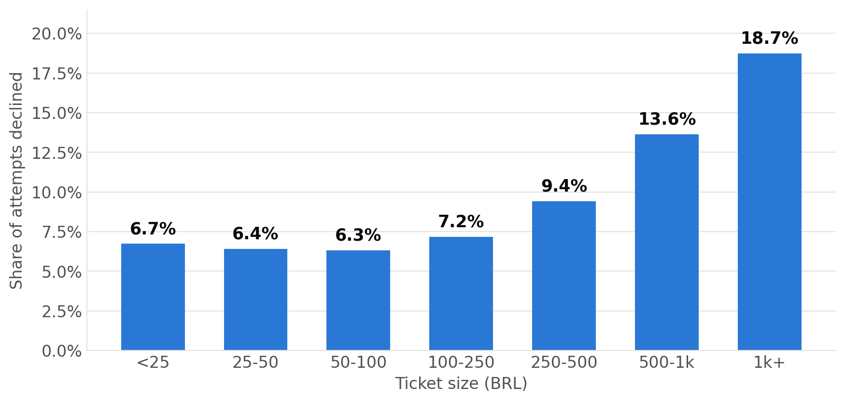
3
A 93% approval rate is hiding a targeted leak
Declines climb from 6.7% on small baskets to 18.7% above R$1,000 - worst exactly where a promotion pushes a trade-up.
4.3x
the odds of a decline when the flag category_1 = Y is present - 6.1% of all transactions
Logistic regression on 99,571 transactions
Amount and instalments both matter - but one anonymised risk flag dominates both.
Chi-square, instalments x authorisation: X² = 446, p < 0.001.
So what: a promotion that pushes cardholders to a bigger basket is pushing them into our weakest approval band. Before the Q4 calendar locks, risk should say what category_1 = Y represents - we may be promoting into a population we then turn away.
Notes:
SPEAKER 3 (4:05-5:10)
Ninety-three per cent approval sounds healthy. It isn't evenly spread.
Below twenty-five Reais we decline under seven per cent of attempts. Above a thousand, nearly nineteen. The network performs worst exactly where a promotion would be trying to push someone to spend more.
We ran a logistic regression to find out what actually drives a decline. It is not mainly the amount and not mainly the instalment plan - it is one anonymised flag, category_1 equals Y, which multiplies the odds of a decline by four point three. That flag sits on six per cent of volume.
So before Elo spends anything on Q4, the risk team should tell us what that flag means. Right now we may be promoting into a population we then turn away - that costs money twice.

Slide 6
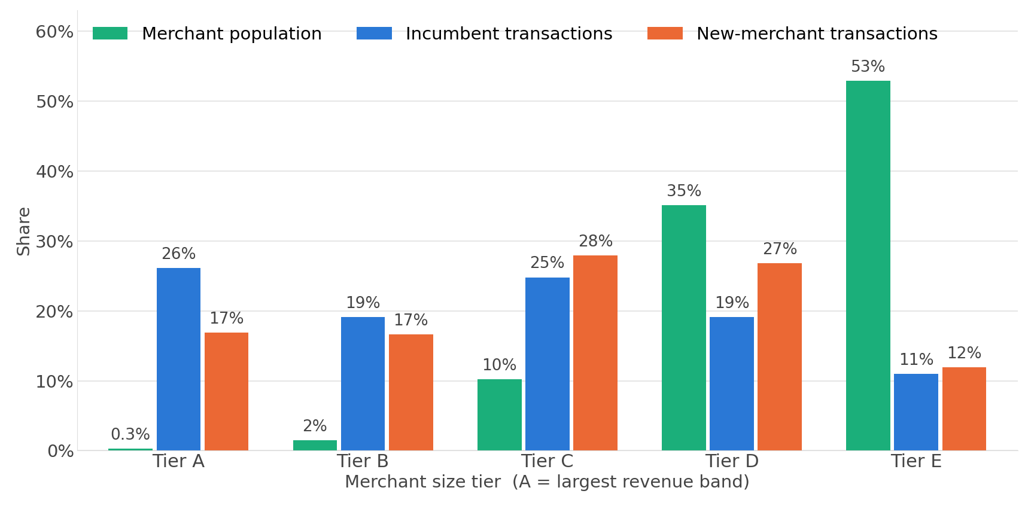
3
Discovery happens in the long tail, not at the top
Tier A is 0.3% of merchants and 26% of incumbent transactions - but only 17% of transactions at brand-new merchants.
So what: a promotion placed with a tier A merchant largely pays for traffic that was happening anyway. New relationships form in tiers C and D. Add the supply-side picture - 39% of merchants are decelerating, and 82% of the reference file never transacts at all - and the merchant base needs pruning as much as promoting.
Notes:
SPEAKER 3 (5:10-6:15)
Now the merchant side. Eighty-eight per cent of our merchants sit in the two smallest revenue bands. Tier A - the giants - is three-tenths of one per cent of the base.
Green is the merchant population, blue is where transactions at known merchants land, orange is where transactions at brand-new merchants land.
Look at tier A: twenty-six per cent of incumbent transactions, but only seventeen per cent of new-merchant transactions. Now tier D: nineteen per cent incumbent, twenty-seven per cent new.
New commercial relationships form in the long tail. A promotion at a tier A merchant is mostly paying for traffic that was coming anyway.
Two more facts: thirty-nine per cent of merchants are decelerating, and eighty-two per cent of the merchants in our reference file never transact at all. That file is an archive, not a marketplace.
Over to [Speaker 4].

Slide 7
4
The file everyone ignores is the one that matters
The new-merchant window is the only place in this export where a new commercial relationship is visible - which is exactly what a promotion buys.
+40%
2x
13
bigger ticket at a merchant the card has never used: R$118.70 against R$84.70
instalment use on a first visit - 4.2% of purchases split, against 2.5% at known merchants
new merchants tried per card in just two months - appetite is not the constraint
Three consequences
Trying somewhere new is a considered purchase, not an impulse - and it is worth more per transaction.
The one place Elo cardholders reach for instalments is a first visit. That is where an instalment-linked offer belongs, and nowhere else.
Cardholders are willing to explore. What they lack is direction - which is a targeting problem, not a demand problem.
Notes:
SPEAKER 4 (6:15-7:15)
This is the file the brief says most teams ignore, and it is the one that matters - because it is the only view in the whole export of a new commercial relationship forming. That is precisely what a promotion is trying to buy.
Three numbers. A first visit carries a forty per cent bigger ticket - a hundred and nineteen Reais against eighty-five. Instalment use roughly doubles. And each card tried about thirteen new merchants in a two-month window.
Read together: discovery is a considered purchase, it is the one moment where instalments are relevant, and our cardholders already want to explore. What they lack is direction.
Which brings us to the map.

Slide 8
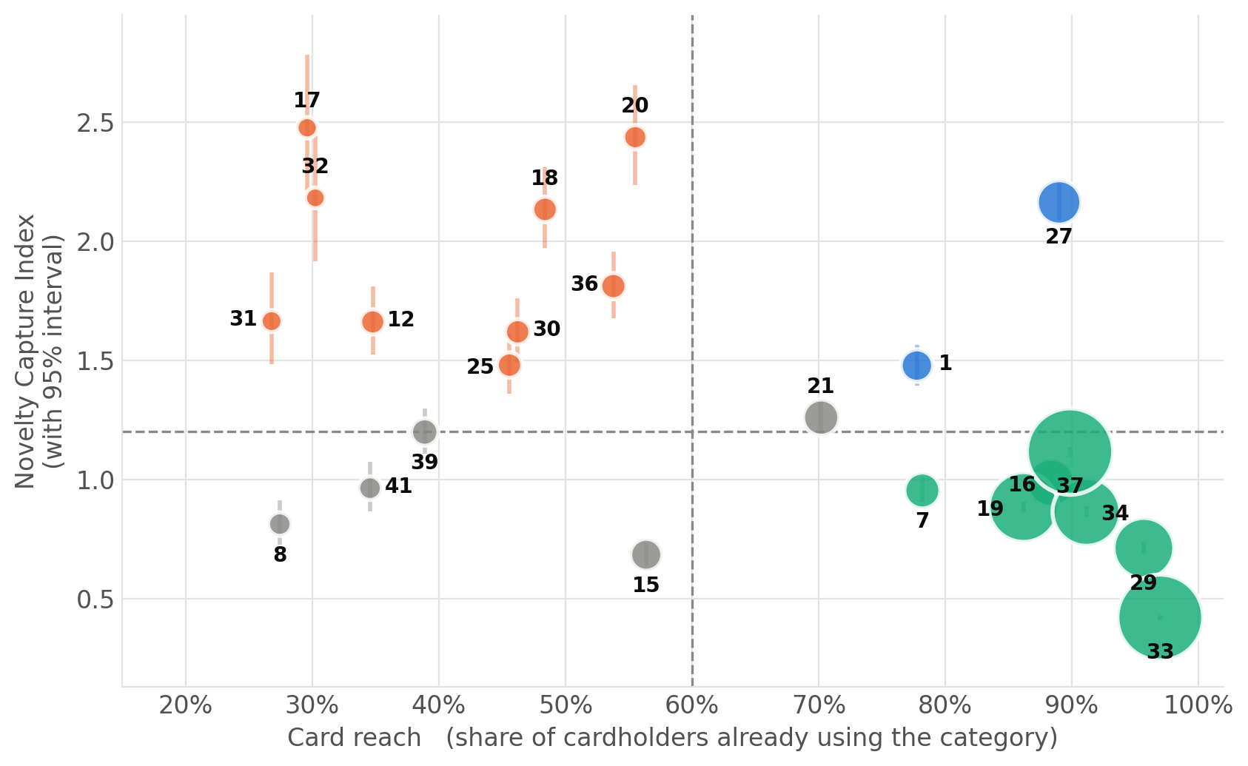
4
Where to point the Q4 promotions programme
Habit channel
33, 37, 19, 34, 29, 16, 7 — 78% of volume, reached by 78-97% of cards, yield 878 per 1,000. Deliver offers here; do not discount.
Merchant discovery
27 and 1 — the category is already reached, but cardholders keep trying new merchants inside it. Promote merchants, not the category.
Category expansion
17, 20, 18, 32, 36, 31, 12, 30, 25 — reached by under 56% of cards, highest tickets in the network (up to R$315). Introduce the category.
Deprioritise
21, 39, 15, 41, 8 — their 95% intervals cross the threshold or sit below it. No budget.
Novelty Capture Index = share of new-merchant volume / share of incumbent volume, with 95% intervals (delta method). Bubble size = share of transactions.
Notes:
SPEAKER 4 (7:15-8:15)
This is the decision. Vertical axis: the Novelty Capture Index - how much of our new-merchant volume a category wins relative to its existing size - with ninety-five per cent intervals, so we are ranking on evidence rather than on point estimates. Horizontal axis: how many of our cardholders already use the category at all.
Bottom right, in green, is the habit channel - seventy-eight per cent of all our volume, reached by nearly every card, and the lowest discovery yield in the network. Subsector 33 alone touches ninety-seven per cent of cards. That is not a segment, it is a broadcast channel: deliver offers through it, do not discount in it.
Top right, in blue, subsectors 27 and 1. Everyone already uses the category, but they keep trying new merchants inside it. So promote individual merchants there, not the category.
Top left, in orange, is category expansion - high discovery, but under fifty-six per cent of cards have ever used them, and they carry the highest tickets in the network. Those categories need introducing.
And note the grey points: 21 and 39 looked like discovery categories on the point estimate. Their intervals cross the line, so they do not get budget. That is what the confidence intervals bought us.
Over to [Speaker 5].

Slide 9
5
Five moves for Q4
Each one falls out of a specific statistic, not a general principle.
1
Move promotional emphasis from habit to discovery
Habit channel yields 878 first-visits per 1,000 transactions; discovery subsectors yield 2,060. Reallocating a third of habit exposure is worth ~28,000 extra first-visits - a 2.35x rate difference.
2
Split the discovery budget two ways
Subsectors 27 and 1 need merchant-level offers - the category is already reached. Subsectors 17, 20, 18, 32, 36, 31, 12, 30, 25 need category introduction, and carry the highest tickets.
3
Treat subsector 33 as a channel, not a target
97% card reach, NCI 0.42 (CI 0.41-0.43). Discounting buys transactions we already had. It has half the merchants its demand needs (coverage index 0.50) - recruit merchants there instead.
4
Answer the category_1 question before spending
4.3x decline odds on 6.1% of volume. One week of risk-team time, closed before the Q4 calendar locks - otherwise we promote into a population we then decline.
5
Reactivate on the lapse index, not on recency
191 cards, 41% of the base, holding 31% of spend, are past 3x their own normal gap between active days. Retention after activation is 74% at twelve months, so these cards are lapsing, not lost - which is what makes them worth reactivating.
What this cannot tell you: no card-level loyalty file was supplied, the two windows are different card samples (16 cards in common), and 463 cards is a small panel. The targeting map ranks where discovery already happens - proving a promotion causes it needs a holdout test. That is the next piece of work.
Notes:
SPEAKER 5 (8:15-9:20)
Five moves.
One: move promotional emphasis from habit to discovery. The habit channel produces eight hundred and seventy-eight first-visits per thousand transactions; the discovery subsectors produce two thousand and sixty. Reallocating a third of habit exposure is worth roughly twenty-eight thousand extra first-visits - a two-point-three-five times rate difference.
Two: split that discovery budget, because it is two different jobs. Where the category is already reached, promote merchants. Where it is not, introduce the category - and those are our highest-ticket categories.
Three: subsector 33 is a channel, not a target. Ninety-seven per cent reach, novelty index zero point four two. Deliver through it, recruit merchants into it, but stop discounting in it.
Four: answer the category_1 question first. Four point three times the decline odds on six per cent of volume. One week of risk-team time.
Five: reactivate on the lapse index rather than recency. A hundred and ninety-one cards, holding thirty-one per cent of spend, are past three times their own normal rhythm - and since seventy-four per cent of cards are still active a year after activation, these cards are lapsing, not lost - which is exactly why they are worth reactivating.
And the limits, plainly: no loyalty file, two different card samples, four hundred and sixty-three cards. This ranks where discovery happens. Proving causation needs a holdout test - that is what we would ask the Board to fund.

Slide 10
Major learnings
Audit before you analyse
99 records were about to hijack every average, and 63 conflicting merchant duplicates would have double-counted ~5,000 transactions. The first hour protected every number after it.
Test your own assumptions with someone else's method
We adopted a community-derived currency transform, so we validated it ourselves with Benford's Law. The one deviation it found turned out to be Brazilian .90 price points - corroboration twice over.
A point estimate is an opinion; an interval is a finding
Two subsectors looked like discovery categories until their 95% intervals crossed the threshold. Attaching intervals changed which categories got budget.
A variable everyone shares cannot target anything
Subsector 33 reaches 97% of cards, so its lift against everything is 1.0. Our most-used category is our least useful selector - and our best delivery channel.
Measure people against themselves
Days-since-last-purchase is meaningless across cards with different rhythms. Dividing by each card's own median gap turned a dead column into a 191-card reactivation list.
TEAM ERROR 404 | Thank you
Notes:
SPEAKER 5 (9:20-9:55)
Finally, what we took away from doing this.
Audit before you analyse - ninety-nine records were about to hijack every average, and sixty-three conflicting merchant duplicates would have double-counted five thousand transactions. Nobody had flagged either.
Test your own assumptions with someone else's method - we checked our currency transform with Benford's Law, and the one deviation it found was Brazilian point-ninety price endings, which is corroboration in itself.
A point estimate is an opinion; an interval is a finding - two subsectors looked like discovery categories until their confidence intervals crossed the threshold.
A variable everyone shares cannot target anything - subsector 33 reaches ninety-seven per cent of cards, so it is our best delivery channel and our worst selector.
And measure people against themselves - dividing days since last purchase by each card's own normal gap turned a dead column into a hundred-and-ninety-one-card reactivation list.
Thank you - we're happy to take questions.

