Slide 1



Clustering of Documents using various techniques
Mortha Sai Sriram,
Paras Jain,
Sajal Soni,
Bhanupratap,
Shashwat Srivastava
Instructor: Dr. Asit Kumar Das

Slide 2
What we did?
Continuation from previous semester (Tokenization, StopWords Removal, Lemmatization, Tf-Idf).
Considered 100 documents from NewsGroup20.
Formed a list of bigrams from the corpus after pre-processing.
Trained this model to obtain a 4 dimensional vector for each bigram (using Google’s Word2Vec).
Used K-Means clustering algorithm(with k=100) on the vectors to classify the bigrams into 100 clusters.

Slide 3
…
Formed 100 dimensional vector corresponding to each document as mentioned below:
Consider a list of length 100 for a document; if x bigrams of the document are present in the ith cluster, the ith element of the list becomes x.
Used different clustering algorithms on these “document clusters” and checked for the average result.
Calculated DB and Dunn Indices for K-Means algorithm to determine the best cluster size.

Slide 4
BIGRAM
What are they?
A sequence of two adjacent elements from a string of tokens, which are typically letters, syllables, or words. A bigram is an n-gram for n=2.
The frequency distribution of every bigram in a string is commonly used for simple statistical analysis of text in many applications, including in computational linguistics, cryptography, speech recognition, and so on.

Slide 5
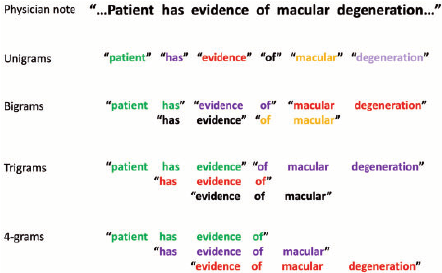
BIGRAM Example:

Slide 6
Word2Vec
Word2vec was created by a team of researchers led by Tomas Mikolov at Google and patented.
What it does?
Word2vec takes as its input a large corpus of text and produces a vector space, typically of several dimensions, with each unique word in the corpus being assigned a corresponding vector in the space.

Slide 7
Word2Vec contd…
The specialty:
Word vectors are positioned in the vector space such that words that share common contexts in the corpus are located in close proximity to one another in the space.
Word2Vec basically place the word in the feature space is such a way that their location is determined by their meaning i.e. words having similar meaning are clustered together and the distance between two words also have same meaning.

Slide 8
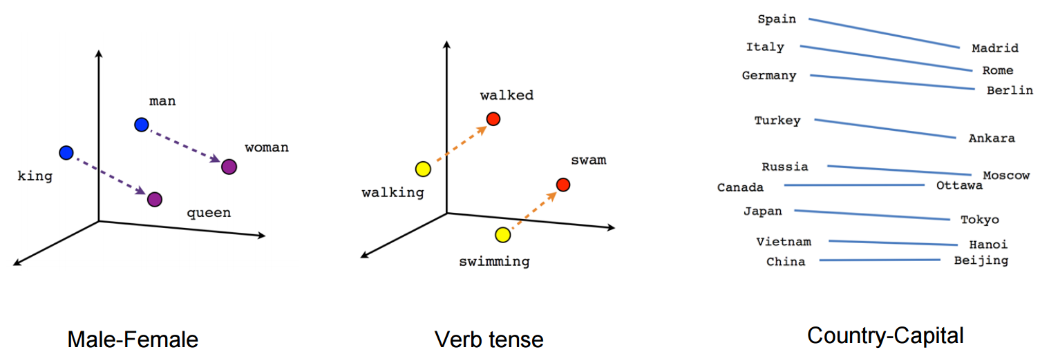
Word2Vec Example:

Slide 9
Clustering
The Definition:
Task of grouping a set of objects in such a way that objects in the same group (called a cluster) are more similar (in some sense) to each other than to those in other groups/clusters.
Popular notions of clusters include groups with small distances between cluster members, dense areas of the data space, intervals or particular statistical distributions.

Slide 10
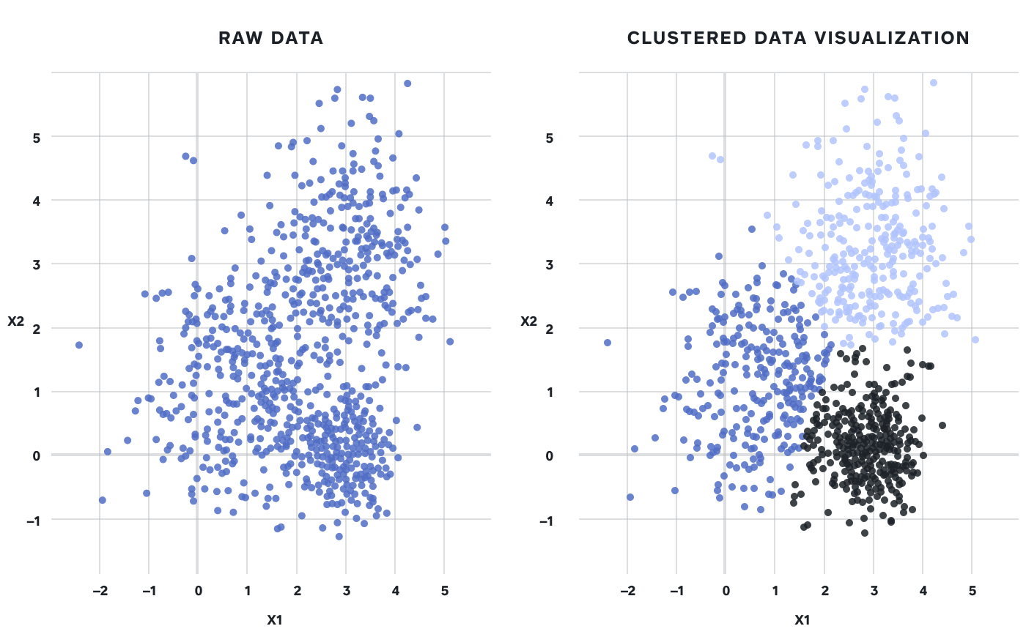
Clustering contd…

Slide 11
Clustering contd…
The appropriate clustering algorithm and parameter settings (including parameters such as the distance function to use or the number of expected clusters) depend on the individual data set and intended use of the results.

Slide 12
Clustering Algorithms
Centroid-based Clustering:
The clusters are formed by the closeness of data points to the centroid of clusters, which may not necessarily be a member of the data set.
When number of clusters is fixed to k, find the k cluster centers and assign the objects to the nearest cluster center, such that the squared distances from the cluster are minimized.

Slide 13
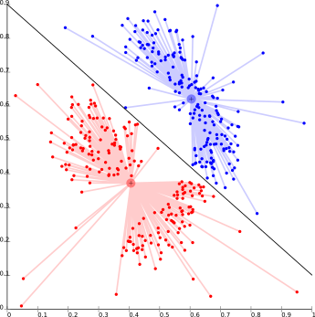
Clustering Algorithms contd…

Slide 14
Clustering Algorithms contd…
The problem is basically one of NP-Hard problems and thus solutions are approximated over a number of trials.
K-means is one of the popular examples of this algorithm.
The biggest problem with K-means is that K has to be specified in advance.

Slide 15
Clustering Algorithms contd…
Connectivity-based Clustering:
The core idea of this clustering is very similar to that of Centroid-based clustering in the sense that clusters are defined on the basis of closeness of data points.
The notion involved: objects being more related to nearby objects than to objects farther away.

Slide 16
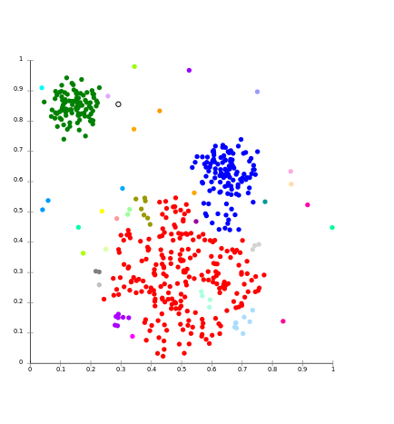
Clustering Algorithms contd…

Slide 17
Clustering Algorithms contd…
Instead of a single partitioning, a hierarchy of clusters is provided that merge at certain distances. This hierarchical clustering may be agglomerative or divisive.
For large data sets, the method is not robust and too slow.

Slide 18
Clustering Algorithms contd…
Density-based Clustering:
In this model there will be a searching of data space for areas of varied density of data points in the data space.
It isolates various density regions based on different densities present in the data space.

Slide 19
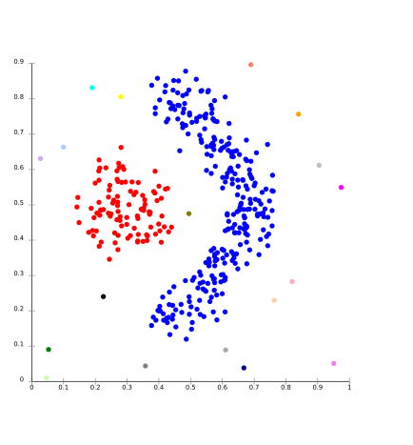
Clustering Algorithms contd…

Slide 20
Validity Indices
The Aim:
To identify sets of clusters that are compact, with a small variance between members of the cluster (intracluster distance), and well separated (intercluster distance), where the means of different clusters are sufficiently far apart compared to intracluster distance.

Slide 21
Validity Indices contd…
Davies Bouldin Index:
Internal evaluation scheme, where the validation of how well the clustering has been done is made using quantities and features inherent to the dataset.
For a given assignment of clusters, its lower value indicates better clustering.
Dunn Index:
This too, is an internal evaluation scheme.
For a given assignment of clusters, its higher value indicates better clustering.

Slide 22
Validity Indices contd…
Significance of Validity Indices:
Based on the Index Value, the most appropriate way of clustering data can be predicted.
For instance, in case of K-means clustering algorithm, evaluating indices for several values of K can help us determine the best K for clustering.

Slide 23
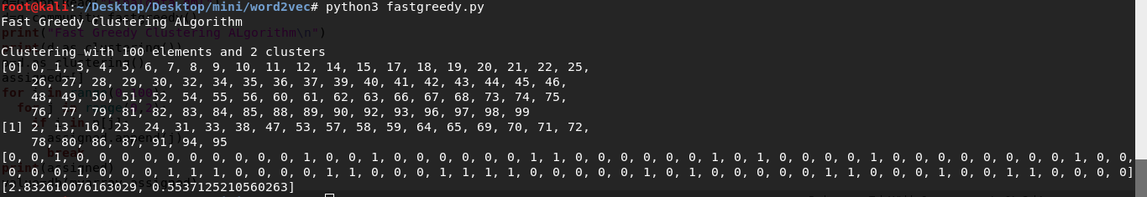
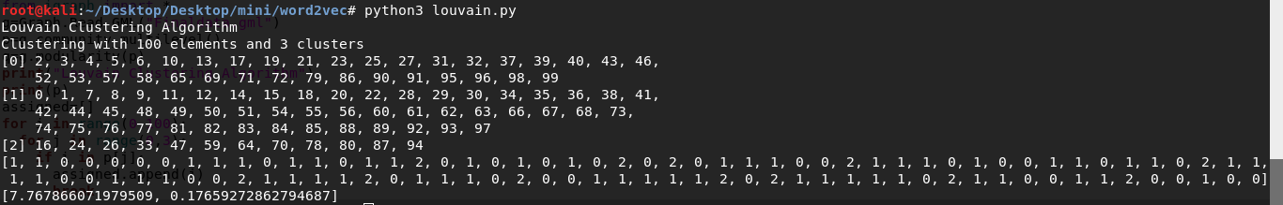
Result
FAST GREEDY CLUSTERING ALGORITHM
LOUVAIN CLUSTERING ALGORITHM

Slide 24
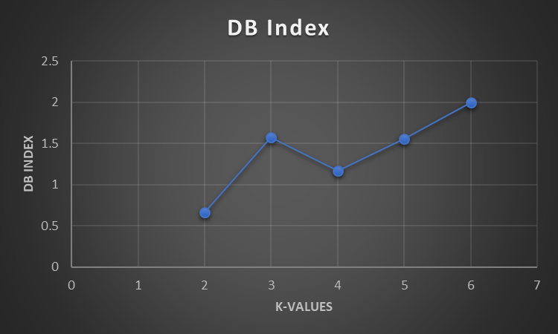
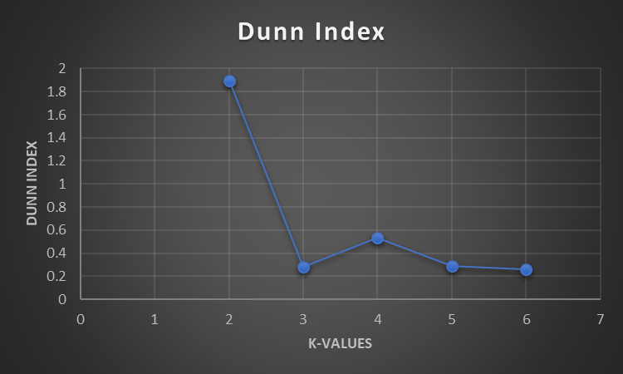
Inference
For K=2, DB Index is minimum while Dunn Index is maximum.
Hence, Clustering for K=2 is most suitable.

Slide 25
Thank You

