Slide 1

CUSTOMER CHURN PREDICTION
- Machine LEARNING CASE STUDY
Theme: Help business improve customer retention while reducing churn.
Notes:
NOTE:
To change the image on this slide, select the picture and delete it. Then click the Pictures icon in the placeholder to insert your own image.

Slide 2
INTRODUCTION & CASE SENARIO
Customer churn occurs when a customer stops using a company’s product or services.
Customer churn prediction uses machine learning to identify customers who are likely to leave.
It analyses customer details, usage patterns, payment history and services experience.
GOAL: To Predict customers who are likely to leave using machine learning and help businesses improve customer retention while reducing churn
CASE SENARIO:
A telecom company has noticed that many customers are discontinuing their services and shifting to competitors.
The company collects the customer details, usage, payments and complaint records
Machine learning analyses this historical data & then the model identifies customers with a high possibility of leaving
The company provides suitable offers and support to retain them

Slide 3
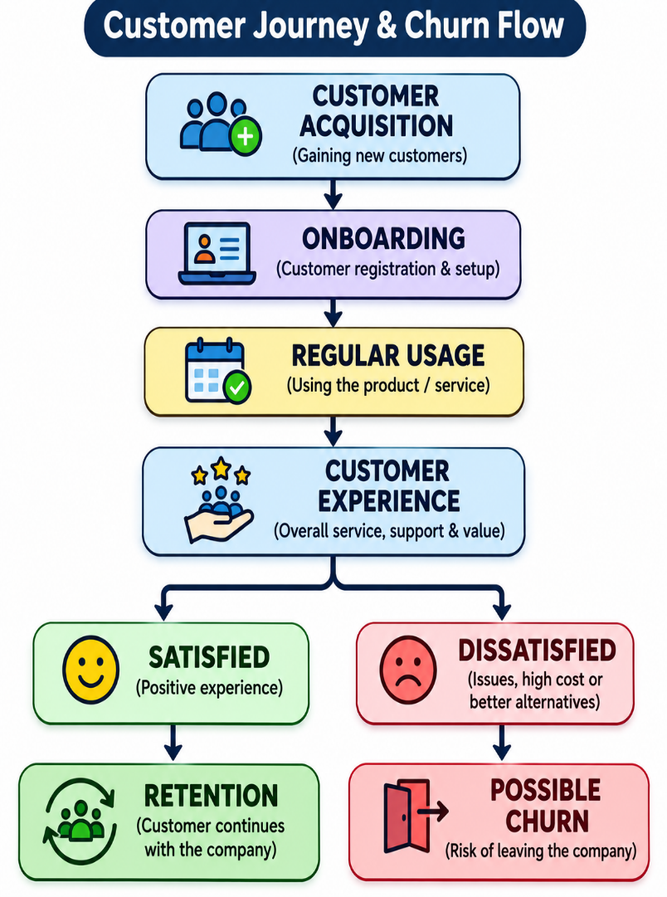
LEARNING OBJECTIVES AND TYPES OF CUSTOMER CHURN
LEARNING OBJECTIVES :
Understand customer churn & its causes
Analyse customer data & identify important features
Apply ML classification algorithms
Evaluate model performance using suitable metrics
Develop strategies to improve customer retention
Types of customer churn:
Voluntary: customer decides to leave the service.
Involuntary: customer loses service due to payment failure or other account issues
Contractual churn: doesn’t renew the contract after its completion
Non – contractual churn: customer stops purchasing or using a service without formal cancellation

Slide 4
Two Content Layout with Table
Dataset Used: IBM customer churn dataset
Contains historical telecom customer information.
Each row –> customer
Each Column -> customer feature
Target column indicates whether the customer has churned
Feature Engineering:
Create Customer tenure groups
Calculate average monthly spending
Identify complaint frequency
Analyses customer usage and engagement
Data Analysis (EDA):
Identify the missing & duplicate values
Analyse churn distribution
Compare churn with tenure & contract type
Identify important customer patterns
Category | Features
Customer details | Customer id, gender, senior citizen
Account details | Tenure, contract, payment method
Financial details | Monthly charges, total charges
Service details | Internet services, phone services
Support details | Complaints and serviced issues
Target variables | CHURN (yes / no)

Slide 5
SYSTEM ARCHITECTURE AND WORKFLOW
CUSTOMER DATASET
DATA COLLECTION
DATA PREPROCESSING
FEATURE ENGINEERING
FEATURE SELECTION
ML MODEL TRAINING
MODEL EVALUATION
CHURN PREDICTION
RISC CLASSIFICATION
RETENTION STRATEGY
Main Workflow:
Data Collection – Gather Historical Customer Records
Data Preprocessing – Handle Missing Values, Duplicate And Categorical Data
Feature Engineering – Create Useful Features From Existing Data
Feature Selection – Select Relevant Features For Prediction
Model Development – Train The Selected Ml Algorithm
Evaluation – Measure The Model’s Performance
Prediction – Identify Customer Who May Leave
Retention – Take Suitable Actions To Retain Customers
Preprocessing Techniques:
Label encoding & one-hot encoding
Standardization & normalization
Missing value & duplicate handling

Slide 6
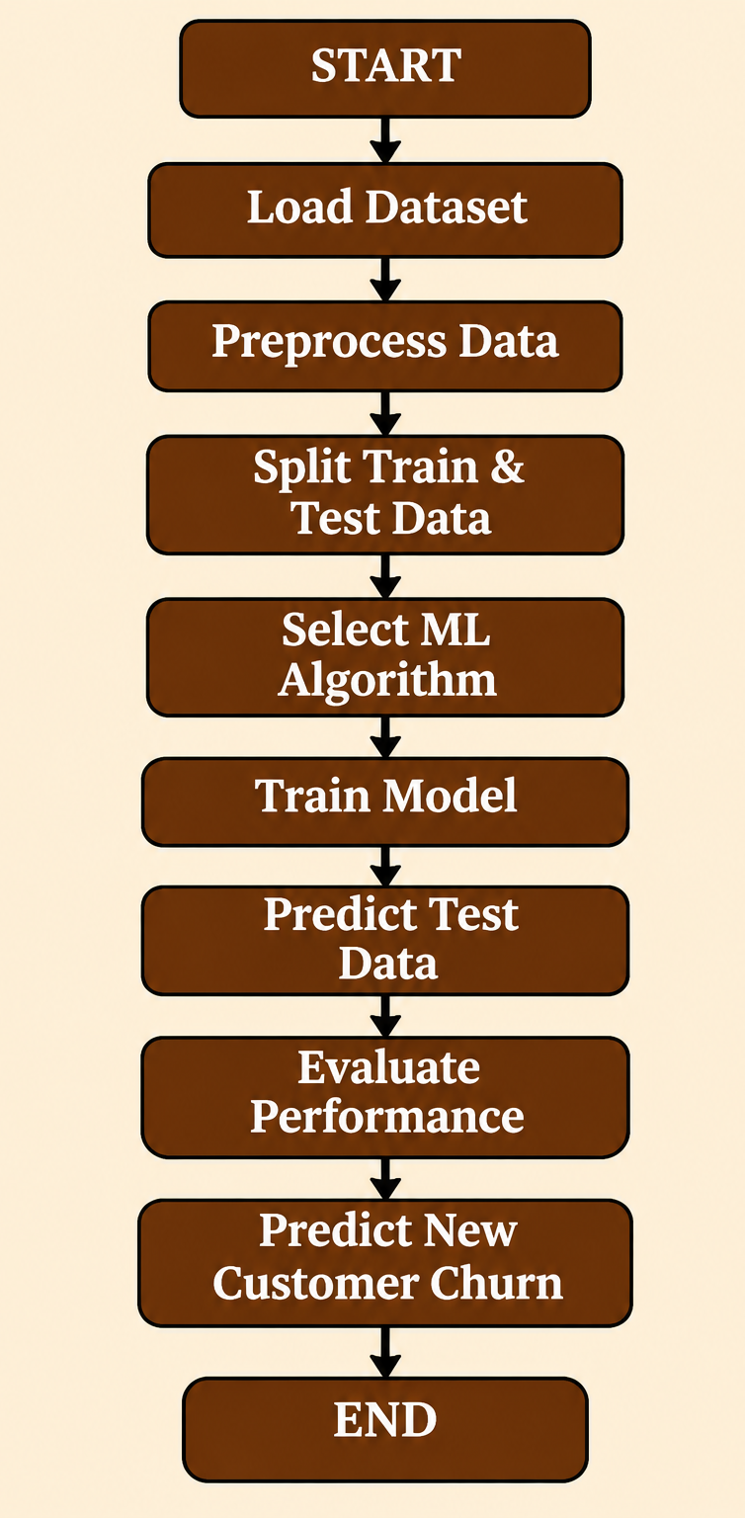


ML ALGORITHM AND ML WORKFLOW
ALGORITHM:
LOGISTIC REGRESSION: predicts the probability of customer churn
Decision Tree: uses decision – based branches for classification
Random forest: combines multiple decision trees to improve prediction stability
Support vector machine: finds a decision boundary b/w classes
KNN: predicts based on similar customer
XGBoost: uses boosting to improve prediction performance
Logistic Regression Formula:
Recommended approach: Start with logistic regression &compare it with random forest and XGBoost

Slide 7
MODEL EVALUATION
CONFUSION MATRIX
Evaluation Formulas:
Actual/Predicted | Churn | No Churn
Churn | TP | FN
No Churn | FP | TN
Accuracy = (TP + TN) / (TP + TN + FP + FN)
Precision = TP / (TP + FP)
Recall = TP / (TP + FN)
F1 – Score = 2 x (Precision x Recall) / (Precision + Recall)
TP – correctly predicted churn
TN – Correctly predicted non – churn
FP – Incorrectly predicted churn
FN – Failed to identify actual churn
ROC - AUC:
Measures how well the model separates churn and non-churn customers.
TPR = TP / (TP + FN)
FPR = FP / (FP + TN)
Class Imbalance Solutions:
SMOTE
Oversampling & Understanding
Class Weights

Slide 8
CHURN RISK & RETENTION STRATEGY
Customer data
Churn prediction
Identify high – risk users
Analyse churn reasons
Select retention action
Send personalised offer
Monitor customer response
Measure retention success
Churn Risk Classification:
Low Risk: 0% - 30% probability
Medium: 31% – 60% probability
High Risk: 61% - 100% probability
Customer Lifetime Value:
CLV = Average Revenue per period x Average Customer Lifetime
Advanced Techniques:
Customer segmentation
Feature importance
Explainable AI
Uplift modelling
RISK LEVEL | ACTION
LOW | Loyalty rewards and regular engagement
MEDIUM | Feedback and personalized offers
HIGH | Priority support and suitable discounts

Slide 9
ADVANCEMENT FEATURES, CHALLENGES AND CONCLUSION
Advanced Features:
Future Scope
Automated churn risk scoring
Real time churn prediction
Personalised retention recommendation
Interactive analysis dashboard
Continues model monitoring
Deep learning & Survival analysis
Real – time customer monitoring
Automated retention campaigns
Conclusion
Challenges:
Customer churn prediction identifies customer who may leave.
ML helps analyse customer behaviour and predict churn
Suitable retention strategies help reduce customer loss
The system supports better customer satisfaction and long - term business growth
Missing or incorrect data & `imbalanced datasets
Overfitting and data leakage
Changing customer behaviour.
Dara privacy and security

Slide 10
Thank you
AP24110010230 – K. JAYARAM
AP24110010276 – A. BHARATH
AP24110010866 – L. SURYA TEJA
AP24110011872 – CH. SAI SRIRAM

