Slide 1


JOB APPLICATION SYSTEM
STUDENT SUPERVISOR
NAME :K.Pavanesh Name:MRS.ASWINI
Regd.No : 191811041 Department: CSE
Year Dept:2nd & CSE College Name: SSE
Saveetha School of Engineering , Department of CSE

Slide 2
ABSTRACT
A job portal is a website dedicated for online information about recruiters as well as job seekers.
A job portal helps both the job seekers and recruiters finding the right organization for the employees.
In the case of job seekers, according to their educational qualification, experience and their preferences.
The job portal shows the list of companies to the job seeker.
Saveetha School of Engineering , Department of CSE

Slide 3
The job seeker has to find the company which is offering of the required profile.
Then check the eligibility of the post or do a search on eligibility basis by visiting the various company which he knows of.
In this manual process, it is bound to happen that seeker may not an offer which exactly matches his/her profile. Due to this lack of information person lost an opportunity and company losses a potential applicant for the job post.

Slide 4

INTRODUCTION
The system has a different segment to process a specific task which is the modules. This will help the system to developed easily and makes it more user-friendly.
The modules of the project are:
Login Module: This will help users to login into the system using id and password. A user who has the valid id and password can only login to their respective accounts. It will help the authentication of the user who enters the system.
Registration Module: In this segment, we will register the new user of the system. As they are two different type of users i.e. employer and job seekers this module can be fragmented into two parts.
Saveetha School of Engineering , Department of CSE

Slide 5
Post Requisition: In this interface, the employer who has registered themselves in the system can post the jobs. They can give the requisition specifying the post and skill needed for that post. It also implies the criteria of recruitment the employer has planned for the post.
Job Search: This module is for the job seeker where they can search all the requisition present in the system. One can filter the search based on their skill and experience of the job. Ones selected a requisition applicant can apply for the post.

Slide 6
LITERATURE SURVEY
Job Procurement: Old and New Ways Job seeking usually involves different ways to look for jobs such as through personal contacts, direct telephone calls to employers, job agency office, scanning online job listings, etc.
lists the following methods to be the traditional (old) ways for recruitment:
••Employment recruitment agencies
••Job fairs
••Advertising in the mass media such as newspapers
••Advertisement in television and radio
••Existing employee contacts
••Schools colleges or universities students services department
••Workers or professional referrals .
Saveetha School of Engineering , Department of CSE

Slide 7
Hardware Requirements of system
The hardware required for online recruitment system for the development of the project is:
PROC ESSOR: Intel P-IV system
PROCESSOR SPEED: 250MHz to 833MHz
RAM: 512MB
RAM HARD DISK: 40GB
Saveetha School of Engineering , Department of CSE

Slide 8
Software Requirements of system
The software required for online recruitment system for the development of the project is:
OPERATING SYSTEM: Windows 2000 Professional
ENVIRONMENT: Visual Studio .NET 2002.
NET FRAMEWORK: Version 1.0
LANGUAGE: Visual Basic.NET

Slide 9
PROPOSED SYSTEM
Pseudo code is a kind of structured English for describing algorithms.
It allows the designer to focus on the logic of the algorithm without being distracted by details of language syntax.
At the same time, the pseudo code needs to be complete.
It describes the entire logic of the algorithm so that implementation becomes a rote mechanical task of translating line by line into source code.
In general the vocabulary used in the pseudo code should be the vocabulary of the problem domain, not of the implementation domain.
The pseudo code is a narrative for someone who knows the requirements (problem domain) and is trying to learn how the solution is organized.
Saveetha School of Engineering , Department of CSE

Slide 10
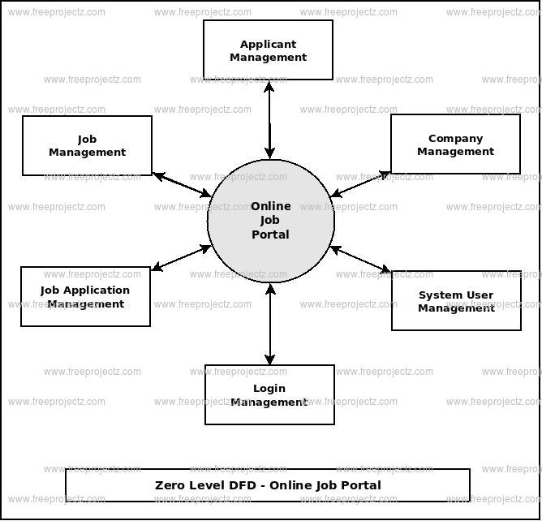
Data flow diagram :
Saveetha School of Engineering , Department of CSE

Slide 11
Query handling :
Since we have developed a web application which will definitely be a multi-user application.
Program structure defines control hierarchy without regard to the sequence of processing and decisions.
Software procedure focuses on the processing details of each module individually.
The Developer carries out unit testing in order to check if the particular module or unit of code is working fine.
Recruitment is a process of finding the potential resources for filling up the vacant positions in an organization.
Saveetha School of Engineering , Department of CSE

Slide 12
Implementation :
Login Module: This will help users to login into the system using id and password.
Registration Module: In this segment, we will register the new user of the system. As they are two different type of users i.e. employer and job seekers
Post Requisition: In this interface, the employer who has registered themselves in the system can post the jobs.
Job Search: This module is for the job seeker where they can search all the requisition present in the system.

Slide 13
PURPOSE
Software that allows candidates to electronically scan resume, and store them in a database that’s easily accessible by hiring managers and recruiters.
The system has a different segment to process a specific task which is the modules.
This will help the system to developed easily and makes it more user-friendly.
. A job portal is a website dedicated for online information about recruiters as well as job seekers.
A job portal helps both the job seekers and recruiters finding the right organization for the employees.

Slide 14
CONCLUSION
In making of this application, we have learnt that handling files and maps is becoming easy.
Using this application, a user gets a different information and a cost effective solution by visiting unknown place efficiently with all the necessary information regarding to various hotspots the user visits.
Also this application satisfies collaboration objective i.e. I make it and you use it; u make it and I use it which is the actual motive of this application.
Saveetha School of Engineering , Department of CSE

Slide 15
REFERENCES
Dr.T.K.Shaik Shavali (MSCI, MCSE, SCE, M.Tech, Ph.D) currently working as HOD in CSE Department in Lords Institute of Engineering and Technology, Hyderabad, Telangana, India.
Gulam Mujtaba Hussain Aqueel presently pursuing B.Tech 4th Year in Lords Institute of Engineering and Technology, Hyderabad, India.
Azbar Sadiqa Jabeen presently pursuing B.Tech 4th Year in Lords Institute of Engineering and Technology, Hyderabad, Telangana India.
Keethana Kopuri presently pursuing B.Tech 4thYear in Lords Institute of Engineering and Technology, Hyderabad, Telangana India.
Saveetha School of Engineering , Department of CSE

Slide 16

Saveetha School of Engineering , Department of CSE

