Slide 1


SECURITY ISSUES IN M COMMERCE
FOR ONLINE TRANSACTION
STUDENT SUPERVISOR
NAME: J.GURU MONISH NAME: DR.T.VIGNESH
DESIGNATION: ASSOSIATE PROFESSOR
DEPT: CSE
YEAR: III COLLEGE NAME: SAVEETHA SCHOOL
DEPT: CSE OF ENGINEERING

Slide 2
ABSTRACT
M-commerce is defined as carrying a business or a service on an internet-enabled mobile based application for making a transaction over the mobile devices for any monetary value.
It can be used for buying product online, paying bills, sending money to someone, booking accommodation,getting your favorite dishes from nearby restaurants, etc.
Today all our devices are connected through the internet and mobile phones. It has become necessity for all the humans in today’s world.
It has become necessity for all the humans in today’s world.
In this ppt ,we are undertaking an examination of the security issues involved in the field of M-commerce.
Due to the transaction over the internet, M-Commerce creates more security concerns than the traditional E-Commerce.

Slide 3
INTRODUCTION
M-commerce security involves wider ranges like data security, computer security, and other related forms of information security framework.
E-commerce includes providing security to users for daily business transaction.
In the present day, security and privacy is major concern in M-Commerce as well as M-Commerce and as well as in other technologies .
M commerce is defined as conducting business or a service on an internet-enabled mobile based application by making a transaction over the mobile devices using any monetary value.
The transactions can be carried out from fixed locations at anywhere at any given time. With growing technologies, MCommerce today has widespread usages
n present, Mobile phones are going to be looked upon as a mode of payment mechanism with the help of communication device.

Slide 4
ISSUES IN ONLINE TRANSACTION
AUTHENTICATION : In authentication, username and password of the user are matches with entries in the database and if the detail matches then he is authenticated as a genuine user and is given the rights to access the information.
Authentication is a process of giving the authority to the individual to change the information according to the situation.
The user authentication involves the two steps in sequence,user identification, claimed identity verification and validation.

Slide 5
CONTD….
AUTHORIZATION :
After authentication, the person can make the necessary changes to the data. Authentication and authorization goes parallel.
If you have the authentic username and password, then you are an authorized person and are allowed to make the essential modifications with the data.

Slide 6
CONTD….
ENCRYPTION :
Encryption provides the means of securing the information using an encryption key in order to protect the confidentiality of the individual.
Using this technique the data is encoded into an encrypted form and only an authentic person having the decryption key is able to access the secured information.
Encryption is the method by which information is converted into secret code that hides the information's true meaning.
The science of encrypting and decrypting information is called cryptography.

Slide 7
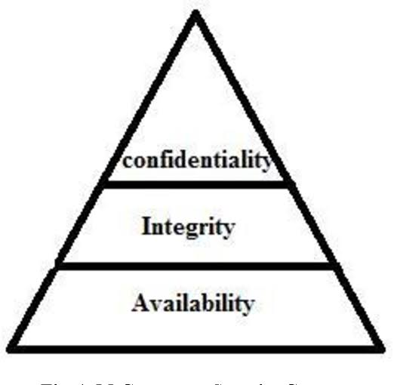
M-COMMERCE SECURITY
CONCERNS

Slide 8
CONTD…..
CONFIDENTIALITY :
Confidentiality refers to protecting information from being accessed by unauthorized parties.
In other words, only the people who are authorized to do so can gain access to sensitive data. Imagine your bank records.
INTEGRITY
Data Integrity is used to save information from being modified by unauthorized users.
Data has value only if it is correct. If data is altered, it might lead to heavy losses.
For example, if our account information is tampered with while transferring money to another account, the money might be lost into unknown accounts.

Slide 9
CONTD…..
AVAILABILITY :
A user authorized can access data only when data is available.
Data holds value only if the right user can access at the correct time.
Hence, to access data, the user needs to have permission to avail the data.
Availability means that information is accessible by authorized users.
If an attacker is not able to compromise the first two elements of information security (see above) they may try to execute attacks like denial of service that would bring down the server, making the website unavailable to legitimate users due to lack of availability.

Slide 10
FEATURES OF M-COMMERCE
UBIQUITY: Mobile devices provide customers the added ability to hold info and allow to perform the transaction from any remote location.
M-commerce users are widely spread, with the similar level of access as is presented over the fixed-line technology. This exchange of info is independent of user’s site.
LOCALIZATION: Internet makes M-commerce more beneficial instead of the wired e-commerce.
Using the location available through the GPS technology, we can easily find the location of any user.
Also, through m commerce, data can be easily sent and received at any location.

Slide 11
CONTD….
PROACTIVE FUNCTIONALITY: This feature ensures that th information can be shared immediately at the time of requirement. Just like ‘opt-in’ marketing, users may choose the given offers at any time they like.
PERSONALIZATION: Generally, only a single person uses a mobile device. Mobile devices take advantage of sending and receiving message, based upon the time and address ,we can also manage sound and sight.

Slide 12
SECURE ONLINE TRANSACTION
CYBER SECURITY
Cyber security is an important topic now a days. In currently, cyber security is one of the major issues for national security.
Customer’s trust and security is also a prime concern f or any
company in 21th century.
TRANSACTION AUTHENTICATION NUMBER (TAN)
Online banking services use transaction authentication number in the form of OTP to authenticate monetary transaction.
TAN enhances the additional security because it provides the two way authentication.

Slide 13
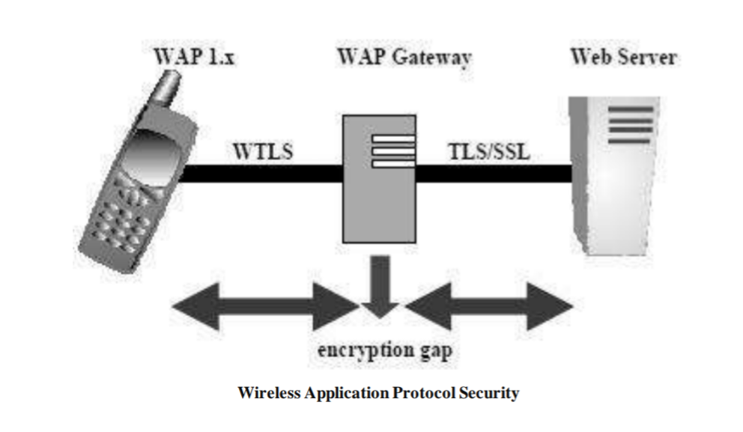
CONTD…….
WIRELESS APPLICATION PROTOCOL :
Wireless application protocol is an open, global specification that authorizes mobile users with wireless devices to simply access and interacts with the services and information directly.
Only solution to wireless communication is WAP

Slide 14
CONTD…….
MOBILE TRANSACTION AUTHENTICATION NUMBER (MTAN)
Bank’s of many countries uses MTAN, first time when a user do the transaction then banks generates TAN and send to user cellular phone via SMS.
SMS may include transfer details and allow user to validate that transaction is not modifying by other person and bank .
The main objective of this is to provide the security to mobile transaction.

Slide 15
SSL LAYER
SSL LAYER :
SSL helps to establish a link of encrypted form between a web server and browser. SSL is also called as slandered security layer.
SSL makes sure that the information transferred between the web server and the web browser will be always secure and integral.
Netscape Inc officially applies SSL protocol. Due to its acceptance and popularity, it is now applied on all web browsers .
SSL have two key objectives:
It provides and ensure privacy, by encrypting the information that runs among the communicate party (the server and client).
It also provides validation of the session partners, including RSA algorithm.

Slide 16
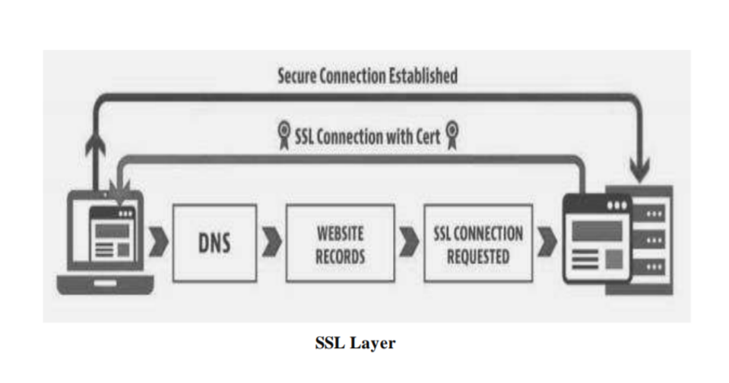
CONTD…….

Slide 17
CONCLUSION
M-Commerce security is extremely vital issue now in these days that wants more study to begin effective and efficient solution.
The issue likes privacy, verification, encryption and authorization is discussed to make secure transactions over the wireless devices. Encryption only is not enough.
Un-authenticated with SSL certificate gives integrity and confidentiality, but they require to third-party verification.
It allows the recipient with a digital SMS to verify the authentication. Security of payment can be enhancing using the SSL Layer.
This security technique is used to give safety to the client as well as the customer to in order to purchase the desired items..

Slide 18
REFERENCES
[1] Yadav S., “M-Commerce and its Security Issues”, 2001.
[2] Xydis, T.G. (2002), “Security Comparison: Bluetooth Communications vs. 802.11”.
[3] Yeun, Chan Y. and Farnham, Tim, “Secure MCommerce with WPKI”, 2001.
[4] Ganley, M.J. (2000), “Elliptical Curve Cryptography”, Zaxus White Paper, 1-9
[5] Goldman, Jeff, “Wireless Security and M-Commerce”, The Feature, March 8, 2001.
[6] Harrison, A. (2000), “Motorola, Certicom Ink Elliptic Crypto Deal”, Computerworld, May 22.
[7]Niels Christian Juul and Niels Jorgensen, “Security Issues in Mobile Commerce Using WAP”, 2002.

Slide 19
THANK YOU

