Slide 1

RESEARCH CAPSTONE · 2026
AI Enabled DevSecOps Framework for Adaptive Quantum Resilient Software Systems
PQC
Adaptive Crypto Agility
A prototype connecting machine-learning risk evaluation, constrained policy decisions, and NIST post-quantum cryptographic primitives.
Student Team
Name | Roll No.
Yellanki Kranthi Giri Venkata Chary | 2420030539
Donthi Sai Srujan Mudhiraj | 2420030083
Golla Rahul | 2420040098
Yerrolla Manikanta Sai | 2420030082
Faculty: Dr. J. Kavitha Reddy | Project Guide: Velthuru Vinisha
Department of Computer Science and Engineering, Koneru Lakshmaiah Education Foundation, Bowrampet, Hyderabad-500043, Telangana, India
Notes:
Good morning faculty and reviewers. Today we present our capstone research: an AI-Enabled DevSecOps Framework for Adaptive Quantum-Resilient Software Systems, developed at Koneru Lakshmaiah Education Foundation.

Slide 2
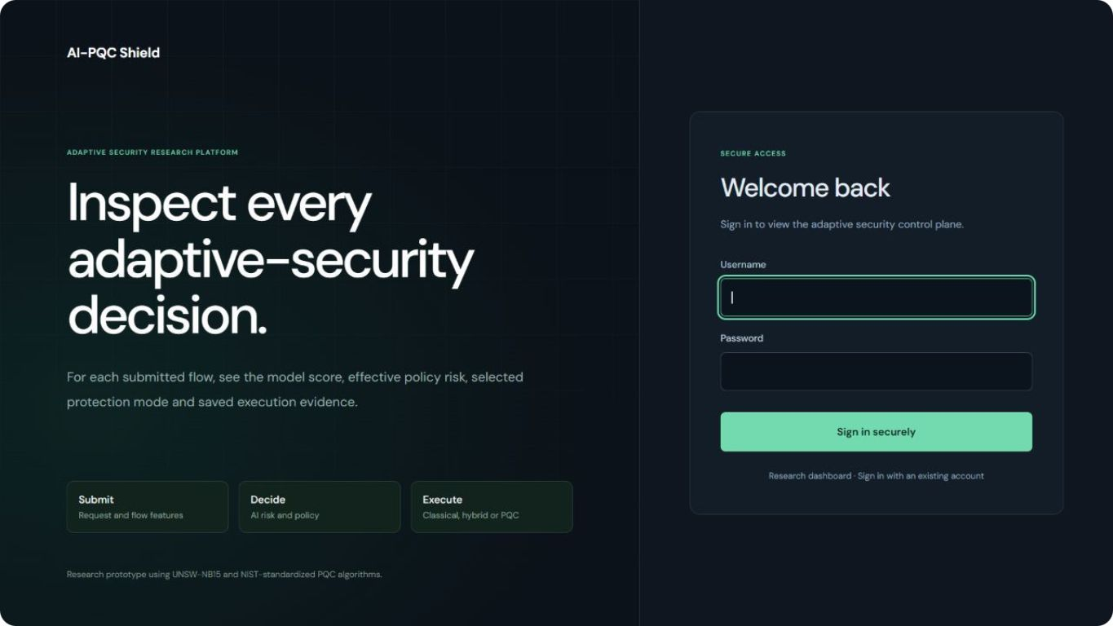
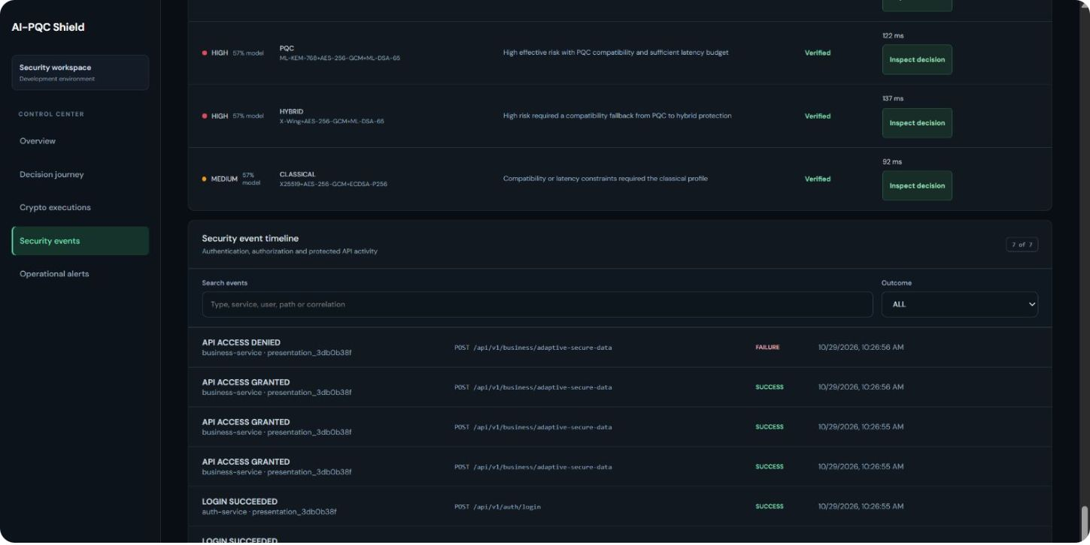
PROBLEM STATEMENT & MOTIVATION
Changing threats require adaptive protection
Distributed microservices expose broad API attack surfaces with static, inflexible cryptographic suites.
Shor's algorithm threatens classical RSA/ECC; yet encryption alone cannot mitigate DDoS or unauthorized requests.
The system combines JWT authentication, AI risk scores and adaptive selection of classical, hybrid or post-quantum cryptography.
Security telemetry, Grafana dashboards, testing and containerized CI/CD link the framework from code to deployment.
Secure Authentication Interface
Classical public-key infrastructure must transition to hybrid and quantum-safe standards without service disruption.
Real-Time Security Event Timeline
Notes:
We address two intersecting vulnerabilities: the impending quantum threat to asymmetric cryptography and the operational reality that microservice architectures face multi-vector attacks like DDoS and credential abuse that encryption alone cannot solve.

Slide 3
SYSTEM ARCHITECTURE
Requests, decisions, and audit event pipelines
1. Edge & Gateway
2. Auth & Business
3. Policy & AI Engine
4. Audit & Observability
Client Dashboard dispatches requests to Spring Cloud Gateway with Eureka Discovery registration.
JWT verification in Auth Service; Business Service handles business logic and policy queries.
Adaptive Policy Engine queries AI Security Service for risk scoring against candidate crypto suites.
Service-owned MySQL databases store immutable logs; Prometheus and Grafana track latencies.
REQUEST FLOW
DECISION PATH
AUDIT PIPELINE
Frontend → API Gateway → Auth / Business Service → In-process Crypto Agility Modules.
Business Service → Adaptive Policy Engine → AI Security Service risk evaluation and Crypto Agility Modules.
Auth and Business Services → Security Monitoring Service → Service-Owned MySQL DBs.
Notes:
Notice that cryptographic agility modules are embedded components within the services, not separated microservices, eliminating unnecessary RPC network overhead during key encapsulation.

Slide 4
END-TO-END WORKFLOW
From sign-in to auditable security decision
Authenticate: Sign in for a signed JWT bearer token, submit a protected request and validate authentication.
Evaluate risk: AI analyzes supplied compatible network features and metrics; policy combines risk, sensitivity, supported modes and latency hints.
Check policy: The Business Service accepts the selection or refuses an unsafe high-risk downgrade.
Execute cryptography: Execute KEM/DSA and locally verify the round trip.
Audit: Record execution and security events in MySQL; monitoring uses Prometheus, and the dashboard shows the decision, result and timing.
Feature-driven evaluation: Compatible telemetry is supplied to the AI risk engine; this is not autonomous monitoring of every live request.
Notes:
Walk through the five-stage pipeline. Emphasize that step two takes telemetry supplied with the request payload, which the policy engine evaluates before executing any cryptographic operations in step four. The Business Service enforces policy constraints, refusing an insecure cipher suite during elevated risk conditions. The system does not intercept raw sockets asynchronously.

Slide 5
DATASET & MODEL METHODOLOGY
Separate datasets require separate evaluation
Different schemas require separate preparation and evaluation, not an automatically combined deployed model.
UNSW-NB15
CICIoT2023
2024 Microservice
DEPLOYED BASELINE
ATTACK EXPERIMENTS
ARCHITECTURE RESEARCH
Supports the existing feature pipeline for Random Forest, the retained deployed network-risk model.
Supports additional attack experiments and offline stress testing of DoS/DDoS flood patterns.
Supports microservice-specific investigation of container-native trace anomalies, inter-service calls and RPC call graphs.
Rigorous Evaluation Criteria: Accuracy, Precision, Recall, Macro-F1, and False-Positive Rate (FPR). No unsupported numerical results are shown.
Notes:
A key academic contribution is recognizing that IoT, enterprise network, and microservice traffic have fundamentally distinct schemas. Merging them into a single model creates dataset shift; separate evaluation preserves experimental validity.

Slide 6
CRYPTOGRAPHIC AGILITY SPECIFICATION
Three cryptographic modes, one unified policy
Mode | Key Encapsulation / Exchange | Payload Encryption | Digital Signature
Classical | X25519 (ECDH) | AES-256-GCM | ECDSA P-256
Hybrid | X-Wing (X25519 + ML-KEM-768) | AES-256-GCM | ML-DSA-65
Post-Quantum | ML-KEM-768 (Kyber) | AES-256-GCM | ML-DSA-65 (Dilithium)
Policy Mapping Matrix
Downgrade Defense & Scope
Generally: low risk → Classical; medium risk → Hybrid; high risk → PQC. Selection is subject to risk, sensitivity and capability constraints.
Reject unsafe high-risk downgrades. Local verification is not proof of end-to-end post-quantum transport.
Notes:
AES-256-GCM encrypts and authenticates in all modes. Key establishment and signatures differ. The general risk-to-mode mapping is subject to sensitivity and capability constraints.

Slide 7
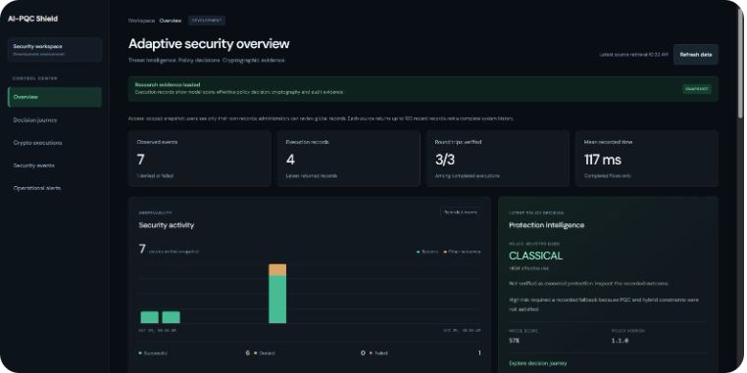
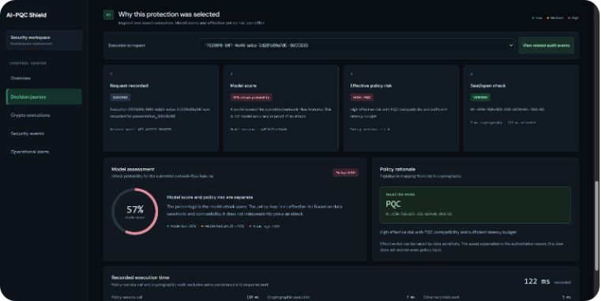

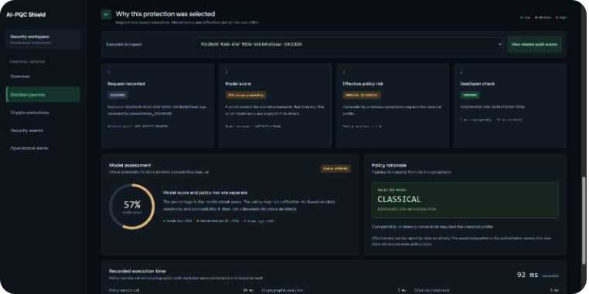
EXPERIMENTAL ARTIFACTS
Real output: operational dashboard and decision traces
Live Dashboard
PQC Decision
Hybrid Decision
Classical Mode
Real-time telemetry showing service states, throughput, and active policy rules.
High-risk trigger forcing ML-KEM-768 key encapsulation and ML-DSA-65.
Medium-risk route assigning dual X-Wing key exchange with AES-256-GCM.
Low-risk benchmark utilizing standard X25519 and ECDSA signatures.
Screenshots captured from live prototype test executions across varying simulated risk levels and payload sensitivities.
Notes:
These four screenshots show the actual running UI. In the middle panels, see how the adaptive policy engine logs its exact rationale, transitioning from Classical to Hybrid to full PQC based on incoming threat scores.

Slide 8
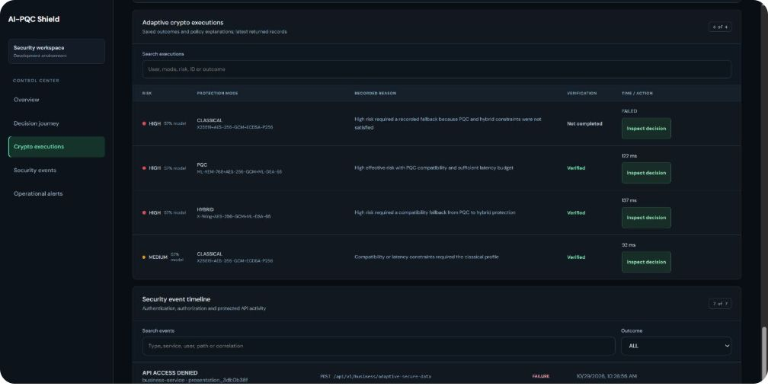
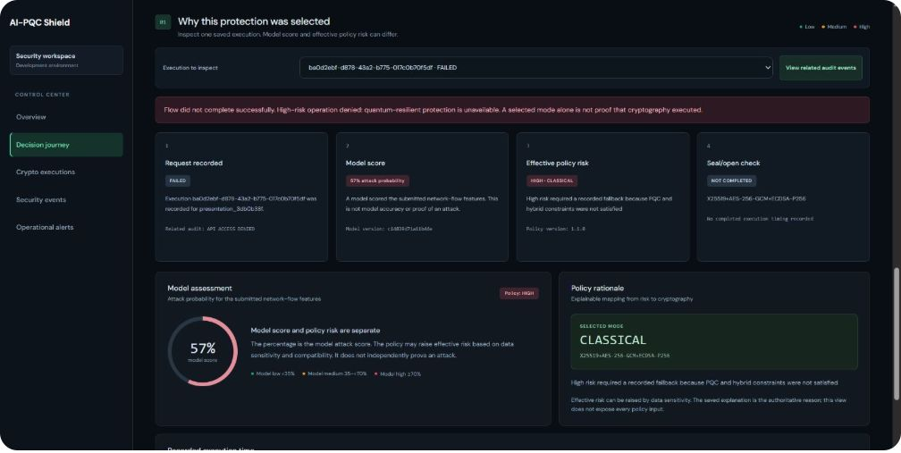
VALIDATION & ENFORCEMENT
Real output: verified execution versus policy refusal
DATABASE AUDIT TRAIL
MySQL Audit Record
[Audit Record Placeholder]
Structured database records persist trace ID, user identity, selected mode, latency (ms), and policy signature to ensure non-repudiation.
Verified Executions
Unsafe Downgrade Blocked
List of completed rounds showing cipher mode, round-trip execution latency, and successful signature verifications.
The engine proactively rejects an unauthenticated or low-security cipher request when risk thresholds mandate PQC.
Direct DB table screenshot unsupplied; schema verified in automated test suite.
“Verified” signifies a completed local cryptographic round-trip; a refused downgrade is not applied protection and demonstrates zero-trust policy enforcement.
Notes:
Slide eight illustrates enforcement rigor: when high-risk conditions are detected, an attempt to force classical mode is explicitly rejected. As noted, database audit rows are preserved in MySQL, represented here by our structured verification block.

Slide 9
RESEARCH INTEGRITY
Evaluation, reproducibility, and system limitations
DevSecOps & Reproducibility
Honest Limitations
Automated Testing: Unit, integration, and policy tests run on GitHub Actions.
Containerization: Fully reproducible multi-container deployment via Docker Compose.
Secret Management: Private `.env` parameterization; zero hardcoded credentials.
Experiment Tracking: Seeded ML training pipelines with locked hyperparameters.
Traffic Mismatch: Synthetic dataset features do not fully capture live cloud entropy.
Model Uncertainty: Residual false-positive rates require manual fallback paths.
Computational Overhead: PQC key encapsulation introduces measurable latency.
Hardening Scope: Key lifecycle management requires hardware security module (HSM) integration.
Note: Functional test pass rates confirm architectural plumbing and do not equate to 100% machine-learning threat detection accuracy.
Notes:
Verified functionality includes authentication, adaptive decisions, local round trips, persistence and monitoring. The contribution is an auditable prototype linking AI-assisted risk estimation with constrained crypto selection. Version-controlled source and configuration, automated tests, Docker Compose and private environment credentials support DevSecOps. Monitoring, traceable identifiers, recorded ML experiments and promotion gates support reproducibility. Limitations include live-traffic mismatch, false alarms, latency, local key lifecycle and incomplete production hardening.
We deliberately highlight our limitations for faculty evaluation. Passing functional software tests validates our DevSecOps plumbing, but does not mean the underlying AI detector is impervious to novel zero-day attacks.

Slide 10
CONCLUSION & FUTURE WORK
A foundation for quantum-resilient software
An auditable prototype connecting AI risk scoring, adaptive cryptographic policies, and automated DevSecOps pipelines.
Model Refinement
DDoS Hardening
HSM Integration
Cost & Scale
Reduce false alarms on complex attacks using live container telemetry.
Conduct authorized bot mitigation and adaptive rate-limiting stress tests.
Transition from local in-memory keys to hardware-backed key management.
Benchmark cloud compute cost and latency at 10,000+ requests/second.
Koneru Lakshmaiah Education Foundation · CSE Department · Hyderabad
Thank You
Notes:
Thank you to our guide Velthuru Vinisha and Dr. J. Kavitha Reddy. We welcome any questions regarding the architectural pipeline, cryptographic trade-offs, or model evaluation methodology.

