Slide 1
CHAPTER 2
Data Types and Variables

Slide 2
CHAPTER 2 OBJECTIVES
What types of data can be used in JavaScript?
How is this data stored?
How can JavaScript be used to process data?

Slide 3
WHAT TYPES OF DATA?
Data comes in many different forms, or types, such as:
- numbers
- text
- special formats, for example, dates
- Boolean data (true/false)
Notes:
Data can come in many different forms, or types. You’ll recognize some of the data types that JavaScript handles from the world outside programming, for example, numbers and text. Other data types are a little bit more abstract and are used to make programming easier, such as array and object data types.

Slide 4
WHAT TYPES OF DATA?
JavaScript is a weakly typed language.
Notes:
Some programming languages are strongly typed languages. In these languages, whenever you use a piece of data you need to explicitly state what sort of data you are dealing with, and use of that data must follow strict rules applicable to its type.
JavaScript, on the other hand, is a weakly typed language and a lot more forgiving about how you use different types of data. When you deal with data, you often don't need to specify what type of data it is; JavaScript will work it out for itself.
JavaScript is very good at working out what data it's dealing with, but there are occasions when it'll get things wrong, or at least not do what you want it to do. In these situations, you need to make it explicit to JavaScript what sort of data type you intended and how it should be used.
Data types also enable you to use data effectively in your code. The things that can be done with data and the results you'll get depend on the type of data being used, even though you don't specify explicitly what type it is.

Slide 5
WHAT TYPES OF DATA?
Numeric data:
Whole numbers, such as 2, also known as integers
Fractional numbers, such as 1.3, also known as floating-point numbers
Notes:
Both integers and floating-point numbers can be positive or negative, and both of them can span a very wide range.
Unless you're writing specialized scientific applications, you're not going to face problems with the size of numbers available in JavaScript.
JavaScript actually treats both integers and floating-point numbers as floating-point numbers. It kindly hides the detail from you so you generally don't need to worry about it.

Slide 6
WHAT TYPES OF DATA?
Text data:
One or more characters of text is a string.
String data is enclosed in single or double quotation marks, for example, "Hello World".
Notes:
We tell JavaScript that text is to be treated as text and not as code simply by enclosing it inside quote marks (").
You must end a string with the same type of quote mark that you started it with, either a single or a double quote mark.
Quote marks are one way to distinguish between numeric data and string data. For example:
3 is numeric data – JavaScript processes 3 as a number.
“3” is string data – JavaScript processes “3” as a string.

Slide 7
WHAT TYPES OF DATA?
The \ character has special meaning in JavaScript.
The \ character is known as the escape character.
Notes:
The escape character tells JavaScript that the character that follows the \ is not the end of the string, but part of the text.
For example, to include an apostrophe in a name, you could write it as:
"Peter O'Toole"
Or you could write it as:
'Peter O\'Toole'
JavaScript has a lot of other special characters that can't be typed in but can be represented using the escape character in conjunction with other characters to create escape sequences.

Slide 8
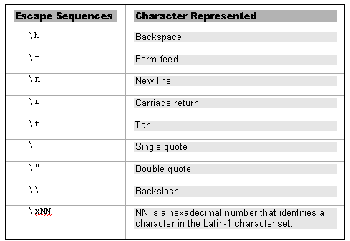
WHAT TYPES OF DATA?
Escape sequences:
Notes:
The least obvious of these is the last, which represents individual characters by their character number in the Latin-1 character set rather than by their normal appearance. (Appendix C contains the full Latin-1 character set.)
Say we wanted to include the copyright symbol © in a string. What would our escape sequence look like?
\xA9
(the character number of the copyright symbol is the hexadecimal number A9)
There is a similar way of referring to characters using their Unicode escape sequence. These are written \uNNNN, where NNNN refers to the Unicode number for that particular character.
For example, to refer to the copyright symbol using this method, you would use \u00A9.

Slide 9
WHAT TYPES OF DATA?
Boolean data:
yes/no
true/false
Notes:
The concept of “yes or no” is so useful it has its own data type in JavaScript: the Boolean data type. The Boolean type has two possible values: true for yes and false for no.
The purpose of Boolean data in JavaScript is the same as in the world outside programming: it allows us to answer yes/no questions and make decisions based on the answer.
For example, ask a yes/no question:
Are you watching a PowerPoint presentation?
Add an action based on the answer to the yes/no question:
If it’s true that you’re watching a PowerPoint presentation, raise your hand.
This is a Boolean logic statement (named after its inventor George Boole), which asks a question and then does something based on whether the answer is true or false.
In JavaScript, you can use the same sort of Boolean logic to give your programs decision-making abilities.

Slide 10
HOW IS DATA STORED?
A variable is a temporary storage container for data.
Notes:
What makes variables good places for temporarily storing your data?
Variables are held in the computer's memory. This means that it is fast to store and retrieve the data.
Variables have a limited lifetime. Once your visitors close the page or move to a new one, your variables are lost, unless you take some steps to save them somewhere.

Slide 11
VARIABLES: VARIABLE NAMES
Rules for variable names in JavaScript:
- the first character must be a letter, an underscore, or a dollar sign:
myVariable
_myVariable
$myVariable
Notes:
Other issues in naming variables in JavaScript:
As with much of JavaScript code, you'll find that variable names are case-sensitive. Issues with variable names and case-sensitivity are a very common source of errors in JavaScript. For example, if you name a variable smith and then refer to it later as Smith, JavaScript sees these as two entirely separate variables.
Also, you can't use certain names and characters for your variable names. Names you can't use are called reserved words. Reserved words are words that JavaScript uses itself, for example, the word var or the word with.
Certain characters are also forbidden in variable names, for example, the ampersand (&) and the percent sign (%).

Slide 12
VARIABLES: VARIABLE NAMES
Rules for variable names in JavaScript:
- the rest of the characters must be alphanumeric, underscore, or dollar signs
Notes:
You are allowed to use numbers in your variable names, but the names must not begin with numbers
You may wish to use a naming convention for your variables, for example, one that describes what sort of data you plan to hold in the variable.
You can notate your variables in lots of different ways—none are right or wrong, but it’s best to stick with one of them.
One common method is Camel notation, where the beginning of the name is lowercase, but each appended word begins with a capital Letter, e.g., myVariable.
Another common method is Hungarian notation, where the beginning of each variable name is a three-letter identifier indicating the data type. For example, we may start integer variable names with int, floating-point variable names with flt, string variable names with str, and so on.

Slide 13
VARIABLES: DECLARING A VARIABLE
You can declare a variable using the var keyword:
var myVariable;
Notes:
Note that the semicolon at the end of the line is not part of the variable name, but instead is used to indicate to JavaScript the end of a statement. This line is an example of a JavaScript statement.

Slide 14
VARIABLES: ASSIGNING A VALUE
You can assign a value to a variable
myVariable = 3;
Notes:
The value to the right of the equals sign is assigned to the variable on the left of the equals sign – the value 3 is stored in the variable named myVariable.

Slide 15
VARIABLES: INITIALIZATION
You can combine declaration and assignment into one step, known as initialization:
var myVariable = 3;

Slide 16
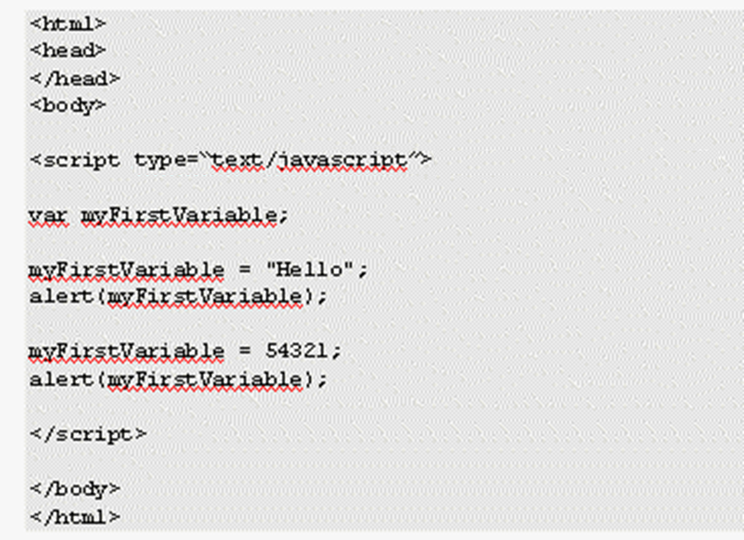
VARIABLES: DECLARING A VARIABLE
Notes:
In this example, Ch2_examp1.htm, we :
- declare a variable
- store some data in it
- access its contents
Variables can hold any type of data, and the type of data being held can be changed. For instance, you can start by storing text and then change to storing numbers, without JavaScript having any problems.
If you declare a variable, its value is undefined until you assign a value to it. Undefined is an actual value in JavaScript, and it allows you to do comparisons. (For example, you can check to see if a variable contains an actual value or if it has not yet been given a value, i.e., is “undefined”.)
In this code, you assign the variable a literal value, that is, a piece of actual data rather than data obtained by a calculation or from another variable. The first literal value is “Hello”, and the second literal value is 54321.

Slide 17
PROCESSING DATA
Variables allow you to temporarily hold information that you can use for processing, for example:
- mathematical calculations
- building up text messages
- processing words that the user has entered
Notes:
Variables are a little bit like the memory store button on the average pocket calculator. Say you were adding up your finances. You might first add up all the money you needed to spend and then store it in temporary memory. Once you had added up all your money coming in, you could deduct the amount stored in the memory to figure out how much is left over. Variables can be used in a similar way. You can first gain the necessary user input and store it in variables, and then you can do your calculations using the values obtained.

Slide 18
PROCESSING DATA
Numerical Calculations:
JavaScript includes basic math capabilities, including addition, subtraction, multiplication, and division
Each basic math capability is represented by a symbol called an operator, for example: +, -, *, /
Notes:
We call these symbols operators because they operate on the values we give them. In other words, they perform some calculation or operation and return a result to us. You can use the results of these calculations almost anywhere you'd use a number or a variable.

Slide 19

PROCESSING DATA
Numerical Calculations:
Notes:
First, you declared a variable, TotalCostOfShopping, to hold the total cost.
In the second line you have the code 10 + 5 + 5. This piece of code is known as an expression. When you assign the variable TotalCostOfShopping with the value of this expression, JavaScript automatically calculates the value of the expression (20) and stores it in the variable. Notice that we've used the = sign to tell JavaScript to store the results of the calculation in the TotalCostOfShopping variable. We call this assigning the value of the calculation to the variable, which is why the single equals sign (=) is called the assignment operator.
Finally, you display the value of the variable in an alert box.

Slide 20
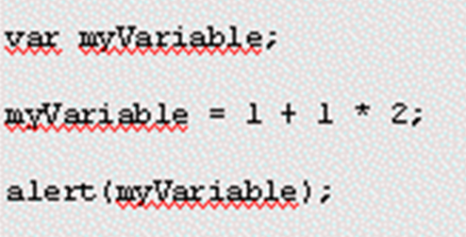
PROCESSING DATA
Numerical Calculations: Operator Precedence
Notes:
Not all operators are created equal; some have a higher precedence—that is, they get dealt with sooner.
What result would you expect the alert box to show as the value of myVariable? You might expect that since 1 + 1 = 2 and 2 * 2 = 4, the answer is 4. Actually, you'll find that the alert box shows 3 as the value stored in myVariable as a result of the calculation. So what gives? Doesn't JavaScript add up right?
The way JavaScript does our calculation is to first calculate 1 * 2 = 2, and then use this result in the addition, so that JavaScript finishes off by doing 1 + 2 = 3.
Why? Because * has a higher precedence than +. The = symbol, also an operator (called the assignment operator), has the lowest precedence—it always gets left until last.
The + and – operators have an equal precedence, so which one gets done first? Well, JavaScript works from left to right, so if operators with equal precedence exist in a calculation, they get calculated in the order in which they appear when going from left to right. The same applies to * and /, which are also of equal precedence.

Slide 21
PROCESSING DATA
Basic String Operations:
concatenation – joining 2 strings together to make one string
Notes:
So how do you concatenate? Easy! Use the + operator. Recall that when applied to numbers, the + operator adds them up, but when used in the context of two strings, it joins them together.
The string now stored in the variable concatString is "Hello Paul". Notice that the last character of the string "Hello " is a space—if we left this out, our concatenated string would be "HelloPaul".

Slide 22
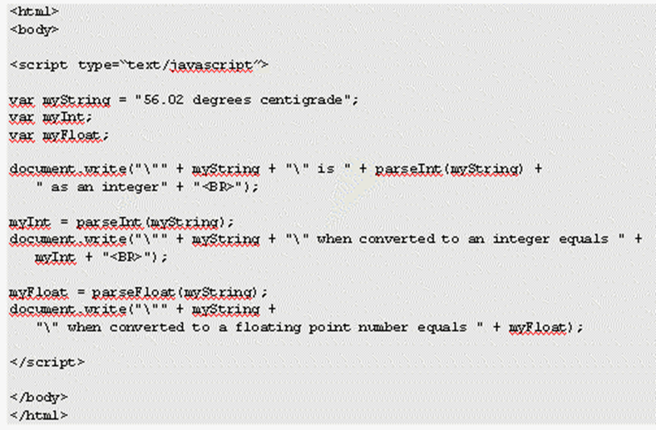
PROCESSING DATA
Data Type Conversion: Converting Strings to Numbers
Notes:
If you add a string and a number together, JavaScript converts the number to a string, then concatenates the two. Usually JavaScript has enough sense to make data type conversions like this whenever it needs to, but there are some situations where you need to convert the type of a piece of data yourself.
Two conversion functions that convert strings to numbers: parseInt() and parseFloat().
parseInt()
This function takes a string and converts it to an integer. It actually goes through (that is, parses) each character of the string you ask it to convert and sees if it's a valid number. If it is valid, parseInt() uses it to build up the number; if it is not valid, the command simply stops converting and returns the number it has converted so far.
For example, if your code is parseInt("123"), JavaScript will convert the string "123" to the number 123. For the code parseInt("123abc"), JavaScript will also return the number 123. When the JavaScript interpreter gets to the letter a, it assumes the number has ended and gives 123 as the integer version of the string "123abc".
parseFloat()
This function works in the same way as parseInt() except that it returns floating-point numbers—fractional numbers—and that a decimal point in the string that it is converting is considered to be part of the allowable number.

Slide 23
PROCESSING DATA
Data Type Conversion:
Converting Strings to Numbers
Strings that won’t convert to numbers are converted to NaN
NaN means Not a Number

Slide 24
PROCESSING DATA
Data Type Conversion:
Converting Strings to Numbers
var myString = "I'm a name not a number";
myInt = parseInt(myString);
alert(myInt);
Notes:
The alert that displays will show NaN.
If you use parseInt() or parseFloat() with any string that is empty or does not start with at least one valid digit, you get NaN, meaning Not a Number.
NaN is actually a special value in JavaScript. It has its own function, isNaN(), which checks whether something is NaN or not. For example:
myVar1 = isNaN("Hello");
will store the value true in the variable myVar1, since "Hello" is not a number, whereas
myVar2 = isNaN("34");
will store the value false in the variable myVar2, since 34 can be converted successfully from a string to a number by the isNaN() function.

Slide 25
HOW IS DATA STORED?
An array is a variable that can store more than one item of data at the same time.

Slide 26

HOW IS DATA STORED?
myVariable:

Slide 27
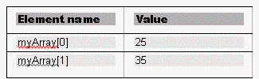
HOW IS DATA STORED?
myArray:
Notes:
You could use an array with the name myArray to store both the numbers 25 and 35.
Each place where a piece of data can be stored in an array is called an element.
How do you distinguish between these two pieces of data in an array? You give each piece of data an index value. To refer to that piece of data you enclose its index value in square brackets after the name of the array. Notice that the index values start at 0 and not 1.
Arrays can be very useful since you can store as many (within the limits of the language, which specifies a maximum of 2 to the power of 32 elements) or as few items of data in an array as you want. Also, you don't have to say up front how many pieces of data you want to store in an array, though you can if you wish.

Slide 28
HOW IS DATA STORED?
Creating an array:
var myArray = new Array();
Notes:
This method uses the new keyword and the Array object constructor function, Array().

Slide 29
HOW IS DATA STORED?
Populating an array:
var myArray = new Array("Joe", 3, "xyz");
or
var myArray = new Array();
myArray[0] = "Joe";
myArray[1] = 3;
myArray[2] = "xyz";
Notes:
You have seen how to declare a new array, but how do you store our pieces of data inside it? You can do this when you define your array by including your data inside the parentheses with each piece of data separated by a comma.
Or
You can declare an array and then use each element name as you would a variable, assigning them with values.

Slide 30
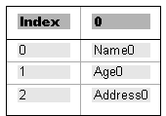
HOW IS DATA STORED?
Multi-dimensional Arrays:
A multi-dimensional array is one with two or more indexes for each element.
Notes:
JavaScript doesn't actually support multi-dimensional arrays, only single ones. However, JavaScript allows us to fake multi-dimensional arrays by creating an array inside another array
var personnel = new Array();
Then you do something new; you tell JavaScript you want index 0 of the personnel array, that is, the element personnel[0], to be another new array.
personnel[0] = new Array();
What the preceding line is doing is creating a new array inside the element with index 0 of our personnel array.
In the next three lines you put values into the newly created personnel[0] array. JavaScript makes it easy to do this; you just state the name of the array, personnel[0], followed by another index in square brackets. The first index (0) belongs to the personnel array; the second index belongs to the personnel[0] array.
personnel[0][0] = "Name0";
personnel[0][1] = "Age0";
personnel[0][2] = "Address0";
The numbers at the top, at the moment just 0, refer to the personnel array. The numbers going down the side, 0, 1, and 2, are actually indices for the new personnel[0] array inside the personnel array.

