Slide 1


Breast cancer Classification with python
By SAI SRUNITH SILVERY

Slide 2
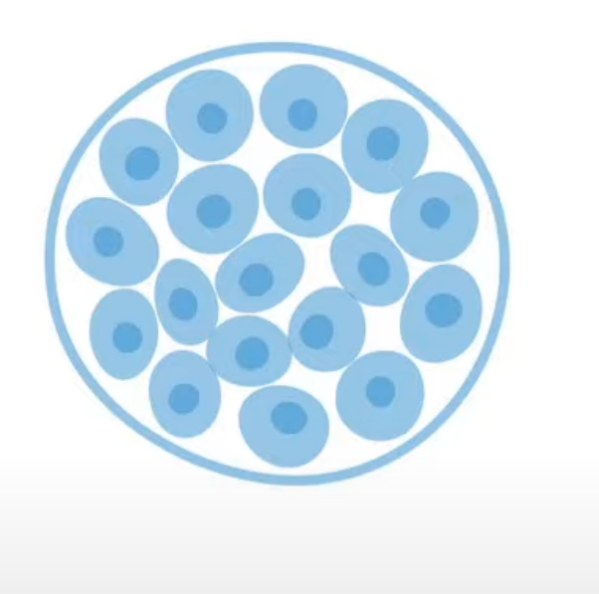
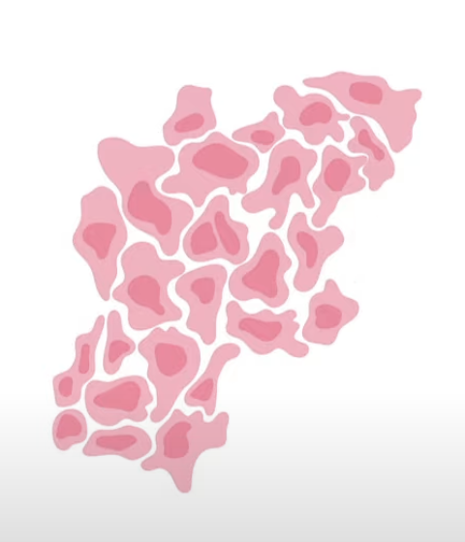
TYPES OF TUMOR
Benign Tumor -Non-cancerous -capsulated -slow growing
Malignant tumor -cancerous -Non capsulated -Fast Growing

Slide 3
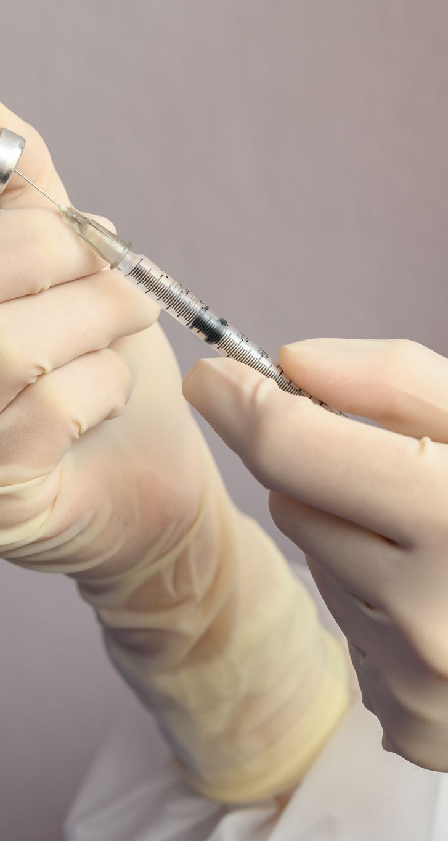
Dataset:
Fine needle aspiration is a type of biopsy procedure. In fine needle aspiration, a thin needle is inserted into an area of abnormal-appearing tissue or body fluid. As with other types of biopsies, the sample collected during fine needle aspiration can help make a diagnosis or rule out conditions such as cancer.

Slide 4
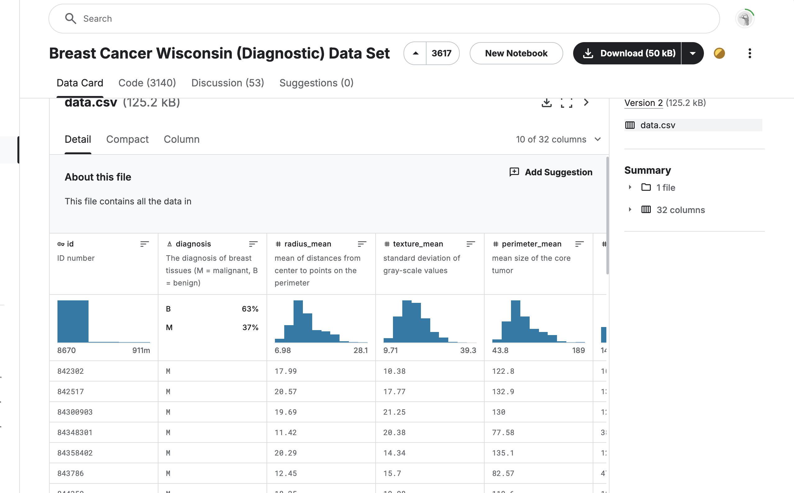

Slide 5
Dataset: The process begins with gathering the dataset, which contains the features and labels necessary for training the model.
Data Pre-processing: This step involves cleaning and preparing the data. It includes handling missing values, scaling features, encoding categorical variables, and any other transformations required to make the data suitable for machine learning.
Train-Test Split: After pre-processing, the data is split into two sets:
Training Set: Used to train the logistic regression model.
Test Set: Used to evaluate the performance of the model on unseen data.
Logistic Regression Model Training: The logistic regression algorithm is applied to the training set, where it learns the relationship between the features and the target labels (benign or malignant).
Trained Logistic Regression Model: Once trained, the model is ready to make predictions. The model can now classify whether a new data point (such as a tumor’s attributes) is benign or malignant.
Prediction on New Data: The trained logistic regression model is used to predict the outcome for new, unseen data (e.g., determining if a new tumor is benign or malignant based on its features).

Slide 6

Thank you

