Slide 1
PANIMALAR ENGINEERING COLLEGE DEPARTMENT OF COMPUTER SCIENCE AND ENGINEERING
ATTENDANCE SYSTEM USING LDA BASED FACE RECOGNITION
SAI SRUTHI N 211422104416
SARMILAA R 211422104440
GUIDE Mrs SHYMALA DEVI

Slide 2
Abstract
Facial recognition, a secure biometric technique, typically requires large databases and is often outsourced by large companies. This project aims to develop an in-house system for educational institutions, allowing student attendance to be recorded through facial recognition. The system uses the Normal Discriminant Function (NDF) for accurate identification, and includes security measures like retinal scanning, thermal imaging, and 2D/3D mapping to prevent impersonation. Principal Component Analysis (PCA) and Linear Discriminant Analysis (LDA) are employed for feature extraction and dimensionality reduction. Each student’s facial data is stored as up to 100 images, with attendance records logged with precise timestamps.

Slide 3
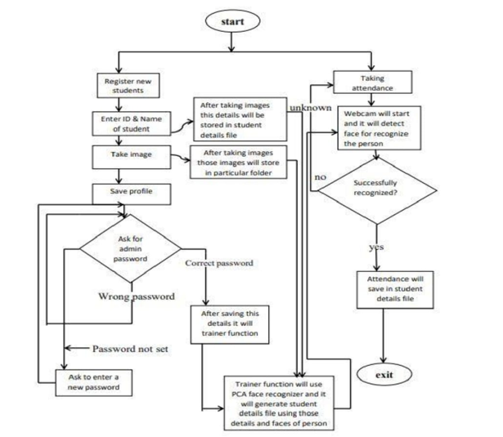
ADMINISTRATOR DIAGRAM
Fig1:Administrator diagram

Slide 4
Exixting system
Most existing systems automate attendance by integrating facial recognition technology with an Eigen-face database and Principal Component Analysis (PCA) using MATLAB GUI. The system captures and preprocesses a student's image, then compares it to the Eigen-face database. If the similarity score exceeds a threshold of 0.3, the system recognizes the face and records attendance. Attendance data is then saved in a Microsoft Excel sheet through the MATLAB GUI. The database initially contains 10 images of each of 15 individuals, captured from various angles and positions.

Slide 5
LIMITATIONS OF EXISTING SYSTEM
→
It is developed for a particular system so we implement this library OpenCV does not provide the same ease of use when compared to MATLAB. Open CV has a flann library of its own. This causes conflict issues when you try to use OpenCV library with the PCL library.
→
Also the existing system only stores images of 15 persons upto 10 images per person. This result in delay of detecting the faces and also most of institutions has larger number of students so the existing system does not fit well for it .

Slide 6
PROPOSED SYSTEM
To address the limitations of existing systems, the proposed system enhances face detection speed and allows for a larger database of student images. It integrates Linear Discriminant Analysis (LDA) with Principal Component Analysis (PCA) and Eigen-face techniques. This approach enables the storage of up to 100 images per student in various postures while minimizing storage requirements. As a result, face detection is faster and more efficient.

Slide 7
UML DIAGRAM
A UML diagram is a diagram based on the UML (Unified Modelling Language) with the purpose of visually representing a system along with its mainactors, roles, actions, artifacts or classes, in order to better understand, alter, maintain, or document information about the system. It is based on diagrammatic representations of software component.

Slide 8
USECASE DIAGRAM
A use case diagram is a dynamic or behaviour diagram in UML. Use case diagrams model the functionality of a system using actors and use cases. Use cases are a set of actions, services, and functions that the system needs to perform. In this context, a “system” is something being developed or operated, such as a web site. The “actors” are people or entities operating under defined roles within the system. Use case diagrams are valuable for visualizing the functional requirements of a system that will translate into design choices and development priorities. Use case diagrams specify how the system interacts with actors without worrying about the details of how that functionality is implemented.

Slide 9
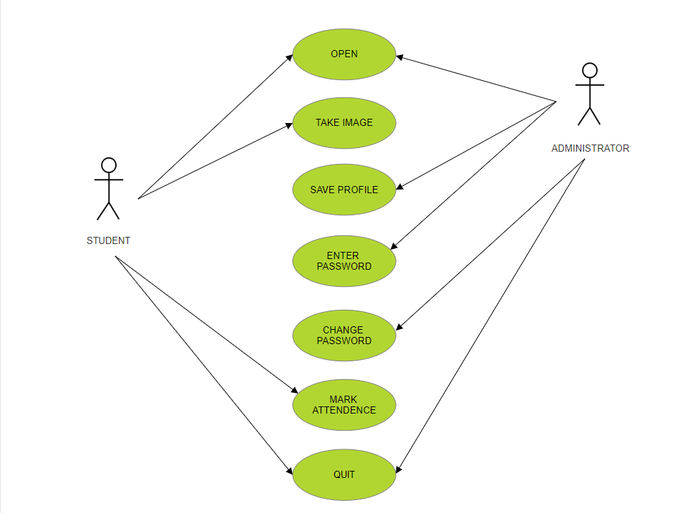
Fig 2:UseCase Diagram

Slide 10
CLASS DIAGRAM
A Class diagram is a Unified Modeling Language(UML) is a type of static structure diagram that describes the structure of a system by showing the system’s classes, their attributes, operations (or methods), and the relationships among objects. The class diagram is the main building block of object- oriented modeling. It is used for general conceptual modeling of the structure of the application, and for detailed modeling translating the models into programming code. Class diagrams can also be used for data modeling. The classes in a class diagram represent both the main elements, interactions in the application, and the classes to be programmed.

Slide 11
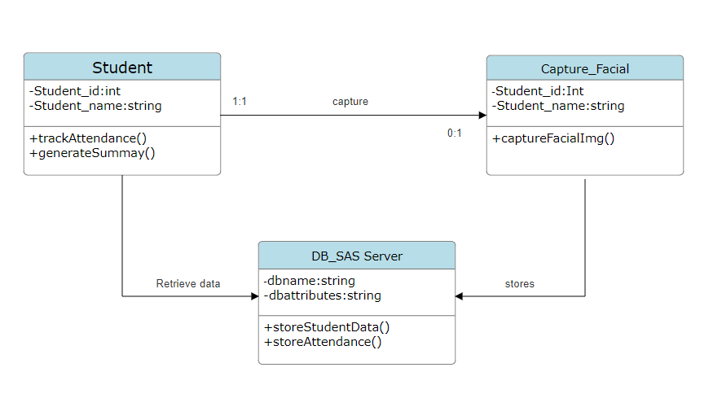
Fig3:Class Diagram

Slide 12
Sequence diagram
A sequence diagram illustrates the interactions between objects in a specific order, showing the sequence of these interactions. Also known as event diagrams or event scenarios, sequence diagrams detail how objects in a system collaborate and the order in which these interactions occur. They are commonly used by business professionals and software developers to document and analyze the requirements of both new and existing systems.

Slide 13
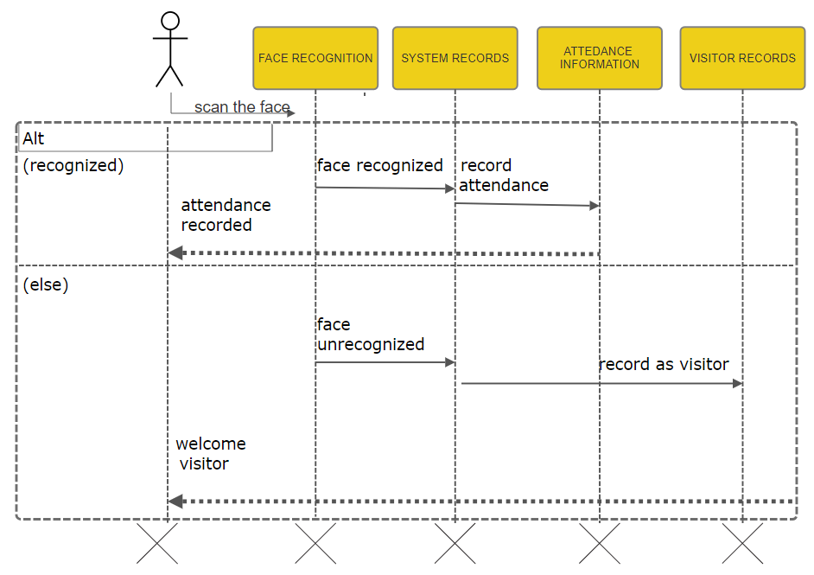
Fig4:Sequence diagram

Slide 14
HARDWARE CONFIGURATION
A standalone computer or laptop (8GB RAM or higher).
High-quality wireless camera to capture images.
Secondary memory to store all the images and database.
SOFTWARE CONFIGURATION
Operating system: Windows 7 or 10
Language : Python
Libraries used : OpenCV-python, pillow pandas , OpenCV-contrib- pythonpymysql.
Integrated development environment : Command prompt.

Slide 15
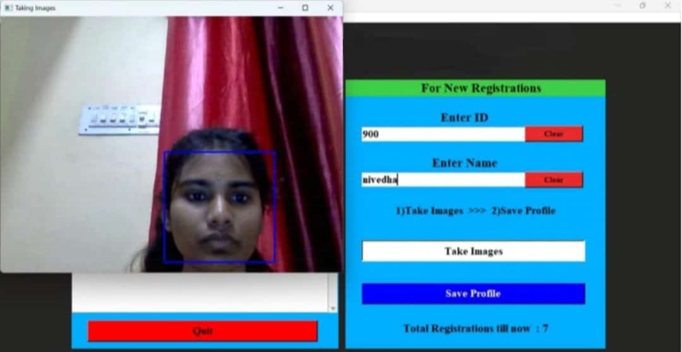
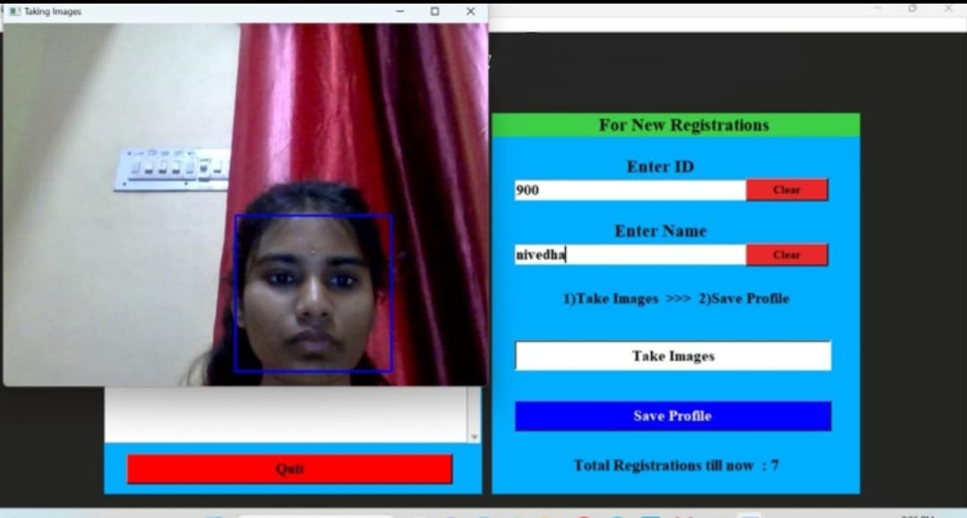
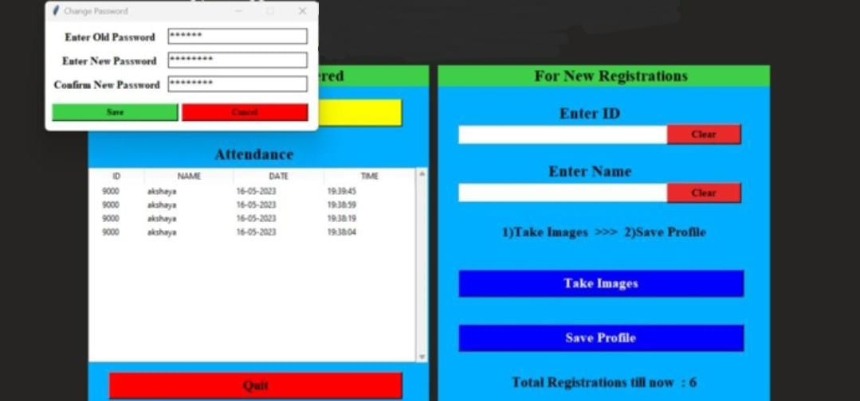
SCREENSHOTS
Fig 5.Taking images for registration for the particular student
Fig 6. Taking attendance by recognizing face
Fig 7.Change password

Slide 16
CONCLUSION
Face recognition systems are becoming essential for applications like security and attendance management in educational institutions. A Face Recognition Based Attendance System automates attendance tracking, reducing errors associated with manual methods. By leveraging Linear Discriminant Analysis (LDA), the system enhances accuracy and efficiency in verifying student identities. The implementation involves collecting diverse student images, preprocessing them, extracting features using LDA, training a recognition model, and automatically marking attendance in real-time. This approach not only saves time and increases accuracy but is also scalable for larger institutions. Additionally, it emphasizes data protection and access control to ensure the security of student information. Overall, this system significantly improves the reliability and efficiency of attendance management.

Slide 17
FUTURE ENHANCEMENT
The results are promising, however the future work will focus on adding some features to the page such as student details other than student id and name and detection of face when a student wearing a face masks and a feature to delete the student from the system & also giving authentication to parents to see the attendance report etc.,

