Slide 1
MATERNAL HEALTH RISK PREDICTION
NAME : KUNDURU SAI SRUTHI
ROLL . NO : 2203A52156

Slide 2
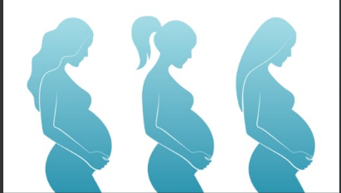
INTRODUCTION :
Data has been collected from different hospitals, community clinics, maternal health cares through the IoT based risk monitoring system. Health risks for pregnant patients could be attributed to a variety of health conditions such as blood pressure age, heart rate etc. Here data has been collected from different healthcare facilities through the Internet-of-Things-based risk monitoring system (data source: Maternal Health Risk Data Maternal Health Risk Data).

Slide 3
INFO OF DATA ATRIBUTES:
Age: Age in years when a woman is pregnant.
Systolic BP: Upper value of Blood Pressure in mmHg, another significant attribute during pregnancy.
Diastolic BP: Lower value of Blood Pressure in mmHg, another significant attribute during pregnancy.
BS: Blood glucose levels is in terms of a molar concentration, mmol/L.
Heart Rate: A normal resting heart rate in beats per minute.
Risk Level: Predicted Risk Intensity Level during pregnancy considering the previous attribute.

Slide 4
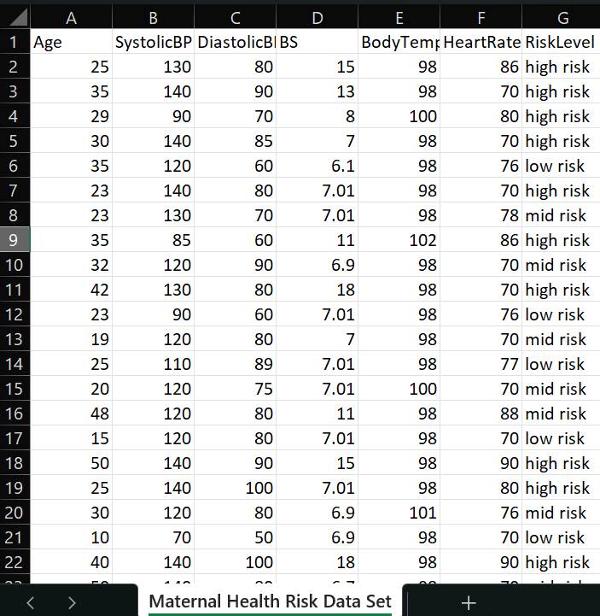
Data set:

Slide 5
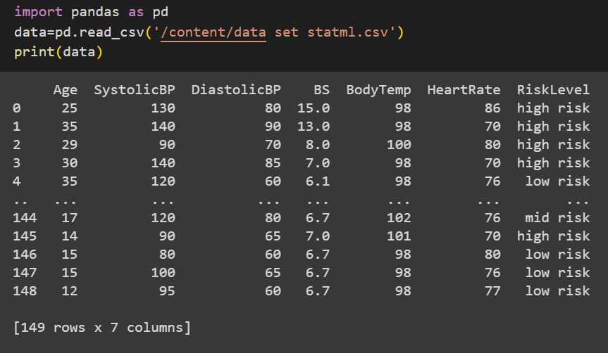
Data set :

Slide 6
Types to deal with project:
Classification and Regression: SVM is primarily used for classification, where it assigns data points to different classes. However, it can also be used for regression tasks, referred to as Support Vector Regression (SVR), where it finds a hyperplane that best fits the data while minimizing errors.
SVMs are widely used in applications like image classification, text classification, bioinformatics, and many others. They are favored for their ability to handle high-dimensional data, robustness against overfitting, and adaptability to both linear and nonlinear problems. However, tuning SVM hyperparameters, especially for non-linear kernels, can be a complex task.

Slide 7
FEATURES AND TARGET VARIABLE:
Here the dataset is loaded using pandas library.
We can see that the dataset have features and a target variable.
Features : Unnamed , Age , systolic bp,diastolic bp,BS,body temperature,heart rate
Target Variable : risk level
From the dataset we can see that it is parametric method approach.
The dataset contains categorical values.
So , this is classification.

Slide 8
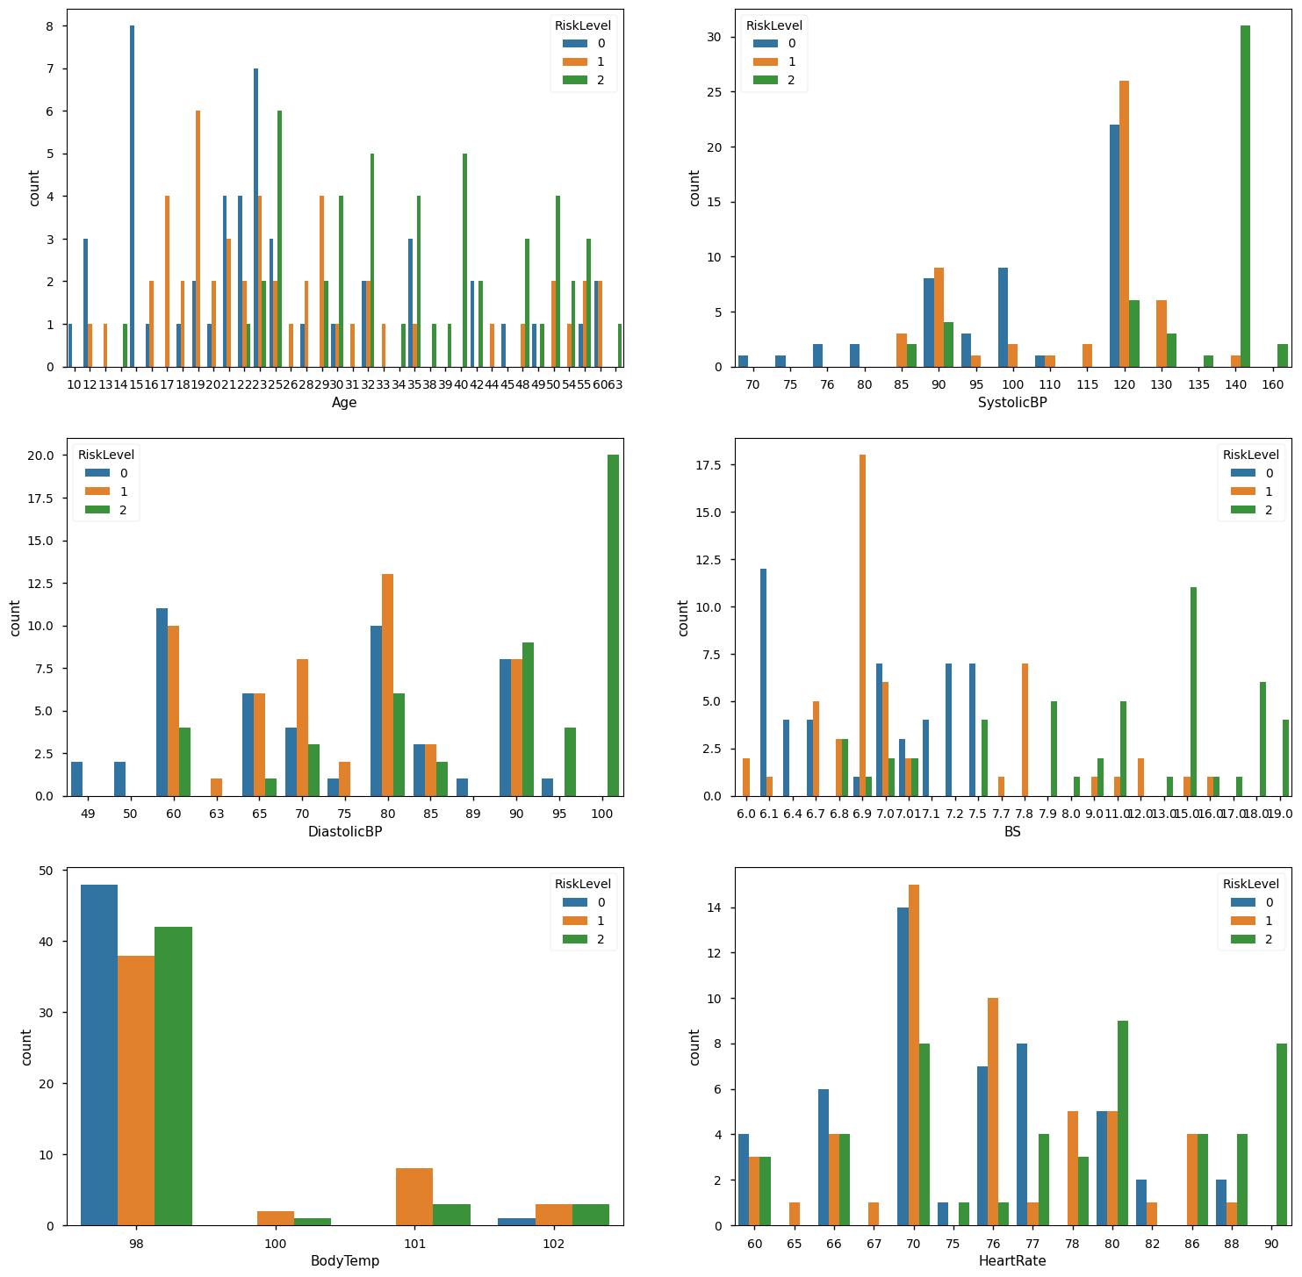
TARGET AND FEATURES COMPARITION:

Slide 9
IMPLEMENTATION:
There are three methods to find the accuracy for the classification dataset.
They are:
Logistic Regression
Support Vector Machine
Perception Learning

Slide 10
LOGISTIC REGRESSION:
Logistic regression is a classification algorithm, used when the value of the target variable is categorical in nature. It follows parametric method approach . It can be applied for supervised data. Logistic regression is most commonly used when the data in question has binary output, so when it belongs to one class or another, or is either a 0 or 1.
Mathematically, a logistic regression model predicts P(Y=1) as a function of X.
It is one of the simplest ML algorithms that can be used for various classification problems .

Slide 11
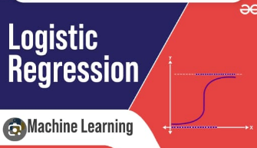
LOGISTIC REGRESSION:
Logistic regression is a supervised machine learning algorithm mainly used for classification tasks where the goal is to predict the probability that an instance of belonging to a given class or not. It is a kind of statistical algorithm, which analyze the relationship between a set of independent variables and the dependent binary variables.Logistic regression is a classification algorithm, used when the value of the target variable is categorical in nature. It follows parametric method approach . It can be applied for supervised data. Logistic regression is most commonly used when the data in question has binary output, so when it belongs to one class or another, or is either a 0 or 1
Mathematically, a logistic regression model predicts P(Y=1) as a function of X.
It is one of the simplest ML algorithms that can be used for various classification problems .

Slide 12
SUPPORT VECTOR MACHINE:
Support Vector Machine (SVM) is a powerful and versatile machine learning algorithm primarily used for classification and regression tasks. It's particularly well-suited for both linear and nonlinear classification problems and is known for its ability to find an optimal hyperplane or decision boundary that maximizes the margin between different classes. Here are the key concepts and characteristics of SVM:
Hyperplane : In SVM, the goal in classification is to find a hyperplane that best separates the data points of different classes. This hyperplane is chosen to maximize the margin, which is the distance between the hyperplane and the nearest data points (support vectors) of each class.
Support vectors: Support vectors are the data points that are closest to the hyperplane and have the smallest margin. They play a critical role in defining the position and orientation of the hyperplane.
Linear and Nonlinear Separation: SVM is effective for linearly separable data, where a straight line (or hyperplane in higher dimensions) can separate the classes. However, SVM can also handle nonlinear data by using techniques like the kernel trick. Kernels allow SVM to transform the original feature space into a higher-dimensional space, where the data becomes linearly separable.

Slide 13
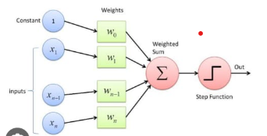
PERCEPTRON LEARNING:
Perceptron is a building block of an Artificial Neural Network.
Perceptron is a linear Machine Learning algorithm used for supervised learning for various binary classifiers.
This algorithm enables neurons to learn elements and processes them one by one during preparation.
The perceptron consists of 4 parts.
•Input values or One input layer
Weights and Bias
Net sum
Activation function

Slide 14
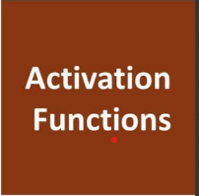
Activation function:
Activation Function: A neuron can be activated or not, is determined by an activation function. The activation function calculates a weighted sum and further adding bias with it to give the result.
The default activation function in perception learning is
Sigmoid function.

Slide 15
LIBRARIES USED:
PANDAS: to load the dataset
MATPLOTLIB.PYPLOT : to implement graphs
SKLEARN.MODEL_SELECECTION : for test and train split
SKLEARN.SVM : for logistic regression in classification
SKLEARN.METRICS:
Accuracy score
Classification report
Confusion matrix
SKLEARN : SVM
SKLEARN.LINEAR_MODEL : Perceptron learning

Slide 16
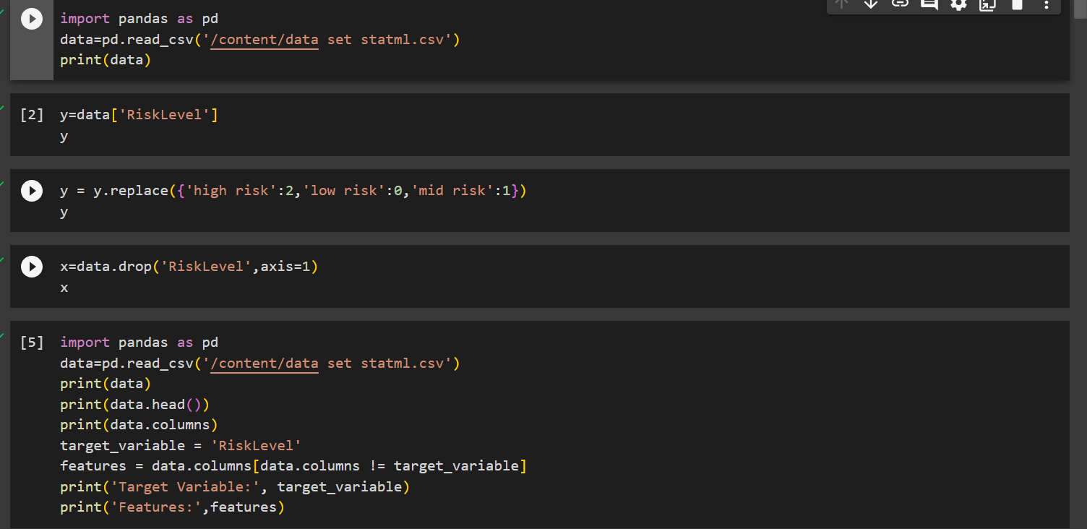
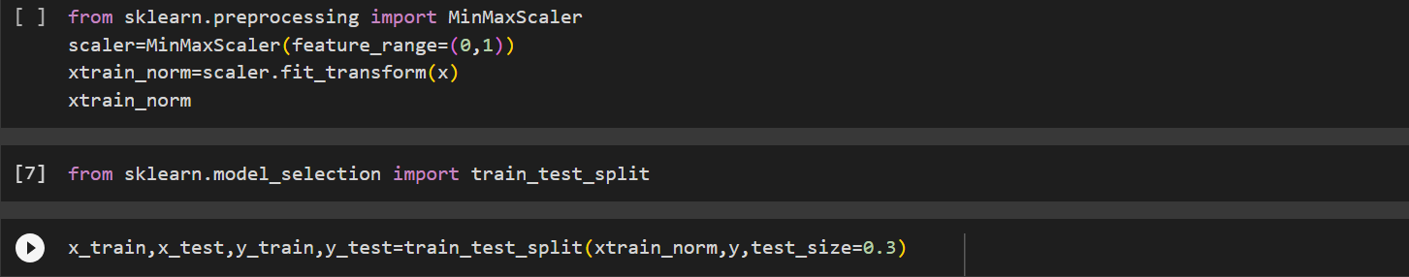
code

Slide 17
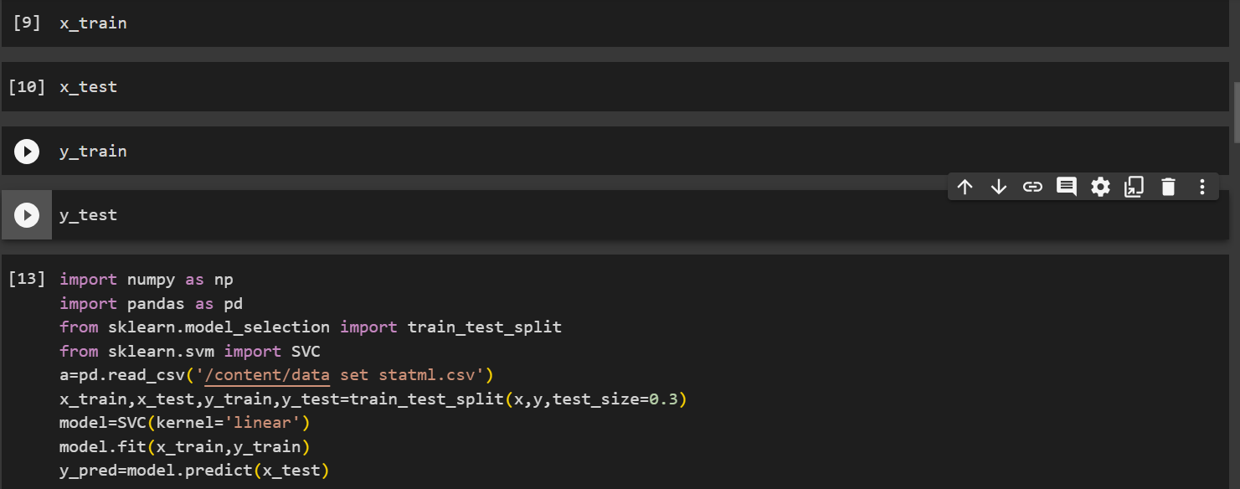

Slide 18
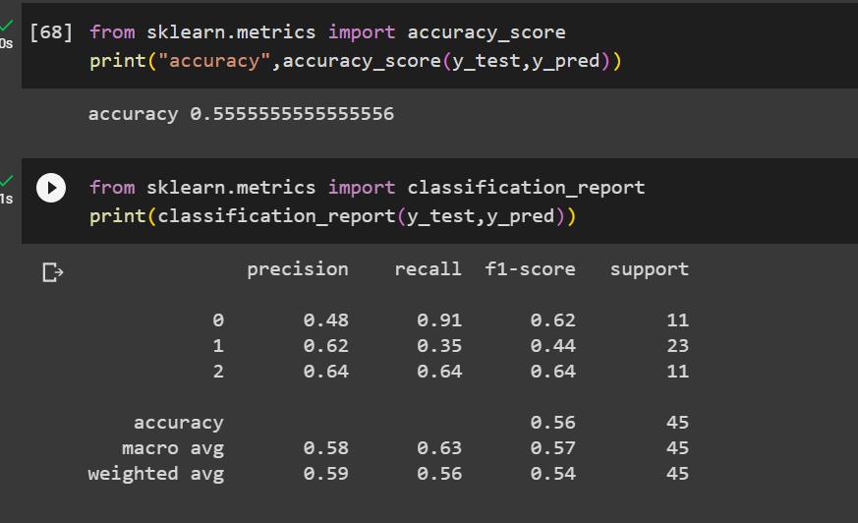
Logistic Accuracy:

Slide 19
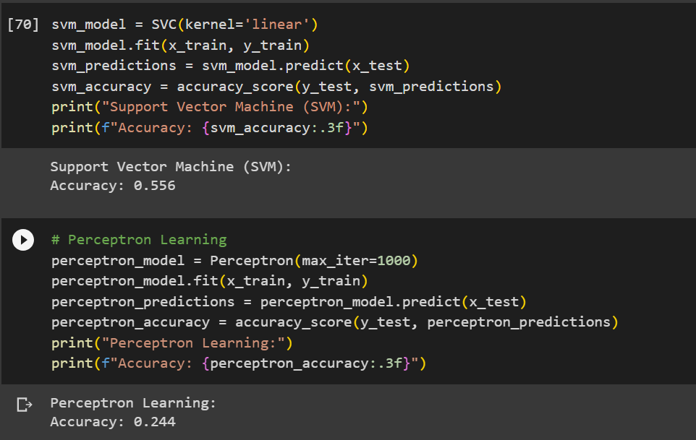
Accuracy svm &perceptron:

Slide 20

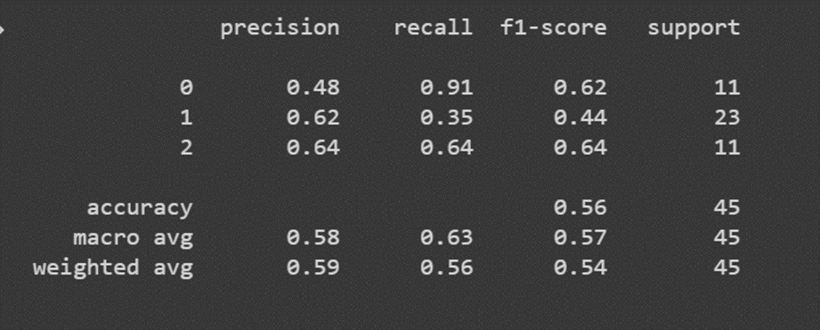
classification report:

Slide 21
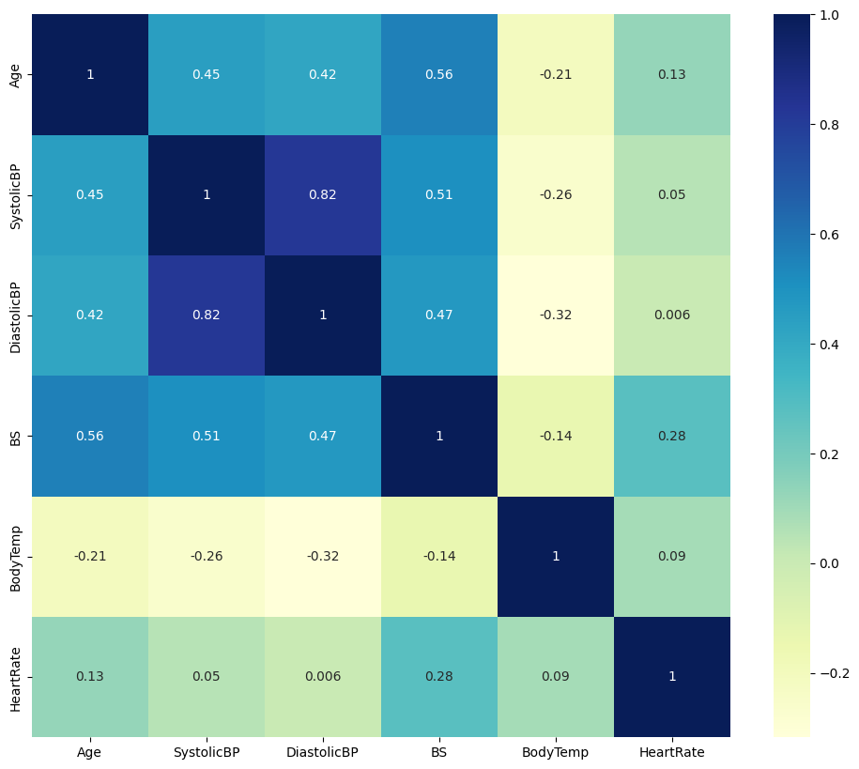
Heatmap:

Slide 22
RESULT ANALYSIS:
Comparison of the results from different sources:
My results:
LOGISTIC REGRESSION:0.5555556
SUPPORT VECTOR MACHINE:0.55555556
PERCEPTRON LEARNING:0.2226666666
Source 1:
LOGISTIC REGRESSION:0.555555555555
SUPPORT VECTOR MACHINE:0.55555555
PERVEPTRON LEARNING:0.5555555555

Slide 23
RESULT ANALYSIS:
Source 2:
LOGISTIC REGRESSION:0.55555557
SUPPORT VECTOR MACHINE:0.334246576
PERVEPTRON LEARNING:0.666666
Source 3:
LOGISTIC REGRESSION:0.365676765
SUPPORT VECTOR MACHINE:0.344567
PERVEPTRON LEARNING:0.3455655

Slide 24
RESULT ANALYSIS:
Source 4:
LOGISTIC REGRESSION:0.4672537455
SUPPORT VECTOR MACHINE:0.3746564737364
PERVEPTRON LEARNING:0.322233475746
Source 5:
LOGISTIC REGRESSION:0.55555555555
SUPPORT VECTOR MACHINE:0.5555555555
PERVEPTRON LEARNING:0.222222222

Slide 25
KNN INPLECATION:
K-Nearest Neighbors (KNN) is a simple, non-parametric machine
learning algorithm used for both classification and regression. It
operates based on instance-based learning, determining the
classification of a new data point by comparing it with the majority
class of its ’k’ nearest neighbors.
KNN computes the distance (usually Euclidean distance) between the
input data point and all other points in the dataset. The ’k’ closest
data points are then chosen based on these distances.
For classification, once the ’k’ nearest neighbors are identified, the
majority class among these neighbors determines the class of the new
data point. This means the most common class among the ’k’
neighbors is assigned to the new point.
It works well with small to medium-sized datasets but might not be
the most efficient for large datasets.

Slide 26
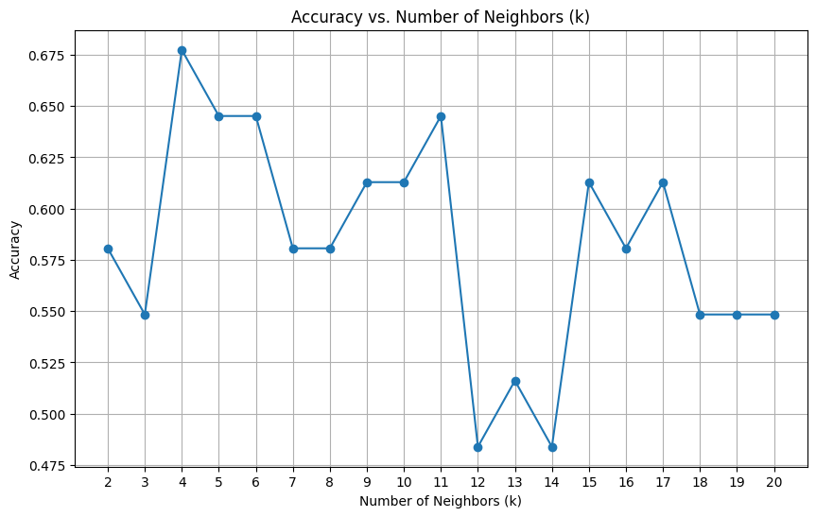
KNN GRAPH:

Slide 27
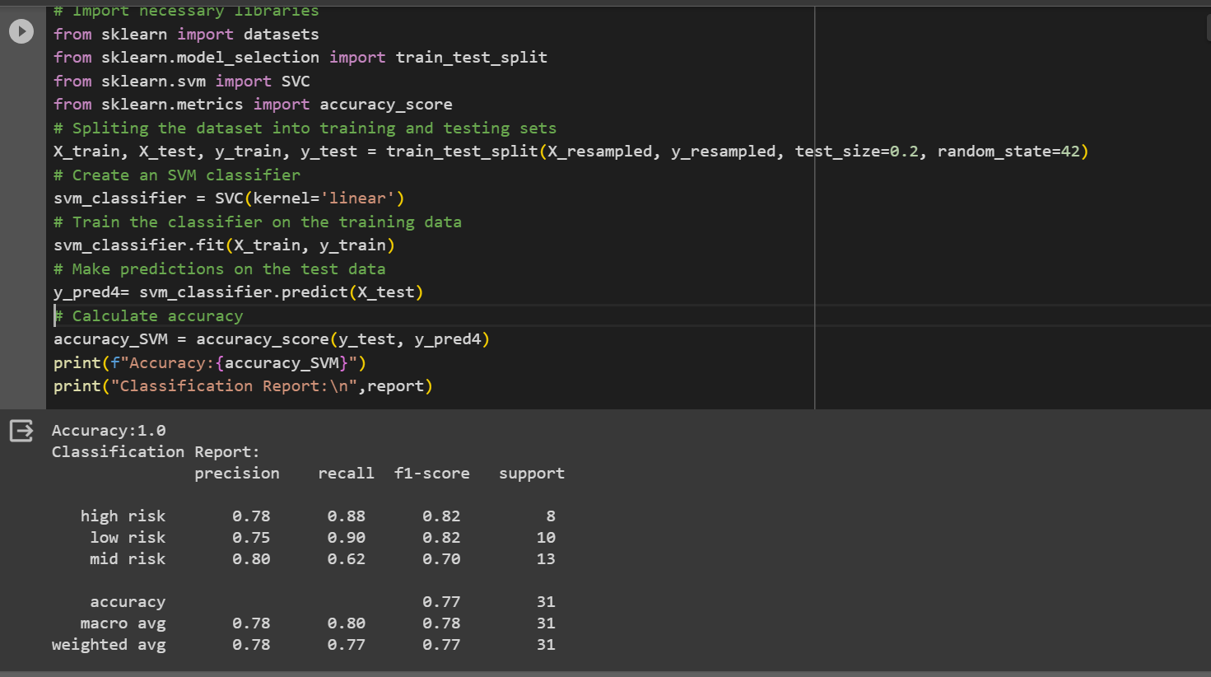

Slide 28
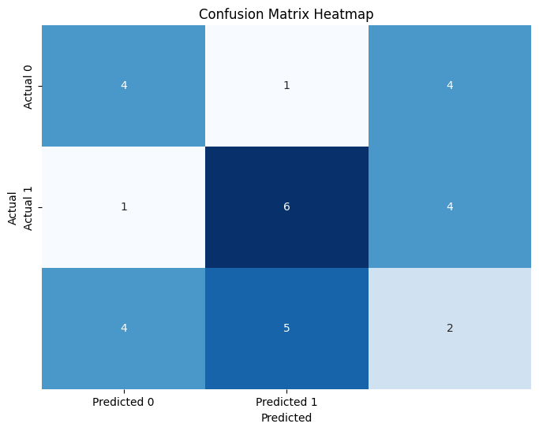
CONFUSION MATRIX:

Slide 29
Bootstrapping:
□ Bootstrapping is a resampling technique commonly used in machine
learning and statistics. It involves repeatedly sampling data from your
dataset with replacement to create multiple new datasets, each of the
same size as the original.
□ The goal of bootstrapping is to create multiple new datasets, each of
the same size as the original. These datasets are called ”bootstrap
samples.Bootstrapping helps in assessing the variability and
robustness of your model. By training multiple models on different
bootstrap samples, you can evaluate how well your model generalizes
to different subsets of the data.
□ Bootstrapping can be used to estimate confidence intervals for various
performance metrics of your model, such as accuracy or mean squared
error. By repeatedly resampling the data and evaluating the model on
each sample, you can get a distribution of the metric and compute its
confidence interval.

Slide 30
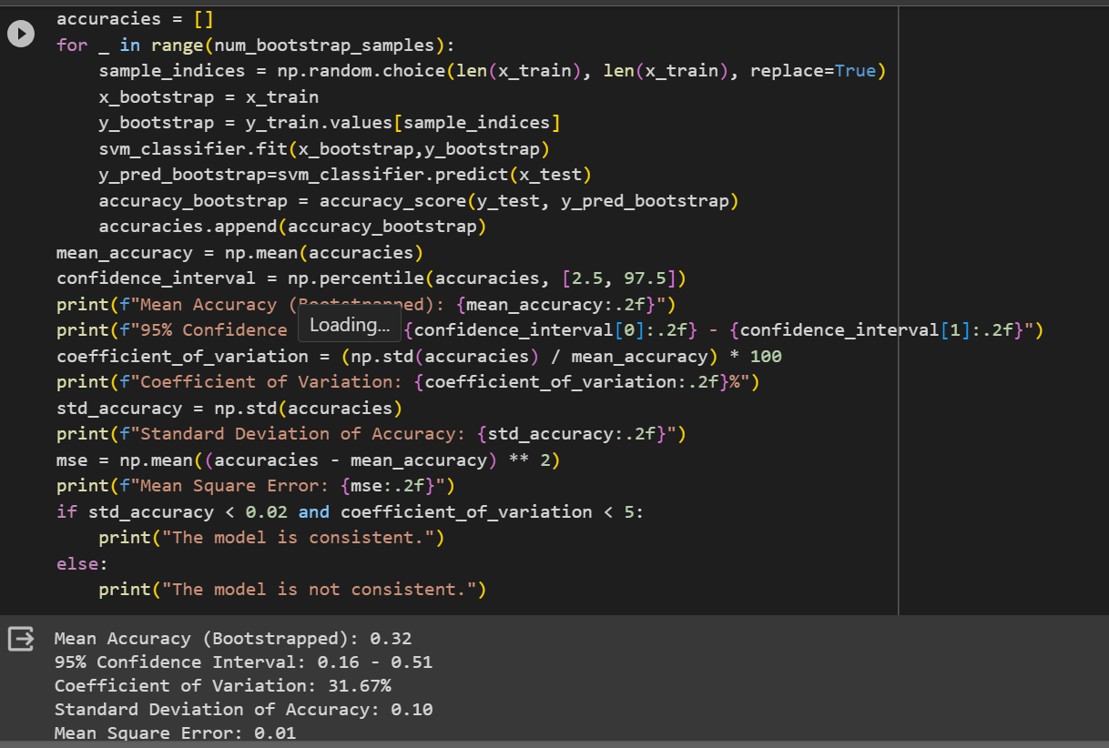
Bootsrapping:

Slide 31
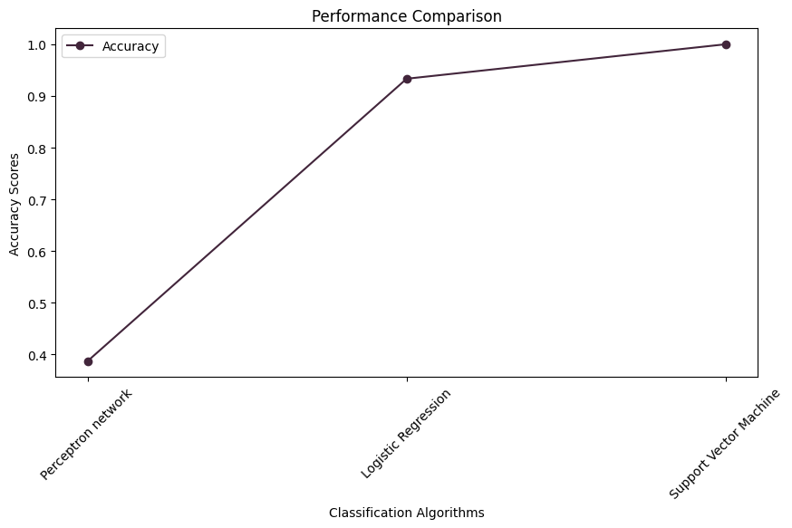
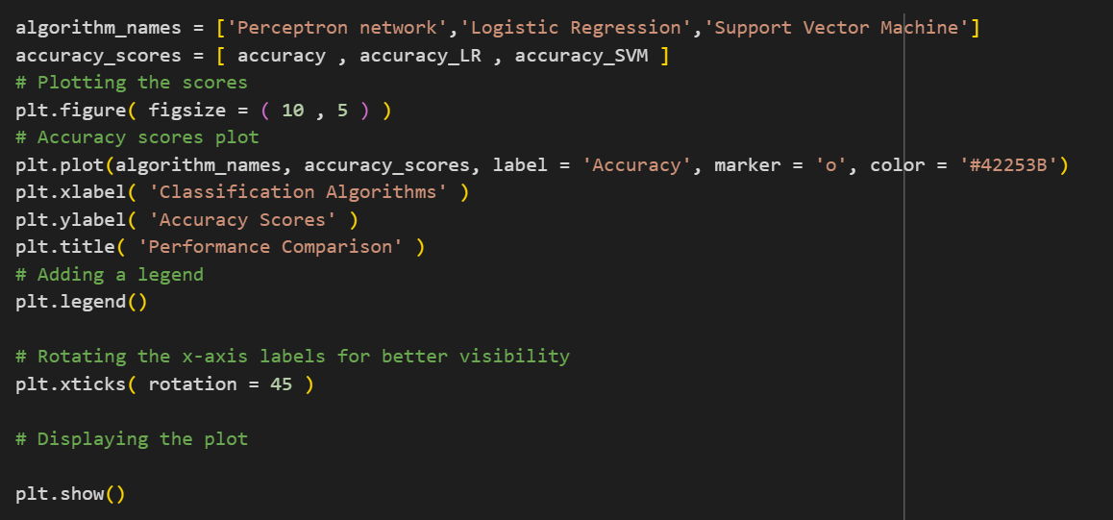
COMPARING THE BELOW:

Slide 32
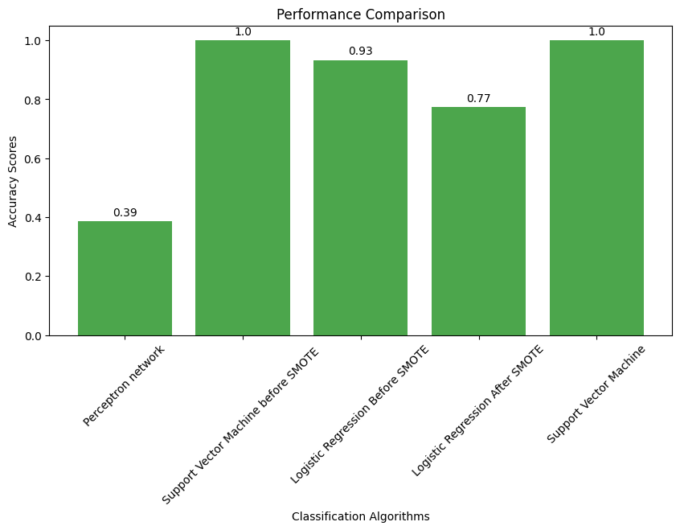
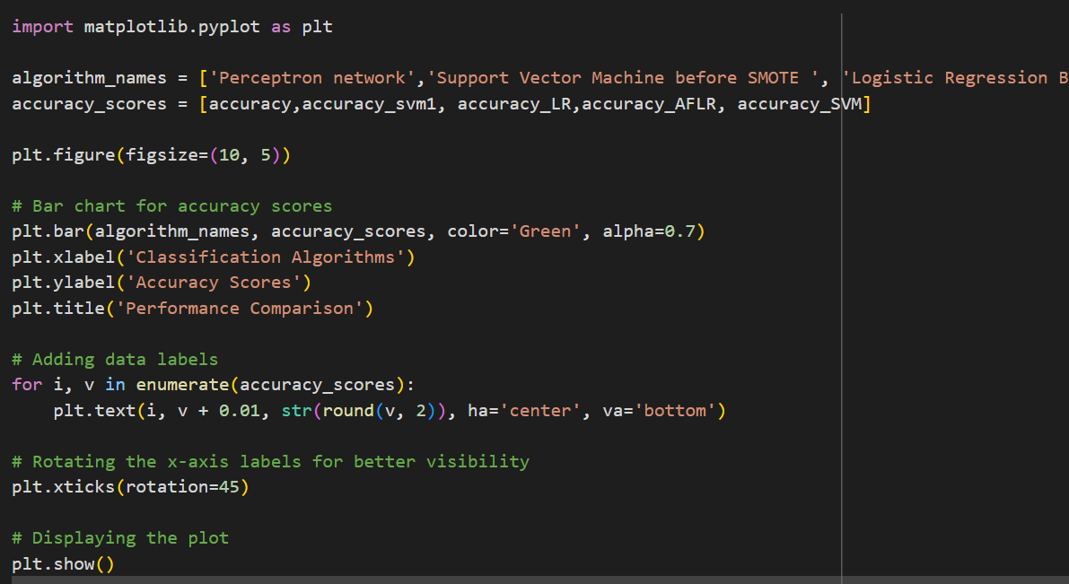

Slide 33
GITHUB LINK:
https://github.com/saisruthikunduru/STATML_PROJECT

Slide 34
THANK YOU

