Slide 1
A Review on Sparse Neural Network
2017.5.12

Slide 2
Sparse Neural Network
Sparse
Stimuli
Activated Neural
hierarchical
High-level abstraction

Slide 3
Sparse Neural Network
Sparse Deep Model
Deep Sparse Model

Slide 4
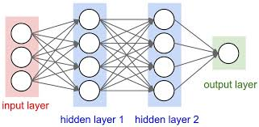
Sparse Deep Model
Overall Framework
sparse regularization
Deep Neural Network

Slide 5
Sparse Deep Model
Sparse Regularization
Combine
Weight Sparseness
Neural Sparseness
Norm
Zero out Wij(k)
Matrix Decomposition
Cluster & Quantization
Huffman
Norm
Activation Function

Slide 6
Sparse Deep Model
Sparse Regularization
Combine
Weight Sparseness
Neural Sparseness
Norm
Zero out Wij(k)
Matrix Decomposition
Cluster & Quantization
Huffman
Norm
Activation Function

Slide 7
Sparse Deep Model
Sparse Regularization
Combine
Weight Sparseness
Neural Sparseness
Norm
Zero out Wij(k)
Matrix Decomposition
Cluster & Quantization
Huffman
Norm
Activation Function

Slide 8

Weight Sparseness
Norm ( Weight Decay )
训练准则公式
$$\left.J(W,b;S\right)$$
$$\left.\ddot{J}(W,b;S)=J(W,b;S)+λR(W\right)$$

Slide 9
Sparse Deep Model
Sparse Regularization
Combine
Weight Sparseness
Neural Sparseness
Norm
Zero out Wij(k)
Matrix Decomposition
Cluster & Quantization
Huffman
Norm
Activation Function

Slide 10
Weight Sparseness
Zero Out Wij(k)
Simplest:
if ( W_{ij} < threshold ) then W_{ij} = 0
Choose a criteria:
OBD
( Optimal Brain Damage )

Slide 11
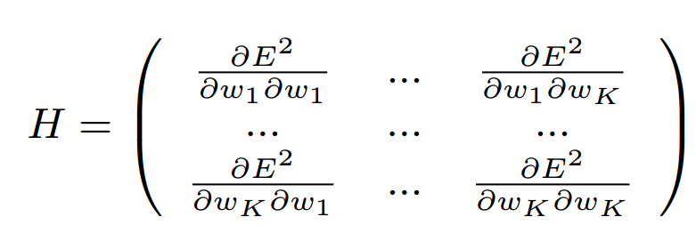
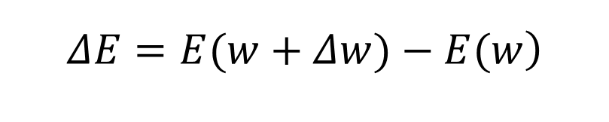
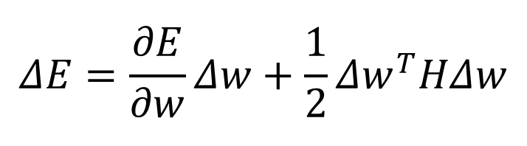
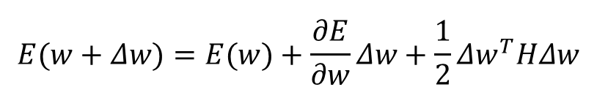
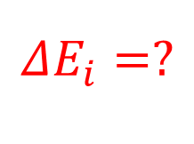
Weight Sparseness
$$\begin{matrix} \\ \left.ΔE=E(w+Δw)−E(w\right) \\ \end{matrix}$$
Zero Out Wij(k)
$$\begin{matrix} \\ E(w+Δw)=E(w)+\frac{∂E}{∂w}Δw+\frac{1}{2}Δw^{T}HΔw \\ \end{matrix}$$
$$\begin{matrix} \\ ΔE=\frac{∂E}{∂w}Δw+\frac{1}{2}Δw^{T}HΔw \\ \end{matrix}$$
OBD
( Optimal Brain Damage )
$$\begin{matrix} \\ ΔE_{i}=? \\ \end{matrix}$$
其中

Slide 12

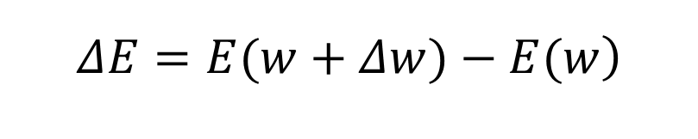
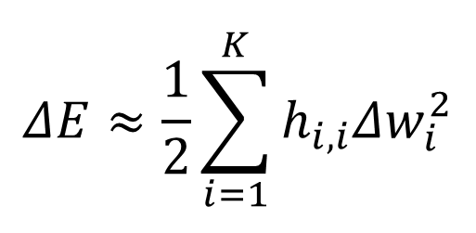
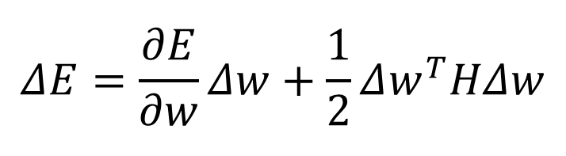
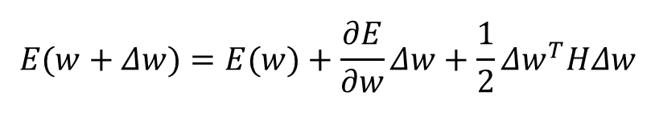
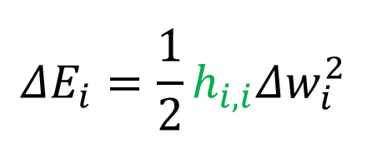
Weight Sparseness
$$\begin{matrix} \\ \left.ΔE=E(w+Δw)−E(w\right) \\ \end{matrix}$$
Zero Out Wij(k)
$$\begin{matrix} \\ E(w+Δw)=E(w)+\frac{∂E}{∂w}Δw+\frac{1}{2}Δw^{T}HΔw \\ \end{matrix}$$
$$\begin{matrix} \\ ΔE=\frac{∂E}{∂w}Δw+\frac{1}{2}Δw^{T}HΔw \\ \end{matrix}$$
OBD
( Optimal Brain Damage )
$$well trained: \begin{matrix} \\ \frac{∂E}{∂w}=0 \\ \end{matrix}$$
$$\begin{matrix} \\ ΔE_{i}=? \\ \end{matrix}$$
$$\begin{matrix} \\ ΔE≈\frac{1}{2}\sum_{i=1}^{K}{h_{i,i}Δw_{i}^{2}} \\ \end{matrix}$$
$$\begin{matrix} \\ ΔE_{i}=\frac{1}{2}h_{i,i}Δw_{i}^{2} \\ \end{matrix}$$

Slide 13


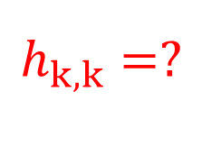
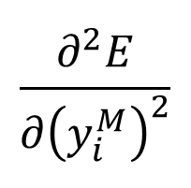
Weight Sparseness
Back Propagation
Zero Out Wij(k)
由 误差函数 & 输出层的激活函数 得到
OBD
$$\begin{matrix} \\ \frac{∂^{2}E}{∂{\left(y_{i}^{M}\right)}^{2}} \\ \end{matrix}$$
( Optimal Brain Damage )
$$\begin{matrix} \\ h_{k,k}=? \\ \end{matrix}$$
代入
其中

Slide 14
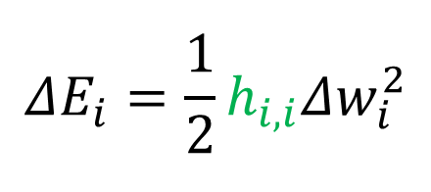
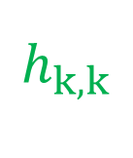
Weight Sparseness
Zero Out Wij(k)
$$\begin{matrix} \\ h_{k,k} \\ \end{matrix}$$
OBD
( Optimal Brain Damage )
$$\begin{matrix} \\ ΔE_{i}=\frac{1}{2}h_{i,i}Δw_{i}^{2} \\ \end{matrix}$$

Slide 15
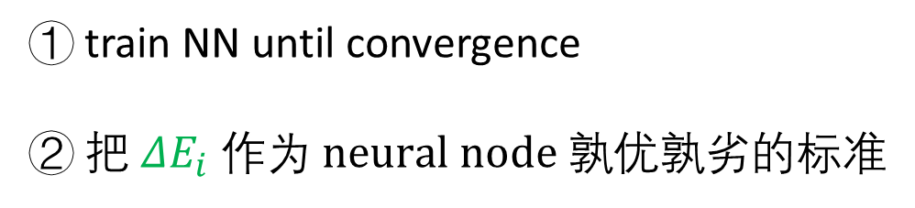
Weight Sparseness
Zero Out Wij(k)
OBD
① train NN until convergence
② 把$ΔE_{i} 作为 neural node 孰优孰劣$的标准
( Optimal Brain Damage )

Slide 16
Sparse Deep Model
Sparse Regularization
Combine
Weight Sparseness
Neural Sparseness
Norm
Zero out Wij(k)
Matrix Decomposition
Cluster & Quantization
Huffman
Norm
Activation Function

Slide 17
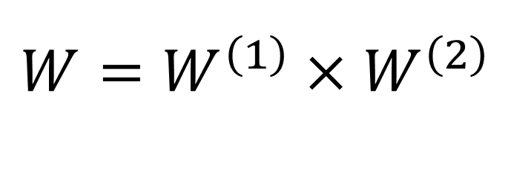
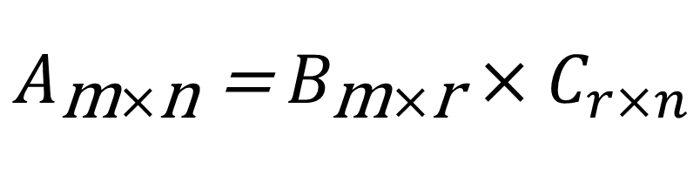
Weight Sparseness
Matrix Decomposition
$$\begin{matrix} \\ A_{\text{m}×\text{n}} \text{=}{ B}_{\text{m}×\text{r}}×C_{r×n} \\ \end{matrix}$$
矩阵分解：
存储空间改变：
m*n
m*r + r*n
$$\begin{matrix} \\ W=W^{\left(1\right)}×W^{\left(2\right)} \\ \end{matrix}$$
网络结构改变：

Slide 18
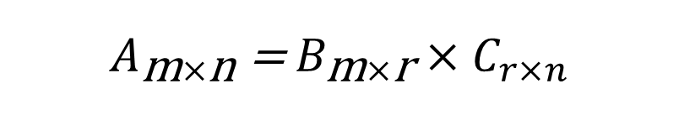
Weight Sparseness
Matrix Decomposition
分解低秩矩阵A_{m*n}
$$\begin{matrix} \\ A_{\text{m}×\text{n}} \text{=}{ B}_{\text{m}×\text{r}}×C_{r×n} \\ \end{matrix}$$
Low-Rank Matrix
A_{m*n}
（r << m,n）
节省存储空间
m*n > m*r + r*n

Slide 19
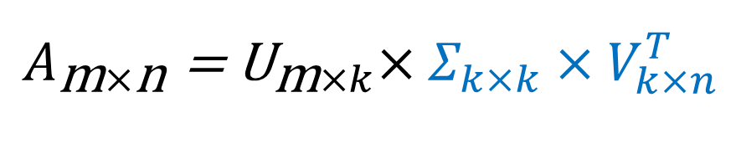
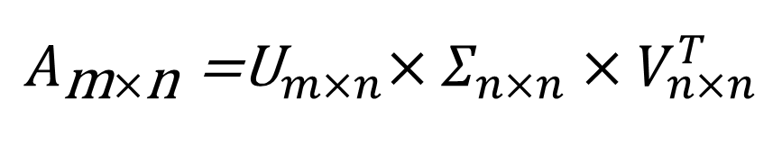
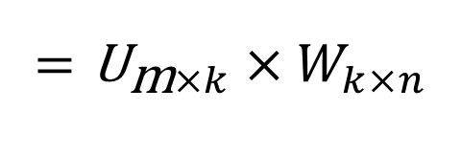
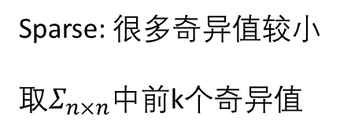
Weight Sparseness
Weight Sparseness
Matrix Decomposition
$$\begin{matrix} \\ A_{\text{m}×\text{n}}{\text{=}\text{U}}_{m×n}×Σ_{n×n}×V_{n×n}^{T} \\ \end{matrix}$$
Sparse: 很多奇异值较小
取$Σ_{n×n}$中前k个奇异值
General Sparse Matrix
A_{m*n}
（k << m,n）
$$\begin{matrix} \\ A_{\text{m}×\text{n}}{\text{=} \text{U}}_{\text{m}×k}×Σ_{k×k}×V_{k×n}^{T} \\ \end{matrix}$$
$$\begin{matrix} \\ ={\text{U}}_{\text{m}×k}×W_{k×n} \\ \end{matrix}$$

Slide 20
Sparse Deep Model
Sparse Regularization
Combine
Weight Sparseness
Neural Sparseness
Norm
Zero out Wij(k)
Matrix Decomposition
Cluster & Quantization
Huffman
Norm
Activation Function

Slide 21
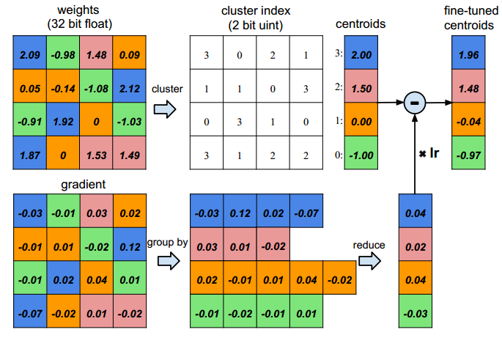
Weight Sparseness
Cluster ( Weight Sharing)
存储空间
n*b
n*log(k) + k*b

Slide 22
Weight Sparseness
Cluster ( Weight Sharing)
Cluster整体减gradient

Slide 23
Sparse Deep Model
Sparse Regularization
Combine
Weight Sparseness
Neural Sparseness
Norm
Zero out Wij(k)
Matrix Decomposition
Cluster & Quantization
Huffman
Norm
Activation Function

Slide 24
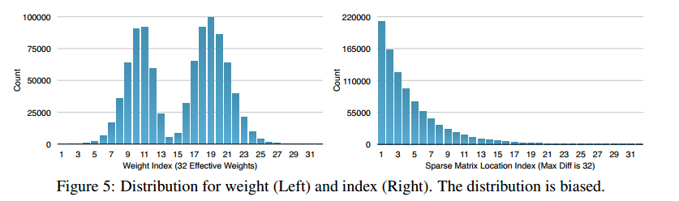
Weight Sparseness
Huffman
Biased Distribution
Huffman coding

Slide 25
Sparse Deep Model
Sparse Regularization
Combine
Weight Sparseness
Neural Sparseness
Norm
Zero out Wij(k)
Matrix Decomposition
Cluster & Quantization
Huffman
Norm
Activation Function

Slide 26
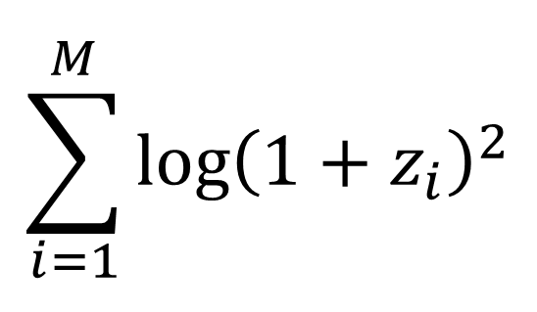
Neural Sparseness
Norm
在损失函数中加入正则项
$$\begin{matrix} \\ \sum_{i=1}^{M}{log{\left(1+z_{i}\right)}^{2}} \\ \end{matrix}$$
随 M增加 而 增加

Slide 27
Sparse Deep Model
Sparse Regularization
Combine
Weight Sparseness
Neural Sparseness
Norm
Zero out Wij(k)
Matrix Decomposition
Cluster & Quantization
Huffman
Norm
Activation Function

Slide 28
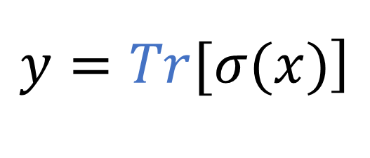
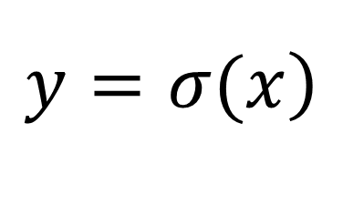
Neural Sparseness
Activation Function
$$\begin{matrix} \\ \left.y=σ(x\right) \\ \end{matrix}$$
$$\begin{matrix} \\ \left.y=Tr[σ(x)\right] \\ \end{matrix}$$

Slide 29
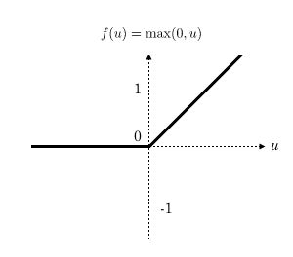
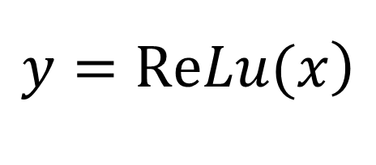
Neural Sparseness
Activation Function
$$\begin{matrix} \\ \left.y=ReLu(x\right) \\ \end{matrix}$$

Slide 30
Sparse Neural Network
Sparse Deep Model
Deep Sparse Model

Slide 31
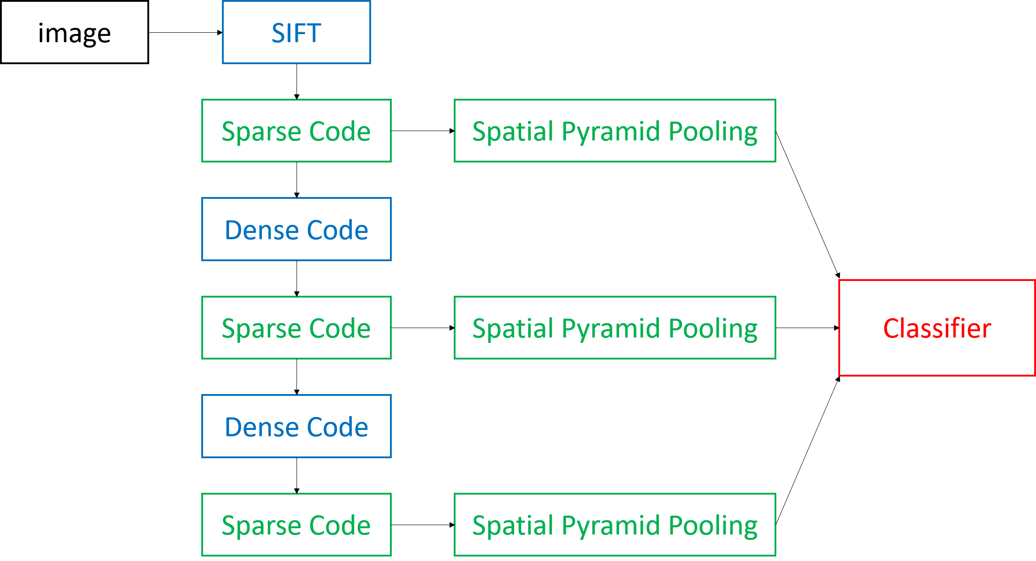
Deep Sparse Model
Overall Framework
Sparse Code
Overcome Difficulties

Slide 32
Deep Sparse Coding
Sparse Coding
Sparse Code

Slide 33
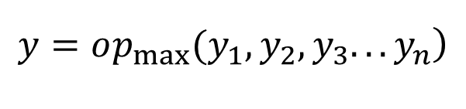
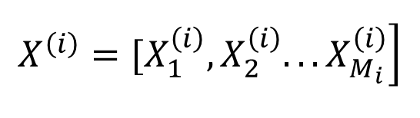
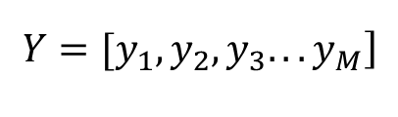
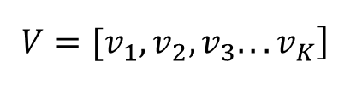
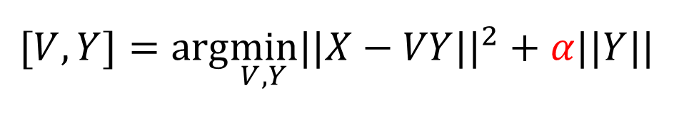
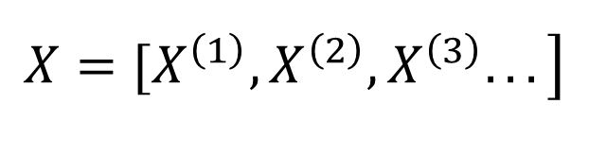
Deep Sparse Coding
Feature Extraction
Sparse Coding
$$\begin{matrix} \\ \left.X=[X^{\left(1\right)},X^{\left(2\right)},X^{\left(3\right)}...\right] \\ \end{matrix}$$
$$\begin{matrix} \\ \left.X^{\left(i\right)}=[X_{1}^{\left(i\right)},X_{2}^{\left(i\right)}...X_{M_{i}}^{\left(i\right)}\right] \\ \end{matrix}$$
其中
Learning
Sparse Code
$$\begin{matrix} \\ [V,Y]=arg\min_{V,Y}||X−VY||^{2}+α||Y|| \\ \end{matrix}$$
(Bag of Visual Words Pipeline)
其中
Dict
$$\begin{matrix} \\ \left.V=[v_{1},v_{2},v_{3}...v_{K}\right] \\ \end{matrix}$$
Sparse Code
$$\begin{matrix} \\ \left.Y=[y_{1},y_{2},y_{3}...y_{M}\right] \\ \end{matrix}$$
Pooling
$$\begin{matrix} \\ \left.y=op_{max}(y_{1},y_{2},y_{3}...y_{n}\right) \\ \end{matrix}$$

Slide 34
Deep Sparse Coding
Dense Coding
Overcome Difficulties
1. Gain spatial info and higher-level feat
2. Dimension increase makes the
model not smooth

Slide 35
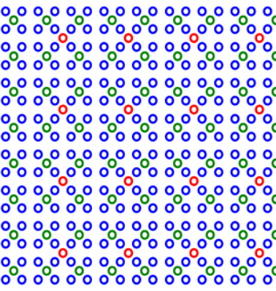
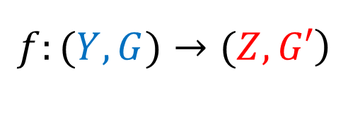
Deep Sparse Coding
1. Local Spatial Pooling
Dense Coding
Dense Code
(Overcome Difficulties)
1. Gain spatial info and higher-level feat
$$\begin{matrix} \\ \left.f:(Y,G)→(Z,G′\right) \\ \end{matrix}$$

Slide 36
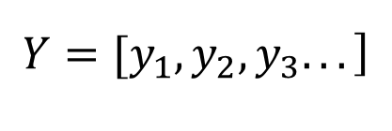
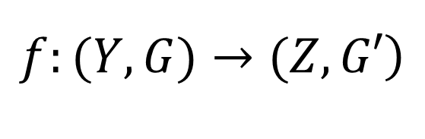
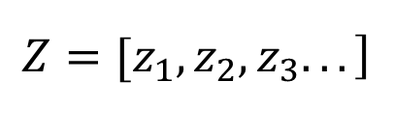
Deep Sparse Coding
1. Local Spatial Pooling
Dense Coding
$$\begin{matrix} \\ \left.f:(Y,G)→(Z,G′\right) \\ \end{matrix}$$
Dense Code
其中
$$\begin{matrix} \\ \left.Y=[y_{1},y_{2},y_{3}...\right] \\ \end{matrix}$$
(Overcome Difficulties)
$$\begin{matrix} \\ \left.Z=[z_{1},z_{2},z_{3}...\right] \\ \end{matrix}$$
1. Gain spatial info and higher-level feat
Lower-level Features → Higher-level Features
Exhibit Larger Scopes

Slide 37
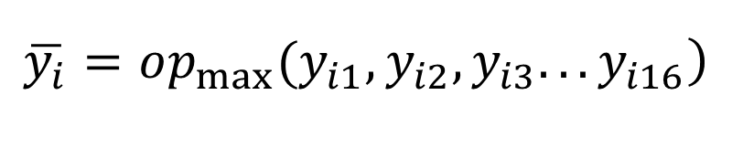
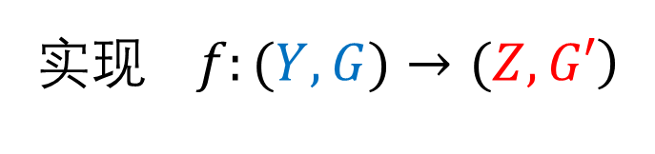
Deep Sparse Coding
1. Local Spatial Pooling
Dense Coding
$$\begin{matrix} \\ \left.实现 f:(Y,G)→(Z,G′\right) \\ \end{matrix}$$
Dense Code
① 确定新的点域G’
② pooling
(Overcome Difficulties)
1. Gain spatial info and higher-level feat
$$\begin{matrix} \\ \left.\overline{y_{i}}=op_{max}(y_{i1},y_{i2},y_{i3}...y_{i16}\right) \\ \end{matrix}$$

Slide 38
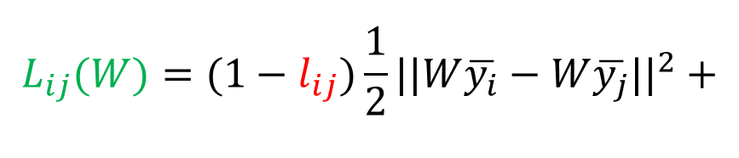
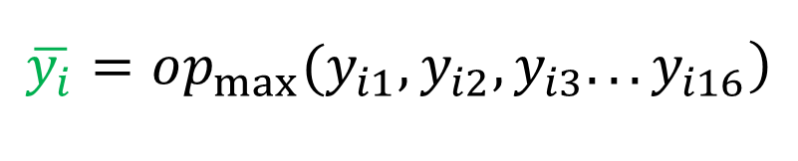
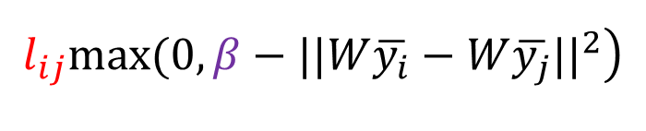
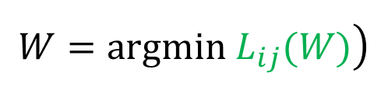
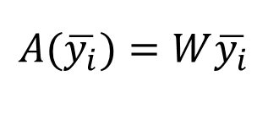
Deep Sparse Coding
2. Dimensionality Reduction
Dense Coding
$$\begin{matrix} \\ \left.\overline{y_{i}}=op_{max}(y_{i1},y_{i2},y_{i3}...y_{i16}\right) \\ \end{matrix}$$
$$\begin{matrix} \\ A(\overline{y_{i}})=W\overline{y_{i}} \\ \end{matrix}$$
Dense Code
(Overcome Difficulties)
$$\begin{matrix} \\ \left.W=argmin L_{ij}(W)\right) \\ \end{matrix}$$
2. Dimension increase makes the model not smooth
其中
$$\begin{matrix} \\ \begin{aligned}L_{ij}(W)=(1−l_{ij})\frac{1}{2}||W\overline{y_{i}}−W\overline{y_{j}}||^{2}+ \\ \end{aligned} \\ \end{matrix}$$
$$\begin{matrix} \\ \left.l_{ij}max(0,β−||W\overline{y_{i}}−W\overline{y_{j}}||^{2}\right) \\ \end{matrix}$$

Slide 39


Deep Sparse Coding
2. Dimensionality Reduction
Dense Coding
$$\begin{matrix} \\ A(\overline{y_{i}})=W\overline{y_{i}} \\ \end{matrix}$$
$$\begin{matrix} \\ \left.W=argmin L_{ij}(W)\right) \\ \end{matrix}$$
Dense Code
(Overcome Difficulties)
Dimensionality Reduction
2. Dimension increase makes the model not smooth
More Smooth

Slide 40
Deep Sparse Model
Overall Framework
Sparse Code
Overcome Difficulties

Slide 41
Sparse Neural Network
Sparse Deep Model
Deep Sparse Model

Slide 42
Sparse Neural Network
谢谢！
2017.5.12

