Slide 1
Software defect Prediction Using McCabe’s and Halstead’s Metrics
Sai Subash Edara
Ajay Kumar Kandula

Slide 2
Introduction
The most crucial feature of a software is Software Quality.
Software Defect Prediction has grown significantly in popularity in recent years, can directly impact quality.
Defective software modules have a significant impact on the quality of software, leading huge costs, delayed schedules, and much higher maintenance expenses.

Slide 3
Motivation
Determining the Defects in the source code that were generated from a program by using the Halstead’s or McCabe’s source code metrics.
Finding out the which machine learning models give more performance in predicting the defect in software by using halstead’s and McCabe’s attributes based on performance metrics

Slide 4
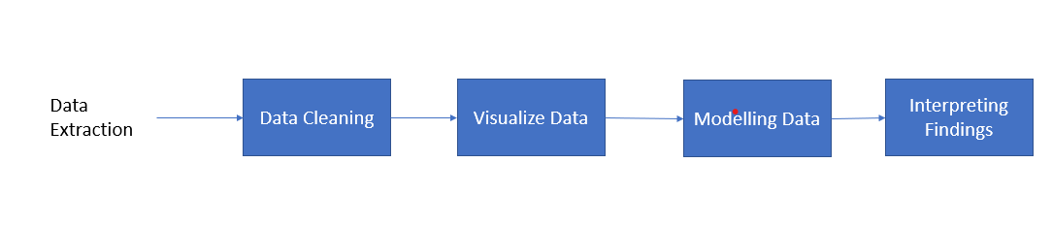
Data Science PipeLine

Slide 5
DataSet
We are using software defect prediction dataset.
The Data from Dataset comes from McCabe and Halstead features extractors of source code.
The McCabe and Halstead metrics are used to measure the complexity of source code.
We have divided our project into three phases. In first phase we classify McCabes attributes, second phase we classify Halstead’s attributes and in the third phase we classify combined attributes.

Slide 6
Halstead’s Attributes
n -- Total operators + Total operands
v -- Volume(total number of used operators and operands in source code unit)
l -- Program Length(number of distinct operators and operands in source code unit)
i – Intelligence (amount of intelligence presented in the program)
d -- Difficulty (error proneness of source code)
Intelligence
e -- Effort (effort to implement)
b -- bugs delivered (number of errors in source code)
t -- time estimator (time to implement)
loCode -- lines count
loComment -- Count of lines of comments
loBlank -- Count of blank lines
locCodeAndComment -- Count of lines of both code and comments

Slide 7
McCabe’s Attributes
loc : McCabe's line count of code
v(g) : McCabe "cyclomatic complexity"
ev(g) : McCabe "essential complexity"
iv(g) : McCabe "design complexity"

Slide 8
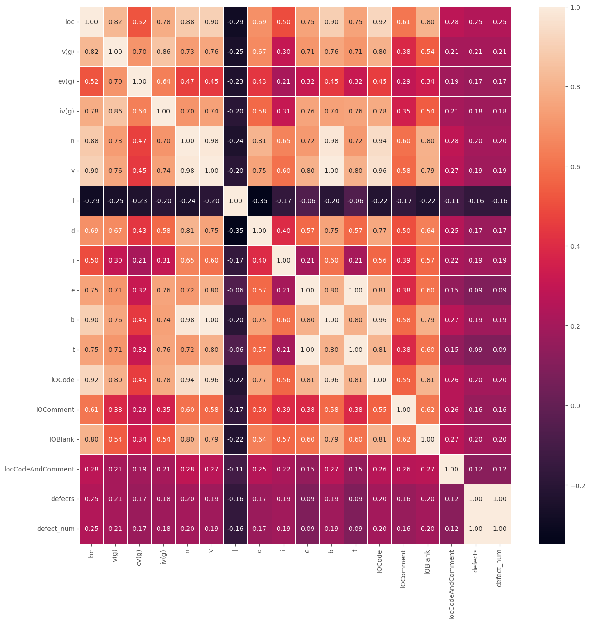
Co-variance of attributes

Slide 9
Dependent variable
Defects
The variable is classified as true / false, so we had to transform the variable into 0/1 wherein 0 represents False(absence of defects) and 1 represents True(presence of defects in the code)

Slide 10
Independent variables- Phase1
In this Phase we are taken McCabe’s metrics
They are:
loc : McCabe's line count of code
v(g) : McCabe "cyclomatic complexity"
ev(g) : McCabe "essential complexity"
iv(g) : McCabe "design complexity"

Slide 11
Independent variables- Phase2
In this Phase we are taken Halstead’s attributes which covariance is high.
They are:
n : Total operators + Total operands
v : Volume
i : Intelligence
loCode : lines count

Slide 12
Independent variables- Phase3
In this Phase we are taken the combination of both Halstead’s and McCabe’s metrics which covariance is high
They are:
n : Total operators + Total operands
loCode : lines count
loc : McCabe's line count of code
v(g) : McCabe "cyclomatic complexity"

Slide 13
Research Question
Which Metrics are more influencing to predict the Defect of source code?
Which Machine learning model is giving more performance to predict Software defect?

Slide 14
Methods
In this project we are using the Machine learning Classification Models.
Supervised learning techniques are used in this project.
The models are:
Decision Model
Random Forest
XGB classifier
Naive Bayes
By using performance metrics of each ML model we will conclude which attributes performing good.

Slide 15
Results- McCabe attributes
 | ROC-AUC Score | Precision | Recall | F1-score
Decision tree | 0.71 | 0.628 | 0.128 | 0.212
Random Forest | 0.727 | 0.6 | 0.076 | 0.134
XGBoost Classifier | 0.696 | 0.53 | 0.18 | 0.269
Naive Bayes | 0.631 | 0.525 | 0.196 | 0.285

Slide 16
Results – Halstead’s Attributes
 | ROC-AUC Score | Precision | Recall | F1-score
Decision tree | 0.695 | 0.55 | 0.017 | 0.034
Random Forest | 0.712 | 0.75 | 0.038 | 0.072
XGBoost Classifier | 0.698 | 0.492 | 0.139 | 0.216
Naive Bayes | 0.641 | 0.48 | 0.169 | 0.25

Slide 17
Results- Combined attributes
 | ROC-AUC Score | Precision | Recall | F1-score
Decision tree | 0.7 | 0.533 | 0.076 | 0.133
Random Forest | 0.729 | 0.697 | 0.084 | 0.149
XGB Classifier | 0.639 | 0.524 | 0.186 | 0.275
Naive Bayes | 0.702 | 0.508 | 0.192 | 0.279

Slide 18
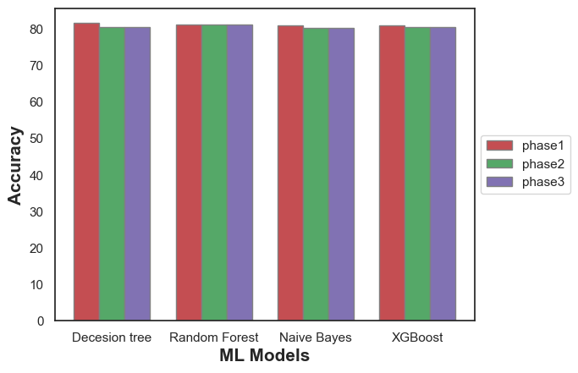
Results- Accuracy

Slide 19
Results
When compared the results of Machine Learning Models for each performance metrics various model are performing well.
For ROC-AUC curve the Decision tree model is performing well compared to other models.
For Recall and F-1 Score Naïve bayes algorithm performs well
For Accuracy and Precession The random forest model is performing well.

Slide 20
Conclusion
When compared amongst all the Halsted’s and McCabes attributes, the models with only Mc Cabe as its independent variables did a better job with respect to the performance metrics obtained. So, to detect whether there is a presence of defects in a program only the Mc Cabe metrics are required.

