Slide 1
Bank Marketing Campaign Term Deposit Subscription Prediction

Slide 2
Contents
Data Understanding
Initial Observations
Handling Outliers And Correlation Analysis
Data Exploration - Categorical Features
Data Exploration - Numerical Features
Data Preprocessing
Model Building
Hyperparameter Tuning
Final Model Selection
Classification Report & Confusion Matrix

Slide 3
Data Understanding
Dataset: 45,211 entries, 17 columns
Target variable: y (Yes/No)
7 numerical & 10 categorical features
No missing or duplicate values
Clean and ready for preprocessing

Slide 4
Initial Observations
Target variable is imbalanced (majority: "No")
“No” - 88.3 and “yes”- 11.7
Important categorical columns: job, education, poutcome
Key numerical columns: duration, balance, age

Slide 5
Handling Outliers And Correlation Analysis
Used IQR method to treat outliers in:
Age, Balance, Duration, Campaign, Pdays, Previous
Outliers clipped instead of removed to preserve useful info
No strong multicollinearity among features
Duration has the most potential predictive power

Slide 6
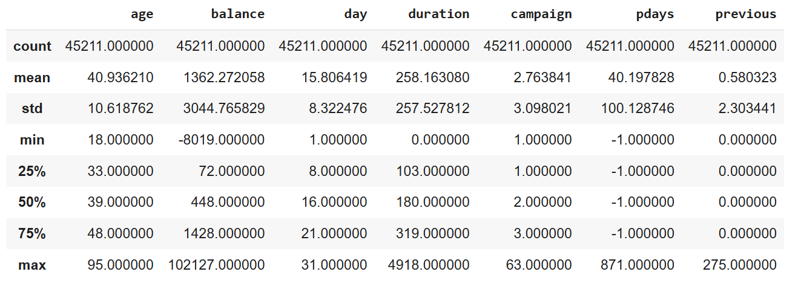
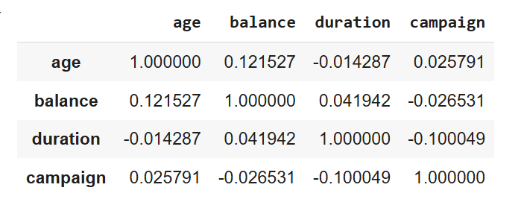
Statistical Analysis
Correlation Matrix

Slide 7
Data Exploration - Categorical Features
Students & retirees show higher “Yes” rates
Singles more likely to subscribe
Tertiary education increases subscription likelihood
Cellular contact = higher success
Successful past outcomes => better conversion

Slide 8
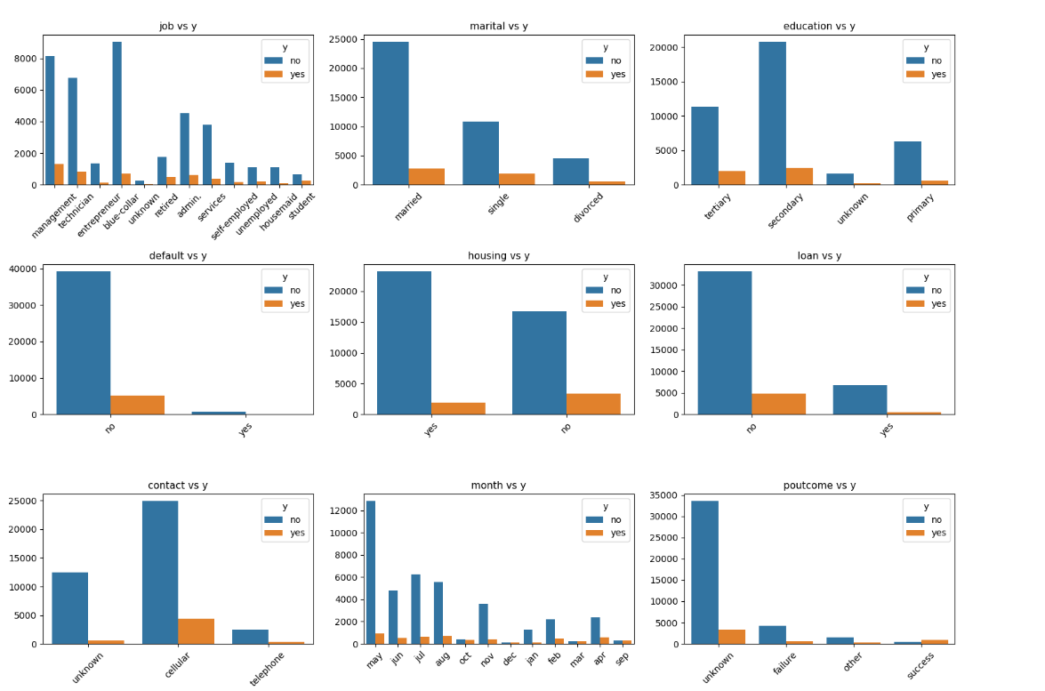

Slide 9
Data Exploration - Numerical Features
Duration: longer calls correlate with “Yes”
Age: Peaks around 35-45 and 60+
Balance: slight trend toward higher balances among “Yes”

Slide 10
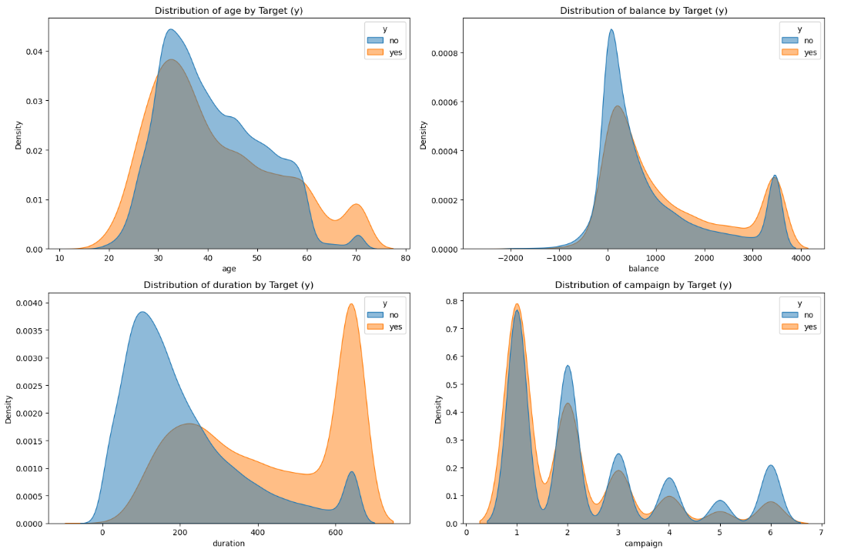

Slide 11
Data Preprocessing
Encoding & Scaling
Applied LabelEncoder to categorical features
Used StandardScaler for numerical features
Stratified train-test split ensures target distribution retained
Handling Imbalance
Applied SMOTE for oversampling minority class ("Yes")
Balanced classes improved model recall & F1-score

Slide 12
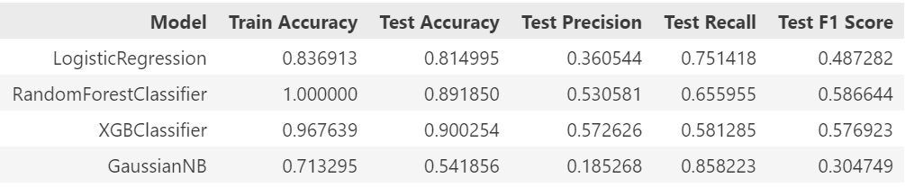
Model Building
Models Trained:
Logistic Regression
Random Forest
XGBoost
GaussianNB

Slide 13
Hyperparameter Tuning
Applied GridSearchCV to optimize:
XGBoost: max_depth, n_estimators, learning_rate, etc.
Random Forest: depth, leaf, estimators, etc.
XGBoost showed stable improvement
RF showed overfitting (100% train accuracy)

Slide 14
Final Model Selection
XGBoost Classifier Selected
Best balance between precision & recall
Handles imbalance effectively
Generalizes better (Train: 96.8%, Test: 90%)

Slide 15
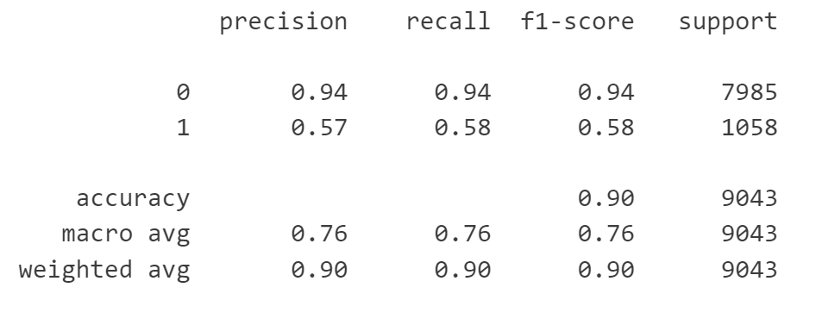
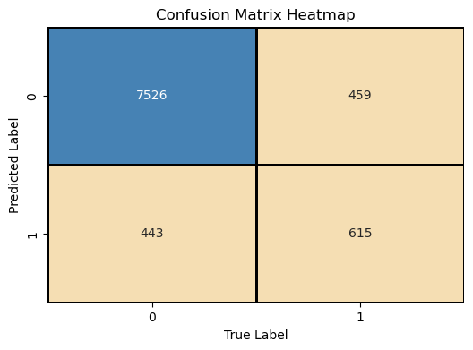
Classification Report & Confusion Matrix

