Slide 1
Predicting Airline Passenger Satisfaction Using Machine Learning A Data-Driven Approach to Enhancing Customer Experience

Slide 2
Contents:
Dataset Overview and Observations
Data Cleaning & Preprocessing
Data Visualisation
EDA Observations
Feature Engineering & Data Preprocessing
Model Building
Model Performance Insights
Feature Importance
Model Evalution
Classification Report Summary

Slide 3
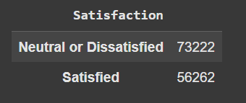
Dataset Overview and Observations
Total Records : 129,880 rows | 24 columns
Missing Values : Arrival Delay → 393 missing values means 0.3%
Data Types : 19 Numerical and 5 Categorical
Data Type Issue : Flight Distance is object type → Should be numeric
Target Column : Satisfaction (binary classification )
Duplicates : No duplicate rows found
Potential Outliers :
Departure Delay : Max = 1592, Median = 0 → Right-skewed
Arrival Delay : Max = 1584, Median = 0 → Right-skewed
Flight Distance : have extreme values (high max values) compared Median

Slide 4
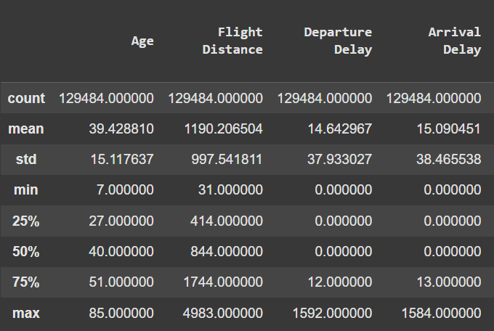
Data Cleaning & Preprocessing
Dropped ID Column: Unique identifier, no impact on model
Flight Distance Conversion:
Originally object type → Converted to float64 using pd.to_numeric(errors="coerce").
Invalid entries converted to NaN
Missing Value Handling:
Arrival Delay → 0.3% missing
Flight Distance → 0.0027% missing
Rows with missing values
dropped → Minimal data loss

Slide 5
Data Cleaning & Preprocessing
Outlier Detection & Treatment (IQR Method):
Applied to Flight Distance, Departure Delay, Arrival Delay
Values beyond bounds capped to reduce extreme skew
Formula:
Lower Bound = Q1 - 1.5 × IQR
Upper Bound = Q3 + 1.5 × IQR
Feature Segmentation:
Num = Numerical Features
Cat = Categorical Features
Target = Satisfaction (Binary)
Correlation Insights:
Departure Delay & Arrival Delay: Strong correlation (0.84)
In-flight Experience & Online Services: Interrelated
Flight Distance, Gate Location: Weak correlation
Final Adjustment:
Dropped Departure Delay to avoid multicollinearity
Retained Arrival Delay → Reduces redundancy, improves model clarity

Slide 6
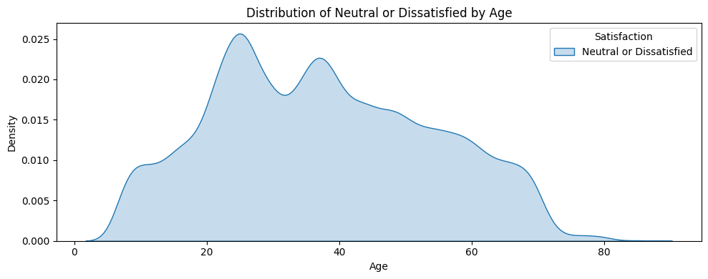
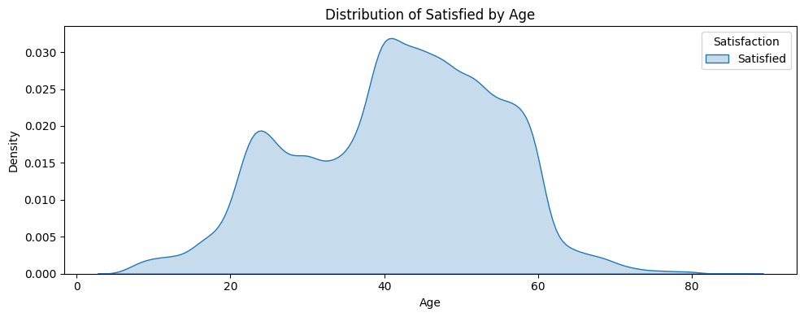
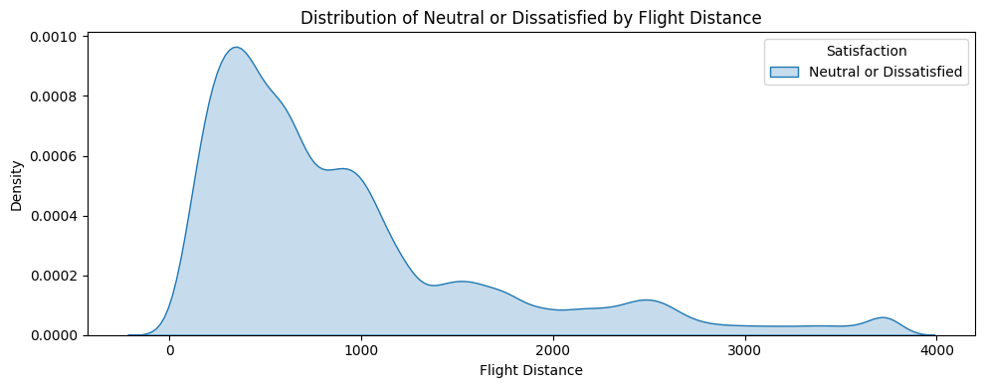
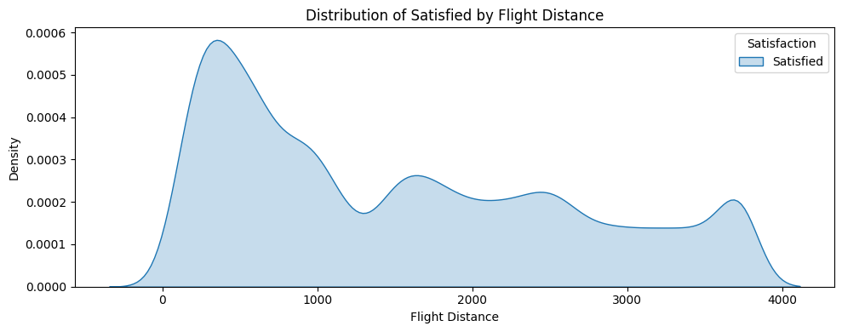
Data Visualisation

Slide 7
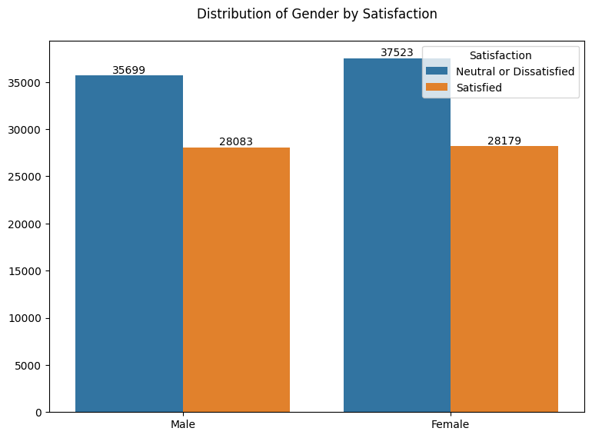
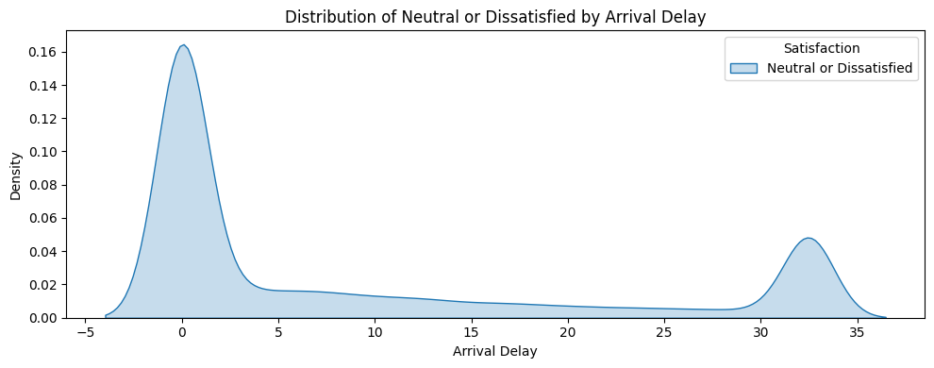
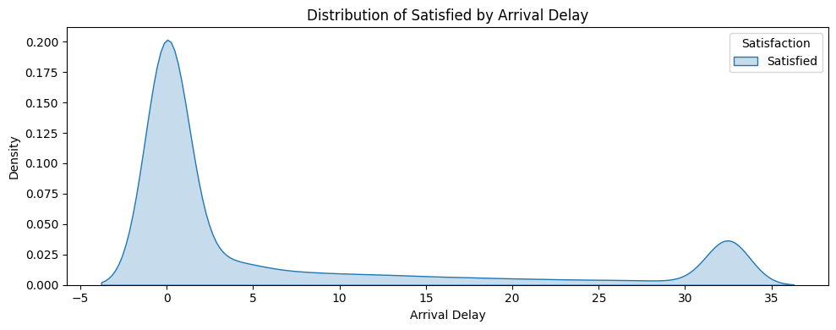
Data Visualisation

Slide 8
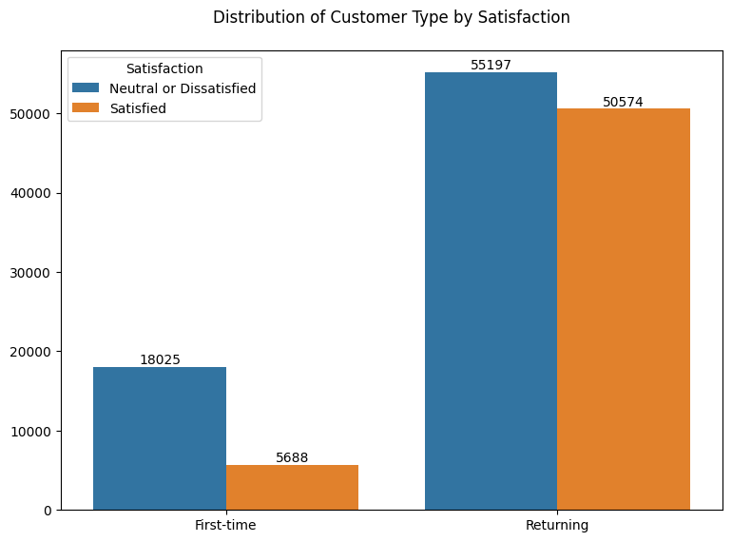
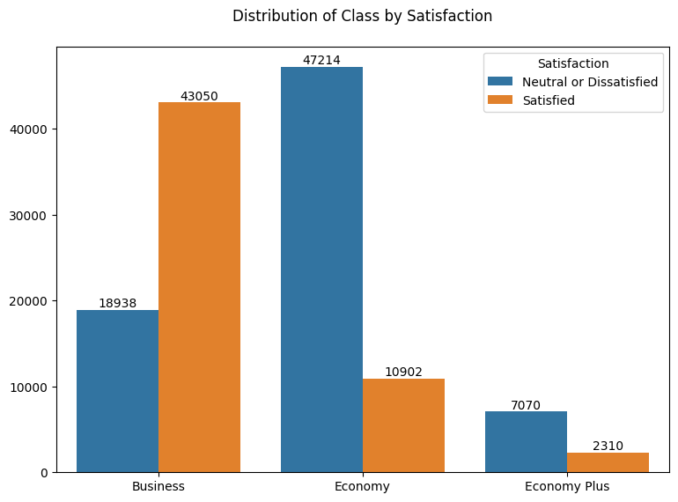
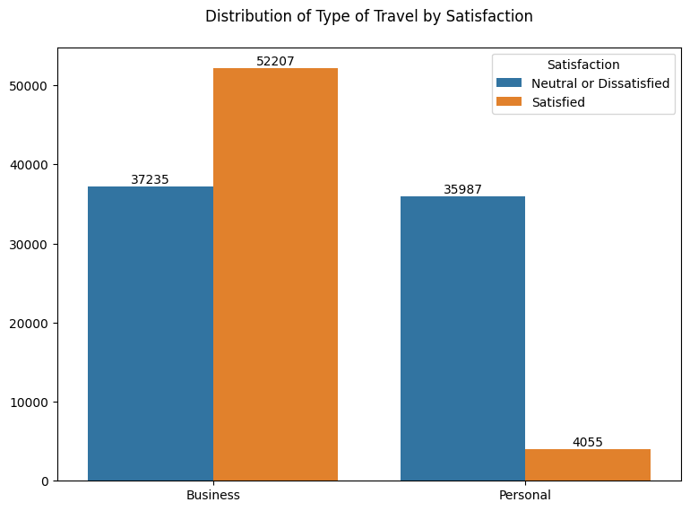
Data Visualisation

Slide 9
EDA Observations
Age & Satisfaction:Ages 20–60 = Most sensitive to service quality & delays
Flight Distance:
Long-distance flights (2000–4000 mi) = More satisfied
Short-distance (0–2000 mi) = More complaints
Arrival Delay Impact : Satisfaction drops significantly after 15–30 min delay
Economy Class Impact : Economy Class passengers have the highest dissatisfaction.
Service Quality Drives Satisfaction : Strong link with comfort (seat, legroom), food, and entertainment
Wifi, Food, Baggage = Top Improvement Areas
Customer Type : Returning customers expect more → Retention depends on service consistency

Slide 10
Feature Engineering & Data Preprocessing
Target variable 'Satisfaction' encoded as:
Neutral or Dissatisfied → 0
Satisfied → 1
Categorical variables encoded using OneHotEncoder And Custom Label Encoding:
Gender : Male = 0, Female = 1
Customer Type: First-time = 0, Returning = 1
Type of Travel: Business = 0, Personal = 1
Class : Economy = 0,Economy Plus =1,Business = 2
Numerical features scaled using MinMaxScaler:
Scaled: Age, Flight Distance, Arrival Delay
Not scaled: Service rating features (already on a 0–5 scale)
Final feature set includes:
17 numerical features
4 categorical features
Total: 21 features ➔ X (features) : 129,484 rows × 21 columns
y (target) ➔Y : 129,484 rows × 1 column

Slide 11
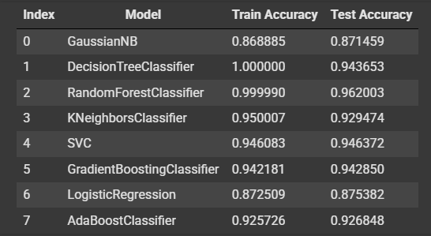
Model Building
Chosen Model: Random Forest Classifier
Highest accuracy with minimal overfitting
Stable and consistent performance
Cross-Validation Results
5-Fold Cross-Validation Scores
[0.96, 0.96, 0.96, 0.96, 0.96]
Mean Accuracy : 0.96
Random Forest shows stable performance across different subsets
Confirms robustness and reliability of the model

Slide 12
Model Performance Insights
Bias: Low
High accuracy on both training and test sets
Variance: Low
Small gap between training (1.0) and test (0.96) accuracy
Overfitting: Not present
Model generalizes well to unseen data
Underfitting: Not observed
Model captures data patterns effectively
Generalization: Strong
Model is likely to perform well on real-world data

Slide 13
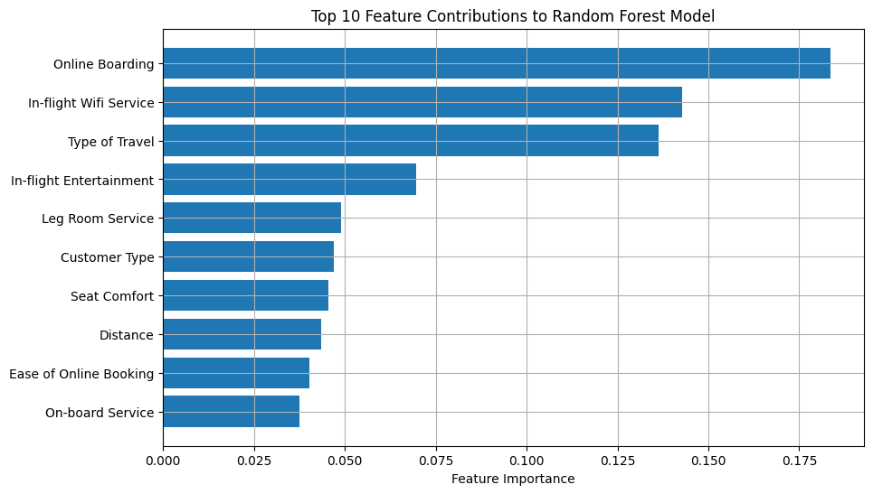
Feature Importance
Online Boarding has the highest importance (0.183665), making it a key factor in customer satisfaction.
In-flight Wifi Service plays a crucial role (0.142735), highlighting the need for reliable connectivity.
Type of Travel (0.136328) affects satisfaction, suggesting a tailored service approach for business vs. leisure travelers.

Slide 14
Feature Importance
Feature | Importance
Online Boarding | 0.183665
In-flight Wifi Service | 0.142735
Type of Travel | 0.136328
In-flight Entertainment | 0.069614
Leg Room Service | 0.048998
Customer Type | 0.046999
Seat Comfort | 0.045444
Distance | 0.043529
Ease of Online Booking | 0.040161
On-board Service | 0.037619
Age Flight | 0.033927
Check-in Service | 0.025704
Baggage Handling | 0.024700
Cleanliness | 0.024570
In-flight Service | 0.023232
Departure and Arrival Time Convenience | 0.019459
Gate Location | 0.017232
Food and Drink | 0.013120
Arrival Delay | 0.012129
Class | 0.006003
Gender | 0.004833
Seat Comfort and Leg Room Service moderately impact satisfaction, with importance scores of 0.045444 and 0.048998, respectively.
Customer Type (0.046999) and Ease of Online Booking (0.040161) are less impactful but still important for improving overall experience.
Class (0.006003) and Gender (0.004833) have minimal influence, with service features being more important in driving satisfaction.

Slide 15
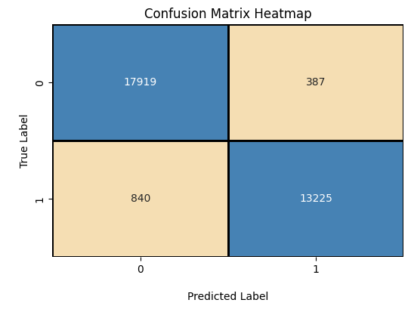
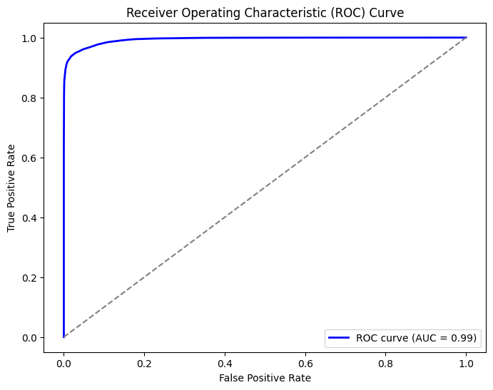
Model Evalution
Accuracy: 96%, confirming consistent and correct predictions across both classes.
True Positives (13,225) and True Negatives (17,919) dominate.
False Negatives (840) > False Positives (387) — some Satisfied users are misclassified as Dissatisfied.
Missing satisfied customers could impact customer feedback handling and post-service follow-ups.
Excellent ROC Curve Performance
ROC curve bends sharply to the top-left, showing strong classification power.
AUC = 0.99, indicating near-perfect separation between satisfied and dissatisfied passengers.
The model is both accurate and discriminative, performing well on unseen data and providing business-relevant insights.

Slide 16
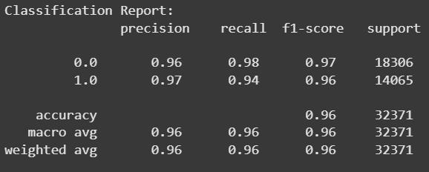
Classification Report Summary
High Accuracy
The model correctly predicts 96% of customer satisfaction responses.
Strong Precision & Recall
Precision: 96% (Neutral/Dissatisfied), 97% (Satisfied)
Recall: 98% (Neutral/Dissatisfied), 94% (Satisfied)
Balanced Performance
F1-Score: 0.97 for Neutral/Dissatisfied, 0.96 for Satisfied
Shows strong balance between precision and recall.
Sufficient and Balanced Data
Evaluated on 32,371 samples
Good distribution: 18,306 (Neutral/Dissatisfied), 14,065 (Satisfied)
Reliable Across Both Classes
Macro & Weighted Avg (0.96) confirm consistent performance, even with slight class imbalance.

Slide 17
Thank You

